Slide 1
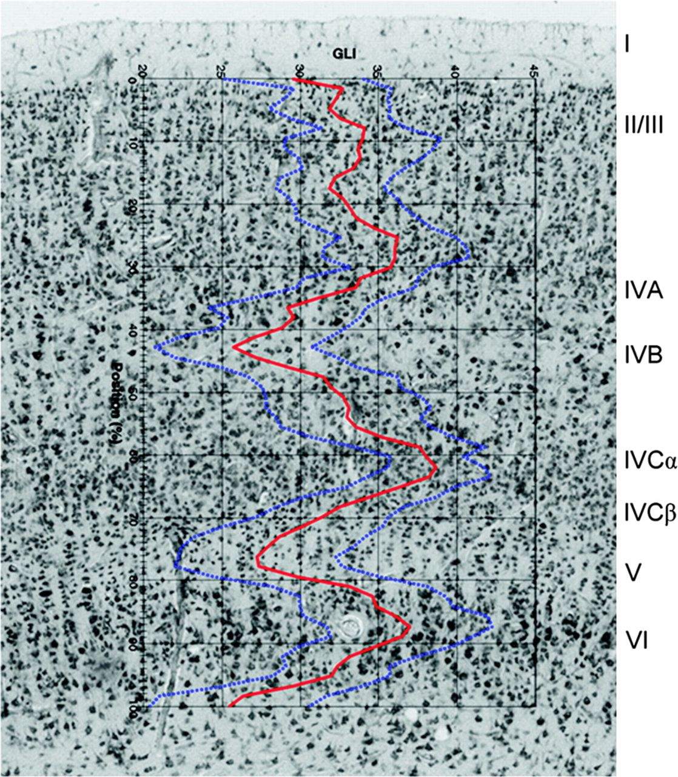
Figure 1. Procedure for obtaining layerwise GLI values. GLI mean profile graphs were extracted and superimposed over ...
Notes:
Figure 1. Procedure for obtaining layerwise GLI values. GLI mean profile graphs were extracted and superimposed over histological images to determine the relative depth of the layer divisions.
Unless provided in the caption above, the following copyright applies to the content of this slide: © The Author 2009. Published by Oxford University Press. All rights reserved. For permissions, please e-mail: journals.permissions@oxfordjournals.org

Slide 2
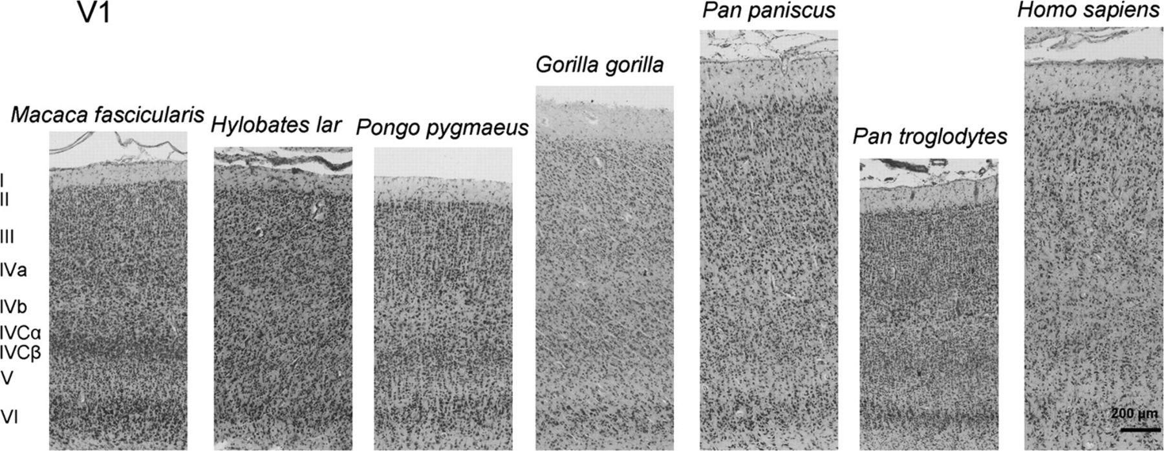
Figure 2. Cytoarchitecture of cortical area V1 in a macaque, a gibbon, an orangutan, a gorilla, a bonobo, a chimpanzee, ...
Notes:
Figure 2. Cytoarchitecture of cortical area V1 in a macaque, a gibbon, an orangutan, a gorilla, a bonobo, a chimpanzee, and a human.
Unless provided in the caption above, the following copyright applies to the content of this slide: © The Author 2009. Published by Oxford University Press. All rights reserved. For permissions, please e-mail: journals.permissions@oxfordjournals.org

Slide 3
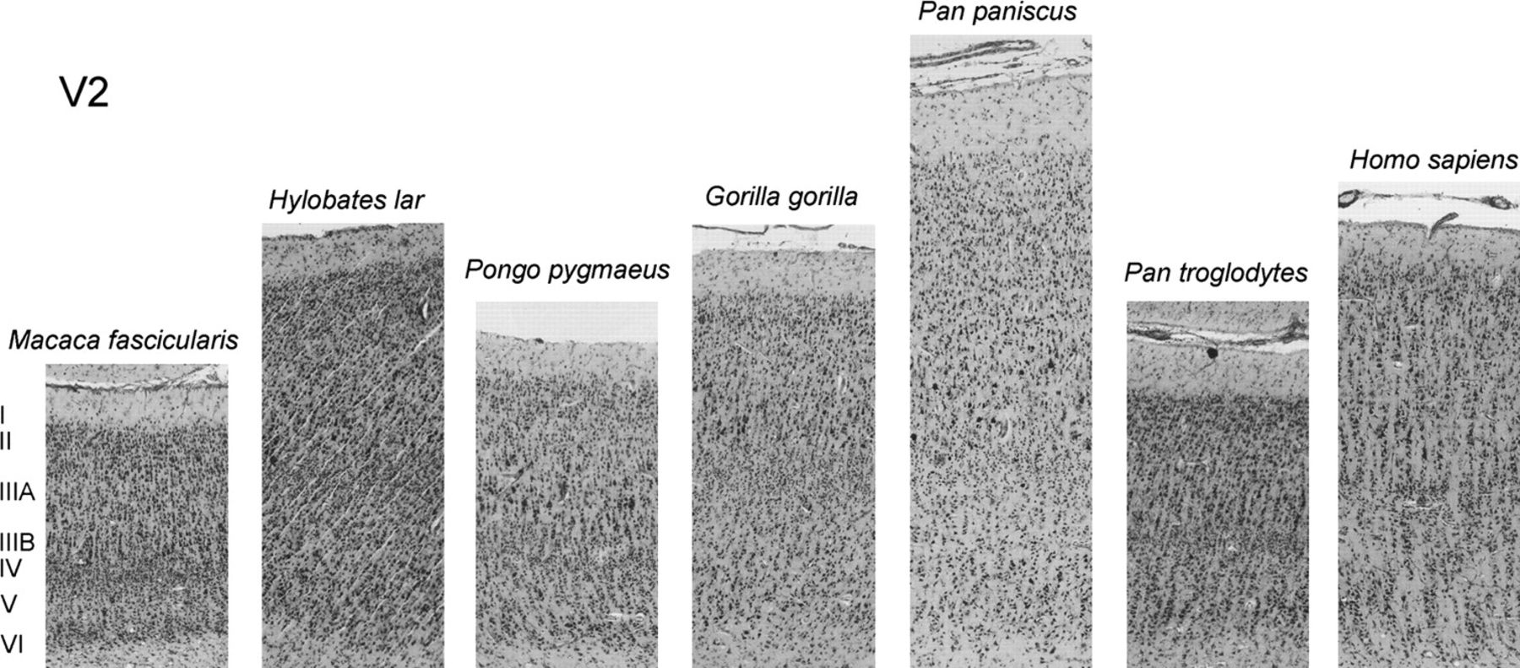
Figure 3. Cytoarchitecture of cortical area V2 in a macaque, a gibbon, an orangutan, a gorilla, a bonobo, a chimpanzee, ...
Notes:
Figure 3. Cytoarchitecture of cortical area V2 in a macaque, a gibbon, an orangutan, a gorilla, a bonobo, a chimpanzee, and a human.
Unless provided in the caption above, the following copyright applies to the content of this slide: © The Author 2009. Published by Oxford University Press. All rights reserved. For permissions, please e-mail: journals.permissions@oxfordjournals.org

Slide 4
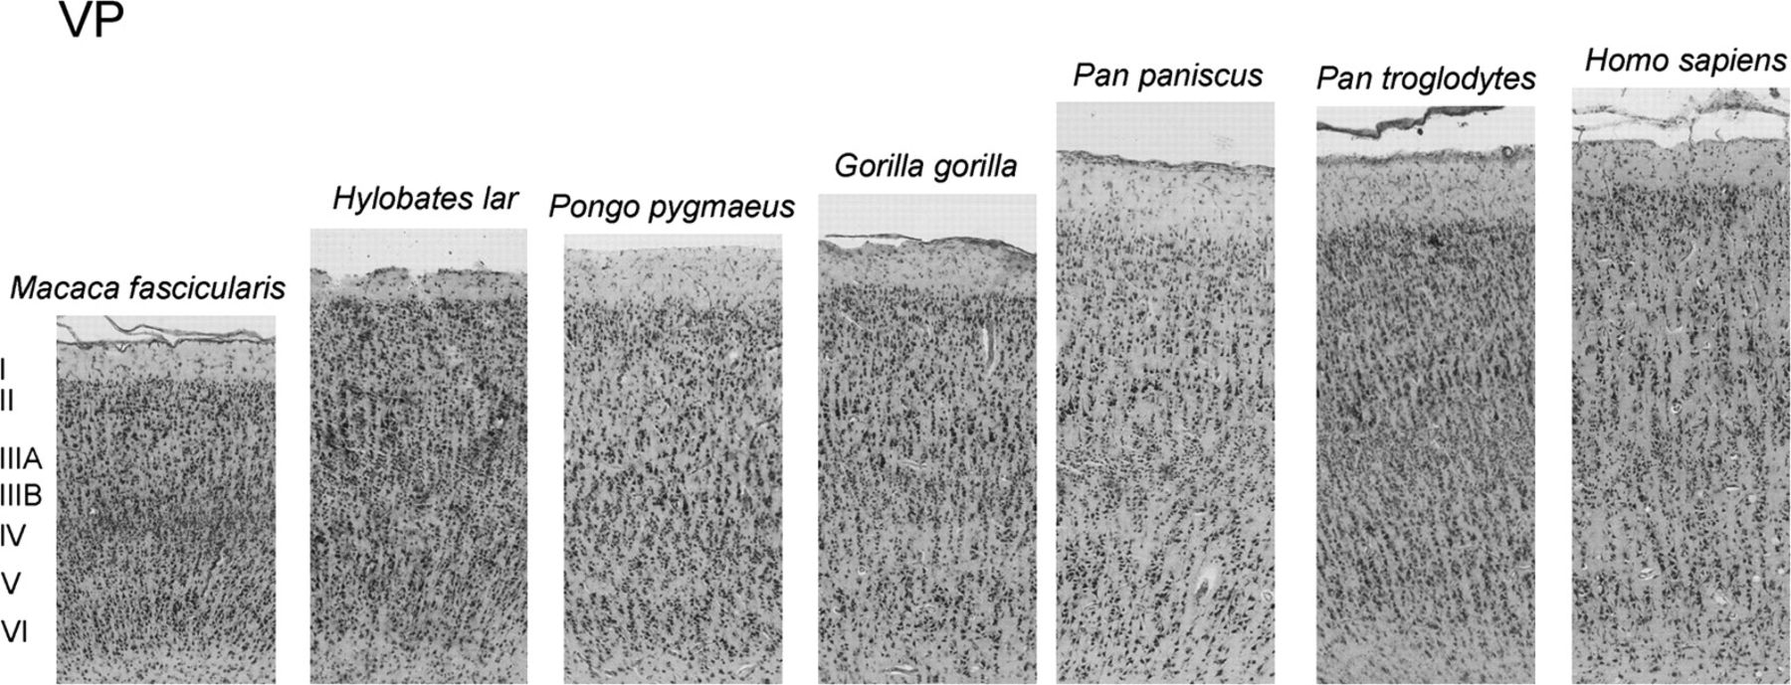
Figure 4. Cytoarchitecture of cortical area VP in a macaque, a gibbon, an orangutan, a gorilla, a bonobo, a chimpanzee, ...
Notes:
Figure 4. Cytoarchitecture of cortical area VP in a macaque, a gibbon, an orangutan, a gorilla, a bonobo, a chimpanzee, and a human.
Unless provided in the caption above, the following copyright applies to the content of this slide: © The Author 2009. Published by Oxford University Press. All rights reserved. For permissions, please e-mail: journals.permissions@oxfordjournals.org

Slide 5
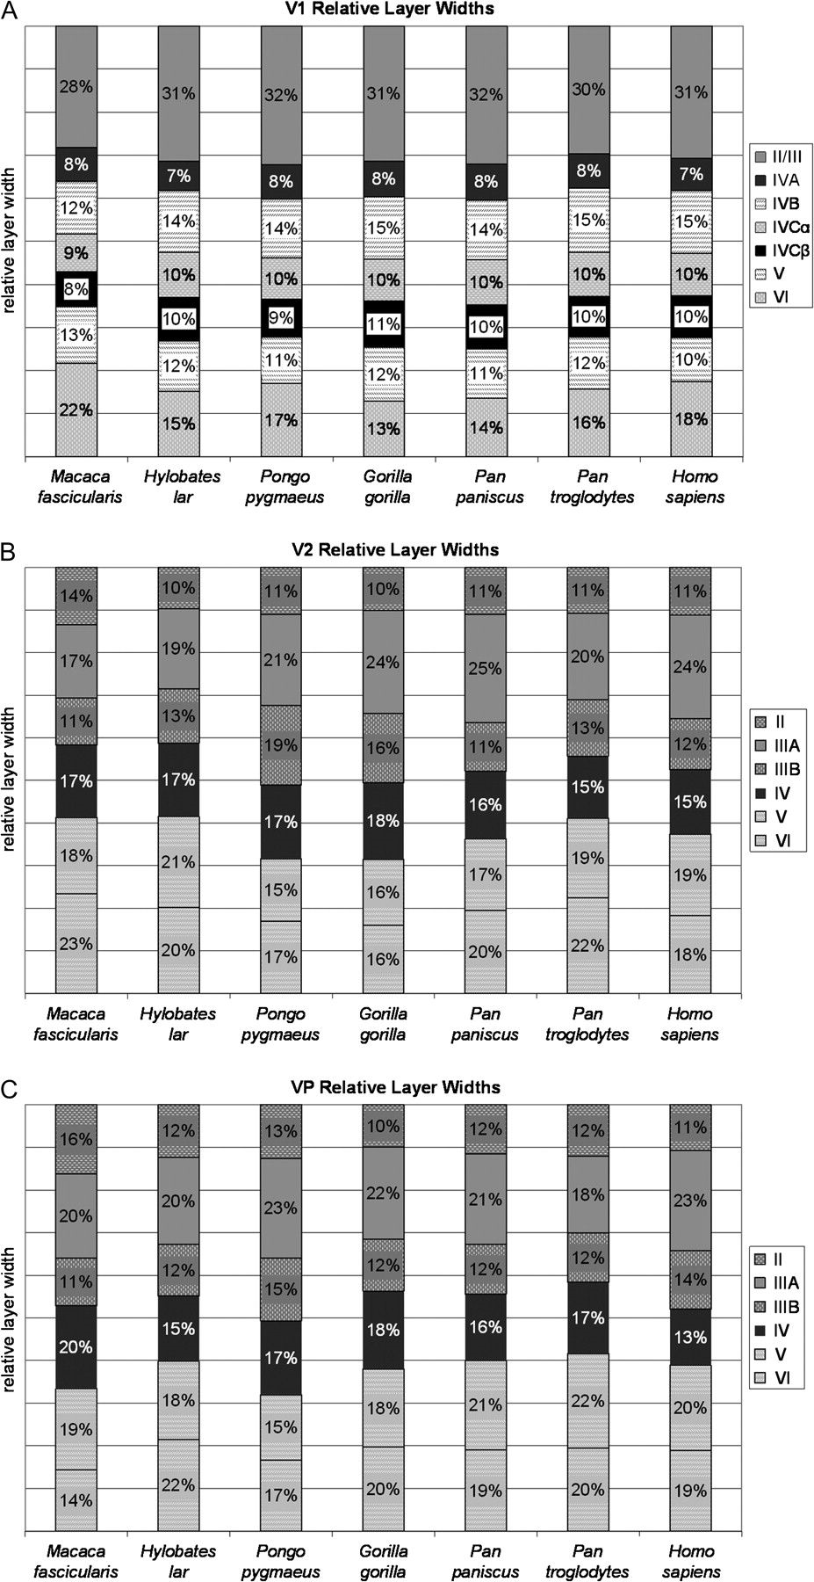
Figure 5. Species mean relative layer widths for areas V1 (A), V2 (B), and VP (C). Each bar represents the proportion ...
Notes:
Figure 5. Species mean relative layer widths for areas V1 (A), V2 (B), and VP (C). Each bar represents the proportion of the total cortical thickness occupied by each layer.
Unless provided in the caption above, the following copyright applies to the content of this slide: © The Author 2009. Published by Oxford University Press. All rights reserved. For permissions, please e-mail: journals.permissions@oxfordjournals.org

Slide 6
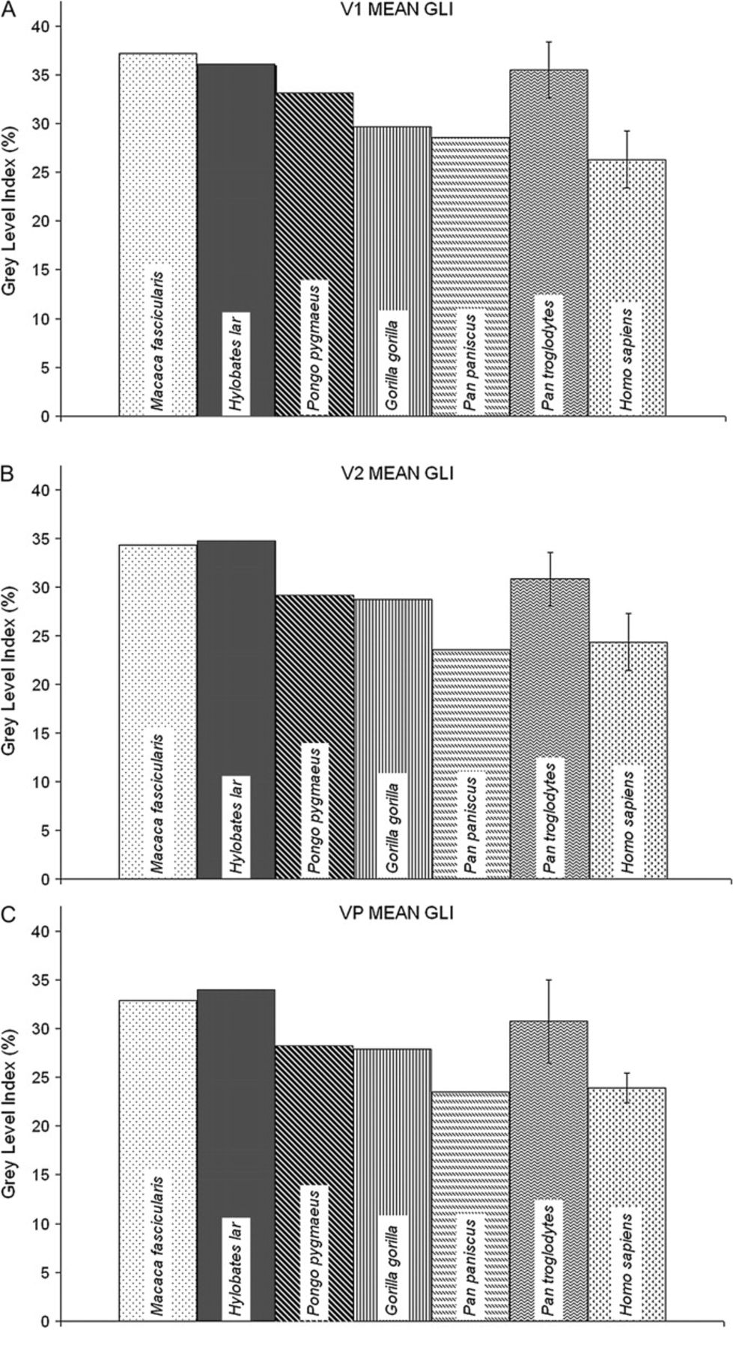
Figure 6. Species mean GLI values for areas V1 (A), V2 (B), and VP (C). Vertical bars denote 95% confidence intervals.
Notes:
Figure 6. Species mean GLI values for areas V1 (A), V2 (B), and VP (C). Vertical bars denote 95% confidence intervals.
Unless provided in the caption above, the following copyright applies to the content of this slide: © The Author 2009. Published by Oxford University Press. All rights reserved. For permissions, please e-mail: journals.permissions@oxfordjournals.org

Slide 7
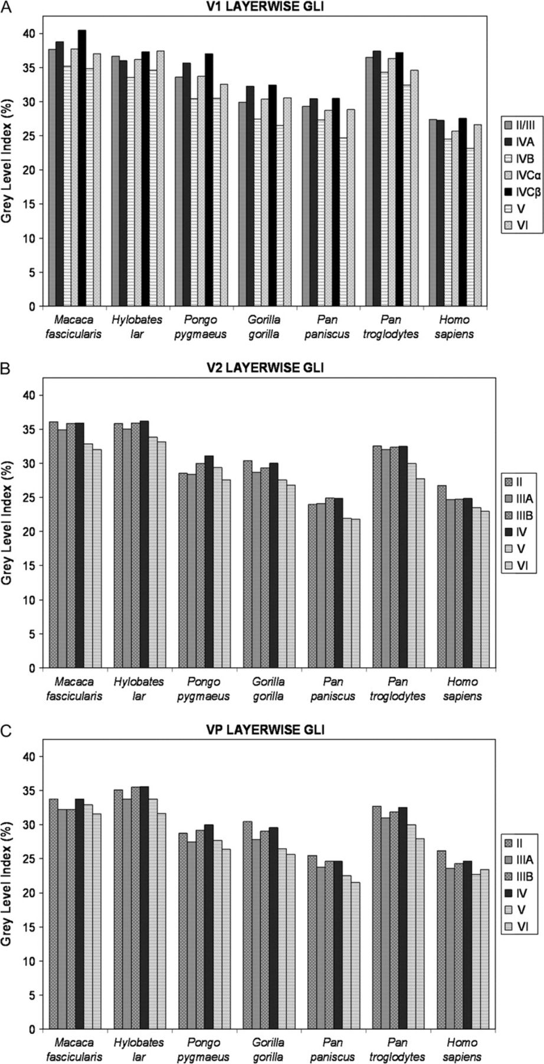
Figure 7. Species mean layerwise GLI values for areas V1 (A), V2 (B), and VP (C).
Notes:
Figure 7. Species mean layerwise GLI values for areas V1 (A), V2 (B), and VP (C).
Unless provided in the caption above, the following copyright applies to the content of this slide: © The Author 2009. Published by Oxford University Press. All rights reserved. For permissions, please e-mail: journals.permissions@oxfordjournals.org

Slide 8
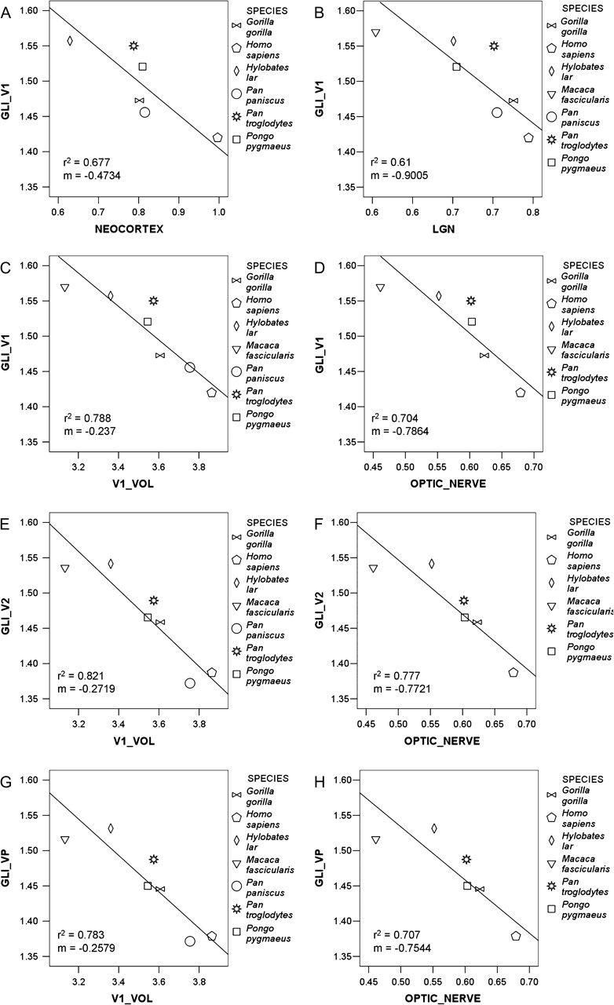
Figure 8. RMA regressions of species mean GLI values on brain and body size variables. V1 GLI as a function of ...
Notes:
Figure 8. RMA regressions of species mean GLI values on brain and body size variables. V1 GLI as a function of neocortex volume (A), LGN volume (B), V1 volume (C), and optic nerve volume (D); V2 GLI values as a function of V1 volume (E); and optic nerve volume (F); and VP GLI values as a function of V1 volume (G); and optic nerve volume (H).
Unless provided in the caption above, the following copyright applies to the content of this slide: © The Author 2009. Published by Oxford University Press. All rights reserved. For permissions, please e-mail: journals.permissions@oxfordjournals.org

Slide 9
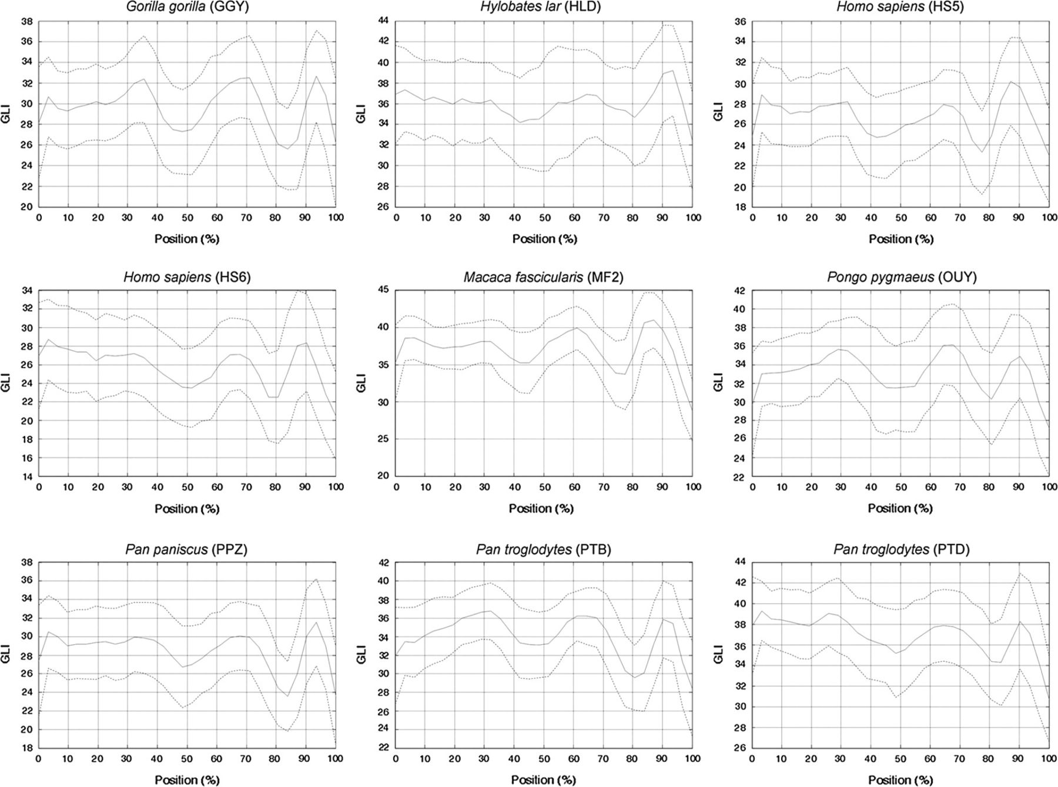
Figure 9. Mean V1 GLI profiles of individual specimens (solid lines) with standard deviation indicated (dotted lines).
Notes:
Figure 9. Mean V1 GLI profiles of individual specimens (solid lines) with standard deviation indicated (dotted lines).
Unless provided in the caption above, the following copyright applies to the content of this slide: © The Author 2009. Published by Oxford University Press. All rights reserved. For permissions, please e-mail: journals.permissions@oxfordjournals.org

Slide 10
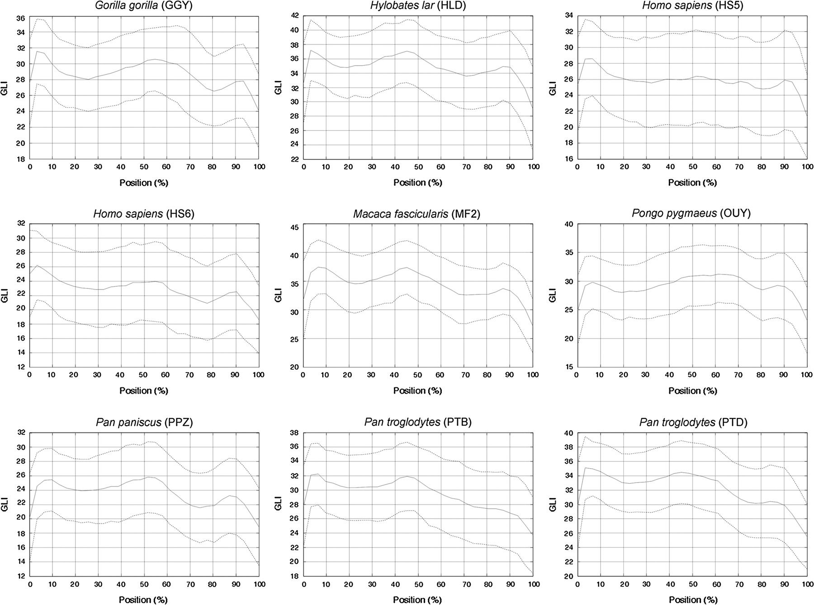
Figure 10. Mean V2 GLI profiles for each individual specimen (solid lines) with standard deviation indicated (dotted ...
Notes:
Figure 10. Mean V2 GLI profiles for each individual specimen (solid lines) with standard deviation indicated (dotted lines).
Unless provided in the caption above, the following copyright applies to the content of this slide: © The Author 2009. Published by Oxford University Press. All rights reserved. For permissions, please e-mail: journals.permissions@oxfordjournals.org

Slide 11
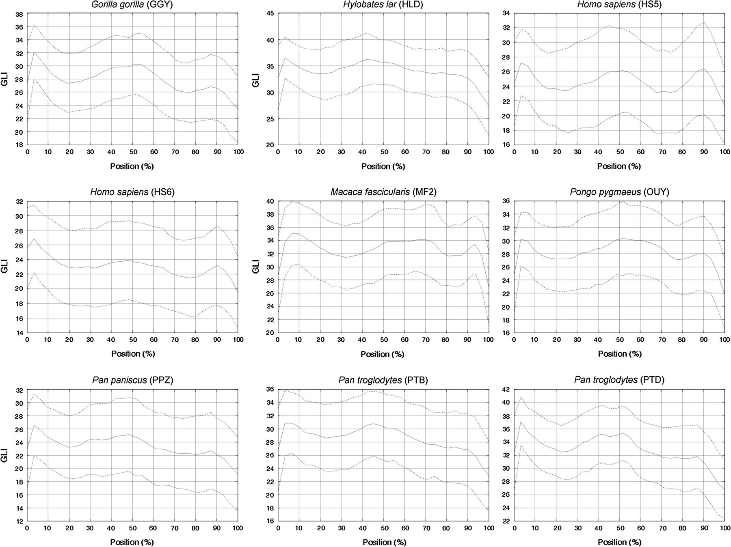
Figure 11. Mean VP GLI profiles of individual specimens (solid lines) with standard deviation indicated (dotted lines).
Notes:
Figure 11. Mean VP GLI profiles of individual specimens (solid lines) with standard deviation indicated (dotted lines).
Unless provided in the caption above, the following copyright applies to the content of this slide: © The Author 2009. Published by Oxford University Press. All rights reserved. For permissions, please e-mail: journals.permissions@oxfordjournals.org

Slide 12
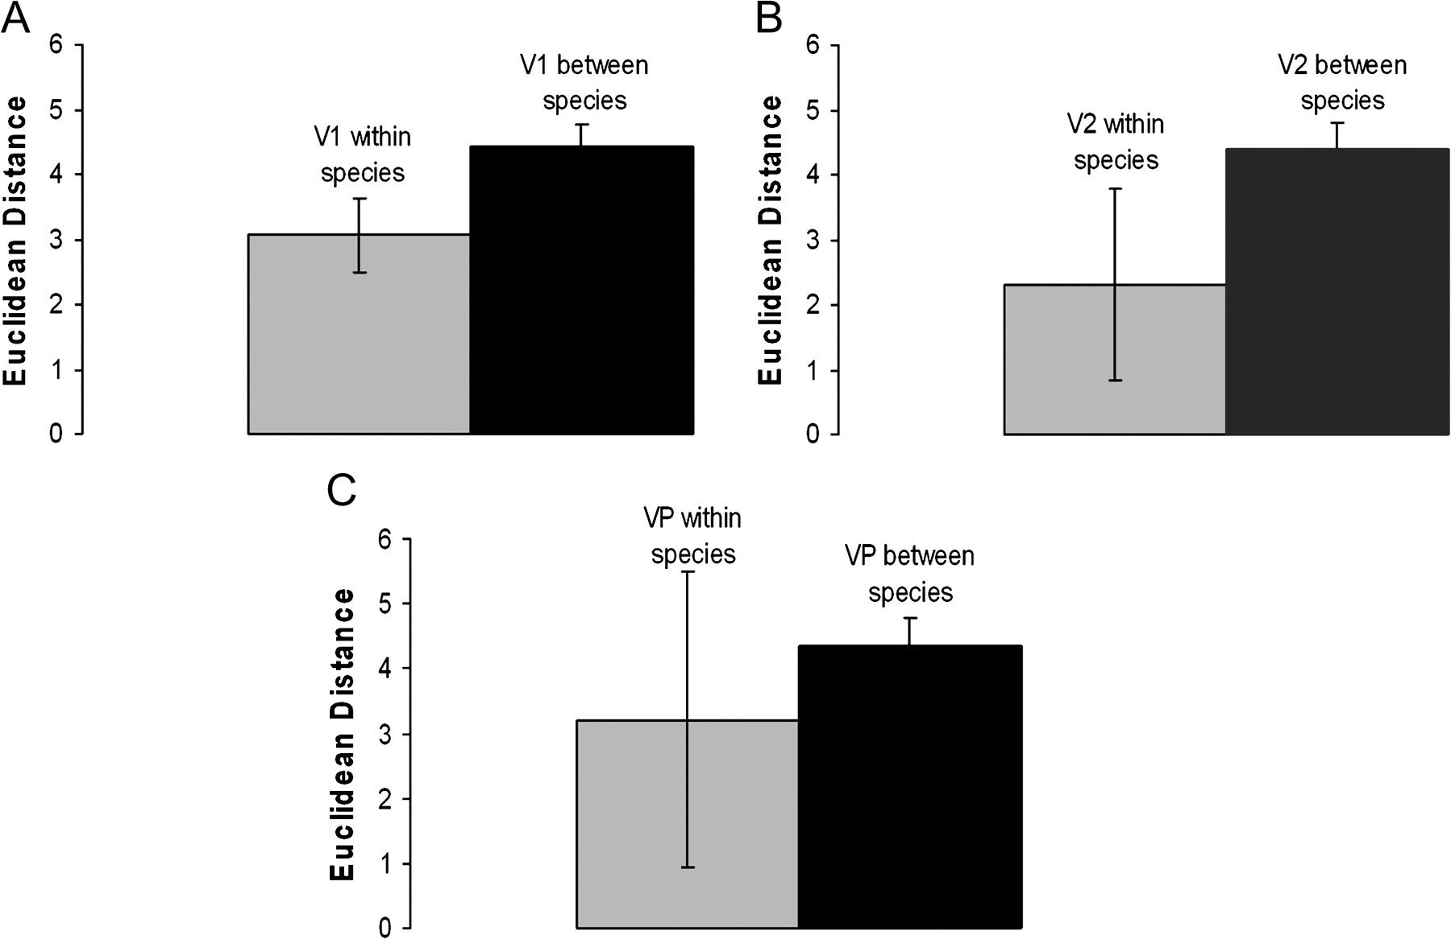
Figure 12. Bar graphs of Euclidean distances of GLI profile feature vectors among and within species (mean and 95% CI) ...
Notes:
Figure 12. Bar graphs of Euclidean distances of GLI profile feature vectors among and within species (mean and 95% CI) for V1 (A), V2 (B), and VP (C).
Unless provided in the caption above, the following copyright applies to the content of this slide: © The Author 2009. Published by Oxford University Press. All rights reserved. For permissions, please e-mail: journals.permissions@oxfordjournals.org

Slide 13
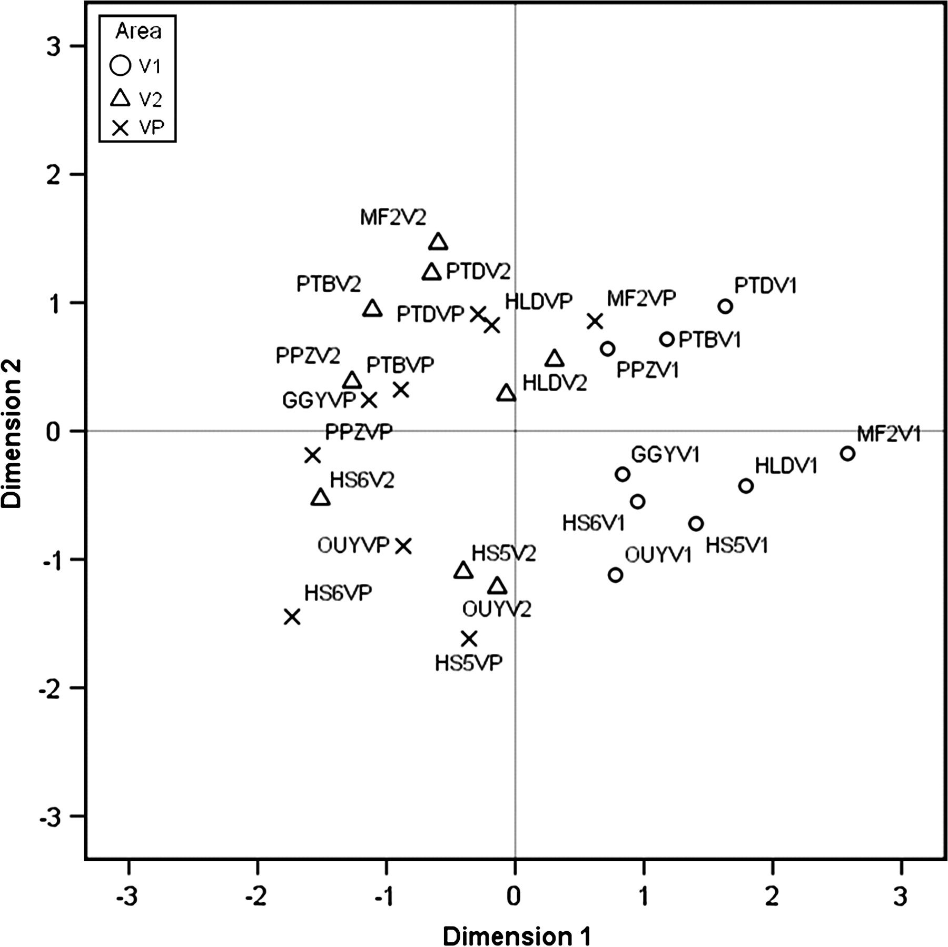
Figure 13. Euclidean distance plot of individual specimen GLI profiles based on a multidimensional scaling procedure. ...
Notes:
Figure 13. Euclidean distance plot of individual specimen GLI profiles based on a multidimensional scaling procedure. Minimum S-stress = 0.005.
Unless provided in the caption above, the following copyright applies to the content of this slide: © The Author 2009. Published by Oxford University Press. All rights reserved. For permissions, please e-mail: journals.permissions@oxfordjournals.org

Slide 14
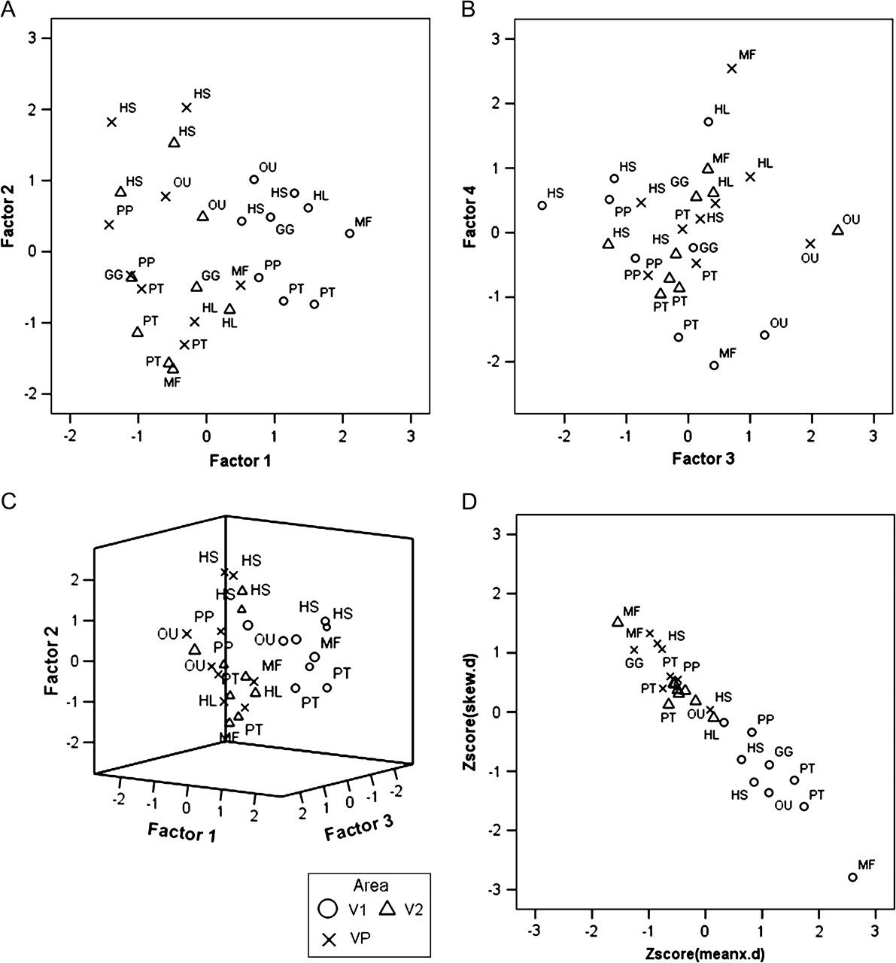
Figure 14. Principal components plots summarizing GLI individual profile data are shown (A,B and C). Also shown is a ...
Notes:
Figure 14. Principal components plots summarizing GLI individual profile data are shown (A,B and C). Also shown is a plot of the strongest positive (skew.d) and negative (meanx.d) loadings for Factor 1 (D). Abbreviations for species names are: HS - Homo sapiens, PT - Pan troglodytes, PP - Pan paniscus, GG - Gorilla gorilla, OU - Pongo pygmaeus, HL - Hylobates lar, MF - Macaca fascicularis.
Unless provided in the caption above, the following copyright applies to the content of this slide: © The Author 2009. Published by Oxford University Press. All rights reserved. For permissions, please e-mail: journals.permissions@oxfordjournals.org

