Slide 1
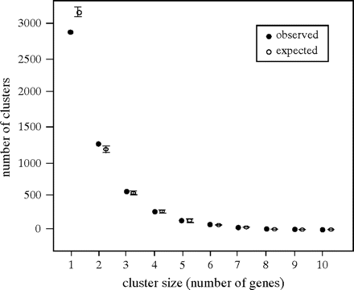
FIG. 1.— Frequency distribution of the size (in number of genes) of clusters of coexpressed genes in the human genome. ...
Notes:
FIG. 1.— Frequency distribution of the size (in number of genes) of clusters of coexpressed genes in the human genome. The data set includes 9,765 genes for which expression data were obtained using 14 tissues from SAGE libraries. We used the method published by Lercher et al. (2002) to detect coexpressed gene clusters in this data set and in data sets obtained after randomly permuting gene positions. Filled circles represent the number of observed clusters for each cluster size (in number of genes). Open circles represent the number of clusters for each size of cluster averaged in 1,000 independent permutations of gene positions. Error bars represent confidence intervals (P = 5%) of the means. As it was previously shown (Lercher et al. 2002), there is a significant clustering in the human genome. Indeed, the observed number of singleton genes (that do not belong to a cluster) is significantly lower (P < 10−16) in the real genome than in permutated genomes. However, the observed number of clusters is close to the expected number.
Unless provided in the caption above, the following copyright applies to the content of this slide: © The Author 2006. Published by Oxford University Press on behalf of the Society for Molecular Biology and Evolution. All rights reserved. For permissions, please e-mail: journals.permissions@oxfordjournals.org

Slide 2
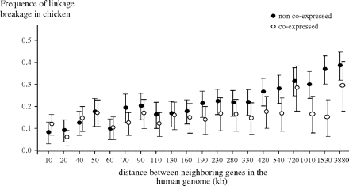
FIG. 2.— Conservation of the linkage between human and chicken according to the physical distance between genes in the ...
Notes:
FIG. 2.— Conservation of the linkage between human and chicken according to the physical distance between genes in the human genome, for genes that are coexpressed or not coexpressed in humans. The data set includes 5,763 genes for which orthologs (determined using reciprocal best hits) are known in humans and chickens and that are expressed in at least in one tissue in humans. The expression pattern of human genes was estimated with SAGE data. For each pair of neighbor genes in the human genome, we determined 1) whether they are coexpressed (they belong to the same cluster) or not in humans, 2) the physical distance between the 2 genes in the human genome, and 3) whether their orthologs are linked in the chicken genome. The relationship between the frequency of linkage conservation and intergenic distance is indicated for coexpressed genes (filled circles) and non–coexpressed genes (open circles). In both cases, the frequency of linkage conservation decreases with increasing intergenic distance (P = 10−7 for coexpressed genes and P < 10−16 for non–coexpressed genes). For a given intergenic distance, there is a significant difference in the frequency of linkage conservation between coexpressed and non–coexpressed genes (P = 10−6).
Unless provided in the caption above, the following copyright applies to the content of this slide: © The Author 2006. Published by Oxford University Press on behalf of the Society for Molecular Biology and Evolution. All rights reserved. For permissions, please e-mail: journals.permissions@oxfordjournals.org

Slide 3
FIG. 3.— Consequences of the coevolution of expression. (a) Top: various possibilities for 2 couples of orthologous ...
Notes:
FIG. 3.— Consequences of the coevolution of expression. (a) Top: various possibilities for 2 couples of orthologous genes that are adjacent in the human genome and in the mouse genome. Both ortholog couples have changed expression in a tissue given between humans and mice. (b) Bottom: a representation of the distribution of the ratios of the observed on the expected expression changes in the same direction (Rs) and in opposite directions (Ro). Rs is significantly different from 1 (P = 10−4), and Ro is marginally significant (P = 0.06, Wilcoxon tests).
Unless provided in the caption above, the following copyright applies to the content of this slide: © The Author 2006. Published by Oxford University Press on behalf of the Society for Molecular Biology and Evolution. All rights reserved. For permissions, please e-mail: journals.permissions@oxfordjournals.org

Slide 4
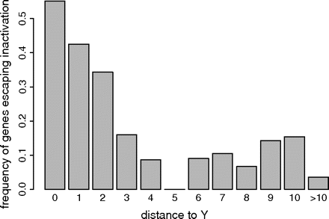
FIG. 4.— Frequency of gene expression on the Xi chromosome function of the distance (in number of genes) to the ...
Notes:
FIG. 4.— Frequency of gene expression on the Xi chromosome function of the distance (in number of genes) to the nearest gene having an homolog on the Y chromosome (data set from Carrel and Willard 2005). The genes having a homolog on the Y chromosome (N = 29, distance = 0) have a much higher probability to be expressed on the Xi chromosome (P = 0.6) than the genes without homolog (N = 577, P = 0.1). However, this probability increases for genes located in proximity to the genes having a homolog on the Y chromosome (3–4 times higher than average for the closest neighbors, distance 1 or 2).
Unless provided in the caption above, the following copyright applies to the content of this slide: © The Author 2006. Published by Oxford University Press on behalf of the Society for Molecular Biology and Evolution. All rights reserved. For permissions, please e-mail: journals.permissions@oxfordjournals.org

