Slide 1
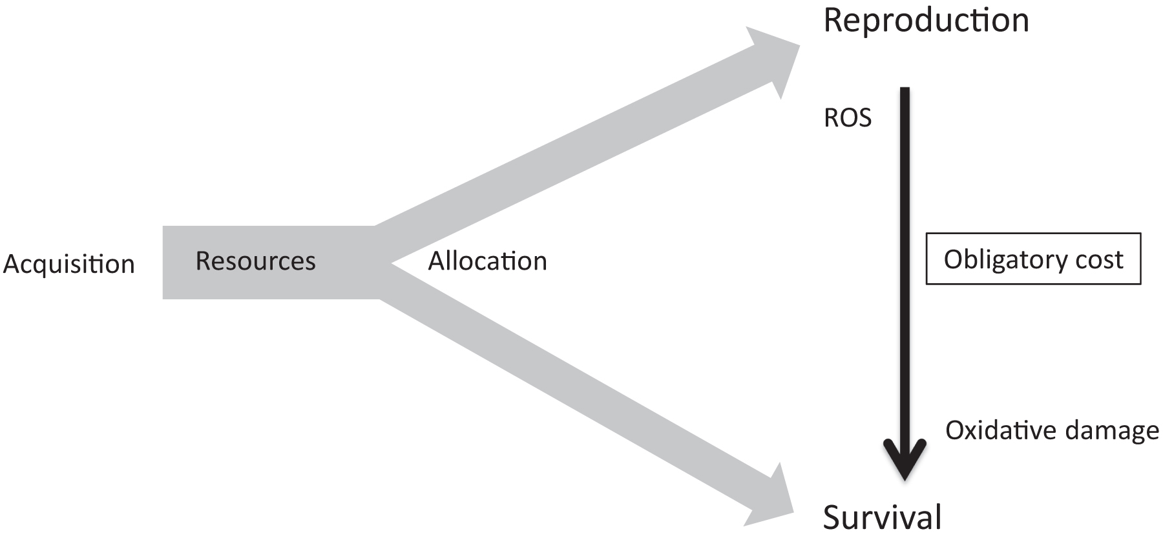
Figure 1. The classical resource-allocation trade-off based on the “Y model” from de Jong and van Noordwijk (1992) and ...
Notes:
Figure 1. The classical resource-allocation trade-off based on the “Y model” from de Jong and van Noordwijk (1992) and the obligatory trade-off based on an inevitable cost (Tatar and Carey 1995). The investment in a trait can not only divert limiting resources for another trait (e.g., energy, macronutrients, and antioxidants) but also trigger an inevitable cost, such as oxidative damage. A direct trade-off may thus coexist with a resource allocation trade-off. However, this also means that the oxidative cost of reproduction may involve a trade-off without involving limiting resources. Abbreviation: ROS, reactive oxygen species.
Unless provided in the caption above, the following copyright applies to the content of this slide: © The Author(s) 2017. Published by Oxford University Press on behalf of the American Institute of Biological Sciences. All rights reserved. For permissions, please e-mail: journals.permissions@oup.com

Slide 2
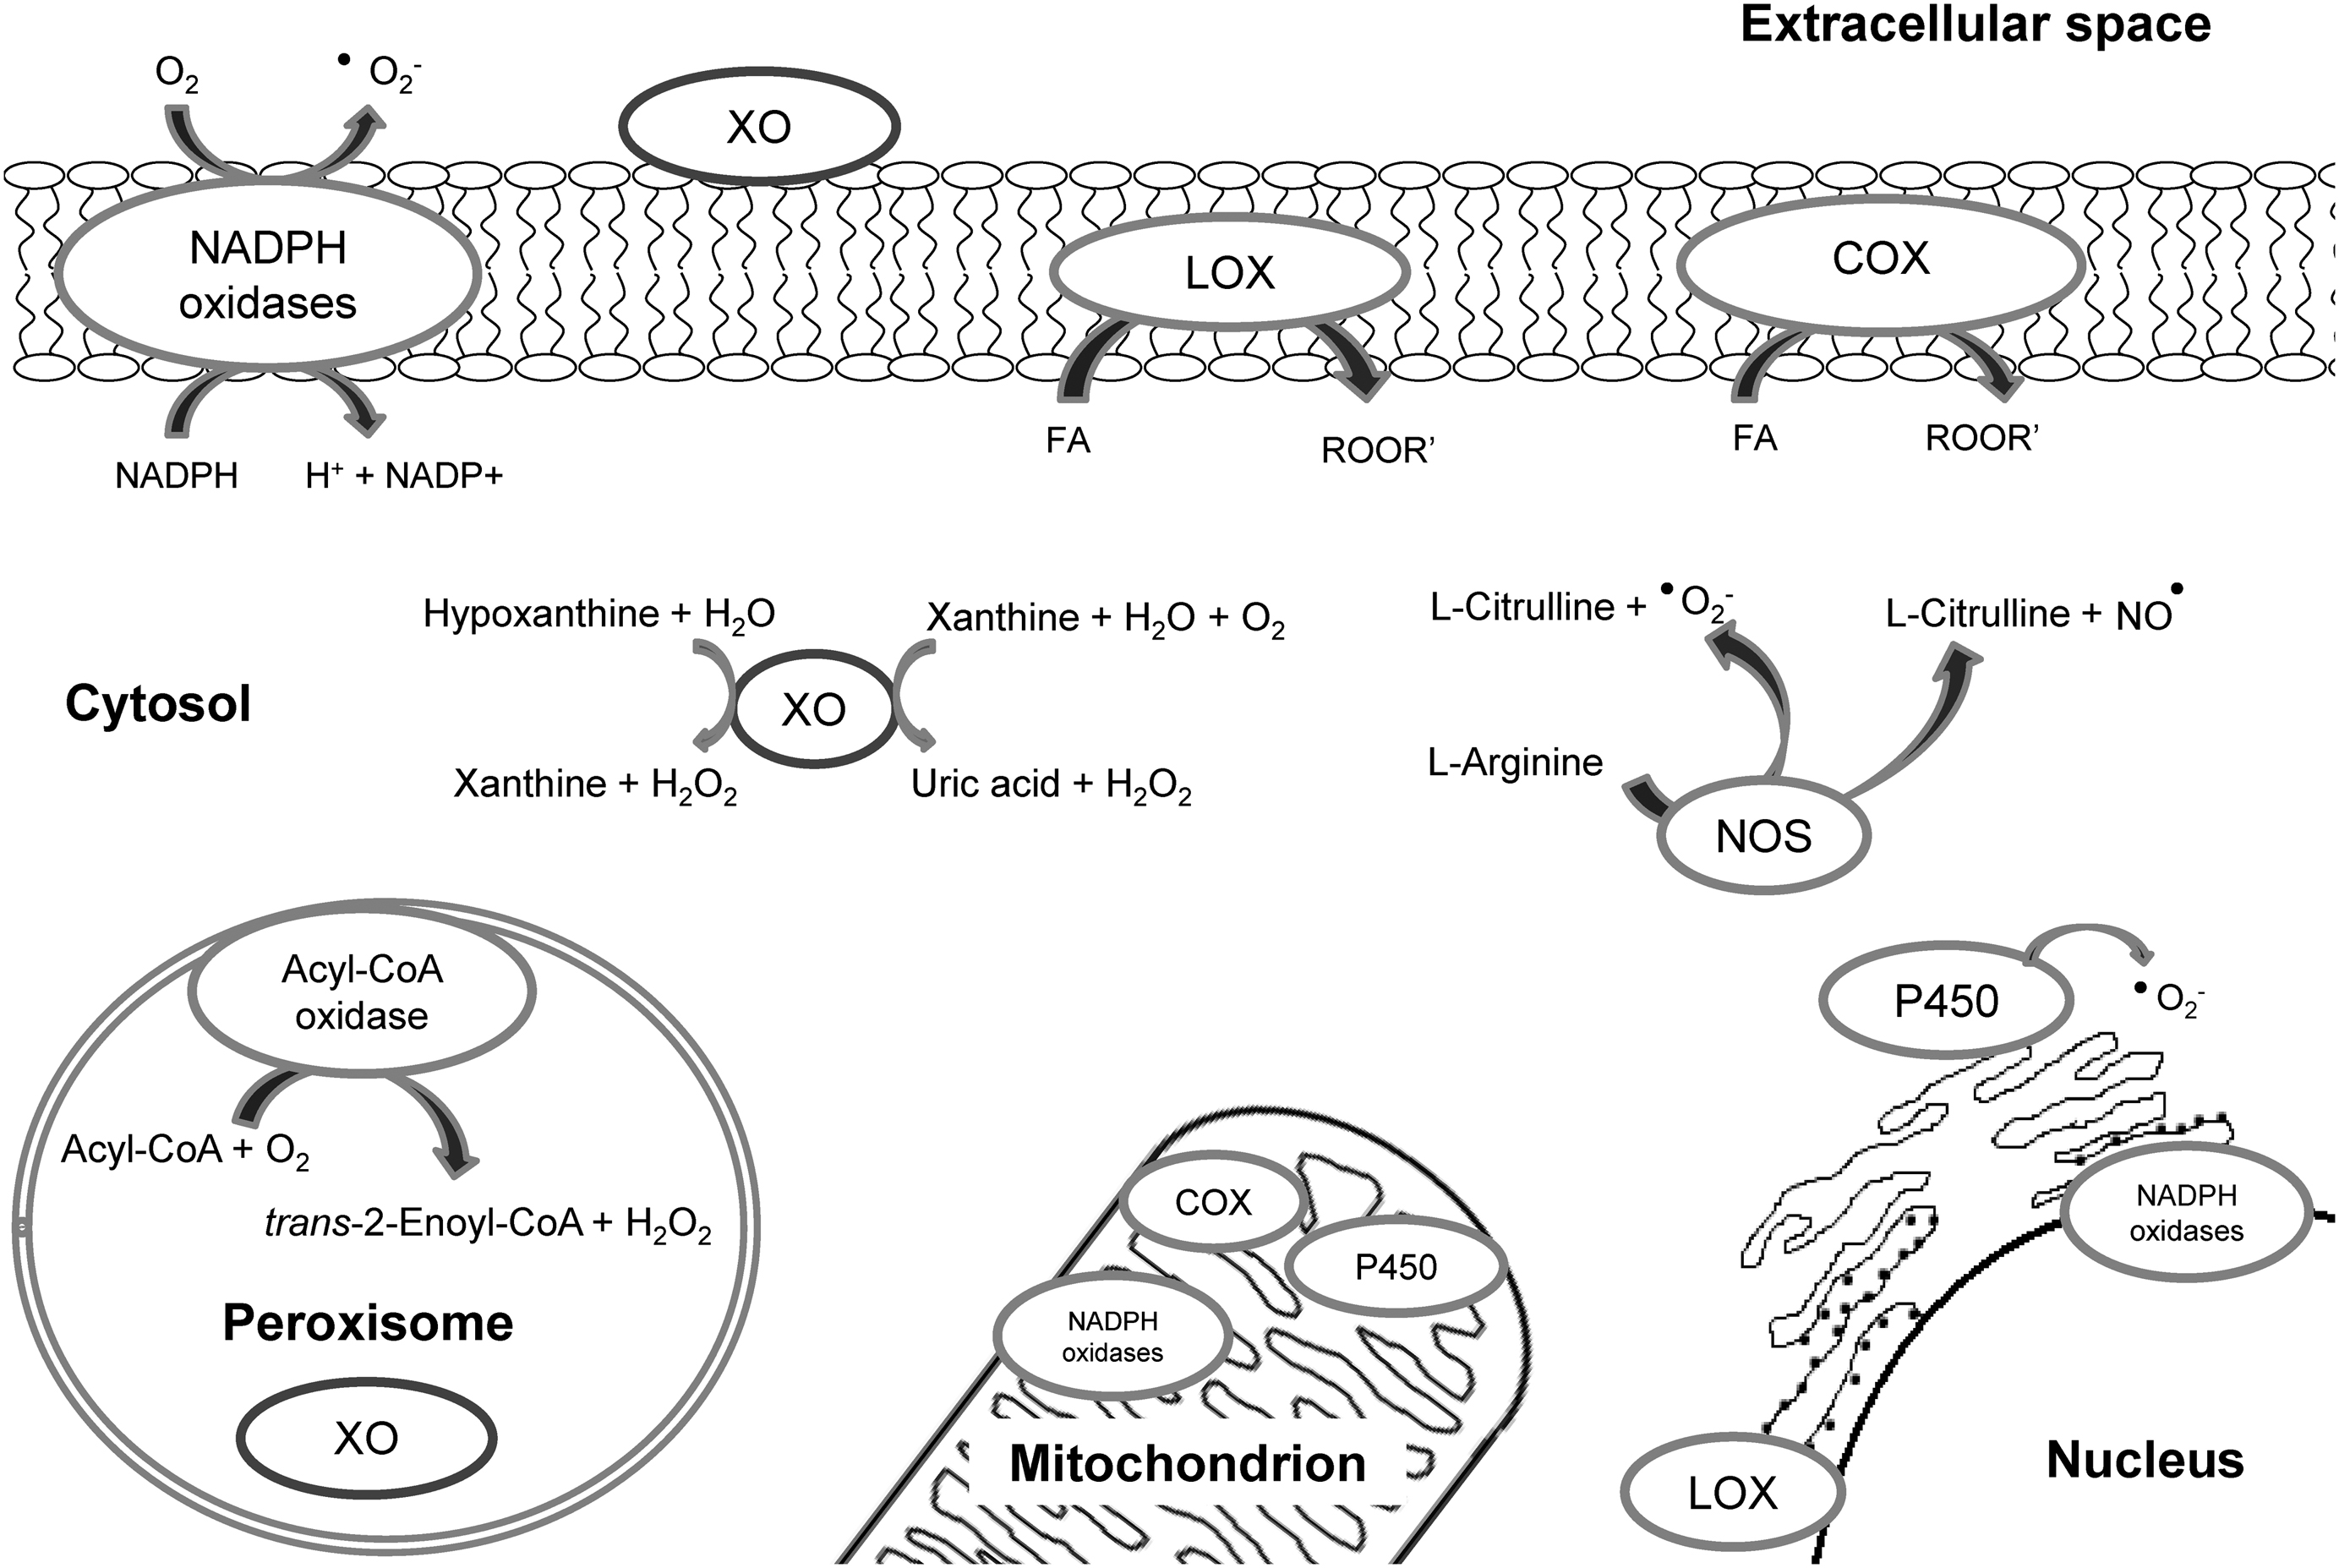
Figure 2. A simplified diagram illustrating the extramitochondrial sources of reactive oxygen species (ROS; based on ...
Notes:
Figure 2. A simplified diagram illustrating the extramitochondrial sources of reactive oxygen species (ROS; based on Bedard and Krause 2007, Covarrubias et al. 2008, Drummond and Sobey 2014). Nicotinamide adenine dinucleotide phosphate (NADPH) oxidases are considered the main extramitochondrial ROS source within the cell (see the main text). They have mostly been described in the cell membrane, where they release superoxide (O2−) to the extracellular space. They can also be found in the nucleus and endoplasmic reticulum membranes. Xanthine oxidases (XO) are other important sources of ROS. They are located in the cell membrane, peroxisome, and cytoplasm, releasing hydrogen peroxide from hypoxanthine or xanthine (purine bases). Nitric oxide synthases (NOS) are located in the cytoplasm, releasing nitric oxide (NO) or superoxide from L-arginine depending on its state (i.e., coupled or uncoupled NOS, respectively). ROS generated by NADPH oxidases also elicit ROS formation from XO and NOS. Other ROS sources include lipoxygenases (LOX) and cyclooxygenases (COX), which are located in the cell membrane and generate peroxides from fatty acids (FA). LOX can also be found in the endoplasmic reticulum. In addition to XO, the peroxisome holds fatty acyl-CoA oxidases, generating hydrogen peroxide. The cytochrome P450 in the endoplasmic reticulum also contributes to ROS production by releasing superoxide. Finally, P450, COX, and even NADPH oxidases (NOX4; Sakellariou Jackson and Vasilaki 2014) are involved in the respiratory chain in the mitochondrion.
Unless provided in the caption above, the following copyright applies to the content of this slide: © The Author(s) 2017. Published by Oxford University Press on behalf of the American Institute of Biological Sciences. All rights reserved. For permissions, please e-mail: journals.permissions@oup.com

Slide 3
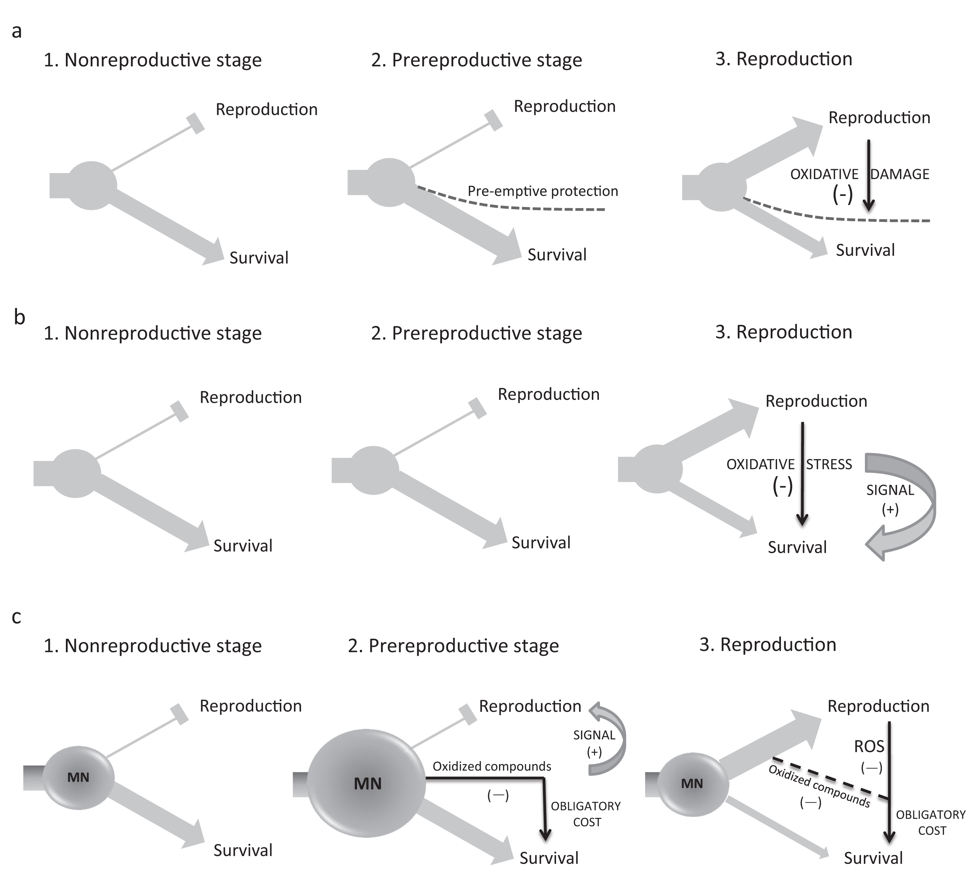
Figure 3. Hypotheses aiming to explain the lower oxidative damage among breeders compared with that among nonbreeders. ...
Notes:
Figure 3. Hypotheses aiming to explain the lower oxidative damage among breeders compared with that among nonbreeders. (a) The oxidative-shielding hypothesis implies that animals preemptively (stage 2) reduce reactive oxygen species (ROS) production and/or increase antioxidant levels in order to protect themselves and their offspring from oxidative damage during reproduction. The mechanism might be activated in advance of the reproductive event. (b) The hormesis-during-reproduction hypothesis suggests that certain intermediate ROS or oxidative-damage levels generated by reproduction trigger some unknown redox-signaling pathway activating a hormetic (compensatory) response that should subsequently reduce oxidative damage. The mechanism would be initiated from the start of the reproductive event. (c) The extortion-for-reproduction hypothesis assumes that animals increase body stores and/or circulating levels of macronutrients (MN; i.e., carbohydrates, lipids, and proteins) in order to reproduce (1, 2, 3). Macronutrients not diverted to reproduction would become oxidized or stimulate NADPH oxidases, increasing ROS and inflicting oxidative damage (2). This process implies an obligatory cost in the trade-off between reproduction and self-maintenance (figure 1). High ROS or oxidative-damage levels would trigger redox signals encouraging reproduction as early as possible. When reproduction takes place (3), macronutrient amounts decline; therefore, the oxidative damage is reduced. At that time, ROS, perhaps derived from increased enzyme metabolism in cells (figure 2), would drive the oxidative cost of reproduction, but circulating oxidized compounds due to resource allocation to reproduction may still contribute to that cost. We predict that the efficiency of (a) or (b) mechanisms becomes weaker with time because of aging, whereas (c) should be reinforced with age as opportunities for breeding decline (see also table 1).
Unless provided in the caption above, the following copyright applies to the content of this slide: © The Author(s) 2017. Published by Oxford University Press on behalf of the American Institute of Biological Sciences. All rights reserved. For permissions, please e-mail: journals.permissions@oup.com

Slide 4
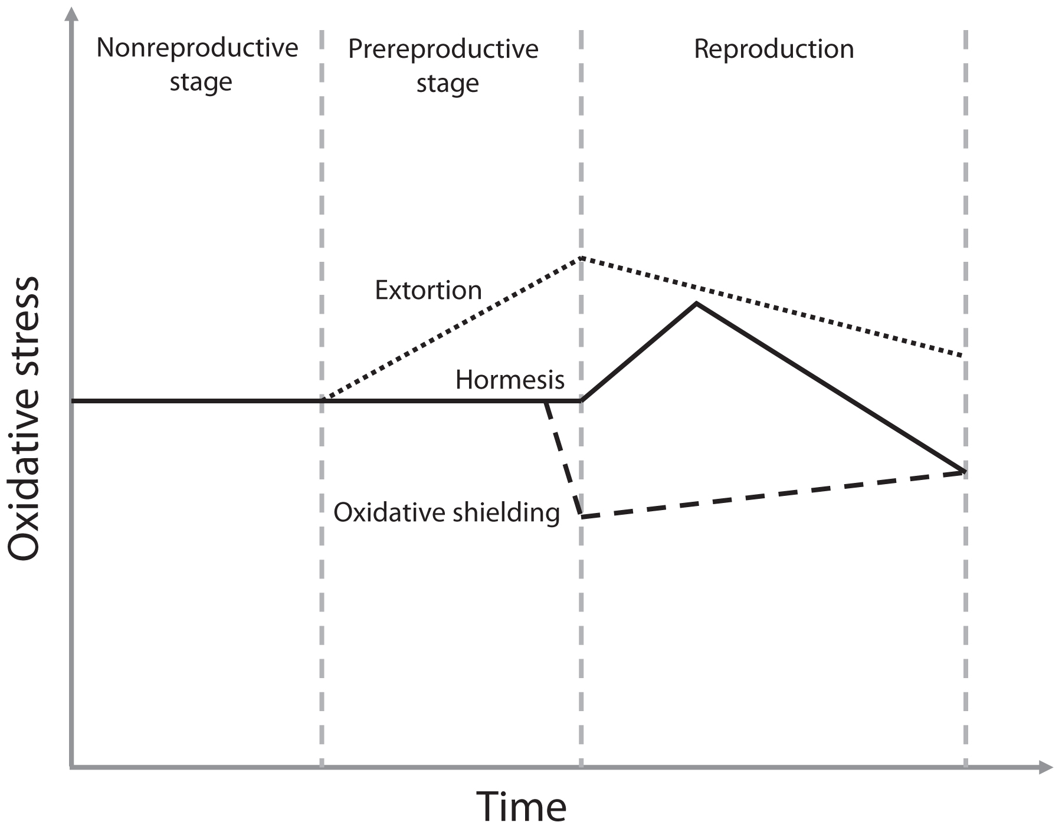
Figure 4. The proposed dynamics of oxidative-damage values throughout nonreproductive and reproductive periods in the ...
Notes:
Figure 4. The proposed dynamics of oxidative-damage values throughout nonreproductive and reproductive periods in the life of an animal. The extortion-for-reproduction hypothesis (dotted line) predicts an increase in the oxidative damage associated with the accumulation of macronutrients in blood and/or storage tissues. The oxidative-shielding hypothesis (dashed line) predicts a preemptive decline in oxidative damage, which should imply a decrease in advance of reproduction effort. This could be triggered by hormones (e.g., estrogens; see main text) and could start abruptly. The duration could subsequently vary depending on reproductive strategies (e.g., mammals could shield pups from the embryo stage until weaning, whereas birds or reptiles should do so only until oviposition). Finally, the hormesis-during-reproduction hypothesis (solid line) implies a transient rise in oxidative damage after the start of reproductive effort. In the latter two cases, the damage level is lower at the end of the reproductive event than at the prereproductive stage. This is not predicted in extortion for reproduction, where damage at the end of reproduction can remain higher than damage in the non-reproductive stage.
Unless provided in the caption above, the following copyright applies to the content of this slide: © The Author(s) 2017. Published by Oxford University Press on behalf of the American Institute of Biological Sciences. All rights reserved. For permissions, please e-mail: journals.permissions@oup.com

