Slide 1
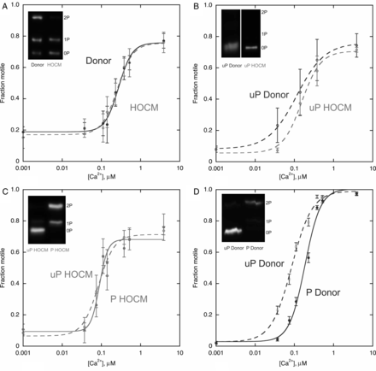
Figure 2 The effects of TnI phosphorylation and exchange of troponin subunits on the Ca²⁺ sensitivity of ...
Notes:
Figure 2 The effects of TnI phosphorylation and exchange of troponin subunits on the Ca2+ sensitivity of thin filaments containing donor and HOCM troponin. Ca2+ activation of the fraction of thin filament motility was measured using the quantitative in vitro motility assay. Ca2+ regulates the fraction of filaments motile and their sliding speed in a similar manner; the fraction motile parameter is plotted here; the complete analysis of individual experiments is shown in the Supplementary material online, part II. Typical comparison experiments done in paired motility cells; The points are the mean and SEM of four measurements made in a single motility cell and the lines are 4-parameter fits to the Hill equation. Mean results from several replicates of each experiment and the measured TnI phosphorylation levels are shown in Table 1. Solid lines and points, high TnI phosphorylation level; dotted lines and open points, low TnI phosphorylation level. (A) Thin filaments containing troponin from donor heart (1.6 mol Pi/mol TnI) and HOCM heart (0.3 mol Pi/mol TnI). Inset: phosphate affinity SDS–PAGE showing TnI phosphorylation levels. (B) Thin filaments containing unphosphorylated troponin from phosphatase-treated donor (0.2 mol Pi/mol TnI) or HOCM heart (0.3 mol Pi/mol TnI). Inset: phosphate affinity SDS–PAGE showing TnI phosphorylation level. (C) Thin filaments containing troponin from a HOCM heart (0.1 mol Pi/mol TnI) or protein kinase A-treated HOCM heart troponin (1.6 mol Pi/mol TnI), Inset: phosphate affinity SDS–PAGE showing TnI phosphorylation levels. (D) Thin filaments containing natively phosphorylated donor heart troponin (1.6 mol Pi/mol TnI) or phosphatase-treated donor troponin (0.2 mol Pi/mol TnI). Inset: phosphate affinity SDS–PAGE showing TnI phosphorylation levels. (E) Thin filaments containing HOCM troponin compared with HOCM troponin with TnT replaced by exchange (HOCM XT; both 0.3 mol Pi/mol TnI). Inset: Pro-Q Diamond-stained gels demonstrating the replacement of TnT. (F) Thin filaments containing unphosphorylated (uP HOCM XT; 0.2 mol Pi/mol TnI) or protein kinase A-phosphorylated HOCM troponin (P HOCM XT; 1.6 mol Pi/mol TnI) with TnT replaced by exchange in both samples. Inset: phosphate affinity SDS–PAGE showing TnI phosphorylation levels. (G) Thin filaments containing HOCM troponin (0.3 mol Pi/mol TnI) compared with HOCM troponin with TnI replaced by exchange (HOCM XI; 0.2 mol Pi/mol TnI). Inset: shows Pro-Q Diamond-stained gels demonstrating the replacement of TnI. (H) Thin filaments containing donor heart troponin compared with donor heart troponin with TnT replaced by exchange (both 1.7 mol Pi/mol TnI).
Unless provided in the caption above, the following copyright applies to the content of this slide: Published on behalf of the European Society of Cardiology. All rights reserved. © The Author 2012. For permissions please email: journals.permissions@oup.com.

Slide 2
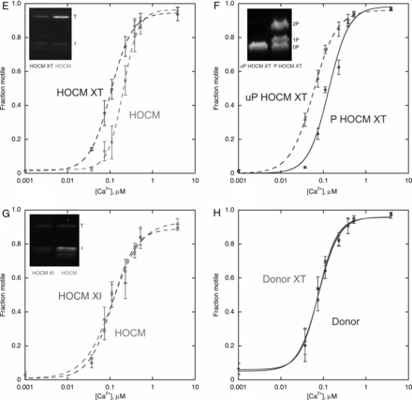
Figure 2 (Continued).
Notes:
Figure 2 (Continued).
Unless provided in the caption above, the following copyright applies to the content of this slide: Published on behalf of the European Society of Cardiology. All rights reserved. © The Author 2012. For permissions please email: journals.permissions@oup.com.

Slide 3
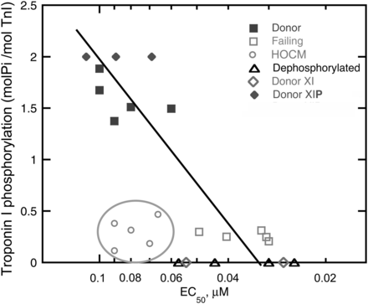
Figure 1 The relationship between TnI phosphorylation and Ca²⁺ sensitivity of thin filaments containing ...
Notes:
Figure 1 The relationship between TnI phosphorylation and Ca2+ sensitivity of thin filaments containing human cardiac troponin. Troponin phosphorylation was measured by phosphate affinity SDS–PAGE (data from Dyer et al.24). EC50 for Ca2+ activation of thin filament motility was measured using a quantitative in vitro motility assay. Natively phosphorylated donor heart troponin (filled square), failing heart troponin (open square), unphosphorylated (phosphatase treated) donor heart troponin (open triangle), unphosphorylated recombinant TnI exchanged into donor heart troponin (XI) (open diamond), protein kinase A-treated recombinant TnI exchanged into donor heart troponin (XIP) (data from Jacques et al.26) (filled diamond). Troponin from myectomy samples from HOCM patients (open circle).
Unless provided in the caption above, the following copyright applies to the content of this slide: Published on behalf of the European Society of Cardiology. All rights reserved. © The Author 2012. For permissions please email: journals.permissions@oup.com.

Slide 4
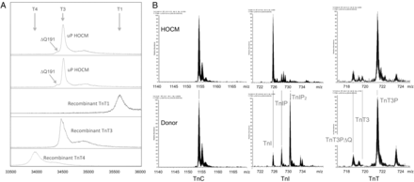
Figure 3 Mass spectrometry of intact troponin subunits. (A) Identification of TnT isoform. The MALDI-TOF spectra show ...
Notes:
Figure 3 Mass spectrometry of intact troponin subunits. (A) Identification of TnT isoform. The MALDI-TOF spectra show the mass of the TnT peak obtained from troponin purified from donor and HOCM heart and dephosphorylated with alkaline phosphatase. For reference, we also show spectra of recombinant T1, T3, and T4 isoforms of hcTnT. The peak of HOCM and donor TnT corresponds to the T3 isoform with no evidence for any T1 or T4 isoforms. A small amount of the ΔQ191 splice variant was observed in both donor and HOCM TnT. (B) FTICR mass spectrometry of native HOCM and donor TnT. High-resolution electrospray mass spectra of TnC (16+ ion), TnI (33+ ion), and TnT (48+ ion) isolated from donor and HOCM heart. The peak of HOCM and donor TnT corresponds to the monophosphorylated T3 isoform. A small amount of the ΔQ191 splice variant was observed in both donor and HOCM TnT. In addition to the major protein species indicated, adducts were seen at +17 Da in the TnC spectra and +98 and +113 in both the TnI and the TnT spectra.
Unless provided in the caption above, the following copyright applies to the content of this slide: Published on behalf of the European Society of Cardiology. All rights reserved. © The Author 2012. For permissions please email: journals.permissions@oup.com.

