Slide 1
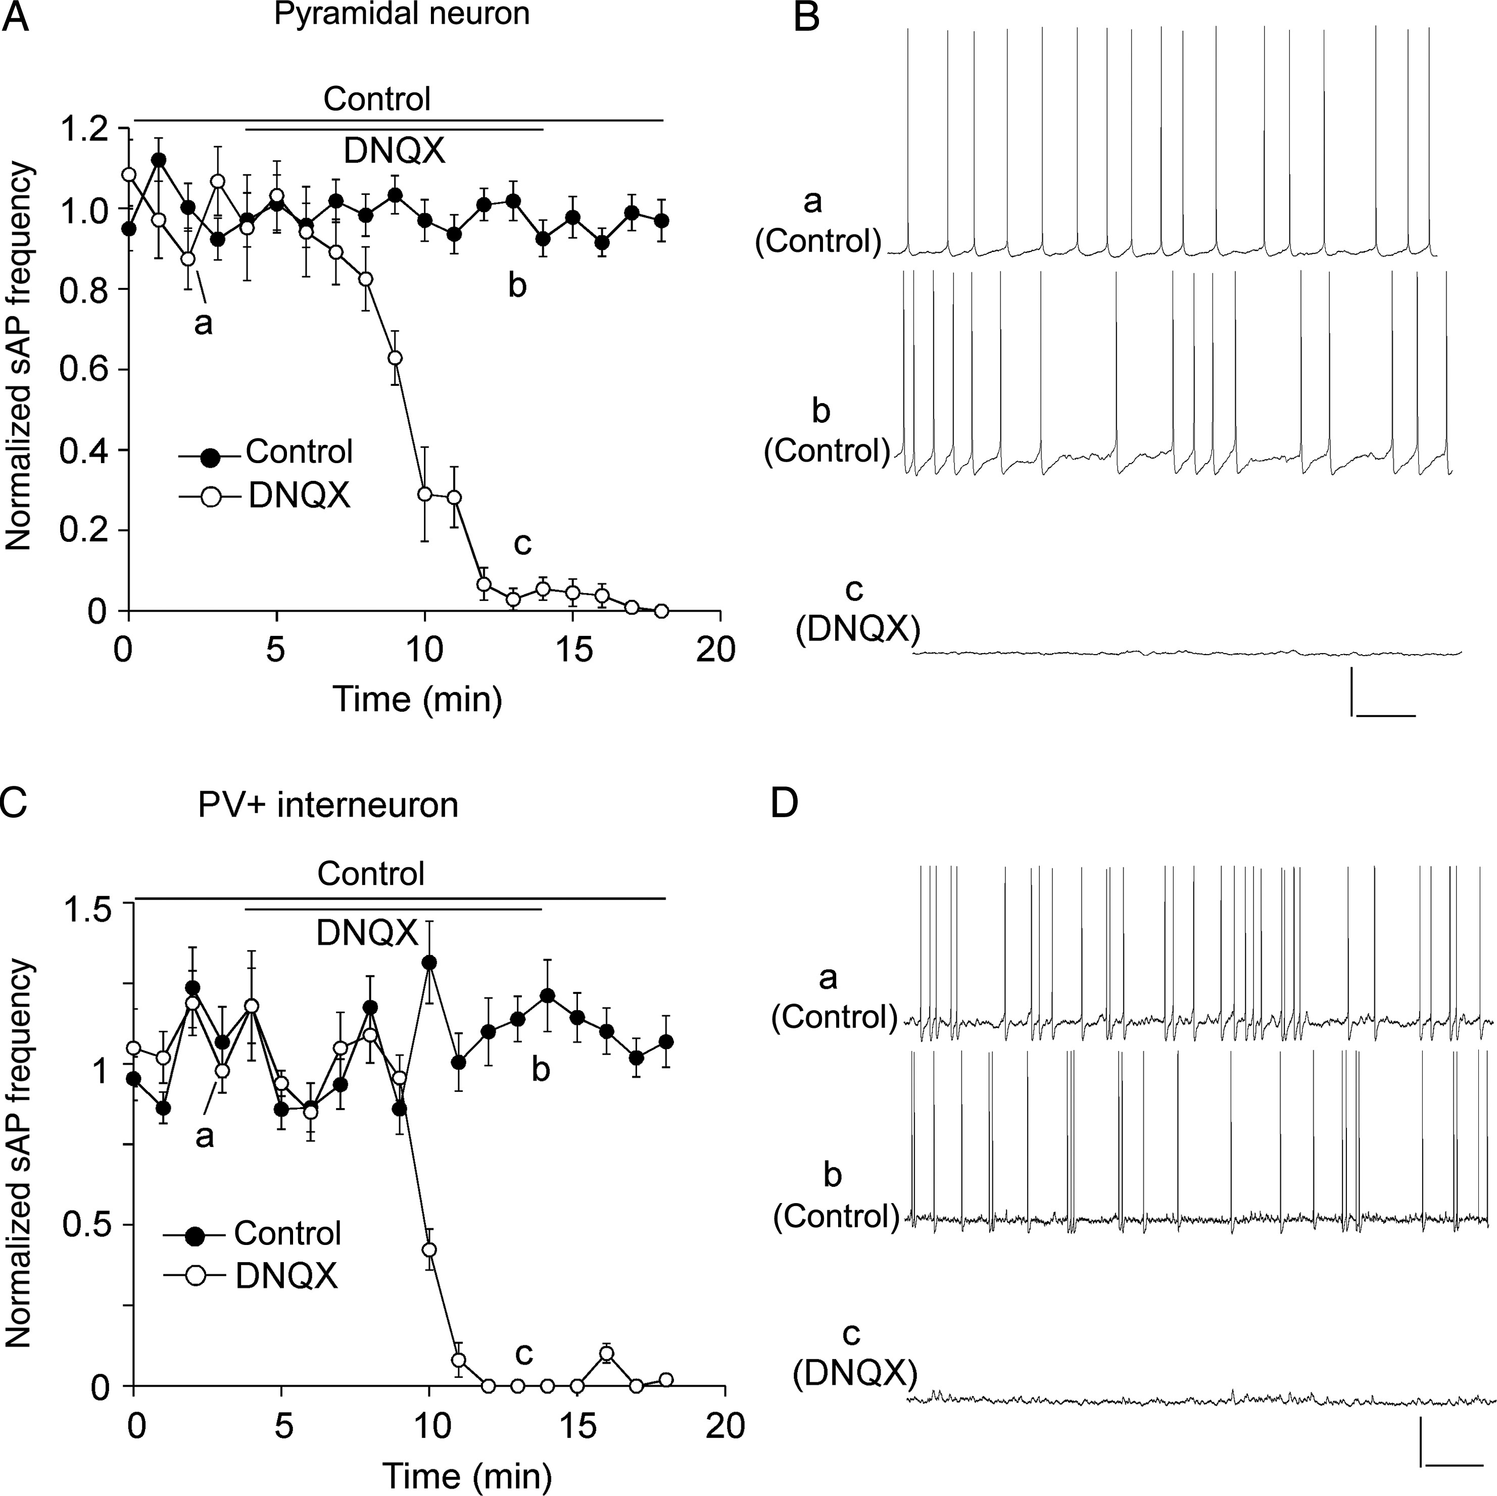
Figure 1. Spontaneous action potentials were dependent on AMPAR-mediated synaptic transmission. (A,C) The plot of ...
Notes:
Figure 1. Spontaneous action potentials were dependent on AMPAR-mediated synaptic transmission. (A,C) The plot of normalized frequency of sAPs before and after the application of AMPAR antagonist DNQX (50 μm) in PFC pyramidal neurons (A) and PV+ interneurons (C). (B,D) Representative traces of sAPs at time points (denoted by a–c) in plots A and C. Scale bars: 20 mV, 1 s.
Unless provided in the caption above, the following copyright applies to the content of this slide: © The Author 2014. Published by Oxford University Press. All rights reserved. For Permissions, please e-mail: journals.permissions@oup.com

Slide 2
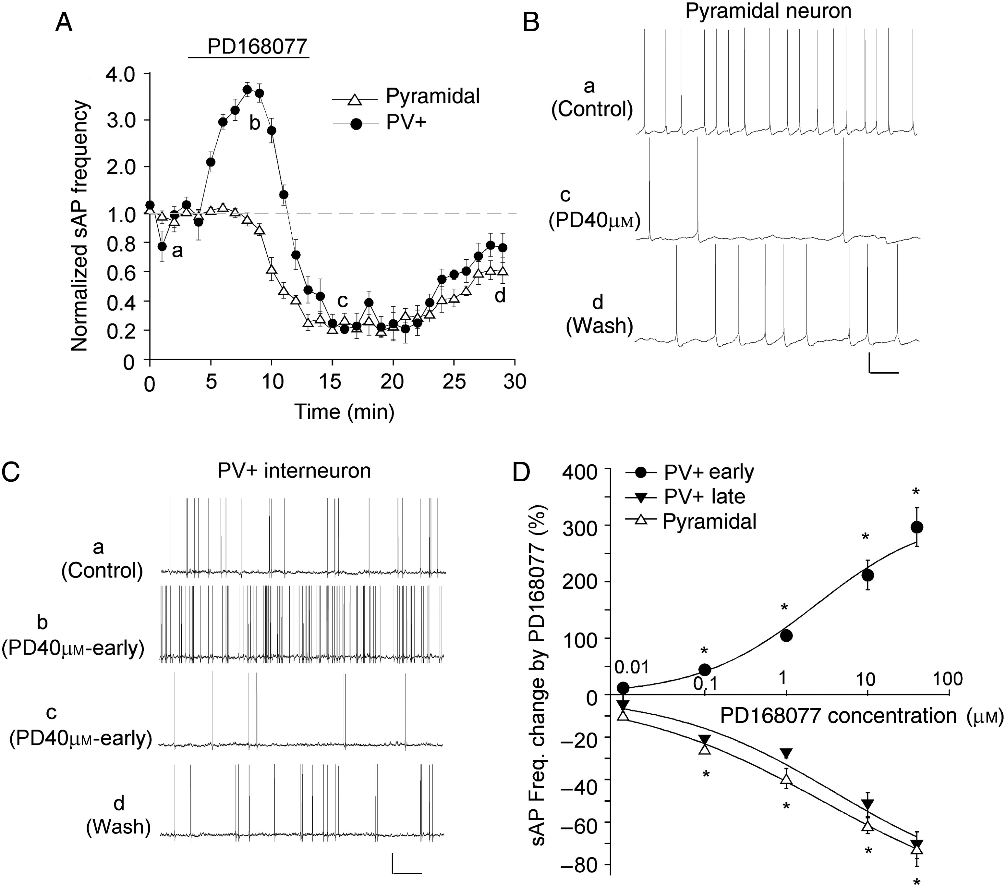
Figure 2. D₄R agonist PD168077 induced different effects on sAP frequency in PFC pyramidal neurons and PV+ ...
Notes:
Figure 2. D4R agonist PD168077 induced different effects on sAP frequency in PFC pyramidal neurons and PV+ interneurons. (A) The time course of normalized sAP frequency showing the effect of PD168077 (40 μm) in PFC pyramidal neurons (triangle unfilled) and PV+ interneurons (round filled). (B,C) Representative traces of sAP at different time points (denoted by a–d) in plot A. Scale bars: 20 mV, 1 s. (D) Dose–response data and fitted curves showing the percentage changes in sAP frequency by different concentrations of PD168077 in PFC pyramidal neurons and PV+ interneurons. *P < 0.01.
Unless provided in the caption above, the following copyright applies to the content of this slide: © The Author 2014. Published by Oxford University Press. All rights reserved. For Permissions, please e-mail: journals.permissions@oup.com

Slide 3
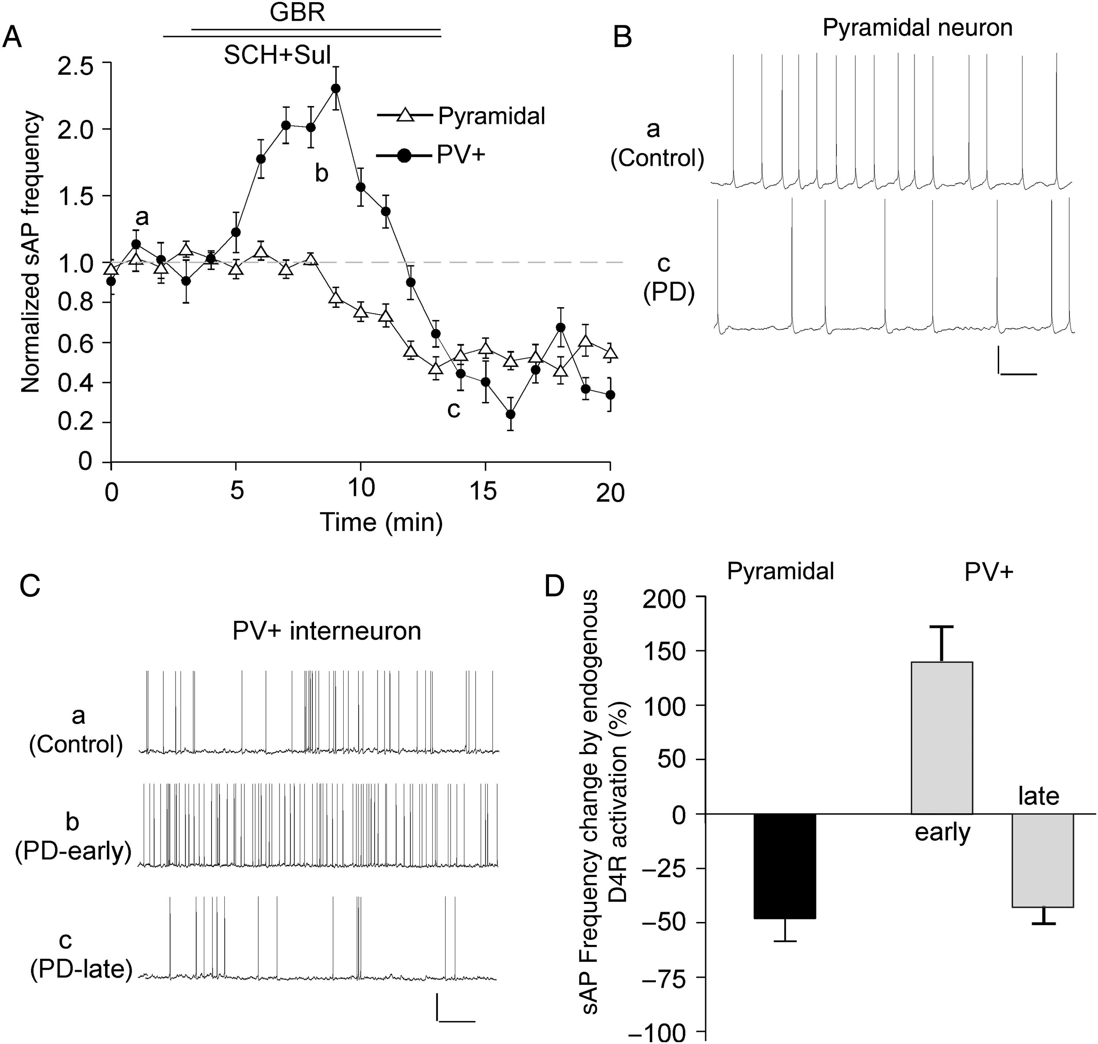
Figure 3. Endogenous D₄R activation induced different effects on sAP frequency in PFC pyramidal neurons and ...
Notes:
Figure 3. Endogenous D4R activation induced different effects on sAP frequency in PFC pyramidal neurons and PV+ interneurons. (A) The time course of normalized sAP frequency showing the effect of dopamine transporter inhibitor GBR-12909 (10 μm), in the presence of D1/5 antagonist SCH23390 (10 μm) and D2/3 antagonist sulpiride (5 μm), in PFC pyramidal neurons (triangle unfilled) and PV+ interneurons (round filled). (B,C) Representative traces of sAP at different time points (denoted by a–c) in plot A. Scale bars: 20 mV, 1 s. (D) Bar graph summary of percentage change of sAP frequency by GBR-12909 (in the presence of SCH23390 and sulpiride) in PFC pyramidal neurons and PV+ interneurons.
Unless provided in the caption above, the following copyright applies to the content of this slide: © The Author 2014. Published by Oxford University Press. All rights reserved. For Permissions, please e-mail: journals.permissions@oup.com

Slide 4
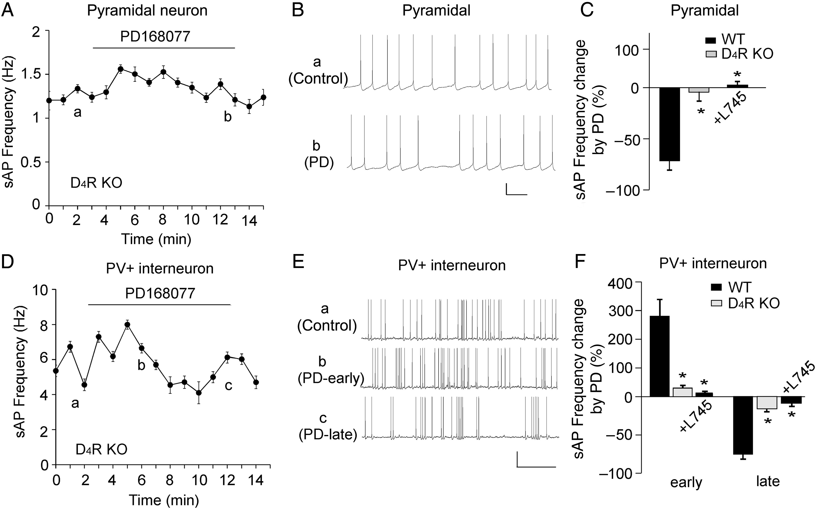
Figure 4. The effect of PD168077 on sAP frequency was mediated by D₄R activation. (A,D) The time course of ...
Notes:
Figure 4. The effect of PD168077 on sAP frequency was mediated by D4R activation. (A,D) The time course of sAP frequency showing the lack of effect of PD168077 (40 μm) in PFC pyramidal neurons (A) and PV+ interneurons (D) from D4R KO mice. (B,E) Representative traces of sAP at different time points (denoted by a–c) in plots A and D. Scale bars: 20 mV, 1 s. (C,F) Bar graph summary of percentage change of sAP frequency by PD168077 in PFC pyramidal neurons (C) and PV+ interneurons (F) from WT vs., D4R KO mice, as well as the effect of PD168077 in the presence of D4 antagonist L745870 (20 μm) in WT mice. *P < 0.01.
Unless provided in the caption above, the following copyright applies to the content of this slide: © The Author 2014. Published by Oxford University Press. All rights reserved. For Permissions, please e-mail: journals.permissions@oup.com

Slide 5
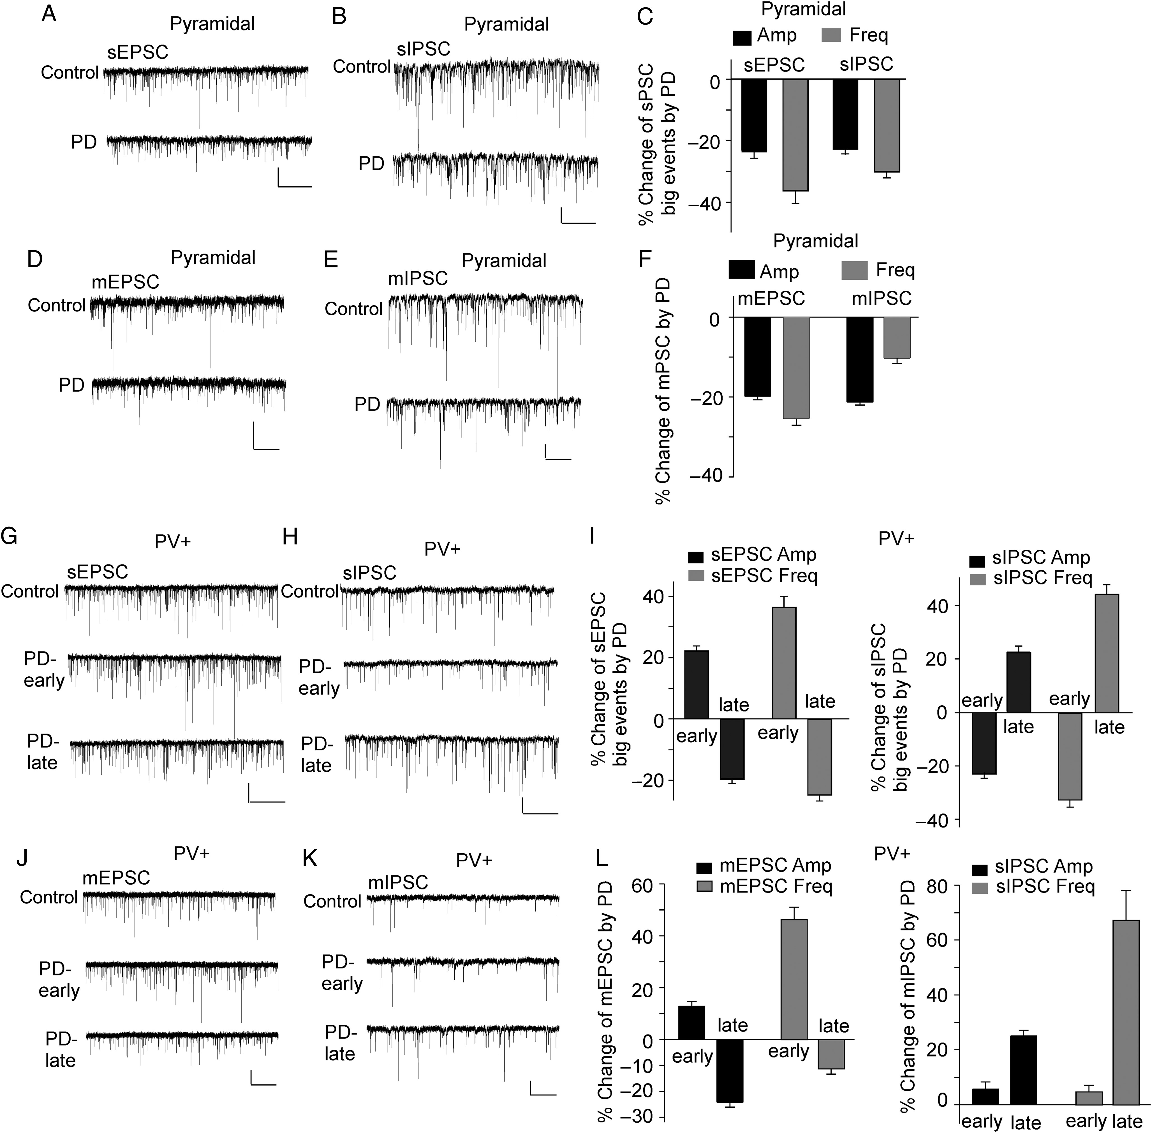
Figure 5. D₄R agonist PD168077 induced different effects on excitatory and inhibitory synaptic transmission ...
Notes:
Figure 5. D4R agonist PD168077 induced different effects on excitatory and inhibitory synaptic transmission in PFC pyramidal neurons and PV+ interneurons. (A–E) Representative traces of sEPSC (A), sIPSC (B), mEPSC (D), and mIPSC (E) before and after PD168077 (40 μm, 10 min) treatment in PFC pyramidal neurons. Scale bars: 20 pA, 5 s (A,B), 2 s (D,E). (C,F) Bar graph summary of the percentage change in the spontaneous (C) and miniature (F) synaptic currents by PD168077 in pyramidal neurons. (G,H,J,K) Representative traces of sEPSC (G), sIPSC (H), mEPSC (J), and mIPSC (K) before and after PD168077 (40 μm, 10 min) treatment in PV+ interneurons. Note, 2 time points (early: 3rd–5th min during PD application; late: 7th–10th min during PD application) were selected to show the biphasic effects of PD168077. Scale bars: 20 pA, 5 s (G,H), 2 s (J,K). (I,L) Bar graph summary of the percentage change in the spontaneous (I) and miniature (L) synaptic currents by PD168077 at 2 time points (early and late) in PV+ interneurons.
Unless provided in the caption above, the following copyright applies to the content of this slide: © The Author 2014. Published by Oxford University Press. All rights reserved. For Permissions, please e-mail: journals.permissions@oup.com

Slide 6
Figure 6. D₄R agonist PD168077 had not effect on the intrinsic excitability. (A,C) Representative traces of ...
Notes:
Figure 6. D4R agonist PD168077 had not effect on the intrinsic excitability. (A,C) Representative traces of action potentials evoked by injected currents (20 s/pulse) before and after PD168077 (40 μm) application in a PFC pyramidal neuron (A) and a PV+ interneuron (C). Scale bars: 20 mV, 50 m. (B,D) The time course of evoked AP frequency showing the lack of effect of PD168077 in a PFC pyramidal neuron (B) and a PV+ interneuron (D). (E) Bar graph summary of the percentage change of evoked AP frequency by PD168077 in PFC pyramidal neurons and PV+ interneurons.
Unless provided in the caption above, the following copyright applies to the content of this slide: © The Author 2014. Published by Oxford University Press. All rights reserved. For Permissions, please e-mail: journals.permissions@oup.com

Slide 7
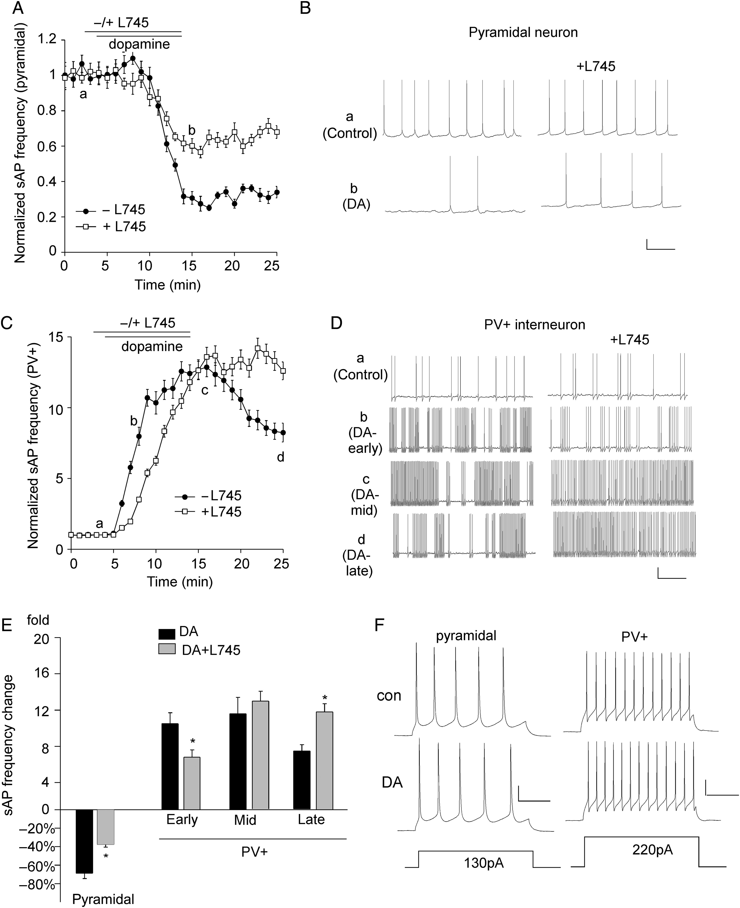
Figure 7. The effects of dopamine on sAP in PFC pyramidal neurons and PV+ interneurons are partially mediated by D4 ...
Notes:
Figure 7. The effects of dopamine on sAP in PFC pyramidal neurons and PV+ interneurons are partially mediated by D4 receptors. (A) The time course of normalized sAP frequency showing the effect of dopamine (1 μm) in the absence (control) or presence of the D4 antagonist L745870 (20 μm) in PFC pyramidal neurons. (B) Representative traces of sAPs at different time points (denoted by a,b) in plot A. Scale bars: 20 mV, 1 s. (C) The time course of normalized sAP frequency showing the effect of dopamine (1 μm) in the absence (control) or presence of L745870 (20 μm) in PFC PV+ interneurons. (D) Representative traces of sAP at different time points (denoted by a–d) in plot C. Scale bars: 20 mV, 1 s. (E) Bar graph summary of the change in sAP frequency by dopamine in the absence or presence of L745870 in PFC pyramidal neurons and PV+ interneurons. The time-dependent effects of dopamine were analyzed in early (b), mid (c), and late (d) stages. *P < 0.05. (F) Representative traces of action potentials evoked by injected currents (20 s/pulse) before and after dopamine (1 μm) application in a PFC pyramidal neuron and a PV+ interneuron. Scale bars: 20 mV, 100 ms.
Unless provided in the caption above, the following copyright applies to the content of this slide: © The Author 2014. Published by Oxford University Press. All rights reserved. For Permissions, please e-mail: journals.permissions@oup.com

Slide 8
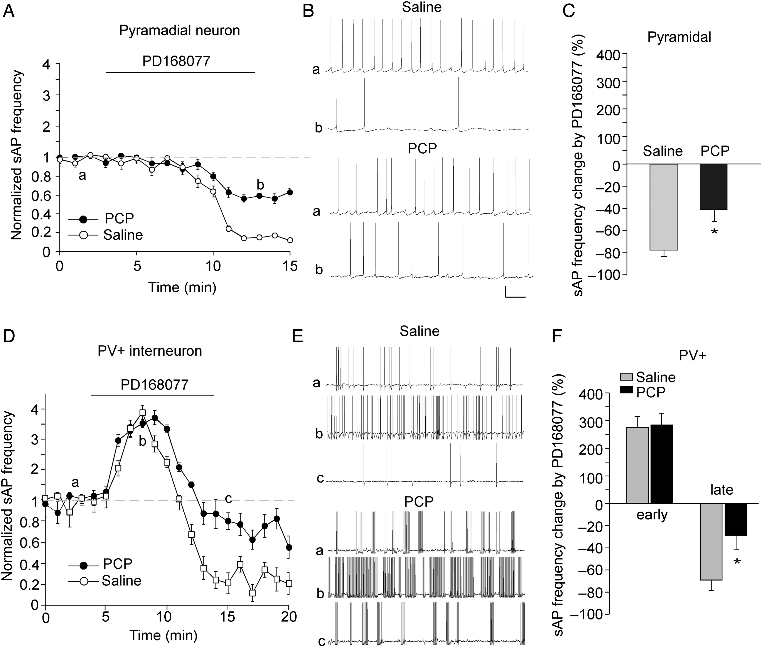
Figure 8. The effects of D₄R on sAP frequency in PFC pyramidal neurons and PV+ interneurons were altered in ...
Notes:
Figure 8. The effects of D4R on sAP frequency in PFC pyramidal neurons and PV+ interneurons were altered in the PCP model of schizophrenia. (A,D) The plot of normalized sAP frequency showing the effect of PD168077 in pyramidal neurons (A) and PV+ interneurons (D) from saline- versus PCP (5 mg/kg, 3-day)-injected mice. (B,E) Representative sAP traces at different time points (denoted by a–c in plots A,D) in pyramidal neurons (B) and PV+ interneuron (E) from saline- versus PCP-injected mice. Scale bars: 20 mV, 1 s. (C,F) Bar graph summary of the percentage change in sAP frequency by PD168077 in pyramidal neurons (C) and PV+ interneurons (F) from saline- versus PCP-injected mice. *P < 0.05.
Unless provided in the caption above, the following copyright applies to the content of this slide: © The Author 2014. Published by Oxford University Press. All rights reserved. For Permissions, please e-mail: journals.permissions@oup.com

