Slide 1
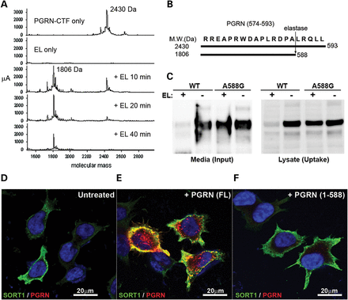
Figure 3. Elastase-mediated removal of C-terminal motif of PGRN blocks PGRN endocytosis by SORT1. (A) A synthetic ...
Notes:
Figure 3. Elastase-mediated removal of C-terminal motif of PGRN blocks PGRN endocytosis by SORT1. (A) A synthetic PGRN574–593 peptide was enzymatically cleaved by recombinant elastase (EL) in a time-dependent manner as analyzed by MS-MALDI analysis. The PGRN574–593 peptide with a molecular weight of 2430 Da was processed into a product with 1806Da indicating the last five residues were removed by EL as shown schematically in (B). (C) WT or EL-site-mutated A588G-rPGRN protein in cell culture media was set up to react with EL in vitro. After reaction, the media was used as input to carry out a cellular endocytosis assay in M17 cells overexpressing SORT1. PGRN endocytosed in cells was detected in cell lysate after treatment (uptake). Unlike WT rPGRN, A588G-rPGRN was more resistant to EL activity as shown by the amount of residual full-length protein in the medium (input), which was endocytosed by cells to a similar extent compared with no EL control. Immunocytofluorescence analysis showed that only full-length rPGRN (FL) (E) but not the carboxyl-terminal-truncated PGRN1-588 (F) was significantly endocytosed by M17SORT1 cells. (D) The untreated M17SORT1 control was included. PGRN and SORT1 were labeled in red and green, respectively.
Unless provided in the caption above, the following copyright applies to the content of this slide: © The Author 2013. Published by Oxford University Press.This is an Open Access article distributed under the terms of the Creative Commons Attribution License (http://creativecommons.org/licenses/by/3.0/), which permits unrestricted reuse, distribution, and reproduction in any medium, provided the original work is properly cited.

Slide 2
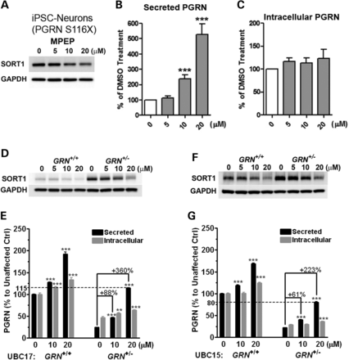
Figure 2. MPEP decreases SORT1 expression and increases extracellular PGRN in cellular models of FTD-GRN. (A–C) MPEP ...
Notes:
Figure 2. MPEP decreases SORT1 expression and increases extracellular PGRN in cellular models of FTD-GRN. (A–C) MPEP decreased SORT1 levels (A) and increased extracellular PGRN levels (B) but not intracellular PGRN (C) in a recently reported PGRN S116X human neuron model differentiated from FTLD patient-specific iPSCs. (D–G) MPEP reduced intracellular SORT1 levels (D and F) and preferentially increased extracellular PGRN levels (E and G) in lymphoblastoid cell lines (LCLs) from two FTD-GRN families, UBC17 (D and E) and UBC15 (F and G). MPEP at 20 μM restored extracellular PGRN to near normal level in mutation carrier (GRN+/−) compared with non-carrier control (GRN+/+). **P < 0.01, ***P < 0.001 versus vehicle control, analysis performed by one-way ANOVA followed by Tukey's post-test.
Unless provided in the caption above, the following copyright applies to the content of this slide: © The Author 2013. Published by Oxford University Press.This is an Open Access article distributed under the terms of the Creative Commons Attribution License (http://creativecommons.org/licenses/by/3.0/), which permits unrestricted reuse, distribution, and reproduction in any medium, provided the original work is properly cited.

Slide 3
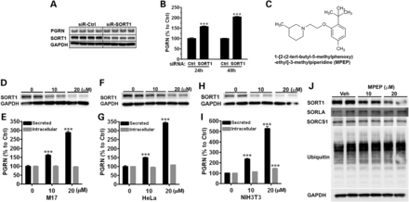
Figure 1. MPEP decreases SORT1 expression and increases extracellular PGRN in mammalian cell lines. (A and B) M17 cells ...
Notes:
Figure 1. MPEP decreases SORT1 expression and increases extracellular PGRN in mammalian cell lines. (A and B) M17 cells were treated with control siRNA (siR-Ctrl) or gene-specific SORT1 siRNA (siR-SORT1). (A) Intracellular levels of PGRN, SORT1 and GAPDH were evaluated by western blot at a 48 h time-point. (B) Suppression of SORT1 levels increased extracellular PGRN levels. (C) Chemical name and structure of MPEP. (D–I) Treatment of M17 cells (D and E), HeLa cells (F and G) or NIH3T3 cells (H and I) with MPEP for 24 h dose dependently reduced SORT1 levels (D, F and H) and increased exPGRN levels (E, G and I) at 10 and 20 μM. (J) Under the same conditions, MPEP did not affect levels of SORLA, SORCS1 and ubiquitinated proteins in M17 cells. ***P < 0.001 versus vehicle control, analysis performed by one-way ANOVA followed by Tukey's post-test.
Unless provided in the caption above, the following copyright applies to the content of this slide: © The Author 2013. Published by Oxford University Press.This is an Open Access article distributed under the terms of the Creative Commons Attribution License (http://creativecommons.org/licenses/by/3.0/), which permits unrestricted reuse, distribution, and reproduction in any medium, provided the original work is properly cited.

Slide 4
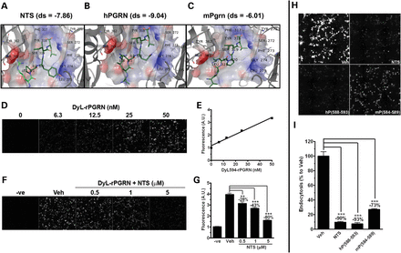
Figure 4. SORT1 ligands competitively inhibit PGRN endocytosis. (A–C) Structure for NTS (A), native human ...
Notes:
Figure 4. SORT1 ligands competitively inhibit PGRN endocytosis. (A–C) Structure for NTS (A), native human PGRN588–593 peptide (B) and mouse Pgrn584–589 peptide (C) docked with SORT1 and the corresponding docking scores are shown. (A) The strongly interacting core of NTS peptide, -PYIL, which is resolved in X-ray structure, is shown in bolder, dark green. SORT1 residues within 4 Å are rendered in gray. Secondary structure for SORT1 is shown as cartoon ribbons. The carboxylate of terminal Leu is visible in the electrostatic surface rendering of the binding pocket. As with NTS, (B) the human PGRN588–593 (-ALRQLL) or (C) the mouse Pgrn584–589 (-VPRPLL) is shown docked with the SORT1-binding pocket (electrostatic surface rendered) with the residues <4 Å indicated. Carboxylate of Leu is in the identical position as NTS. (D and E) A quantitative cell-based assay has been established to measure PGRN endocytosis by SORT1. DyLight™ 594-labeled rPGRN was endocytosed dose dependently in COS-1SORT1 cells. (D) Images were captured by BD-pathway system. (E) Quantitative cellular endocytosis of DyL-rPGRN was measured by fluorescence signal from treated cells. (F) NTS at 0.1, 1 and 5 μM dose dependently inhibited PGRN endocytosis. Untreated COS-1SORT1 cells were included as negative control (−ve). (G) Quantification of signal from (F). (H and I) SORT1 ligands at 10 μM, NTS, human PGRN588–593 peptide and mouse PGRN584–589 peptide competitively inhibited DyL-rPGRN endocytosis as compared with vehicle control, respectively. ***P < 0.001 versus vehicle control, analysis performed either by (G) one-way ANOVA followed by Tukey's post-test or (I) by unpaired student t-tests.
Unless provided in the caption above, the following copyright applies to the content of this slide: © The Author 2013. Published by Oxford University Press.This is an Open Access article distributed under the terms of the Creative Commons Attribution License (http://creativecommons.org/licenses/by/3.0/), which permits unrestricted reuse, distribution, and reproduction in any medium, provided the original work is properly cited.

Slide 5
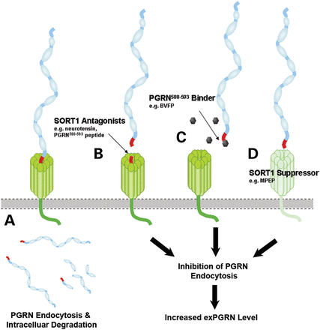
Figure 6. Schematic diagram summarizing the strategies applied to inhibit SORT1-mediated endocytosis in the current ...
Notes:
Figure 6. Schematic diagram summarizing the strategies applied to inhibit SORT1-mediated endocytosis in the current study. (A) Under normal conditions, extracellular PGRN interacts with the β-propeller tunnel structure of SORT1 using its C-terminal end binding motif as shown in red color. SORT1 facilitates endocytosis of exPGRN and directs it to the endolysosomal pathway for degradation. (B) High-affinity SORT1 ligands such as NTS or the PGRN(588–593) peptide competitively limits the access of exPGRN to SORT1-binding sites, thereby inhibiting PGRN endocytosis. (C) To improve target specificity, we have also identified a small-molecule binder, BVFP, targeting the PGRN(588–593) motif that is essential for PGRN–SORT1 interaction. We demonstrated that pretreatment of BVFP to rPGRN significantly reduced the amount of rPGRN captured by SORT1 in vitro and inhibited SORT1-mediated rPGRN endocytosis. (D) Suppressors of SORT1 expression, such as MPEP, reduce SORT1-mediated endocytosis, thereby increasing extracellular PGRN levels. The above-mentioned strategies, used alone or in combination with others, are potential avenues for discovery of SORT1-dependent PGRN enhancers for the treatment of FTD-GRN.
Unless provided in the caption above, the following copyright applies to the content of this slide: © The Author 2013. Published by Oxford University Press.This is an Open Access article distributed under the terms of the Creative Commons Attribution License (http://creativecommons.org/licenses/by/3.0/), which permits unrestricted reuse, distribution, and reproduction in any medium, provided the original work is properly cited.

Slide 6
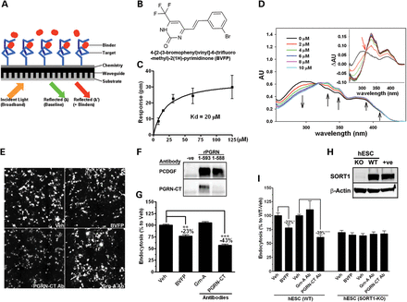
Figure 5. Small-molecule and antibody binders of the PGRN_{588–593} motif inhibit SORT1-mediated PGRN ...
Notes:
Figure 5. Small-molecule and antibody binders of the PGRN588–593 motif inhibit SORT1-mediated PGRN endocytosis. (A) Schematic diagram illustrating the detection mechanism of Epic® biochemical binding assay. When screening for compound binders of PGRN588–593 peptide (target), the specific binding events are detected by changes in reflected resonant wavelength before (λ) and after (λ′) addition of a potential compound binder. (B) Structure and chemical name of BVFP, an identified compound that binds the PGRN(588–593) peptide. (C) Saturated binding curve of BVFP to PGRN(588–593) peptide (n = 4). (D) Wavelength red-shifting of UV-absorption spectra of BVFP (20 μM) upon titration with the PGRN(588–593) peptide. The interaction between BVFP and the peptide is represented by distinct changes in the absorption intensities (black arrows). The presence of an isosbestic point at 313 nm (inset red arrow) also confirmed the interactions. (E) The PGRN(588–593) binders, BVFP (5 μM) and PGRN-CT antibody (80 nM) inhibited rPGRN endocytosis as tested by the quantitative cell-based assay in COS-1SORT1 cells. Both binders were pre-incubated with rPGRN1-593 for an hour and then added to the cells for an hour to allow endocytosis. A GRN-A specific antibody (80 nM) was used as a negative control. (F) Vehicle control (−ve), full-length protein (rPGRN1-593) or truncated protein (rPGRN1-588) was analyzed by western blot using PCDGF or PGRN-CT antibody for detection. The PGRN-CT antibody was confirmed to be PGRN(588–593) dependent. (G) Fluorescence signal quantification of (E). (H) Western blot analysis confirmed the absence of SORT1 protein in the SORT1KO-hESCs. (I) BVFP and the PGRN-CT antibody inhibited PGRN endocytosis in WT-hESCs but not in SORT1KO-hESCs indicating that the effect was SORT1 dependent. *P < 0.05, **P < 0.01, ***P < 0.001 versus vehicle control, analysis performed by unpaired student t-tests.
Unless provided in the caption above, the following copyright applies to the content of this slide: © The Author 2013. Published by Oxford University Press.This is an Open Access article distributed under the terms of the Creative Commons Attribution License (http://creativecommons.org/licenses/by/3.0/), which permits unrestricted reuse, distribution, and reproduction in any medium, provided the original work is properly cited.

