Slide 1
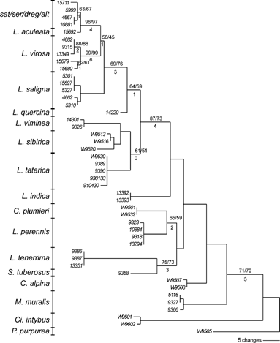
FIGURE 2. One of the MPTs based on the unweighted Wagner parsimony search on the ITS-1 sequences. Above ...
Notes:
FIGURE 2. One of the MPTs based on the unweighted Wagner parsimony search on the ITS-1 sequences. Above branches: bootstrap values/jackknife values. Below branches: branch supports. sat/ser/dreg/alt: group of intermixed and closely related species L. sativa, L. serriola, L. dregeana, and L. altaica. Genus abbreviations: L = Lactuca, C = Cicerbita, Ci = Cichorium, M = Mycelis, S = Steptorhamphus, P = Prenanthes.
Unless provided in the caption above, the following copyright applies to the content of this slide: © 2005 Society of Systematic BiologistsThis article is published and distributed under the terms of the Oxford University Press, Standard Journals Publication Model (https://academic.oup.com/journals/pages/open_access/funder_policies/chorus/standard_publication_model)

Slide 2
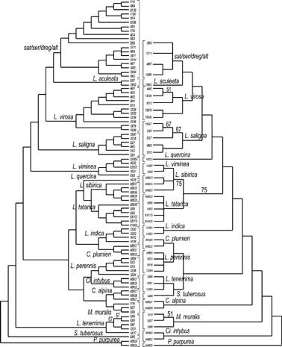
FIGURE 3. The 50% majority rule consensus trees based on unweighted Wagner parsimony searches. Left: tree ...
Notes:
FIGURE 3. The 50% majority rule consensus trees based on unweighted Wagner parsimony searches. Left: tree based on the combined AFLP primer combinations E35/M48 and E35/M49. Right: tree based on ITS-1 sequences. Above branches: percentage of trees showing the depicted topology. For branches on which no percentages are indicated, all trees showed the same topology.
Unless provided in the caption above, the following copyright applies to the content of this slide: © 2005 Society of Systematic BiologistsThis article is published and distributed under the terms of the Oxford University Press, Standard Journals Publication Model (https://academic.oup.com/journals/pages/open_access/funder_policies/chorus/standard_publication_model)

Slide 3
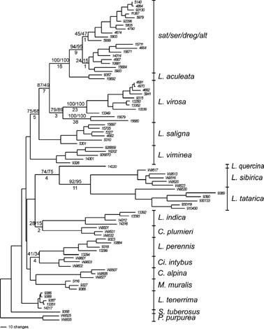
FIGURE 1. One of the MPTs based the unweighted Wagner parsimony search on the combined AFLP primer ...
Notes:
FIGURE 1. One of the MPTs based the unweighted Wagner parsimony search on the combined AFLP primer combinations E35/M48 and E35/M49. Above branches: bootstrap values/jackknife values. Below branches: branch supports. sat/ser/dreg/alt: group of intermixed and closely related species Lactuca sativa, L. serriola, L. dregeana, and L. altaica. Genus abbreviations: L = Lactuca, C = Cicerbita, Ci = Cichorium, M = Mycelis, S = Steptorhamphus, P = Prenanthes.
Unless provided in the caption above, the following copyright applies to the content of this slide: © 2005 Society of Systematic BiologistsThis article is published and distributed under the terms of the Oxford University Press, Standard Journals Publication Model (https://academic.oup.com/journals/pages/open_access/funder_policies/chorus/standard_publication_model)

Slide 4
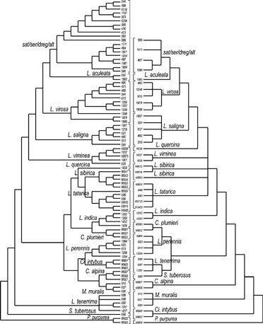
FIGURE 4. Strict consensus trees based on unweighted Wagner parsimony searches. Left: tree based on the ...
Notes:
FIGURE 4. Strict consensus trees based on unweighted Wagner parsimony searches. Left: tree based on the combined AFLP primer combinations E35/M48 and E35/M49. Right: tree based on ITS-1 sequences.
Unless provided in the caption above, the following copyright applies to the content of this slide: © 2005 Society of Systematic BiologistsThis article is published and distributed under the terms of the Oxford University Press, Standard Journals Publication Model (https://academic.oup.com/journals/pages/open_access/funder_policies/chorus/standard_publication_model)

Slide 5
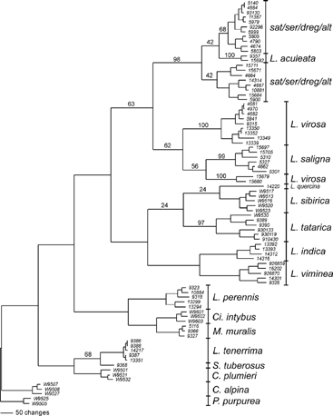
FIGURE 5. One of the MPTs based on the Dollo parsimony search on the combined AFLP primer combinations ...
Notes:
FIGURE 5. One of the MPTs based on the Dollo parsimony search on the combined AFLP primer combinations E35/M48 and E35/M49. Above branches: bootstrap values (50% and higher; values below 50% are only depicted for the sat/ser/dreg/alt and L. sibirica/L. tatarica/L. quercina groups). sat/ser/dreg/alt: group of intermixed and closely related species L. sativa, L. serriola, L. dregeana, and L. altaica. Genus abbreviations: L = Lactuca, C = Cicerbita, Ci = Cichorium, M = Mycelis, S = Steptorhamphus, P = Prenanthes.
Unless provided in the caption above, the following copyright applies to the content of this slide: © 2005 Society of Systematic BiologistsThis article is published and distributed under the terms of the Oxford University Press, Standard Journals Publication Model (https://academic.oup.com/journals/pages/open_access/funder_policies/chorus/standard_publication_model)

Slide 6
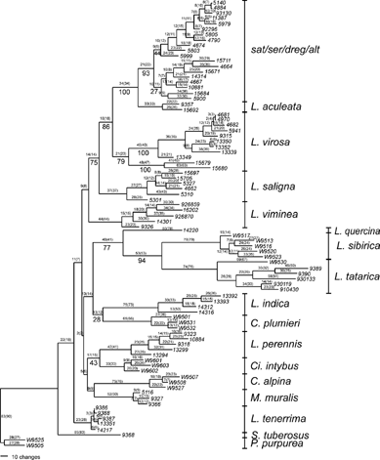
FIGURE 6. One of the MPTs based on the weighted parsimony search on the combined AFLP primer combinations ...
Notes:
FIGURE 6. One of the MPTs based on the weighted parsimony search on the combined AFLP primer combinations E35/M48 and E35/M49. Above branches, before brackets: branch lengths. Above branches, between brackets: length of the corresponding branch in the unweighted parsimony tree (Fig. 1). Below branches: bootstrap values (only 50% and higher). sat/ser/dreg/alt: group of intermixed and closely related species L. sativa, L. serriola, L. dregeana, and L. altaica. Genus abbreviations: L = Lactuca, C = Cicerbita, Ci = Cichorium, M = Mycelis, S = Steptorhamphus, P = Prenanthes.
Unless provided in the caption above, the following copyright applies to the content of this slide: © 2005 Society of Systematic BiologistsThis article is published and distributed under the terms of the Oxford University Press, Standard Journals Publication Model (https://academic.oup.com/journals/pages/open_access/funder_policies/chorus/standard_publication_model)

Slide 7
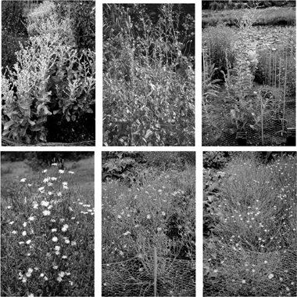
Cultivated lettuce and its wild relatives. Top row: L. sativa (cultivated lettuce), L. serriola (prickly ...
Notes:
Cultivated lettuce and its wild relatives. Top row: L. sativa (cultivated lettuce), L. serriola (prickly lettuce), L. aculeata. Bottom row: L. tatarica, L. perennis, L. tenerrima.
Unless provided in the caption above, the following copyright applies to the content of this slide: © 2005 Society of Systematic BiologistsThis article is published and distributed under the terms of the Oxford University Press, Standard Journals Publication Model (https://academic.oup.com/journals/pages/open_access/funder_policies/chorus/standard_publication_model)

