Slide 1
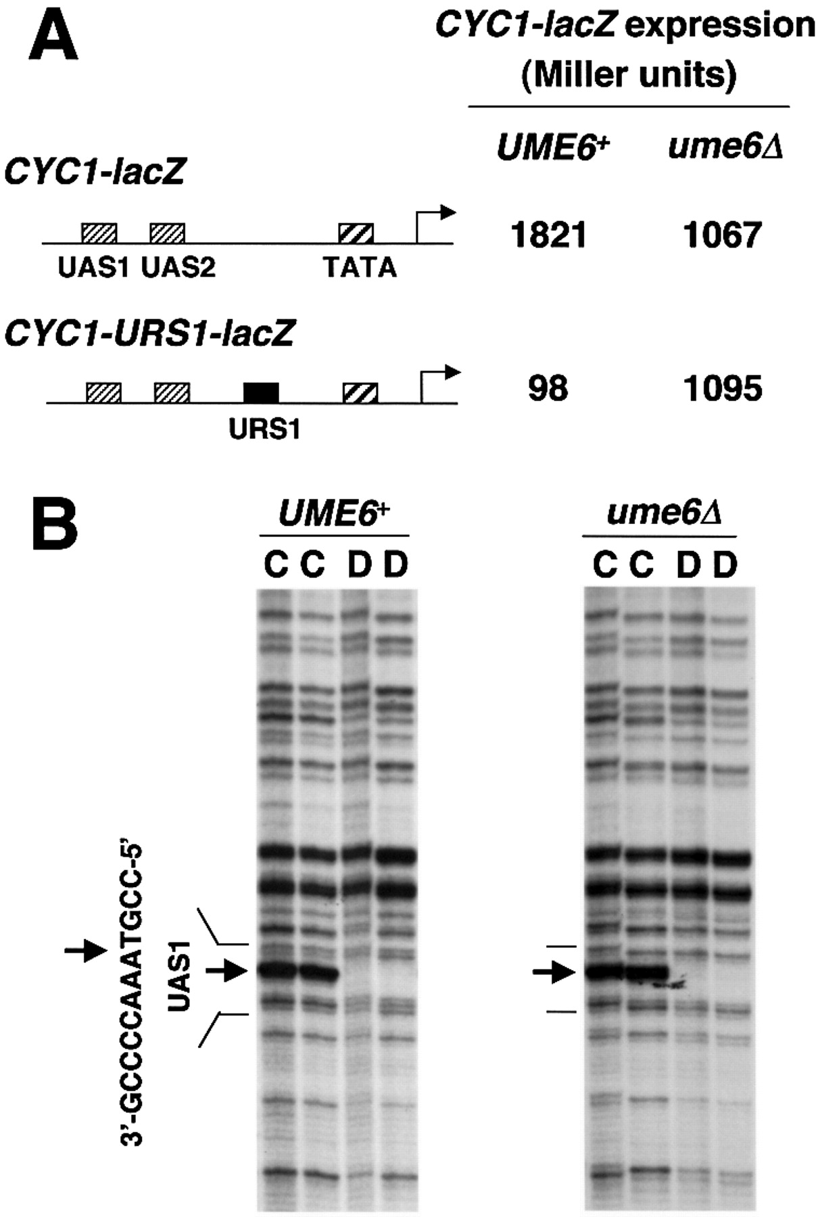
Figure 1. (A) Repression of CYC1‐lacZ reporter gene through URS1, a Ume6p binding site, in high copy plasmids ...
Notes:
Figure 1. (A) Repression of CYC1‐lacZ reporter gene through URS1, a Ume6p binding site, in high copy plasmids [CYC1‐lacZ, pKB112; CYC1‐URS1‐lacZ, pKB143 (17,18)] in UME6 and ume6Δ strains (yx423 and yx268, respectively). CYC1‐lacZ expression is indicated in Miller units of β‐galactosidase. Location of UAS1, UAS2, TATA and regions are diagrammed. The standard deviations were <20% for the triplicate determinations. (B) In vivo UV photofootprinting of the bottom strand of the UAS1 region in a CYC1‐URS1‐lacZ plasmid in UME6 and ume6Δ strains (yx423 and yx268, respectively). Lanes marked C are samples from intact cells irradiated with UV light (500 and 750 mJ/cm2); lanes marked D are samples from purified DNA irradiated with UV light (120 and 240 mJ/cm2). The UAS1 sequence is shown to the left of the gels. Arrows indicate sites of enhancement of UV photoproducts in irradiated cells (lane C) compared with irradiated purified DNA (lanes D).
Unless provided in the caption above, the following copyright applies to the content of this slide:

Slide 2
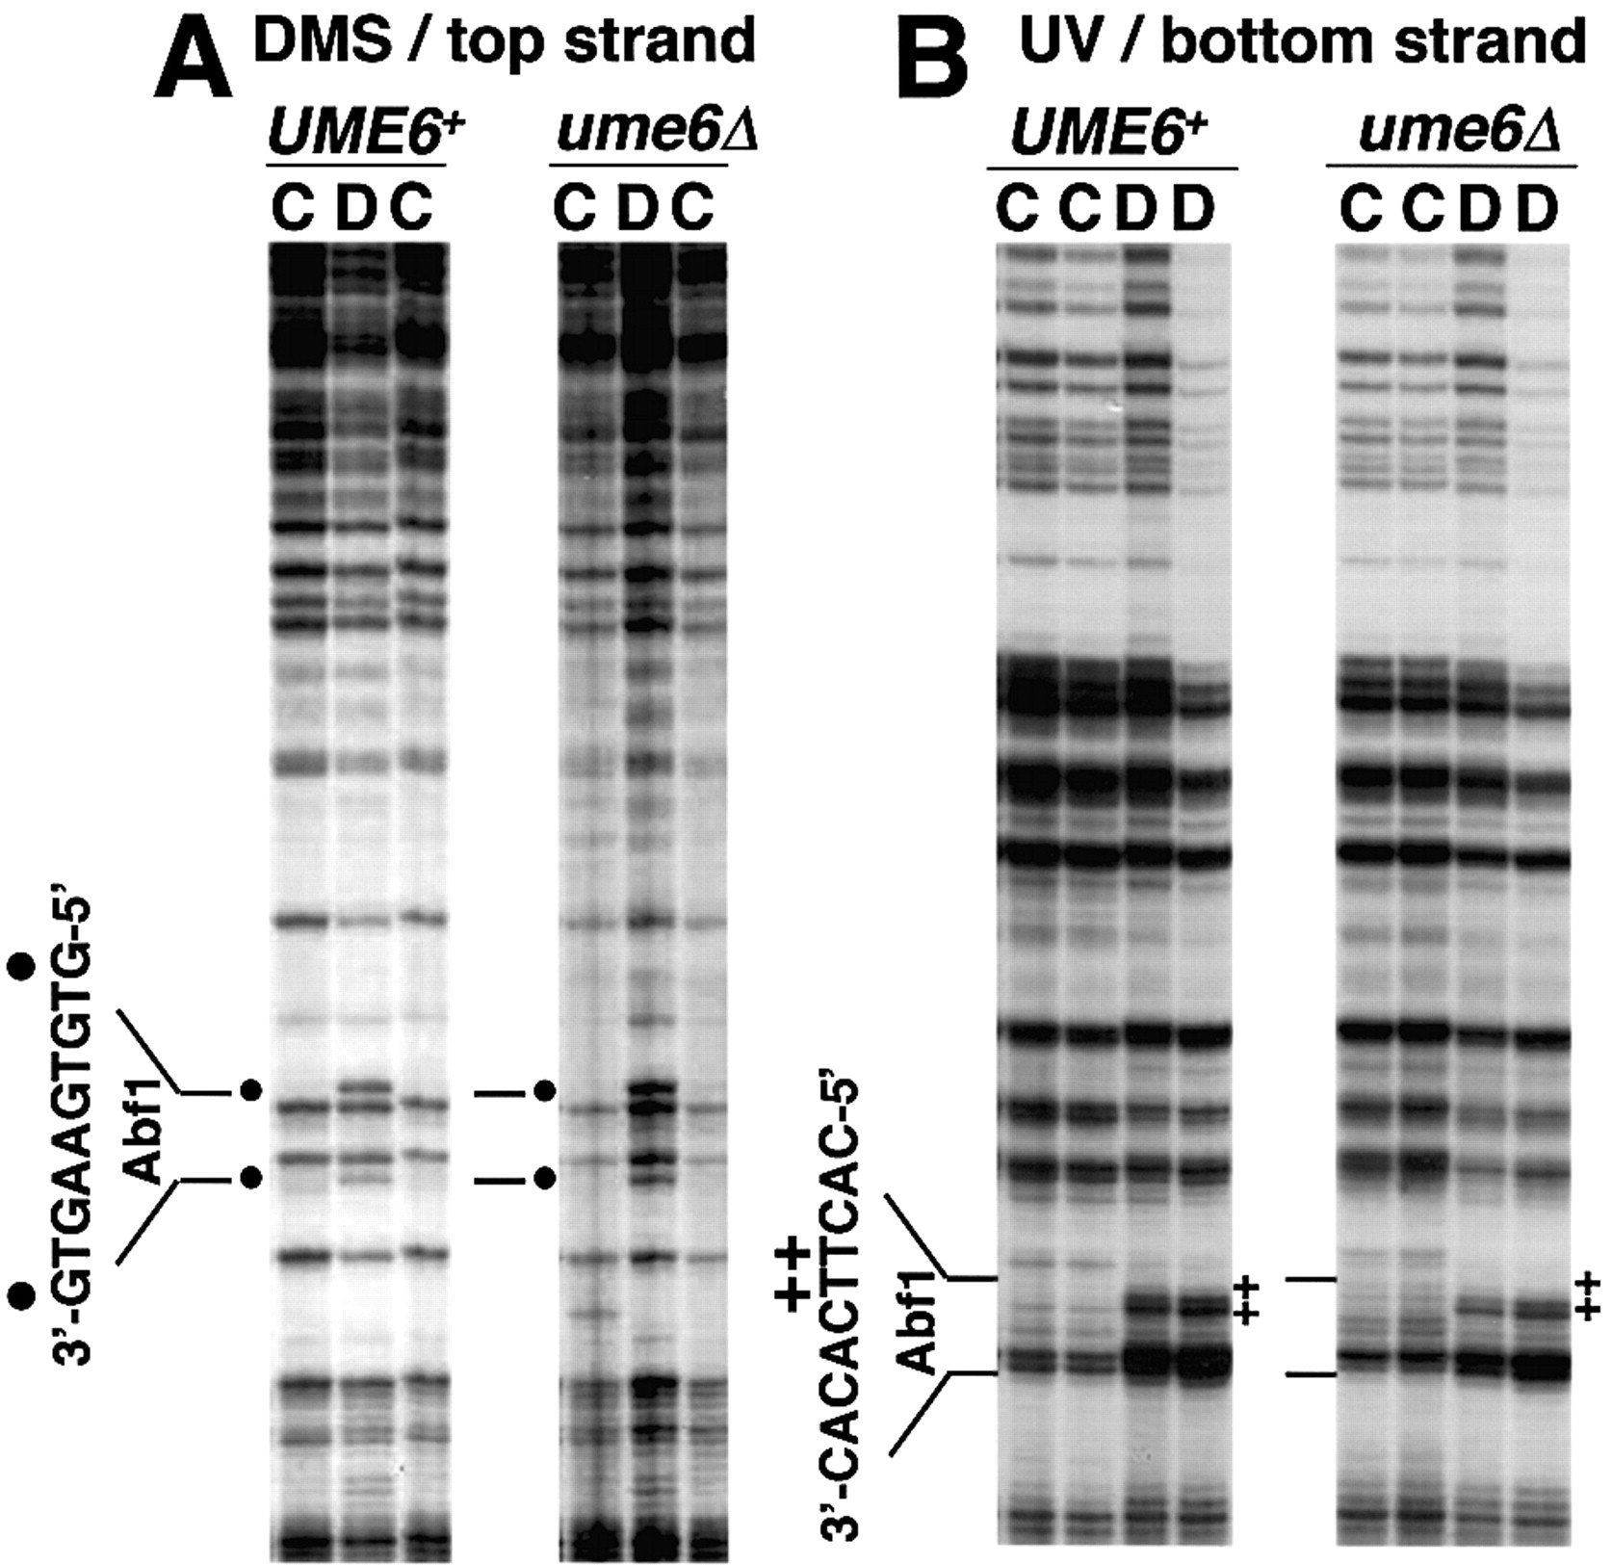
Figure 2.In vivo footprinting of Abf1p in a high copy HOP1‐lacZ plasmid, pAV79B (20), in UME6 and ume6Δ ...
Notes:
Figure 2.In vivo footprinting of Abf1p in a high copy HOP1‐lacZ plasmid, pAV79B (20), in UME6 and ume6Δ strains (yx423 and yx268, respectively). The Abf1p binding site is shown to the left of the gels. (A) DMS footprints of the top strand of the HOP1 promoter. Lanes marked C are samples from intact cells treated with 0.12 and 0.06% DMS; lanes marked D are samples from purified DNA treated with 0.1% DMS. Dots indicate sites protected from DMS modification in cells. (B) UV photofootprints of the bottom strand of the HOP1 promoter. Lanes marked C are samples from intact cells irradiated with UV light (500 and 750 mJ/cm2); lanes marked D are samples from purified DNA irradiated with UV light (120 and 240 mJ/cm2). + indicates sites protected from UV irradiation in cells.
Unless provided in the caption above, the following copyright applies to the content of this slide:

Slide 3
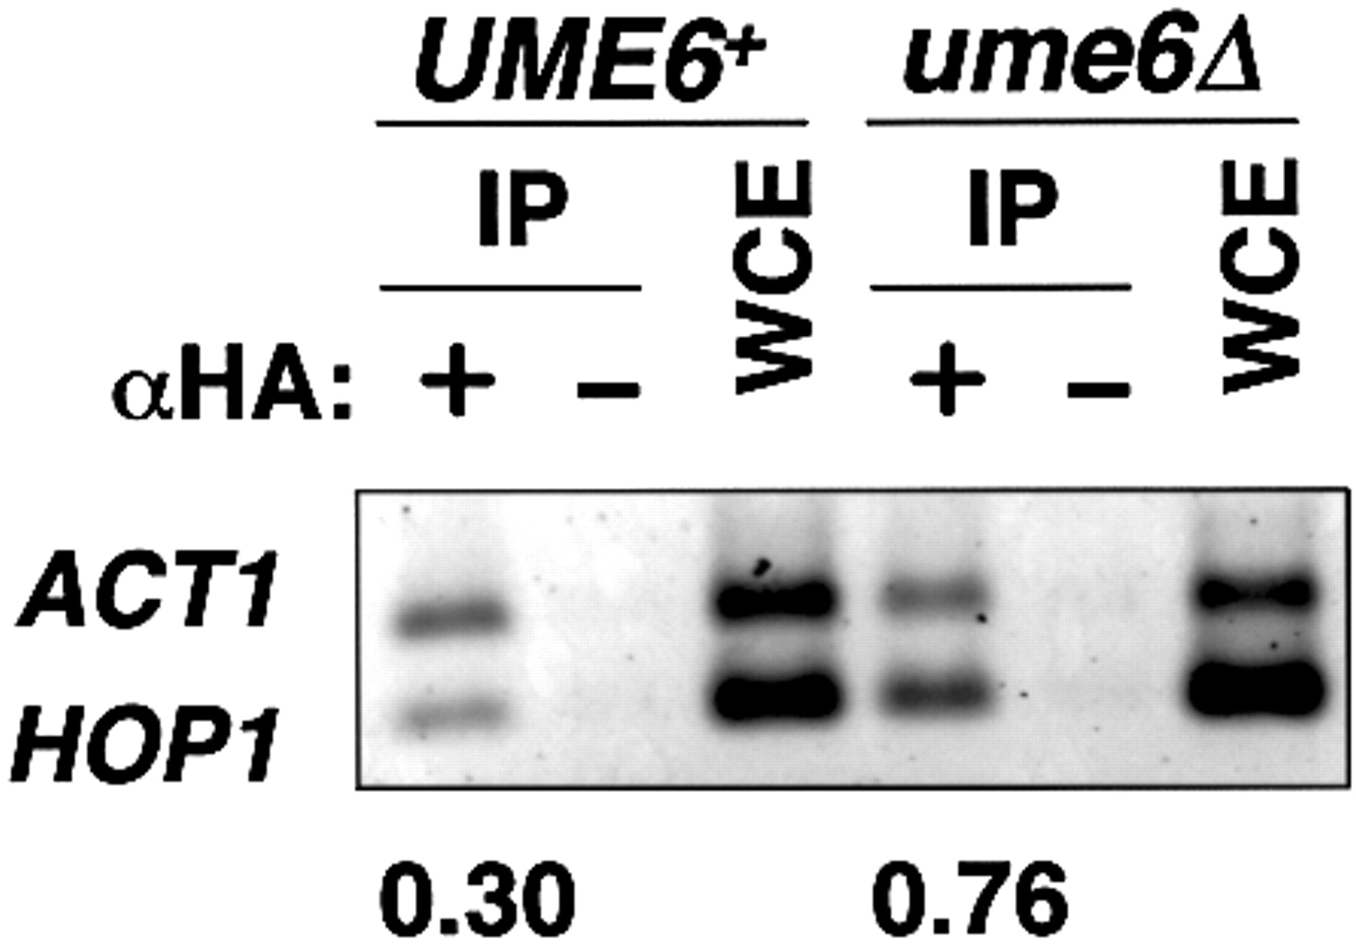
Figure 3. ChIP assay for HA3‐TBP binding in UME6 and ume6Δ strains (AMP107 and MHS24, respectively) ...
Notes:
Figure 3. ChIP assay for HA3‐TBP binding in UME6 and ume6Δ strains (AMP107 and MHS24, respectively) expressing HA3‐TBP. IP indicates chromatin immunoprecipitated DNA with or without monoclonal anti‐HA antibody (lanes marked with αHA: + and –, respectively). WCE indicates DNA isolated from whole cell extract. Multiplex PCR reactions were performed with primer sets for promoters of ACT1 and HOP1. PCR amplified regions were: ACT1, –300 to –56; HOP1, –179 to –1. Agarose gel was stained with SYBR‐Green, visualized and quantitated by a Luminescent Image Analyzer. The ratios HOP1/ACT1 in IP were normalized by dividing by HOP1/ACT1 in WCE, and are shown at the bottom of the gel. The ChIP experiment was carried out with three independent sets of samples, and the results shown here are typical.
Unless provided in the caption above, the following copyright applies to the content of this slide:

Slide 4
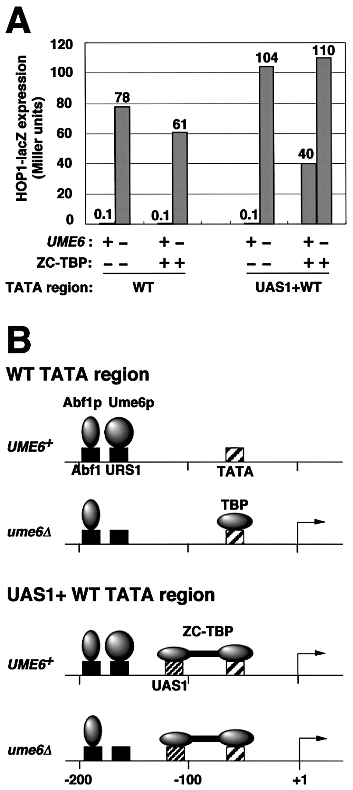
Figure 4. Effect of artificial recruitment of TBP on repression of the HOP1 promoter by Ume6p. (A) HOP1‐lacZ ...
Notes:
Figure 4. Effect of artificial recruitment of TBP on repression of the HOP1 promoter by Ume6p. (A) HOP1‐lacZ expression in Miller units was measured in pAV79B (wild‐type HOP1 promoter, referred to as WT TATA region) (20) and pKT5‐1 [HOP1 promoter region in which –131 to –114 was replaced by the ZC binding site (CYC1 UAS1), referred to as UAS1+WT TATA region] in UME6 and ume6Δ strains with or without ZC‐TBP expression. Strains used were AMP1780 (MATα hap1::LEU2), MHS22 (MATα hap1::LEU2 ume6Δ2), AMP1779 (MATα hap1::ZC‐TBP‐TRP1) and MHS21 (MATα hap1::ZC‐TBP‐TRP1 ume6Δ2). All strains lack Hap1p, the activator that binds to CYC1 UAS1. The standard deviations were <20% for the triplicate determinations. (B) Model for occupancy of Abf1p, TBP and ZC‐TBP in wild‐type HOP1 (WT TATA) and HOP1‐UAS1 (UAS1+WT TATA) promoters. TBP binds to the derepressed wild‐type HOP1 promoter, but does not bind to the repressed one. ZC‐TBP, which is artificially recruited by ZC (zinc cluster DNA binding domain of Hap1p) to the CYC1 UAS1, binds to both repressed and derepressed HOP1‐UAS1 promoter.
Unless provided in the caption above, the following copyright applies to the content of this slide:

