Slide 1
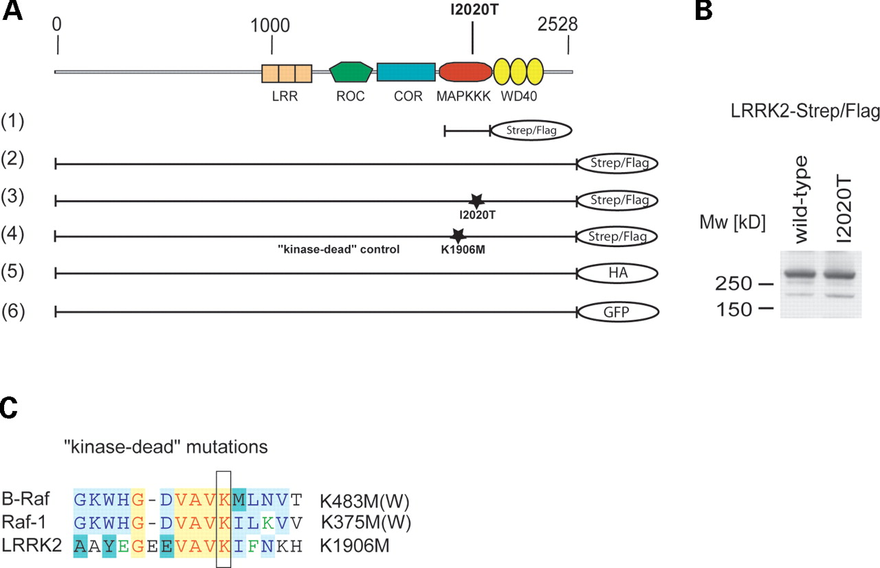
Figure 1. (A) Overview of LRRK2-domain structure and constructs used in this study. Human LRRK2 consists of ...
Notes:
Figure 1. (A) Overview of LRRK2-domain structure and constructs used in this study. Human LRRK2 consists of five predicted domains: N-terminal LRRs, followed by a GTPase (Roc), a COR, an MAPKKK and a WD40 repeat domain. The kinase domain of human LRRK2 (1), the full-length LRRK2 (2), a disease-associated LRRK2 mutant I2020T (3) and a kinase-dead mutant LRRK2-K1906M (4) were cloned in frame into a modified pcDNA3.0, containing a C-terminal Strep/Flag tandem affinity tag. The mutations are localized, as marked, in the kinase domain of LRRK2. Additionally, wild-type LRRK2 was C-terminally tagged with an HA epitope (5) and a GFP tag (6). (B) LRRK2-Strep/Flag and LRRK2 I2020T-Strep/Flag constructs express an ∼280 kDa protein in HEK293 cells, visualized by western blotting (anti-Flag M2) after SDS–PAGE. (C) Sequence alignment of B-Raf, Raf-1 and LRRK2. For the kinase-dead mutation of LRRK2, a conserved lysine within the active centre of the kinase domain was exchanged by methionine. Homologous mutations in Raf-1 and B-Raf are known to disrupt their kinase activity.
Unless provided in the caption above, the following copyright applies to the content of this slide: © The Author 2005. Published by Oxford University Press. All rights reserved. For Permissions, please email: journals.permissions@oxfordjournals.org

Slide 2
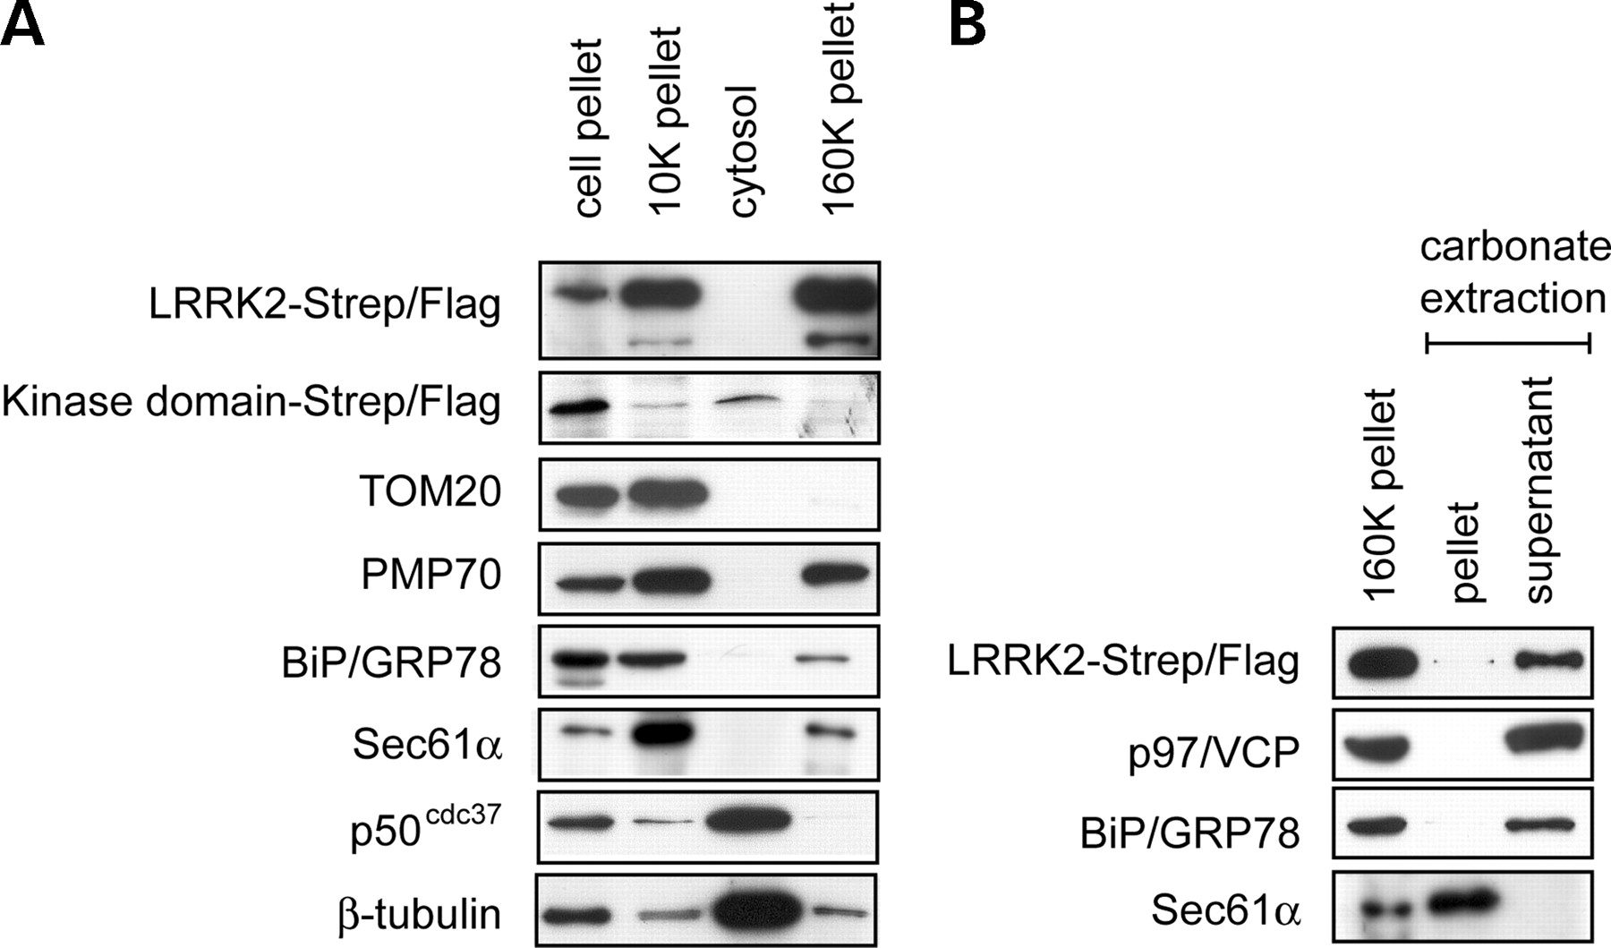
Figure 2. LRRK2 appears in the particulate fractions upon subcellular fractionation and is associated with ...
Notes:
Figure 2. LRRK2 appears in the particulate fractions upon subcellular fractionation and is associated with membranes. (A) LRRK2 co-sediments with membranes. HEK293 cells were fractionated into a cell pellet (700g) an organelle pellet (10K pellet), a soluble cytosolic fraction (cytosol) and a microsomal fraction (160K pellet). The fractions were analysed by SDS–PAGE and western blotting with antibodies against the Flag-tag, TOM20 (mitochondria), PMP70 (peroxisomes), BiP/GRP78 (ER lumen), Sec61α (ER membrane), p50cdc37 (cytosol) and β-tubulin (microtubules). (B) Alkaline extraction of LRRK2. The 160K pellet was treated with 100 mm sodium carbonate. Membrane and soluble fraction (pellet and supernatant, respectively) were separated by centrifugation and analysed as in (A) using antibodies against the integral ER membrane protein Sec61α, the cytosolic ER-associated protein p97/VCP and the luminal ER protein BiP/GRP78.
Unless provided in the caption above, the following copyright applies to the content of this slide: © The Author 2005. Published by Oxford University Press. All rights reserved. For Permissions, please email: journals.permissions@oxfordjournals.org

Slide 3
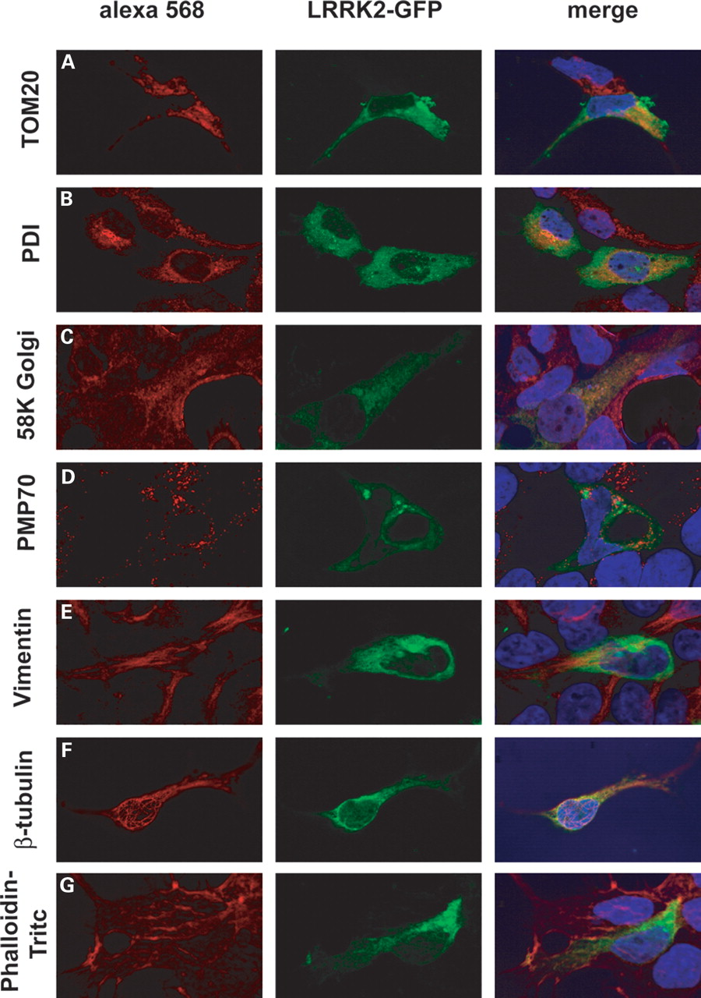
Figure 3. LRRK2-GFP localizes to mitochondria, endoplasmic reticulum, Golgi and the microtubular ...
Notes:
Figure 3. LRRK2-GFP localizes to mitochondria, endoplasmic reticulum, Golgi and the microtubular cytoskeleton. HEK293 expressing LRRK2-GFP (GFP fluorescence shown in the middle panel) were immunostained for (A) mitochondria (TOM20), (B) endoplasmic reticulum (PDI), (C) Golgi (58K Golgi), (D) peroxisomes (PMP70), (E) intermediate filaments (Vimentin), (F) microtubular cytoskeleton (β-tubulin) and (G) phalloidin–TRITC (actin cytoskeleton). The right panel depicts digitally merged images taken from the same micrograph section and merges red Alexa 568 staining (specific markers), green fluorescence GFP and nuclear staining with DAPI.
Unless provided in the caption above, the following copyright applies to the content of this slide: © The Author 2005. Published by Oxford University Press. All rights reserved. For Permissions, please email: journals.permissions@oxfordjournals.org

Slide 4
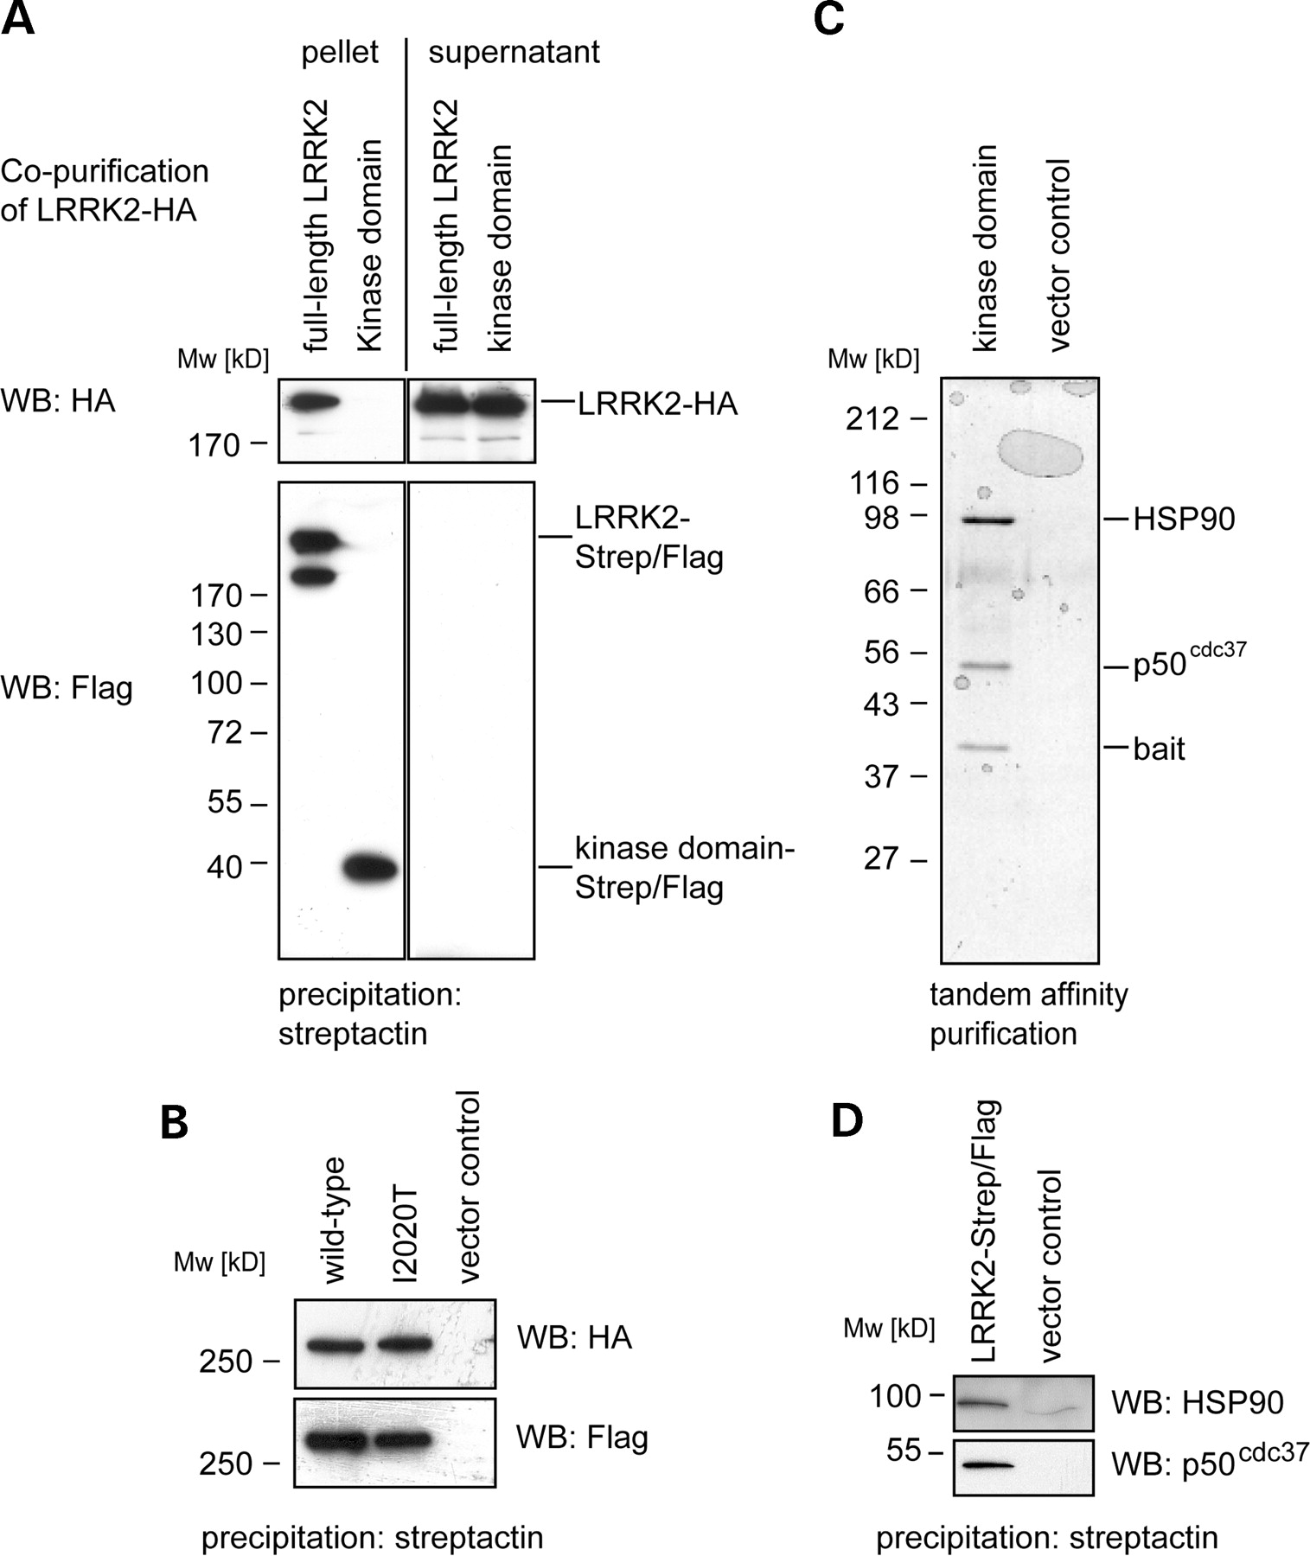
Figure 4. LRRK2 dimerizes and interacts with HSP90 and p50^{cdc37} (A) Co-purification of differently ...
Notes:
Figure 4. LRRK2 dimerizes and interacts with HSP90 and p50cdc37 (A) Co-purification of differently tagged LRRK2-constructs: HA-tagged full-length LRRK2 was tested for its ability to interact with two different Strep/Flag-tagged LRRK2 baits (a full-length and a kinase domain only construct). The constructs were co-expressed transiently in HEK293 cells prior to cell lysis and purification. The result of the co-purification of HA-tagged LRRK2 with the Strep/Flag-tagged baits is shown in the upper left panel (pellet). The co-precipitated HA-tagged LRRK2 was visualized by western blotting (3F10 anti-HA). Controls: In order to demonstrate equal expression of LRRK2-HA, a western blot (anti-HA) of the supernatants is shown (upper right panel). Equal loading of purified bait proteins was ensured by western blotting (anti-Flag, lower left panel). Purification efficiency of Strep/Flag-tagged baits was determined by Western blotting of the depleted supernatants: after their affinity binding to the beads, no detectable bait protein remained in the supernatants (lower right panel). (B) Both, Strep/Flag-tagged wild-type LRRK2 and I2020T mutant co-precipitate wild-type LRRK2-HA (upper panel). Equal expression of the Strep/Flag-tagged baits was confirmed by western blotting (lower panel). (C) TAP of Strep/Flag-tagged LRRK2 kinase domain and a vector control (expression of the Strep/Flag-tagged only) from transiently transfected HEK293 cells. After SDS–PAGE separation of the purified protein complexes and colloidal Coomassie staining, three protein bands were visible, identified by mass-spectrometry as bait (LRRK2 kinase domain, 39 kDa), p50cdc37 (50 kDa) and HSP90 (90 kDa). (D) Interaction of full-length LRRK2 with HSP90 and p50cdc37 was identified by western blotting.
Unless provided in the caption above, the following copyright applies to the content of this slide: © The Author 2005. Published by Oxford University Press. All rights reserved. For Permissions, please email: journals.permissions@oxfordjournals.org

Slide 5
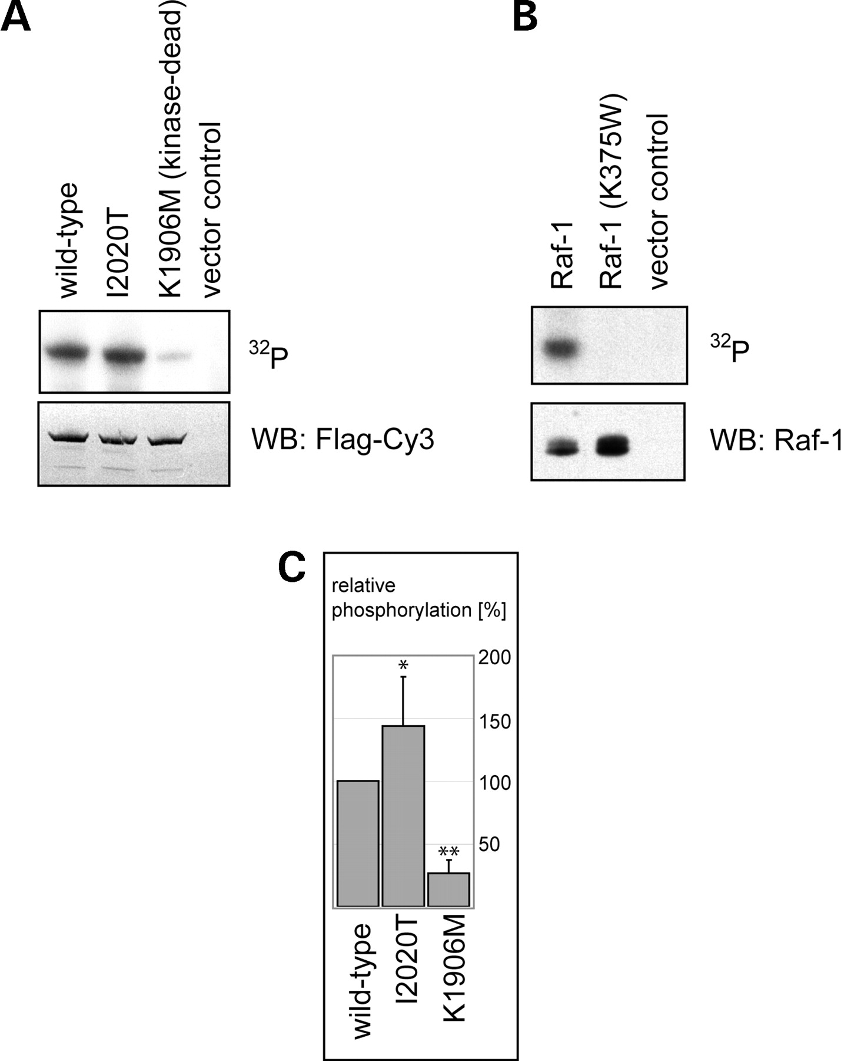
Figure 5. LRRK2 wild-type and the disease-associated mutant I2020T reveal kinase activity by ...
Notes:
Figure 5. LRRK2 wild-type and the disease-associated mutant I2020T reveal kinase activity by autophosphorylation. (A) The Flag-tagged full-length wild-type LRRK2, a LRRK2-I2020T mutant or a kinase impaired (kinase-dead control) K1906M mutant were transiently expressed in HEK293 cells. LRRK2 variants affinity purified by IP with anti-Flag M2 agarose were directly subjected to the kinase assays. The purified protein samples were incubated with [γ-32P]-ATP for 1 h, subjected to SDS–PAGE and blotted onto PVDF membranes. Autoradiography from these blots was performed using a phosphoimaging system (upper panel): [γ-32P]-ATP incorporation can be observed for both the wild-type LRRK2 protein (first lane) and the I2020T mutant protein (second lane). The kinase-dead and the vector control are shown in the third and fourth lane, respectively. Equal protein input was controlled by staining the same blot with an anti-Flag antibody (lower panel). (B) Autophosphorylation of the MAPKKK Raf-1. Recombinant GST-Raf-1, a kinase-dead GST-Raf301 (K375W) and the empty vector were expressed in COS7 cells. Cells were starved overnight and stimulated with TPA (100 ng/ml, 20 min) prior to lysis. The purified GST-fusion proteins were subjected to the kinase assay. The autoradiogram is shown in the upper panel and the corresponding loading control, a western blot with an anti-Raf1 antibody, in the lower panel. (C) Quantification of phosphorylation levels of wild-type LRRK2, I2020T mutant and the K1906M kinase-dead control. Phosphorylation values were normalized to wild-type LRRK2 (100%). Differences were proved for their significance by a paired t-test. A 40% increase in phosphorylation level of I2020T mutant when compared with the wild-type LRRK2 was obtained with P<0.05. The observed phosphorylation of the kinase-dead control was <30% of the wild-type level (**P<0.005).
Unless provided in the caption above, the following copyright applies to the content of this slide: © The Author 2005. Published by Oxford University Press. All rights reserved. For Permissions, please email: journals.permissions@oxfordjournals.org

