Slide 1
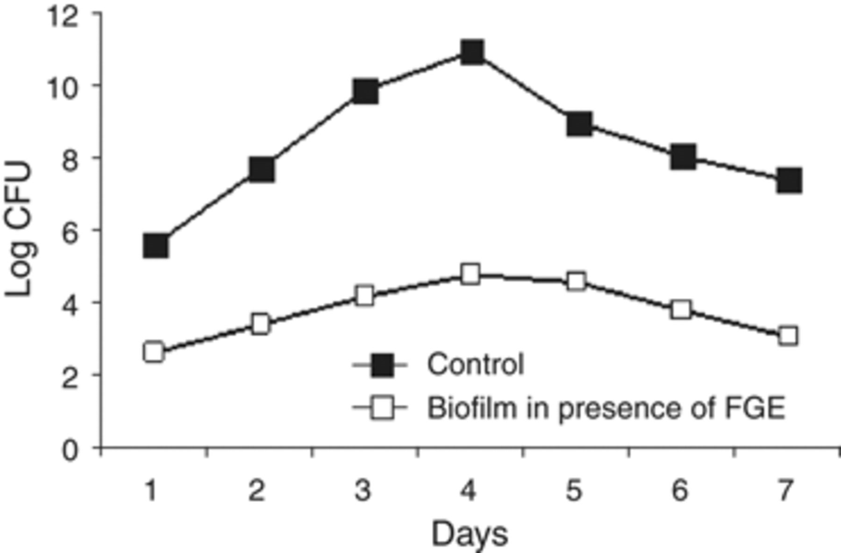
Figure 1 Generation of biofilm (expressed in log CFU) on catheter pieces by a selected clinical isolate of Pseudomonas ...
Notes:
Figure 1 Generation of biofilm (expressed in log CFU) on catheter pieces by a selected clinical isolate of Pseudomonas aeruginosa in the absence and presence of a selected concentration of FGE from day 1 to day 7.
Unless provided in the caption above, the following copyright applies to the content of this slide: © 2009 Federation of European Microbiological Societies.

Slide 2
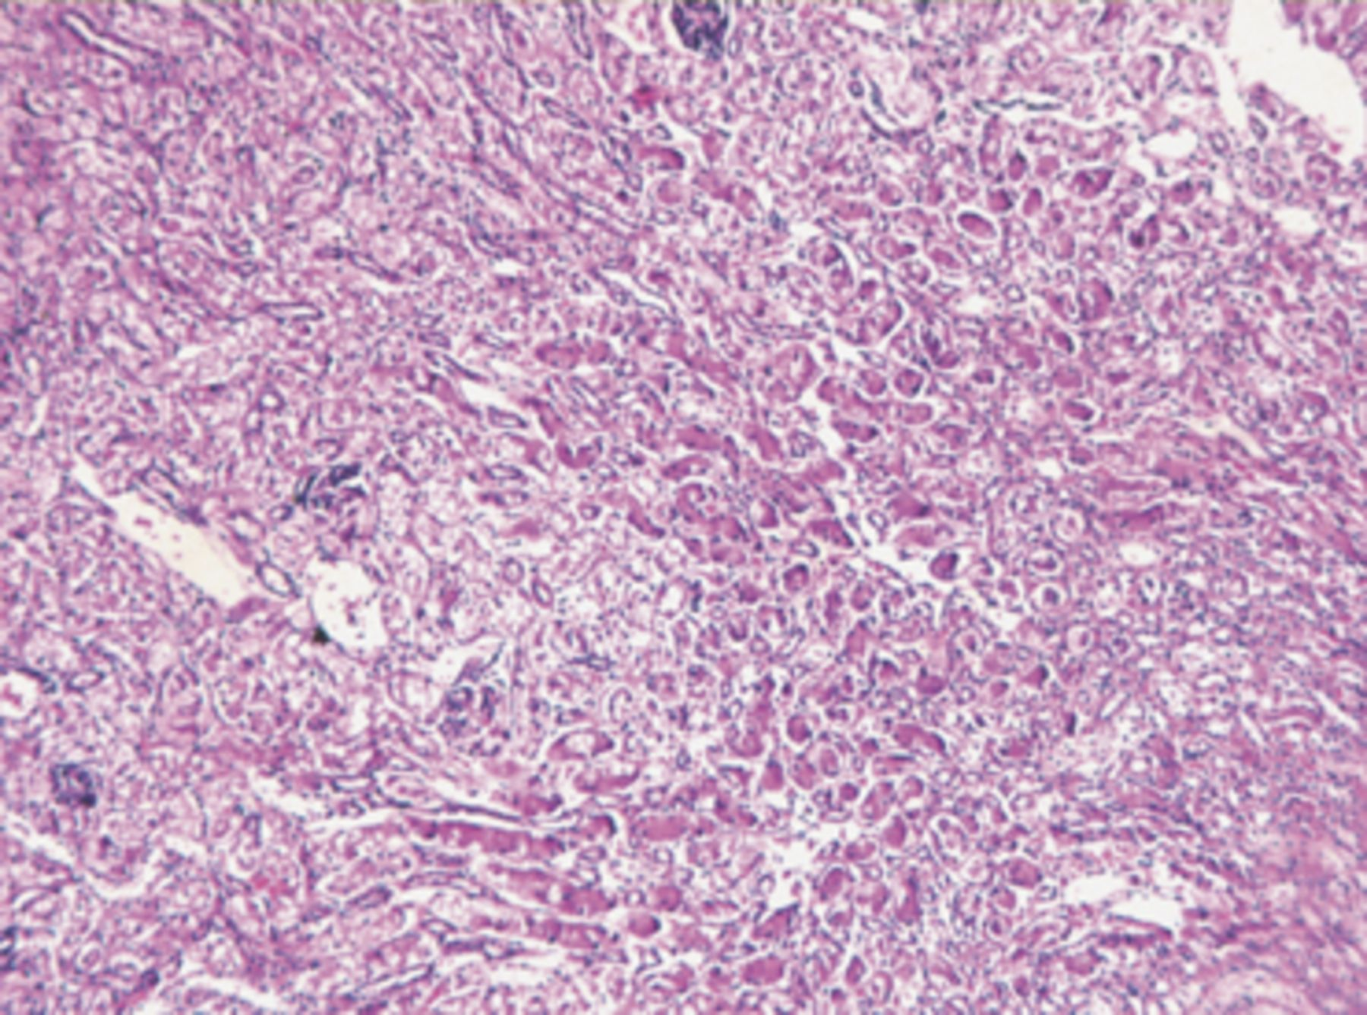
Figure 2 Photomicrograph showing severe inflammation between the tubules along with interstitial infiltration of ...
Notes:
Figure 2 Photomicrograph showing severe inflammation between the tubules along with interstitial infiltration of lymphocytes, tubule destruction and formation of protein casting in tubules along with the renal pelvis of kidney tissue of control unfed mice infected with biofilm cells of Pseudomonas aeruginosa (haematoxylin and eosin, × 25).
Unless provided in the caption above, the following copyright applies to the content of this slide: © 2009 Federation of European Microbiological Societies.

Slide 3
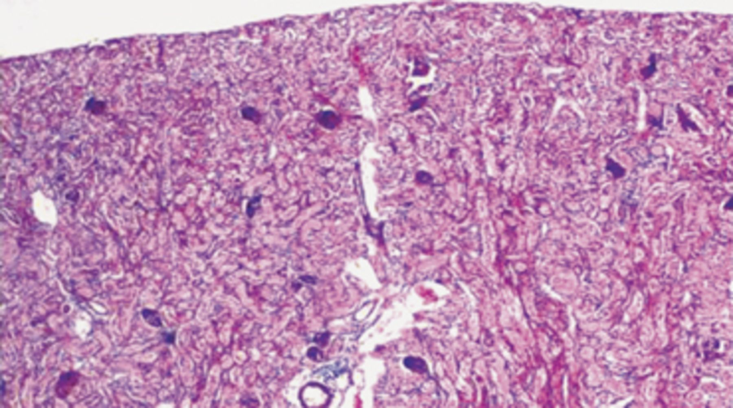
Figure 3 Photomicrograph showing mild inflammation with markedly reduced infiltration of lymphocytes in the ...
Notes:
Figure 3 Photomicrograph showing mild inflammation with markedly reduced infiltration of lymphocytes in the interstitium, with normal tubules of the medulla region along the renal pelvis of kidney tissue of FGE-fed mice followed by infection with biofilm cells of Pseudomonas aeruginosa (haematoxylin and eosin, × 25).
Unless provided in the caption above, the following copyright applies to the content of this slide: © 2009 Federation of European Microbiological Societies.

Slide 4
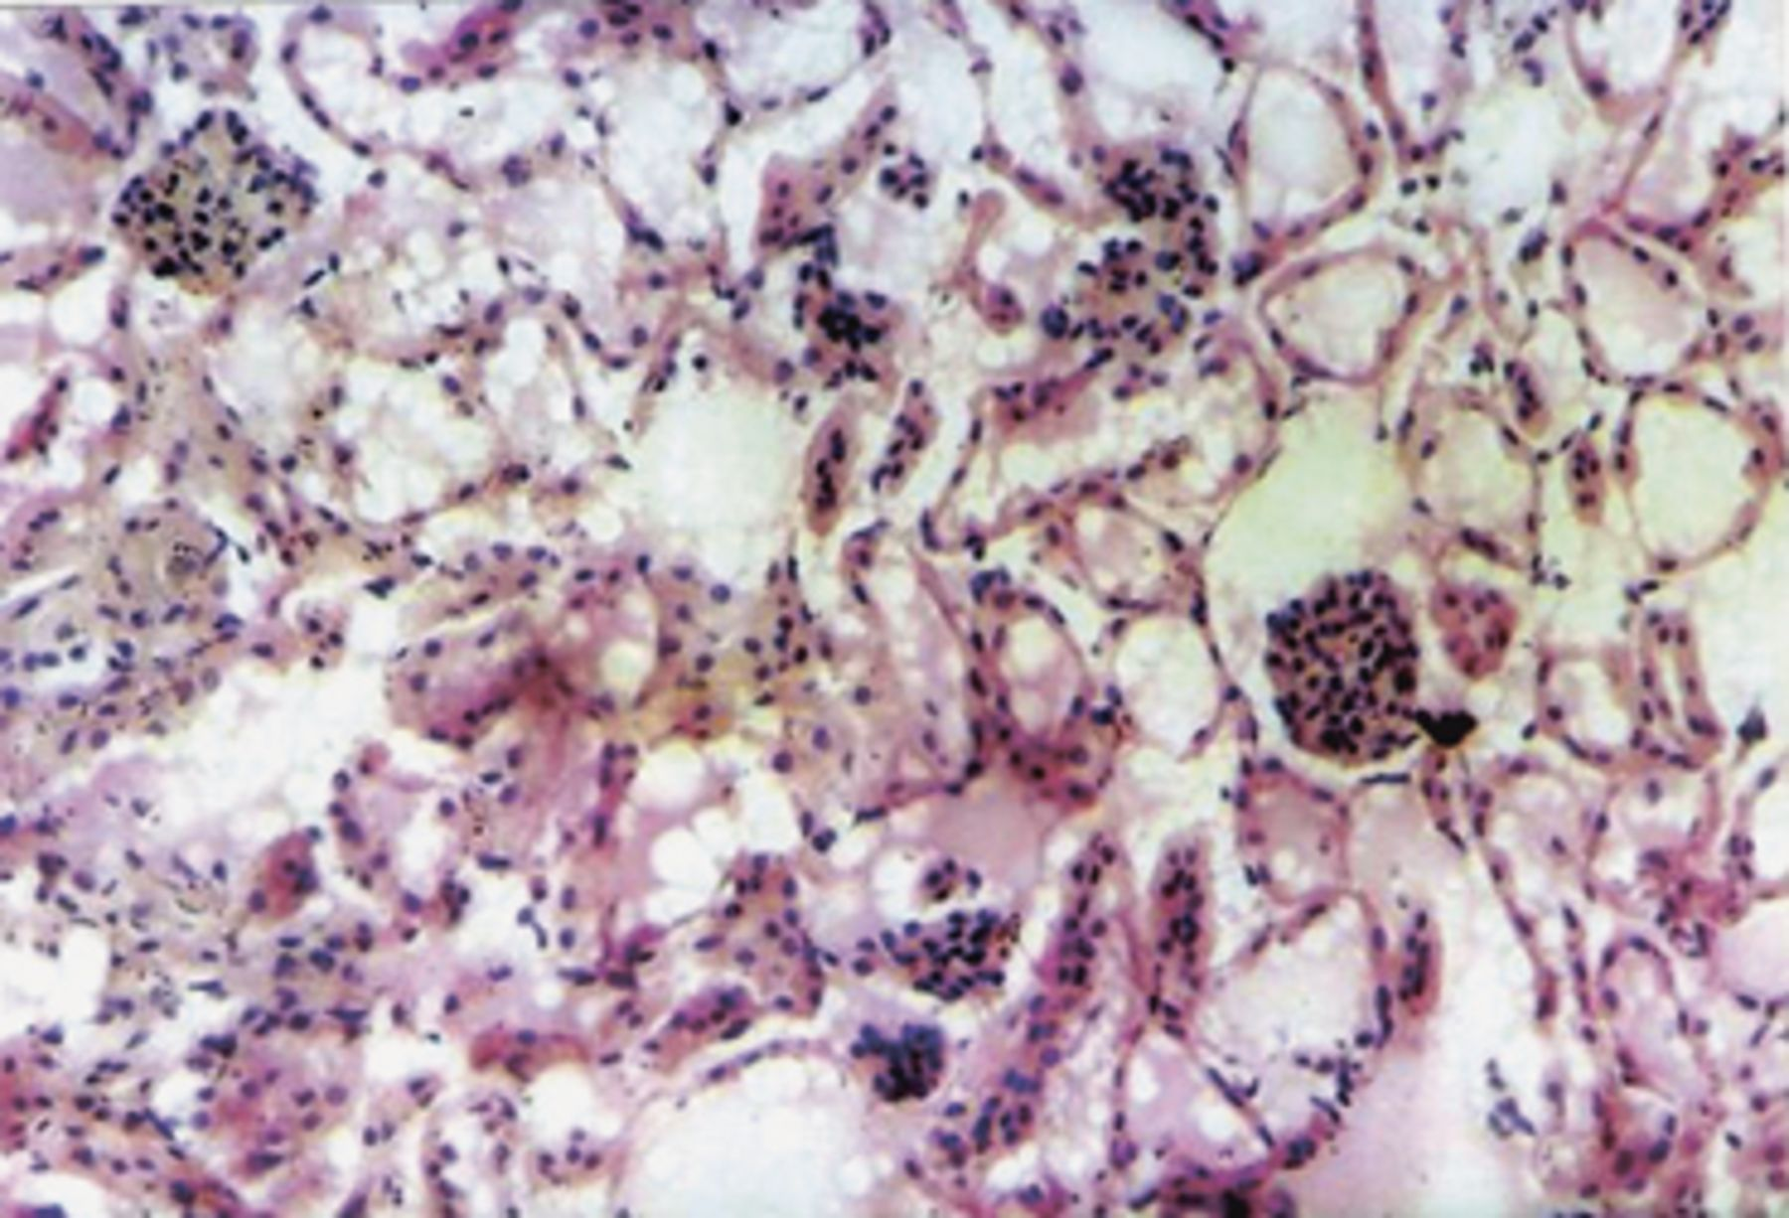
Figure 4 Photomicrograph showing normal glomeruli and tubules in renal tissue of FGE-fed mice followed by infection ...
Notes:
Figure 4 Photomicrograph showing normal glomeruli and tubules in renal tissue of FGE-fed mice followed by infection with biofilm cells of Pseudomonas aeruginosa (haematoxylin and eosin, × 100).
Unless provided in the caption above, the following copyright applies to the content of this slide: © 2009 Federation of European Microbiological Societies.

Slide 5
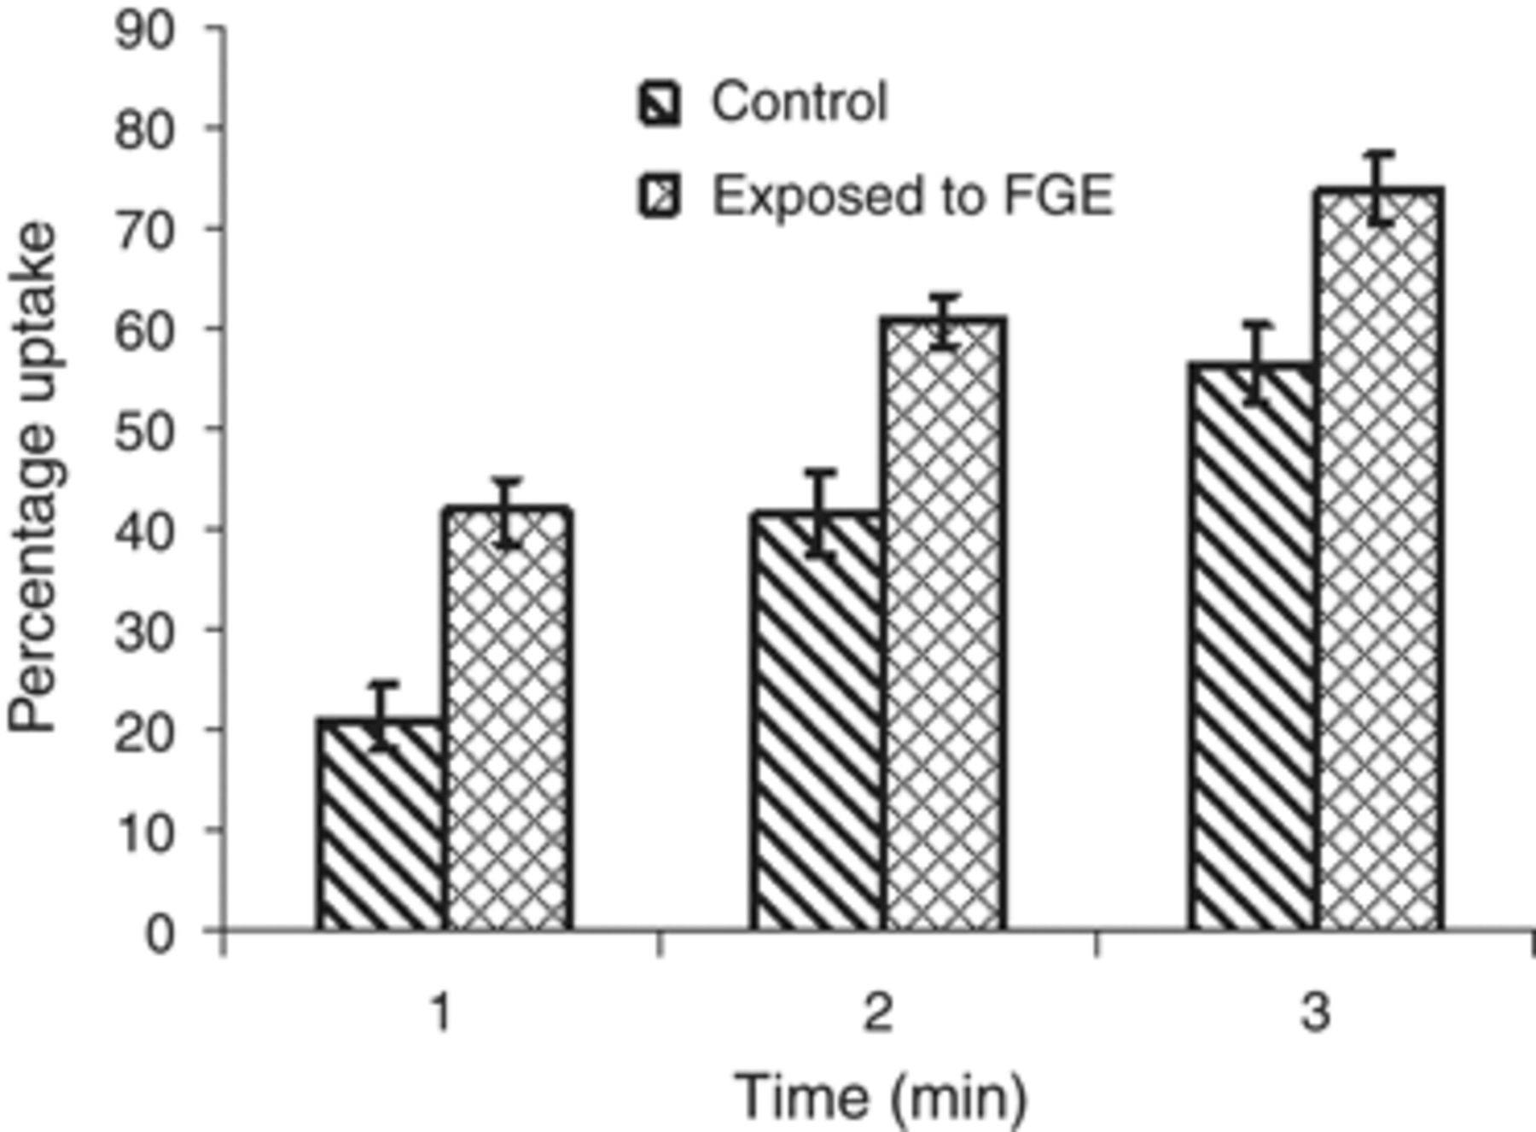
Figure 5 Percentage uptake of Pseudomonas aeruginosa by peritoneal macrophages in the absence and presence of FGE ...
Notes:
Figure 5 Percentage uptake of Pseudomonas aeruginosa by peritoneal macrophages in the absence and presence of FGE after 30, 60 and 90 min (P≤0.001).
Unless provided in the caption above, the following copyright applies to the content of this slide: © 2009 Federation of European Microbiological Societies.

Slide 6
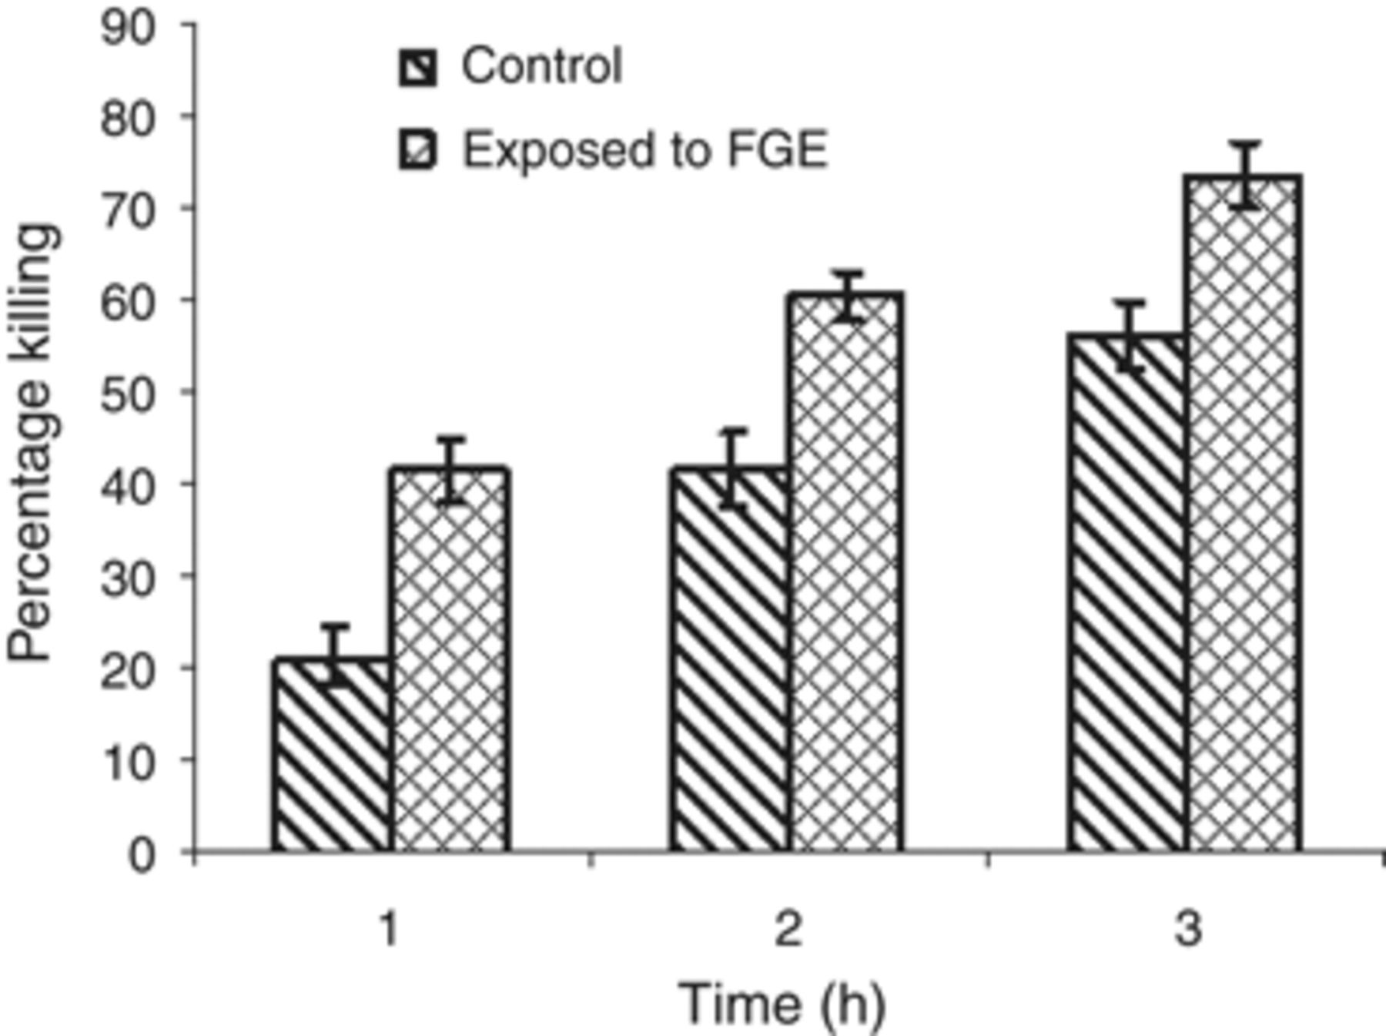
Figure 6 Percentage killing of Pseudomonas aeruginosa by peritoneal macrophages in the absence and presence of FGE ...
Notes:
Figure 6 Percentage killing of Pseudomonas aeruginosa by peritoneal macrophages in the absence and presence of FGE after 1, 2 and 3 h (P≤0.001).
Unless provided in the caption above, the following copyright applies to the content of this slide: © 2009 Federation of European Microbiological Societies.

