Slide 1
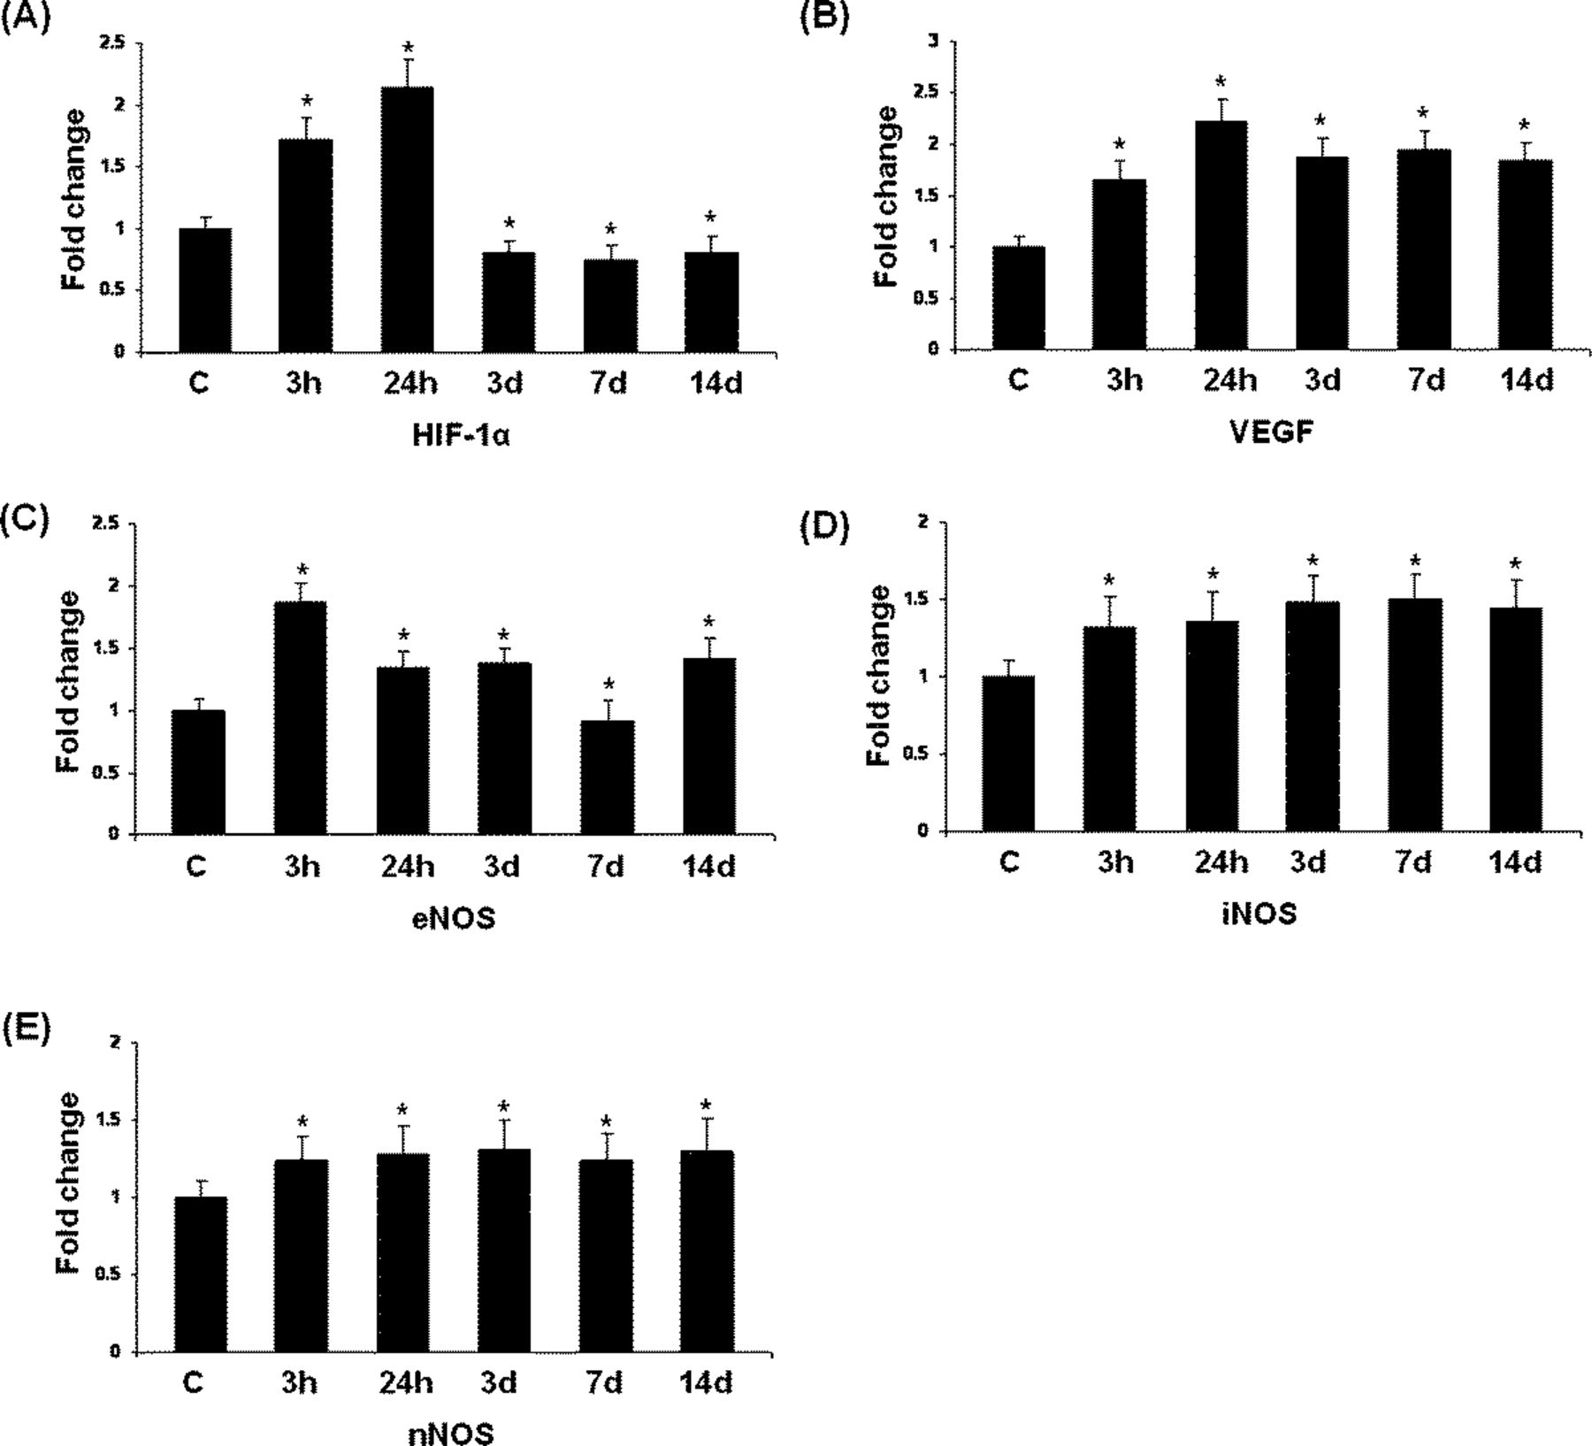
FIGURE 1. Reverse transcription-polymerase chain reaction analysis of hypoxia-inducible factor-1α (HIF-1α) (A), ...
Notes:
FIGURE 1. Reverse transcription-polymerase chain reaction analysis of hypoxia-inducible factor-1α (HIF-1α) (A), vascular endothelial growth factor (VEGF) (B), endothelial nitric oxide synthase (eNOS) (C), inducible nitric oxide synthase (iNOS) (D), and neuronal nitric oxide synthase (nNOS) (E) expression in the brainstem of rats at 3 and 24 hours and at 3, 7, and 14 days after hypoxia exposure and controls [C]. Bar graphs represent fold changes quantified by normalization to β-actin as an internal control. Bar, mean ± SD. Differences in the mRNA levels are significant (*, p < 0.01) after hypoxia versus controls.
Unless provided in the caption above, the following copyright applies to the content of this slide: Copyright © 2011 by the American Association of Neuropathologists, Inc.

Slide 2
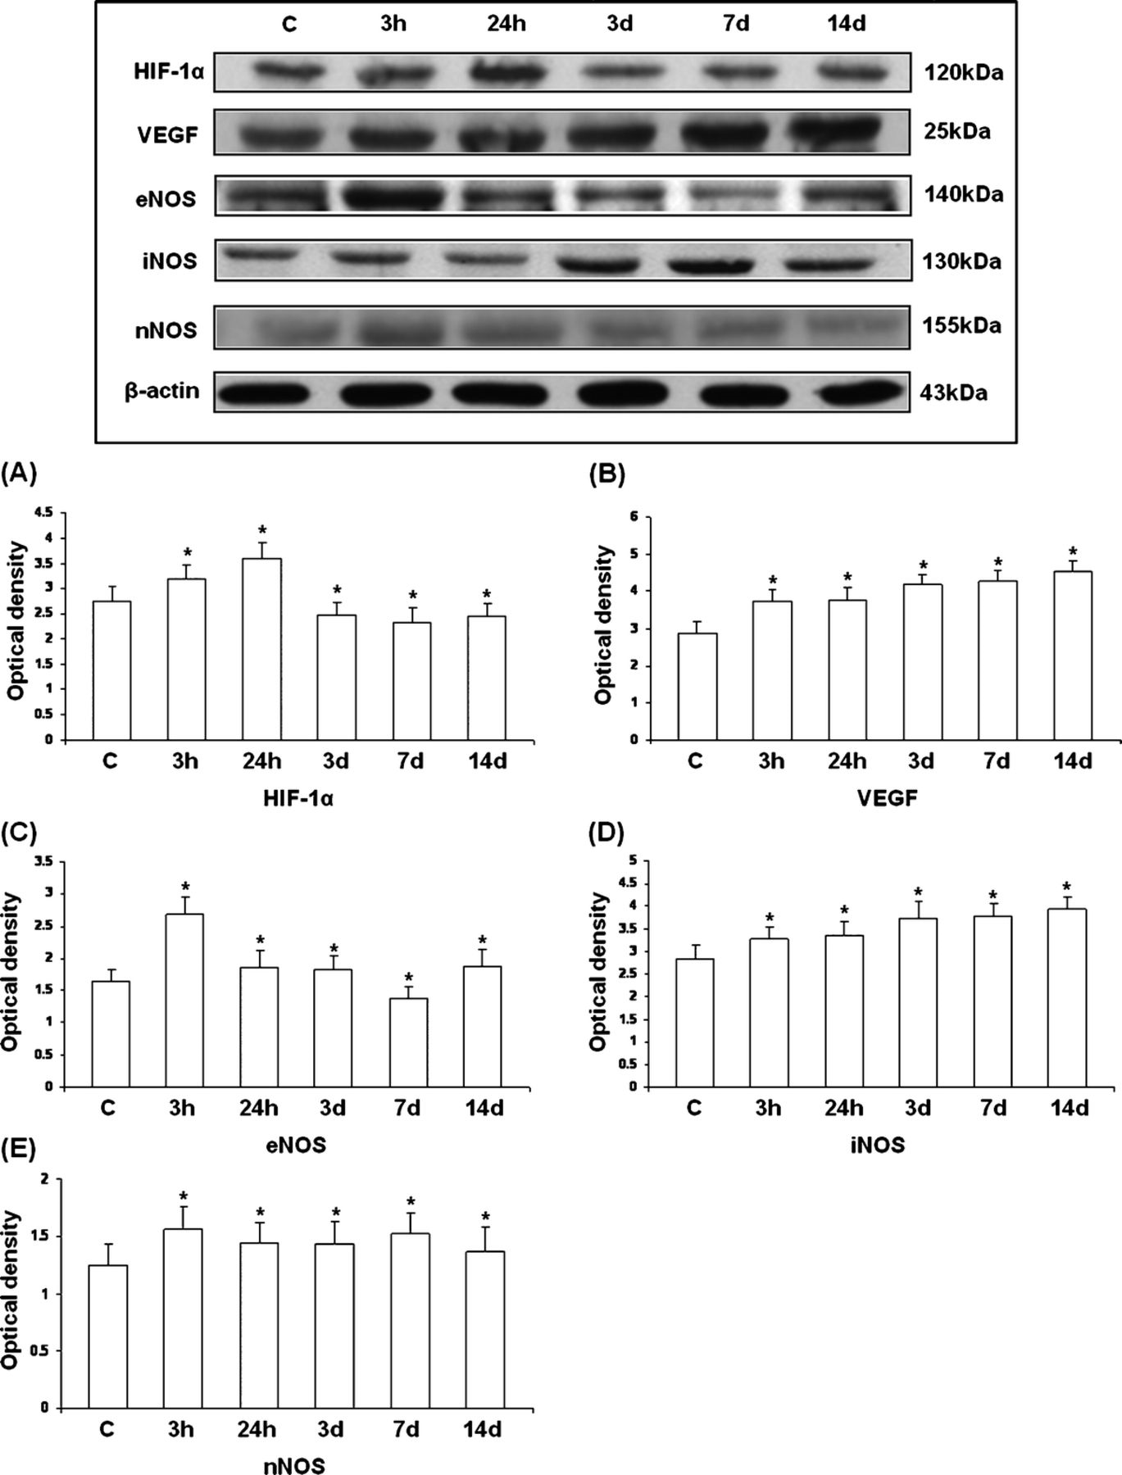
FIGURE 2. Western blotting of hypoxia-inducible factor-1α (HIF-1α; 120 kDa), vascular endothelial growth factor (VEGF; ...
Notes:
FIGURE 2. Western blotting of hypoxia-inducible factor-1α (HIF-1α; 120 kDa), vascular endothelial growth factor (VEGF; 25 kDa), endothelial nitric oxide synthase (eNOS; 140 kDa), inducible nitric oxide synthase (iNOS; 130 kDa), and neuronal nitric oxide synthase (nNOS; 155 kDa) protein expression in the brainstem of rats at 3 and 24 hours and at 3, 7, and 14 days after the hypoxic exposure and control rats [C]. Immunoreactive bands are seen in the upper panel. Bar graphs (A, HIF-1α; B, VEGF; C, eNOS; D, iNOS; and E,nNOS) show significant changes in optical densities after hypoxic exposure (mean ± SD). Level of significance: *, p < 0.01, versus controls.
Unless provided in the caption above, the following copyright applies to the content of this slide: Copyright © 2011 by the American Association of Neuropathologists, Inc.

Slide 3
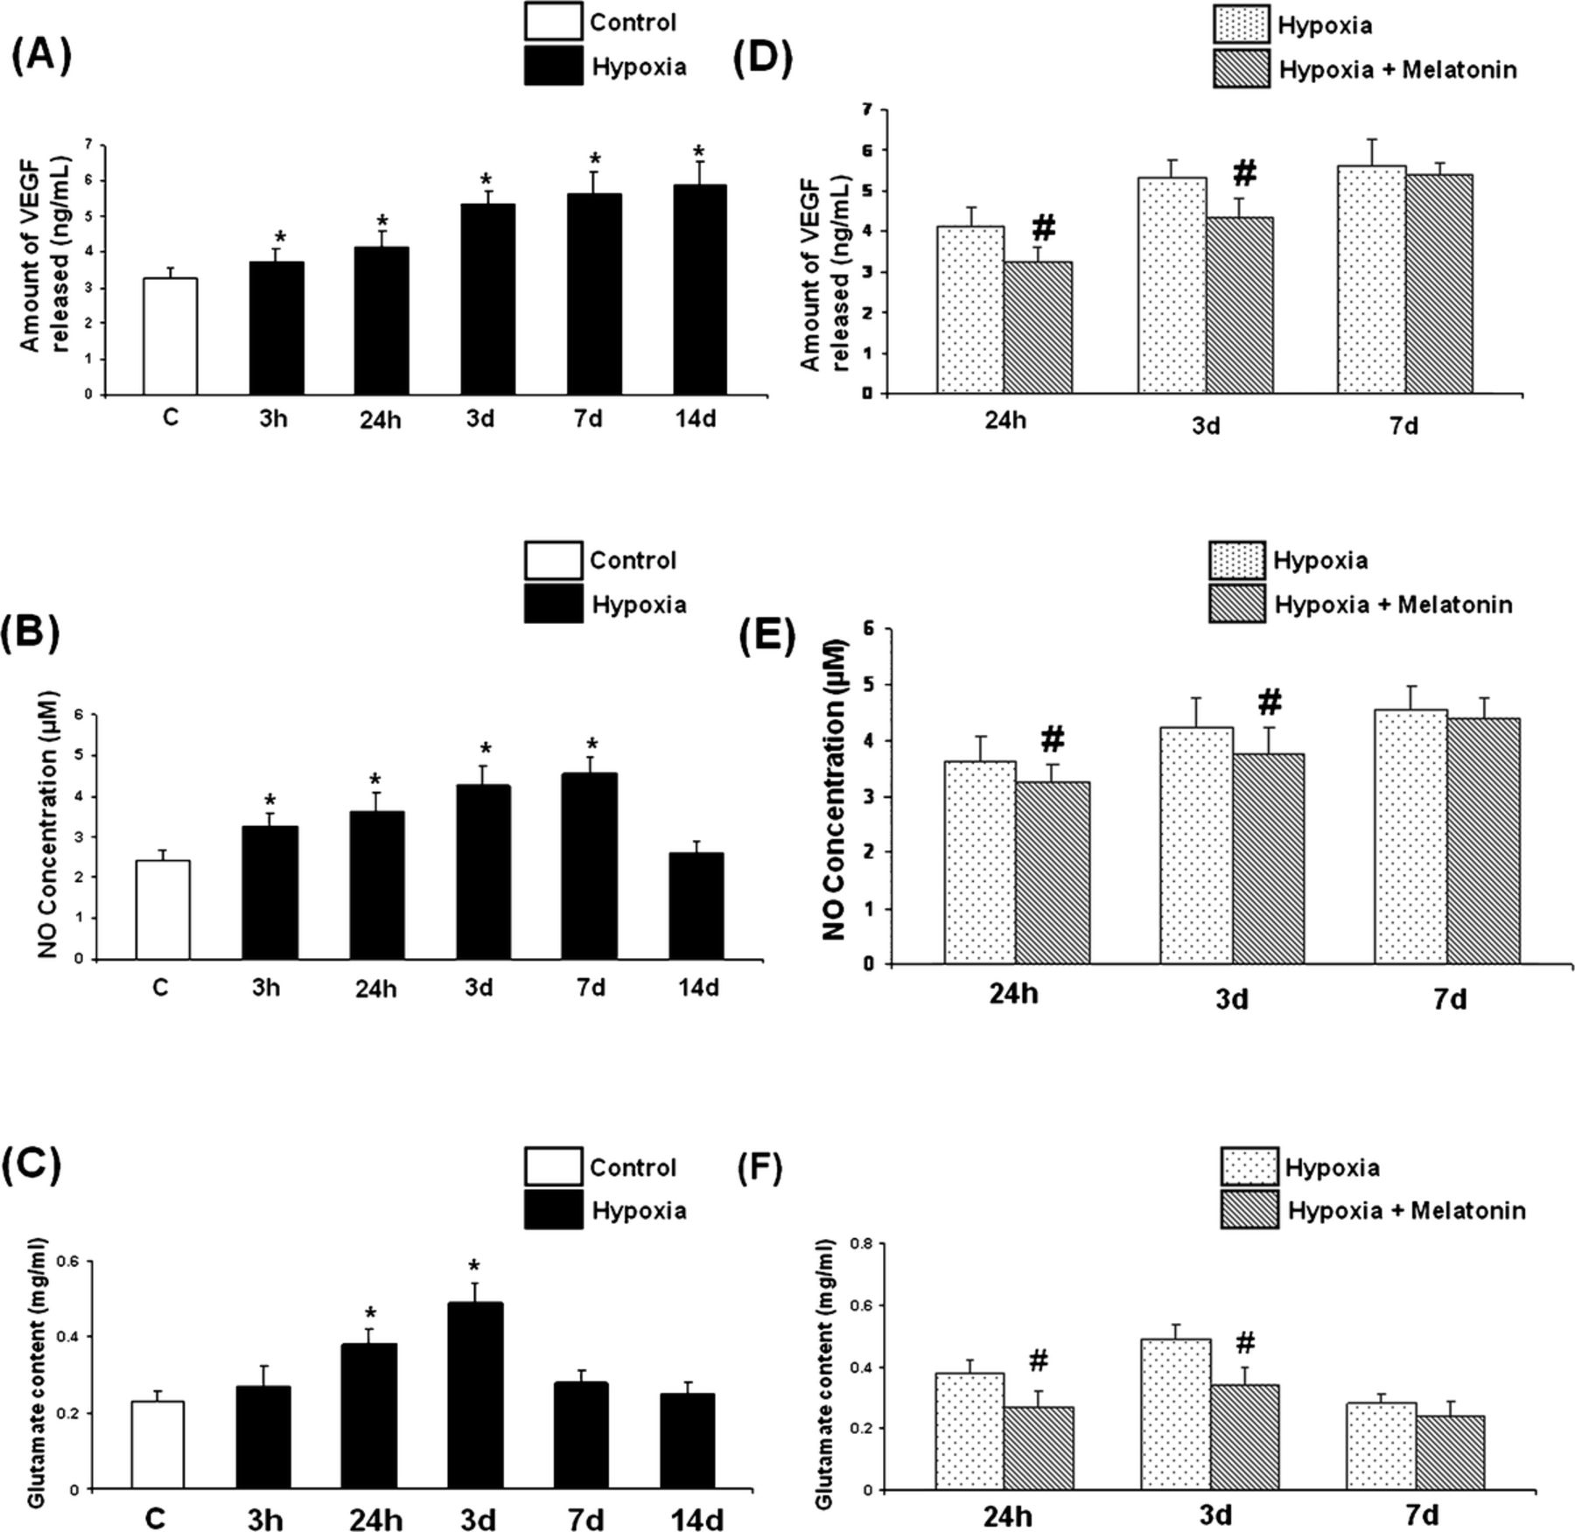
FIGURE 3. (A-C) Vascular endothelial growth factor (VEGF) (A), nitric oxide (NO) (B), and glutamate (C) concentrations ...
Notes:
FIGURE 3. (A-C) Vascular endothelial growth factor (VEGF) (A), nitric oxide (NO) (B), and glutamate (C) concentrations inbrainstem of control [C] rats and at 3 and 24 hours and at 3, 7, and 14 days after hypoxia exposure. Data represent mean ± SD. *,p < 0.01 for differences in levels between control and hypoxic rats. (D-F) Reductions in brainstem levels of VEGF (D), NO (E), and glutamate (F) at 24 hours and 3 days after melatonin administration in hypoxic rats. #, p < 0.01.
Unless provided in the caption above, the following copyright applies to the content of this slide: Copyright © 2011 by the American Association of Neuropathologists, Inc.

Slide 4
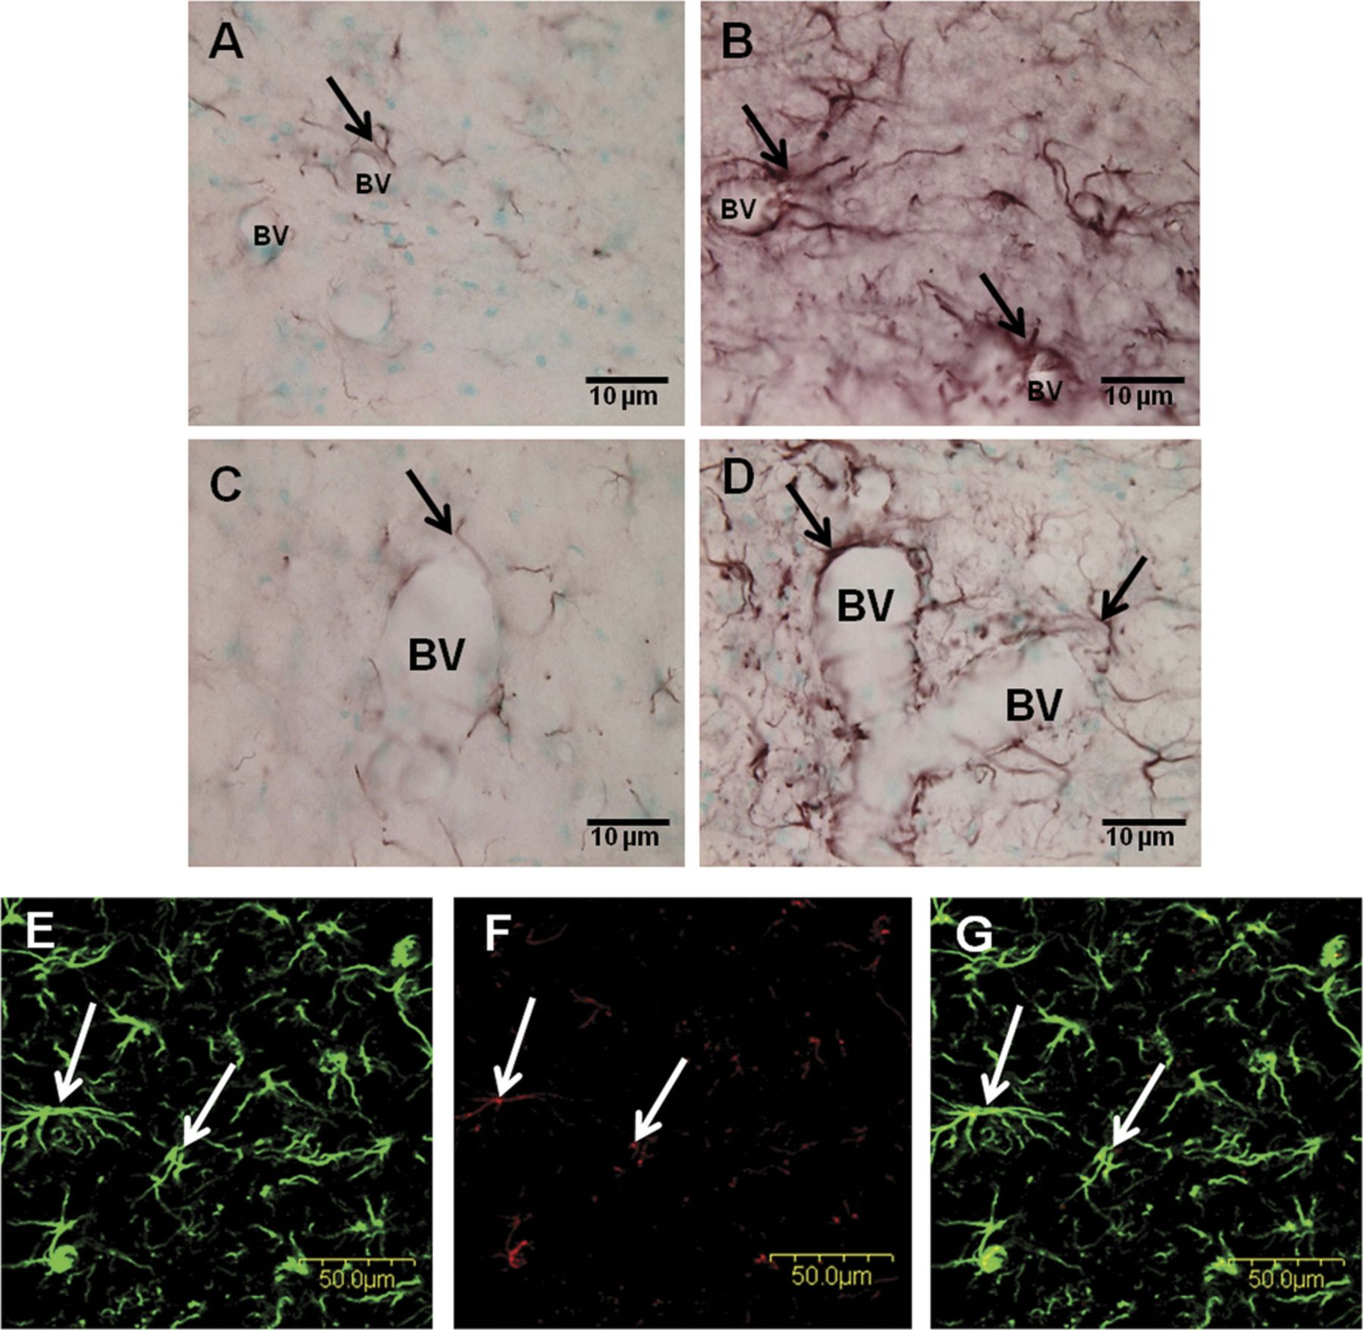
FIGURE 4. Vascular endothelial growth factor (VEGF) immunohistochemistry. (A, C) There is weak expression in branched ...
Notes:
FIGURE 4. Vascular endothelial growth factor (VEGF) immunohistochemistry. (A, C) There is weak expression in branched cells (arrows) in close association with blood vessels (BV) in the nucleus tractus solitarius (NTS) (A) and ventrolateral medulla (VLM) (C) of a control rat. (B, D) The expression of VEGF is enhanced at 3 days after hypoxic exposure when compared with the controls. The stained branched cells are morphologically consistent with astrocytes. (E-G) The VEGF-immunopositive branched cells are identified as astrocytes (arrows) when doubly stained for glial fibrillary acidic protein (GFAP) (E, G; green) and VEGF (F; red) (arrows) in the VLM of a control rat. Colocalized expression of VEGF with GFAP-immunoreactive astrocytes can be seen in G. Scale bars = 10 μm (A-D); 50 μm (E-G).
Unless provided in the caption above, the following copyright applies to the content of this slide: Copyright © 2011 by the American Association of Neuropathologists, Inc.

Slide 5
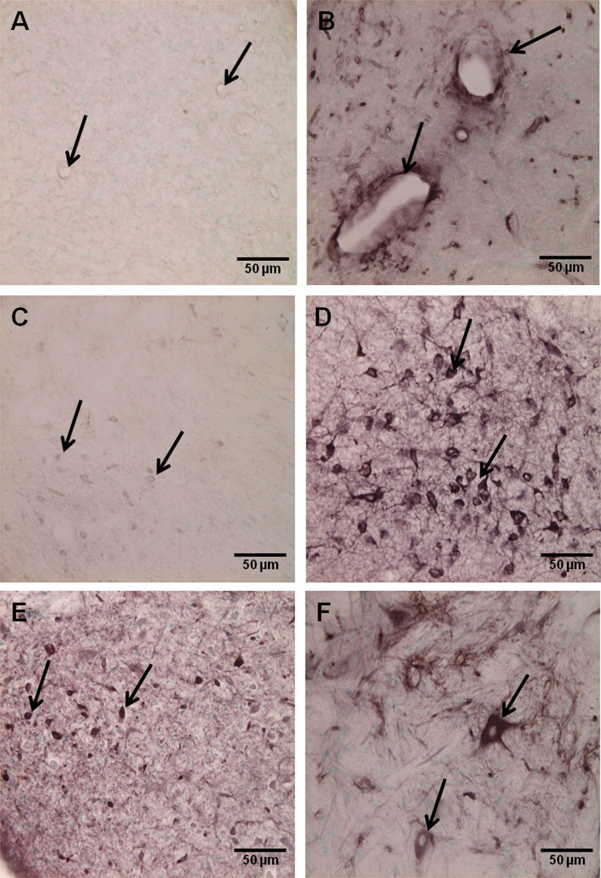
FIGURE 5. Nitric oxide synthase immunohistochemistry. (A, B) Expression of endothelial nitric oxide synthase (eNOS) in ...
Notes:
FIGURE 5. Nitric oxide synthase immunohistochemistry. (A, B) Expression of endothelial nitric oxide synthase (eNOS) in blood vessels (arrows) in the nucleus tractus solitarius (NTS) is minimal in a control rat (A) but is markedly enhanced (arrows) at 3 hours after the hypoxic exposure (B). (C, D) Expression of nNOS in the NTS is very weak in neurons (arrows) in a control rat (C) but is enhanced at 24 hours after the hypoxic exposure (D). (E, F) Inducible nitric oxide synthase (iNOS) expression in the NTS (E) and ventrolateral medulla (F) at 24 hours after hypoxia exposure. Many neurons (arrows) show intense iNOS immunostaining. Scale bars = 50 μm (A-F).
Unless provided in the caption above, the following copyright applies to the content of this slide: Copyright © 2011 by the American Association of Neuropathologists, Inc.

Slide 6
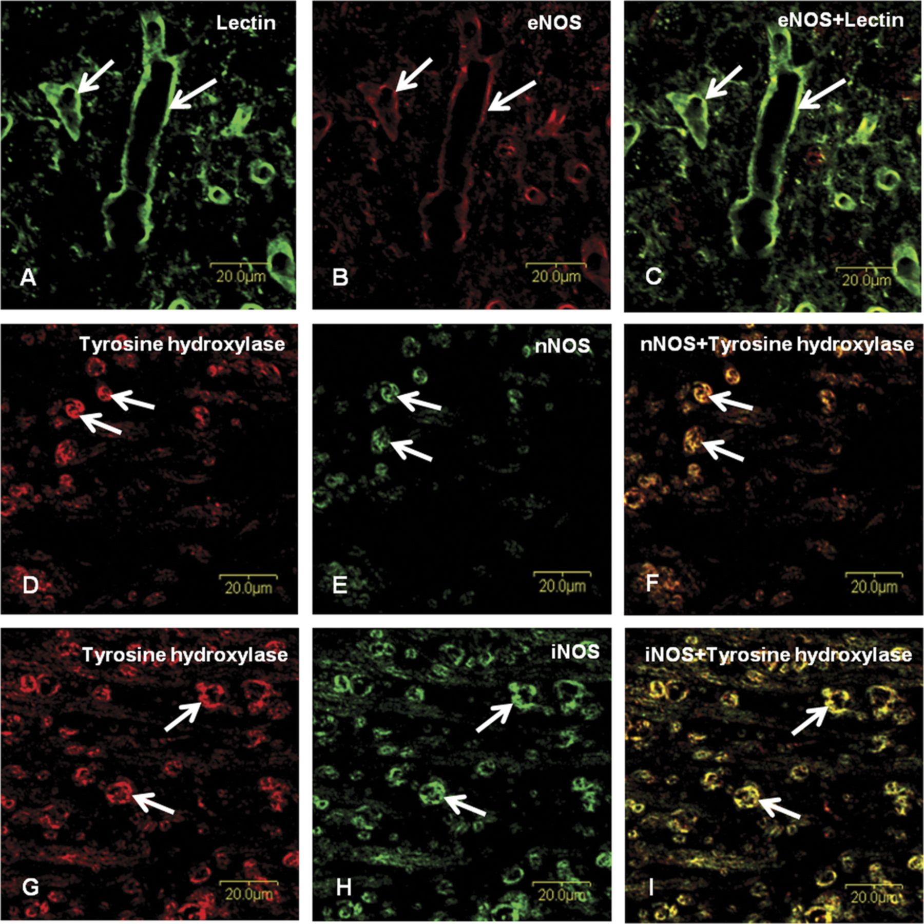
FIGURE 6. Nitric oxide synthase colocalization. (A-C) Confocal images showing the distribution of lectin-labeled (A, ...
Notes:
FIGURE 6. Nitric oxide synthase colocalization. (A-C) Confocal images showing the distribution of lectin-labeled (A, green) and endothelial nitric oxide synthase (eNOS)-labeled (B, red) blood vessels (arrows) in the nucleus tractus solitarius (NTS) at 24 hours after the hypoxic exposure. Colocalized expression (arrows) is shown in C. (D-G) Confocal images showing the distribution of tyrosine hydroxylase-labeled (D, G; green) and neuronal nitric oxide synthase (nNOS)/inducible nitric oxide synthase (iNOS)-labeled (E, H; red) neurons (arrows) in the NTS at 24 hours after hypoxia exposure. Colocalized labeling of tyrosine hydroxylase stained neurons with nNOS/iNOS (arrows) is detected in F and I. Scale bars = 20 μm (A-I).
Unless provided in the caption above, the following copyright applies to the content of this slide: Copyright © 2011 by the American Association of Neuropathologists, Inc.

Slide 7
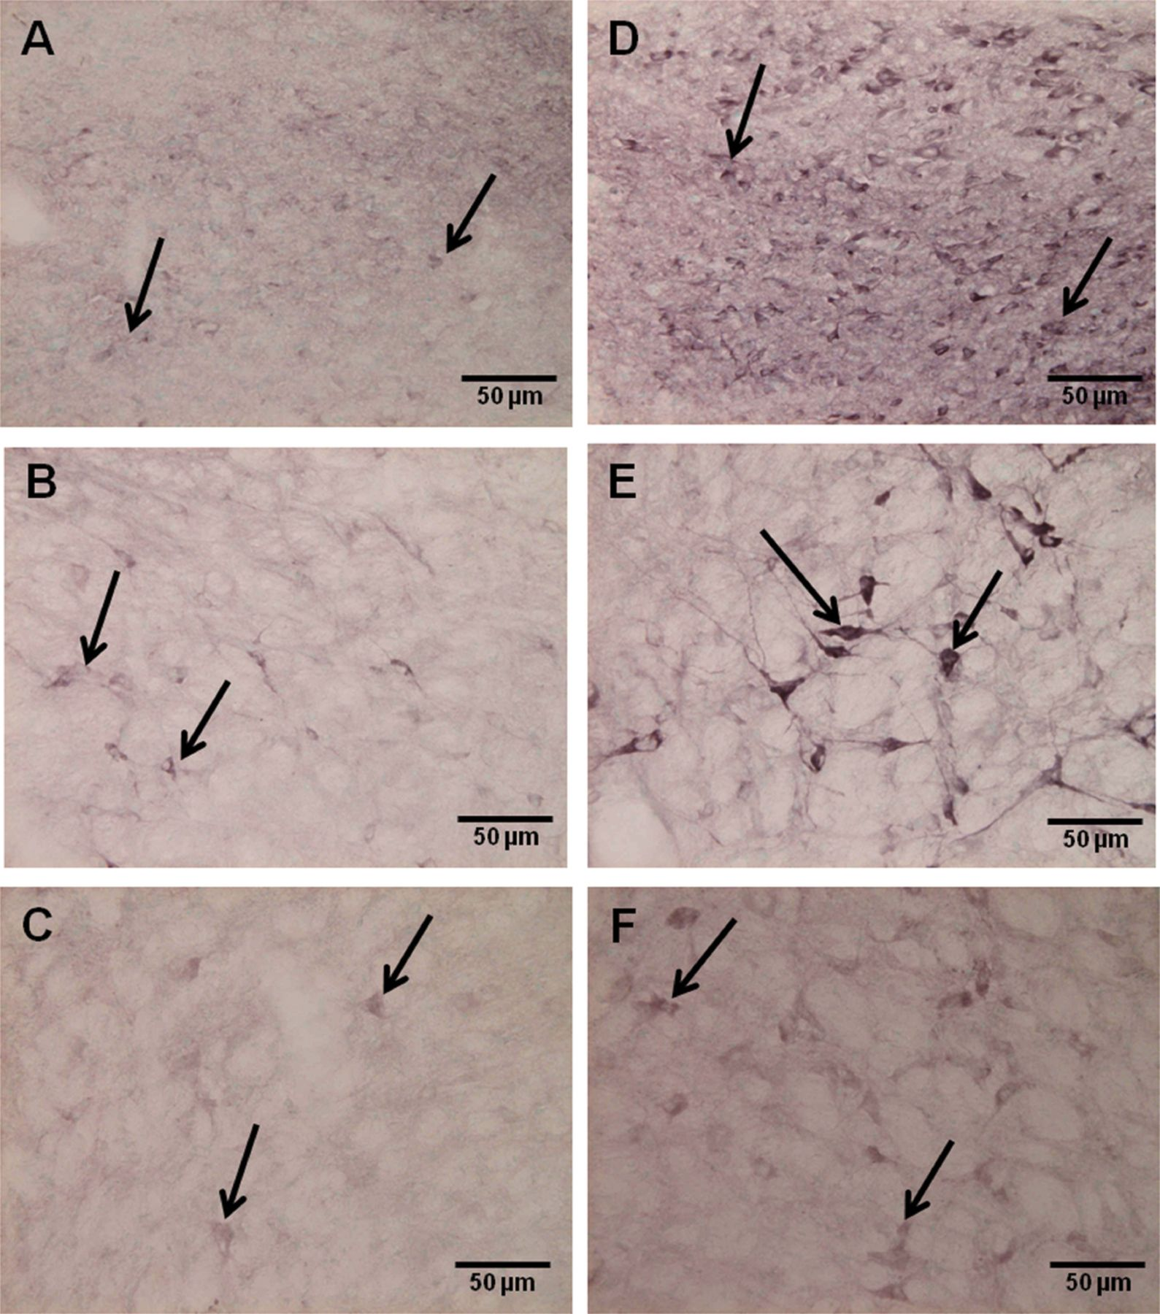
FIGURE 7. Ionotropic AMPA GluR2/3 and NR1 immunohistochemistry. (A, B) Neurons (arrows) in the nucleus ...
Notes:
FIGURE 7. Ionotropic AMPA GluR2/3 and NR1 immunohistochemistry. (A, B) Neurons (arrows) in the nucleus tractussolitarius (NTS) (A) and ventrolateral medulla (VLM) (B) in a control rat. (D, E) Enhanced expression of GluR2/3 is seen in the neurons (arrows) in the NTS (D) and VLM (E) at 24 hours after hypoxic exposure. (C, F) NR1 expression in the neurons (arrows) in the VLM of a control rat (C) is weak in comparison to its upregulation at 24 hours after hypoxic expression (F). Scale bars = 50 μm (A-F).
Unless provided in the caption above, the following copyright applies to the content of this slide: Copyright © 2011 by the American Association of Neuropathologists, Inc.

Slide 8
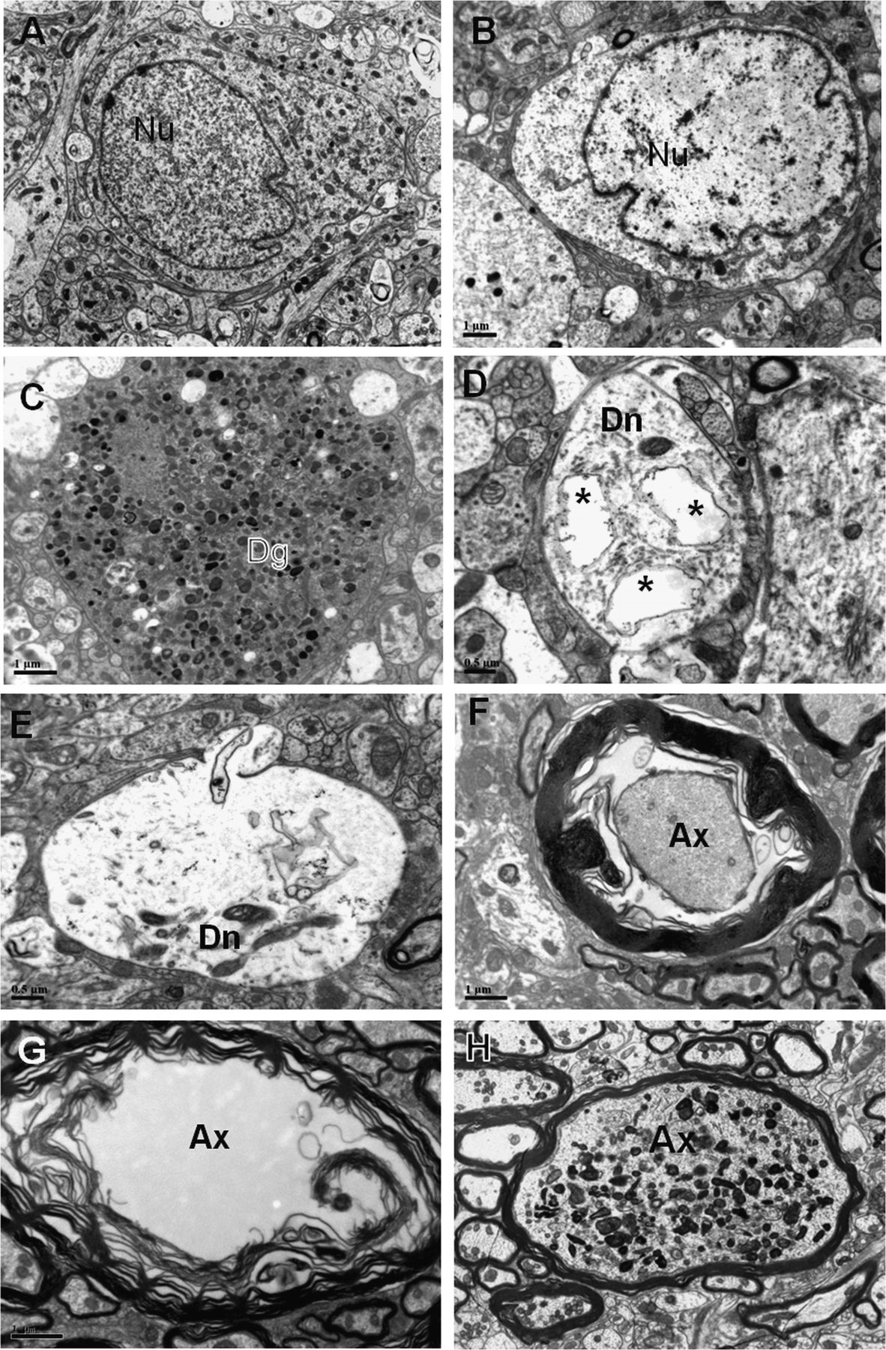
FIGURE 8. Electron microscopy. (A) A neuron (Nu) with evenly dispersed euchromatin in the nucleus and cytoplasm with ...
Notes:
FIGURE 8. Electron microscopy. (A) A neuron (Nu) with evenly dispersed euchromatin in the nucleus and cytoplasm with mitochondria and cisternae of rough endoplasmic reticulum from the nucleus tractus solitarius (NTS) of a control rat. (B-H) Hypoxia-exposed rats. At 24 hours after exposure, a neuron (Nu) in the NTS appears swollen with watery cytoplasm containing a few cisternae of rough endoplasmic reticulum and mitochondria (B). At 7 days after exposure, there is a degenerating cell (Dg) filled with dense bodies in the NTS (C); some dendrites (Dn) in the NTS (D) and ventrolateral medulla (VLM) (E) are swollen with the appearance of vacuoles (asterisks in D). Axons (Ax) in the VLM of a rat at 3 days after exposure show disintegrated myelin sheaths (F, G). The axon in F appears to be separated from the myelin sheath. At 7 days after exposure, an axon (Ax) in the NTS shows accumulation of dense bodies in the axoplasm (H). Scale bars = 1 μm (A-C, F-H); 0.5 μm (D, E).
Unless provided in the caption above, the following copyright applies to the content of this slide: Copyright © 2011 by the American Association of Neuropathologists, Inc.

Slide 9
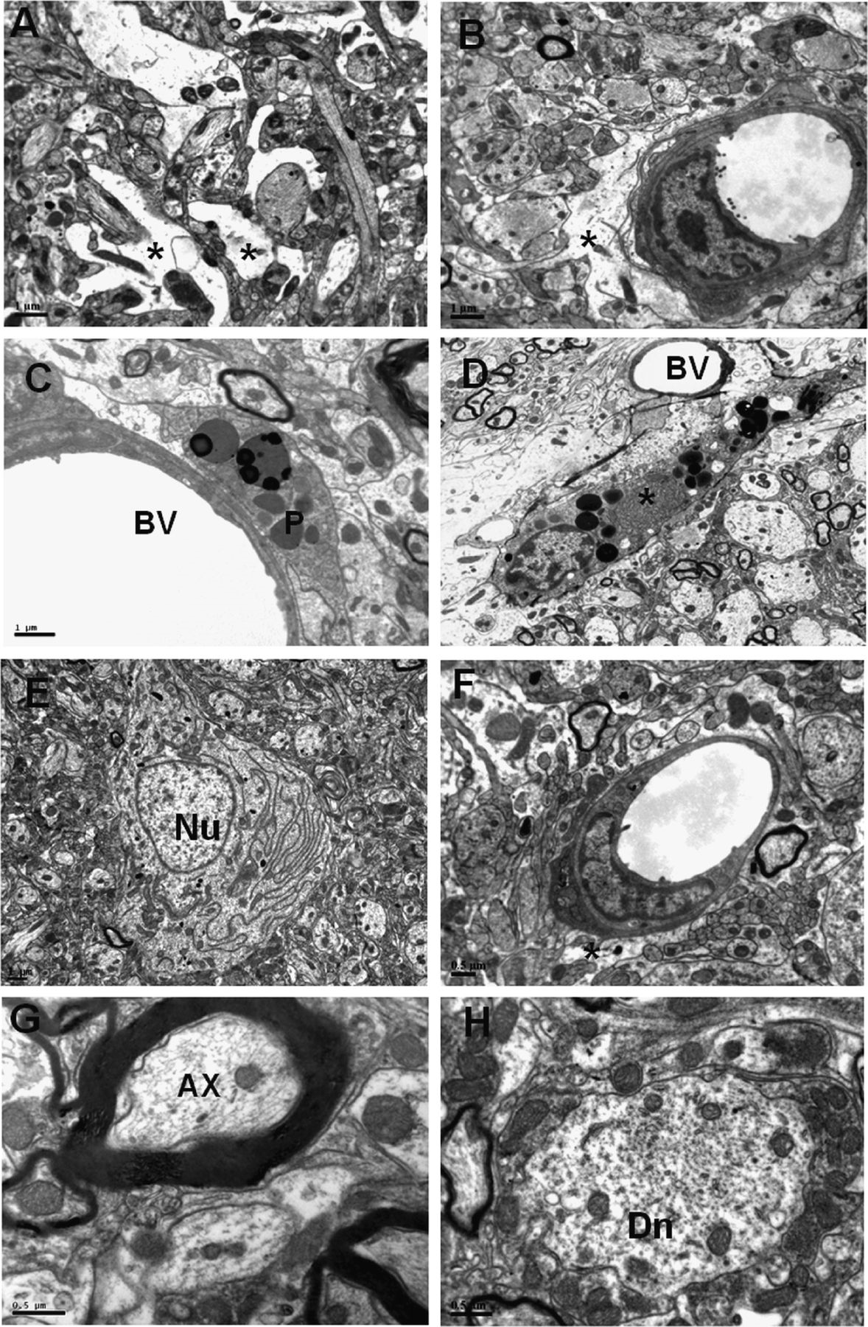
FIGURE 9. Electron microscopy of the nucleus tractus solitarius (NTS) from hypoxia-exposed rats: (A-D) At 24 hours ...
Notes:
FIGURE 9. Electron microscopy of the nucleus tractus solitarius (NTS) from hypoxia-exposed rats: (A-D) At 24 hours after exposure, there is edema evidenced by the presence of swollen astrocyte processes (asterisks) in the neuropil (A) and in close association with the blood vessels (B). Perivascular cells (P) in close association with the blood vessels (BV) are seen at in the NTS at 3 (C) and 7days (D) after exposure. The cells contain many lipid droplets. The cell in D appears to have engulfed some fibrillar material (asterisk). (E-H) Melatonin-treated hypoxic rats. After melatonin administration, a neuron (Nu) in the NTS appears structurally normal (E) and swelling of astrocytes and their processes (asterisks in F) is diminished. The myelin sheath of axons (Ax) in G appears to be fairly well preserved, and the swelling of dendrites (Dn) in H is reduced. Scale bars = 1 μm (A-C, E); 2 μm (D); 0.5 μm (F-H).
Unless provided in the caption above, the following copyright applies to the content of this slide: Copyright © 2011 by the American Association of Neuropathologists, Inc.

Slide 10
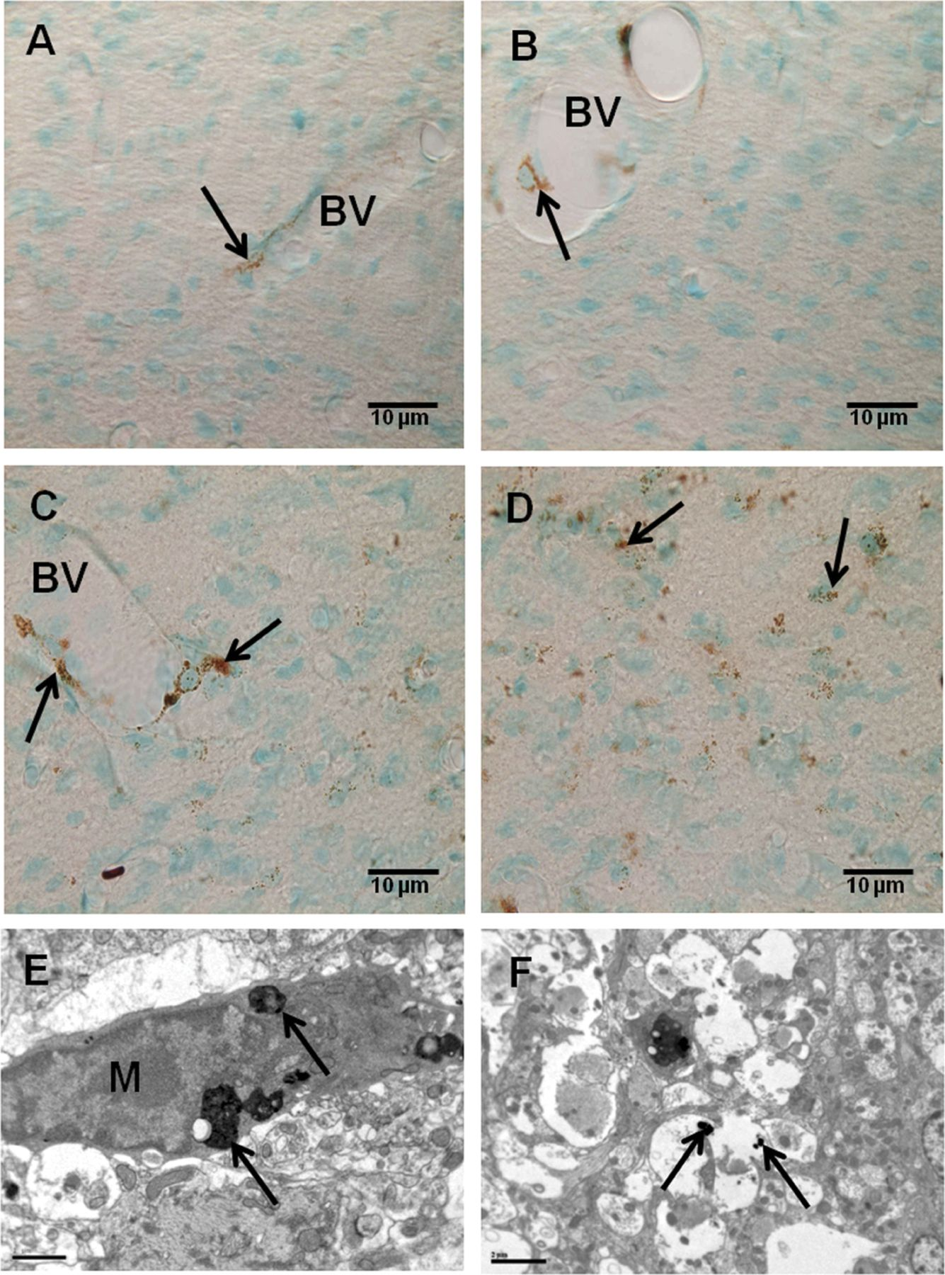
FIGURE 10. Horseradish peroxidase (HRP) labeling studies. (A, B) HRP is localized in endothelial cells (arrow) of blood ...
Notes:
FIGURE 10. Horseradish peroxidase (HRP) labeling studies. (A, B) HRP is localized in endothelial cells (arrow) of blood vessels (BV) (A) and occasional perivascular cells (B) (arrow) in the nucleus tractus solitarius (NTS) of a control rat at 3 (A) and 24 hours (B) after HRP administration. (C, D) HRP leakage from a blood vessel (BV) in the NTS of a hypoxic rat at 3 hours after HRP injection is evidenced by the labeling of perivascular cells (arrows) with HRP reaction product. Some HRP reaction products are also seen in the neuropil (C). At 24 hours after the injection (D), the leaked HRP (arrows) is present throughout the NTS. (E, F) Electron micrographs showing that HRP (arrows) is internalized in the microglial cell (M) in E and the pale profiles identified as hypertrophic astrocyte processes in F. Scale bars = 10 μm (A-D); 1 μm (E); 2 μm (F).
Unless provided in the caption above, the following copyright applies to the content of this slide: Copyright © 2011 by the American Association of Neuropathologists, Inc.

