Slide 1
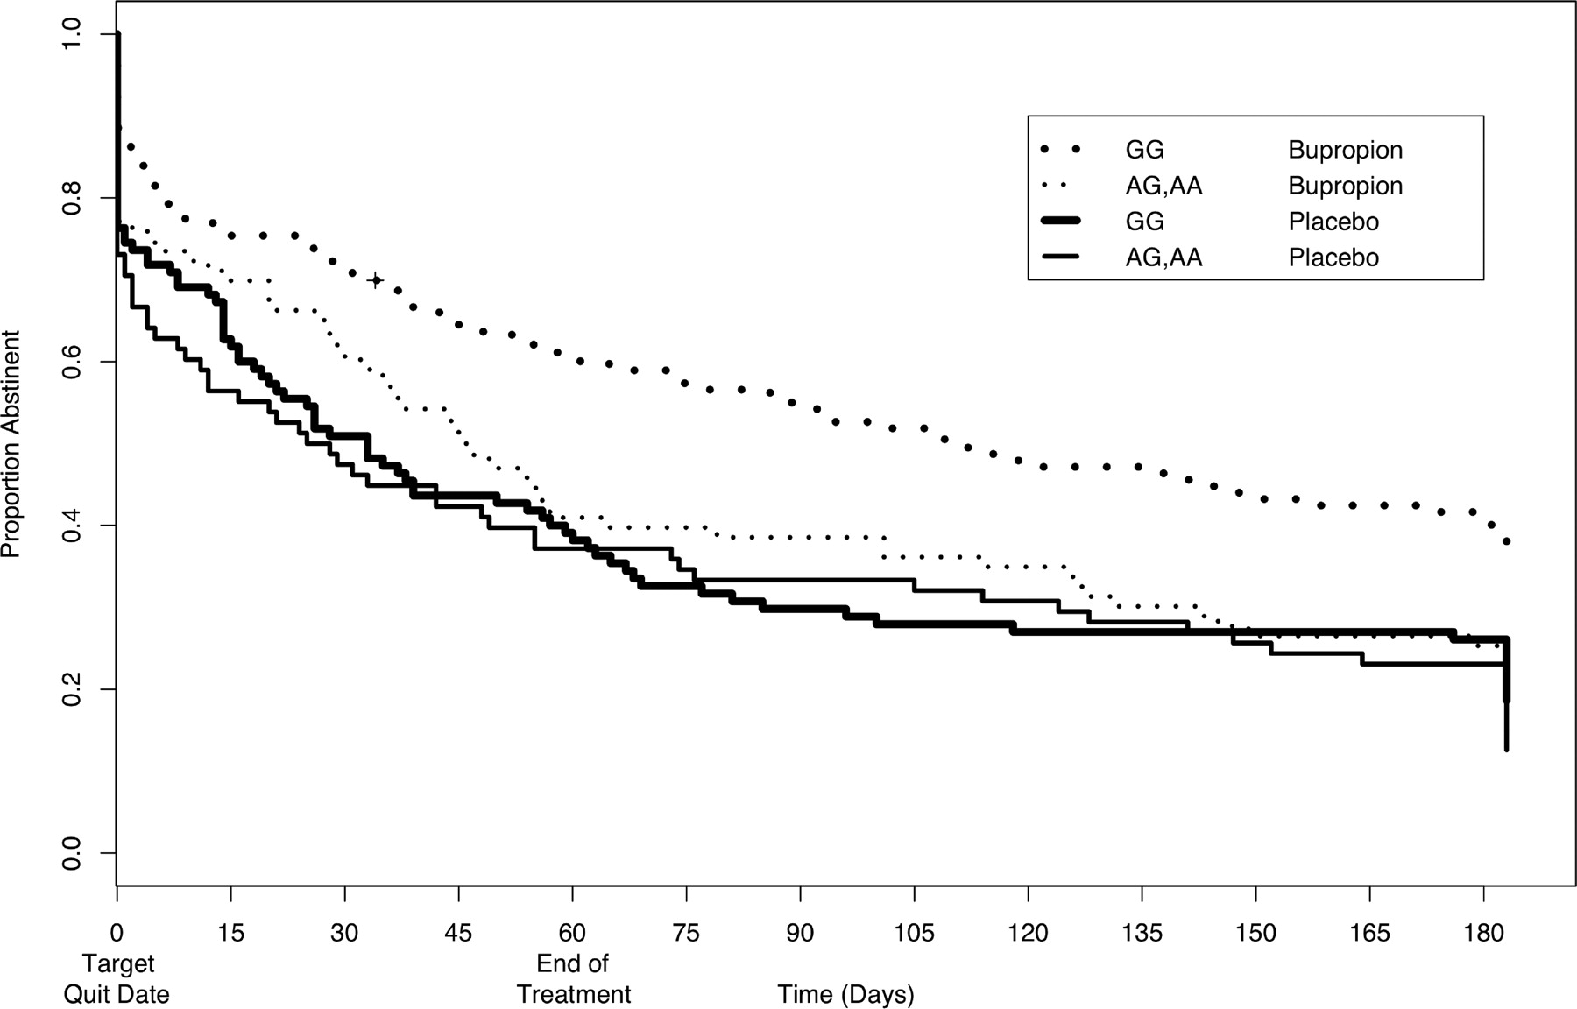
Figure 3. Time to relapse to 6-month follow-up for CHRNB2 rs2072661. Time to relapse to 6-month follow-up in ...
Notes:
Figure 3. Time to relapse to 6-month follow-up for CHRNB2 rs2072661. Time to relapse to 6-month follow-up in individuals with at least one variant allele for CHRNB2 rs2072661 (thin lines) was compared with those having both alleles common (thick lines), stratifying by treatment group: buproprion (dotted lines) and placebo (solid lines).
Unless provided in the caption above, the following copyright applies to the content of this slide: © 2008 The Author(s)This is an Open Access article distributed under the terms of the Creative Commons Attribution Non-Commercial License (http://creativecommons.org/licenses/by-nc/2.0/uk/) which permits unrestricted non-commercial use, distribution, and reproduction in any medium, provided the original work is properly cited.

Slide 2
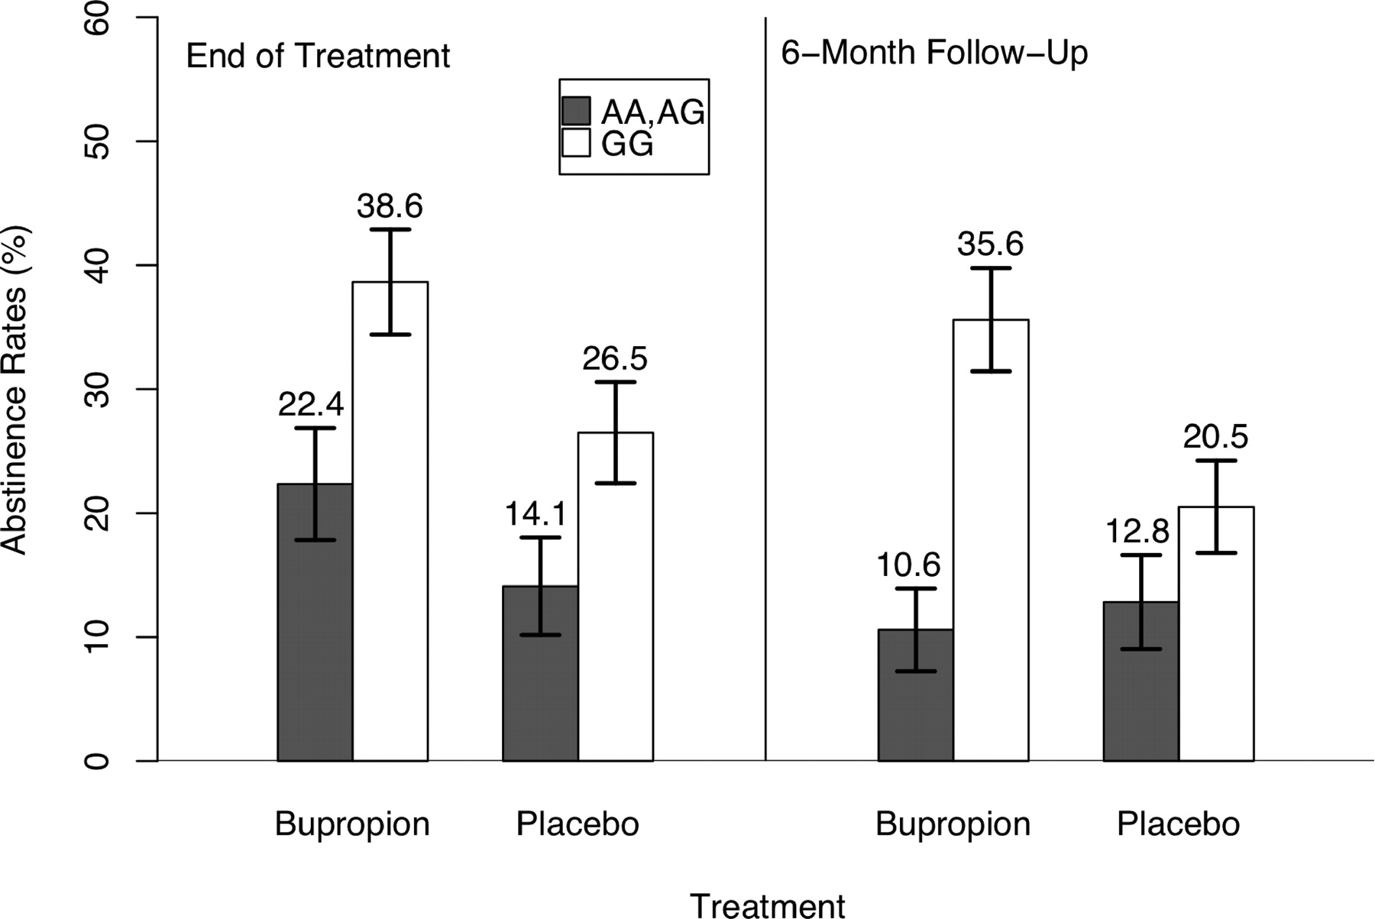
Figure 2. Abstinence rates by CHRNB2 rs2072661 and by bupropion treatment. Abstinence rates comparing individuals with ...
Notes:
Figure 2. Abstinence rates by CHRNB2 rs2072661 and by bupropion treatment. Abstinence rates comparing individuals with at least one variant allele for CHRNB2 rs2072661 (filled bars) to those with both common alleles (unfilled bars) were stratified by treatment (buproprion or placebo) and estimated at each time point (end of treatment and 6-month follow-up).
Unless provided in the caption above, the following copyright applies to the content of this slide: © 2008 The Author(s)This is an Open Access article distributed under the terms of the Creative Commons Attribution Non-Commercial License (http://creativecommons.org/licenses/by-nc/2.0/uk/) which permits unrestricted non-commercial use, distribution, and reproduction in any medium, provided the original work is properly cited.

Slide 3
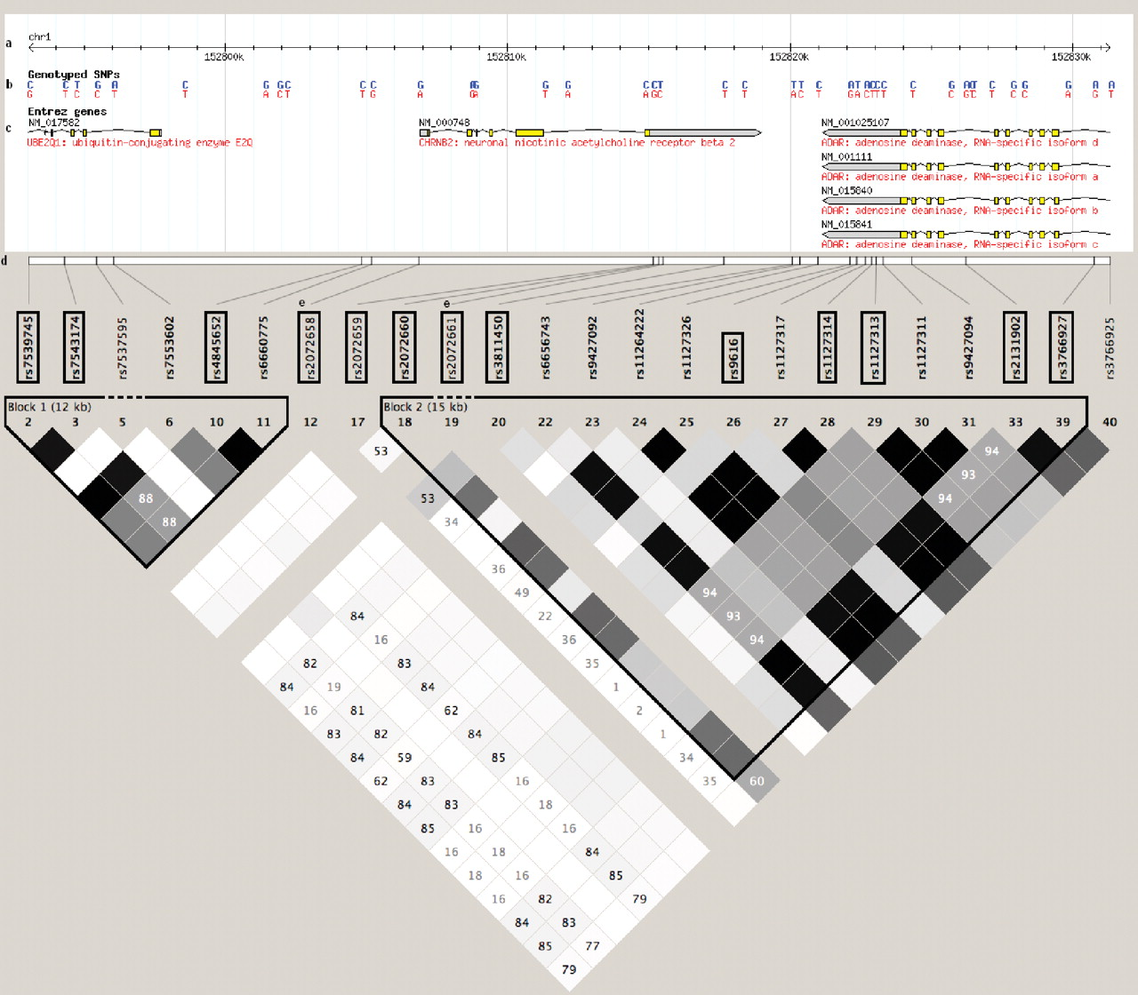
Figure 1. Block structure for CHRNB2 from HapMap Genome Build 36. The linkage disequilibrium (LD) plot was obtained ...
Notes:
Figure 1. Block structure for CHRNB2 from HapMap Genome Build 36. The linkage disequilibrium (LD) plot was obtained using Haploview ( 25 ) and HapMap Build 36. The scale at the top of the figure depicts the HapMap region for CHRNB2 (Chromosome 1: 152,806,881 to 152,818,975), and roughly 10 kb upstream and downstream of this region. Single nucleotide polymorphisms (SNPs) genotyped by HapMap are identified in blue (minor alleles) and red (major alleles). Gene regions with the direction of their respective reading frame, exons, and introns, are also given. The 13 SNPs in boxes are the tagSNPs selected in this gene region. rs2072658 and rs2072661 have no HapMap or LD information. The r2 LD color scheme is depicted. Two blocks are delineated using the default block definitions from Haploview.
Unless provided in the caption above, the following copyright applies to the content of this slide: © 2008 The Author(s)This is an Open Access article distributed under the terms of the Creative Commons Attribution Non-Commercial License (http://creativecommons.org/licenses/by-nc/2.0/uk/) which permits unrestricted non-commercial use, distribution, and reproduction in any medium, provided the original work is properly cited.

