Slide 1
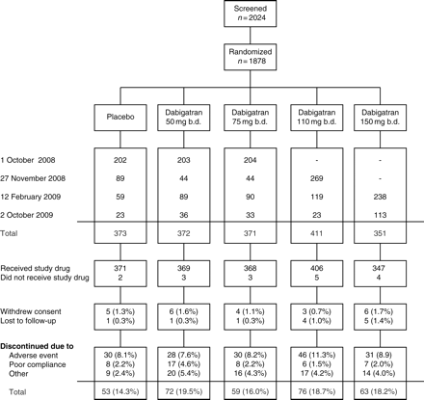
Figure 1 Study design (adaptive dose-escalation) and patient flow.
Notes:
Figure 1 Study design (adaptive dose-escalation) and patient flow.
Unless provided in the caption above, the following copyright applies to the content of this slide: Published on behalf of the European Society of Cardiology. All rights reserved. © The Author 2011. For permissions please email: journals.permissions@oup.com

Slide 2
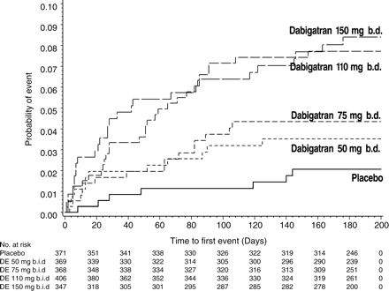
Figure 2 Kaplan–Meier curve depicting the primary endpoint, i.e. the composite of major and clinically relevant minor ...
Notes:
Figure 2 Kaplan–Meier curve depicting the primary endpoint, i.e. the composite of major and clinically relevant minor bleeding. Compared with placebo, primary outcomes differed significantly (P< 0.001) for the 110 and 150 mg dabigatran doses using Cox proportional hazards regression models. Number of subjects at risk are given below the x-axis.
Unless provided in the caption above, the following copyright applies to the content of this slide: Published on behalf of the European Society of Cardiology. All rights reserved. © The Author 2011. For permissions please email: journals.permissions@oup.com

Slide 3
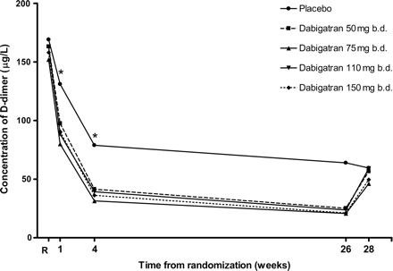
Figure 3 Median D-dimer concentration over time. Compared with placebo, median D-dimer concentrations were ...
Notes:
Figure 3 Median D-dimer concentration over time. Compared with placebo, median D-dimer concentrations were significantly (P< 0.001) lower after 1 and 4 weeks in all four dabigatran dose groups using Cochran–Armitage linear trend test.
Unless provided in the caption above, the following copyright applies to the content of this slide: Published on behalf of the European Society of Cardiology. All rights reserved. © The Author 2011. For permissions please email: journals.permissions@oup.com

