Slide 1
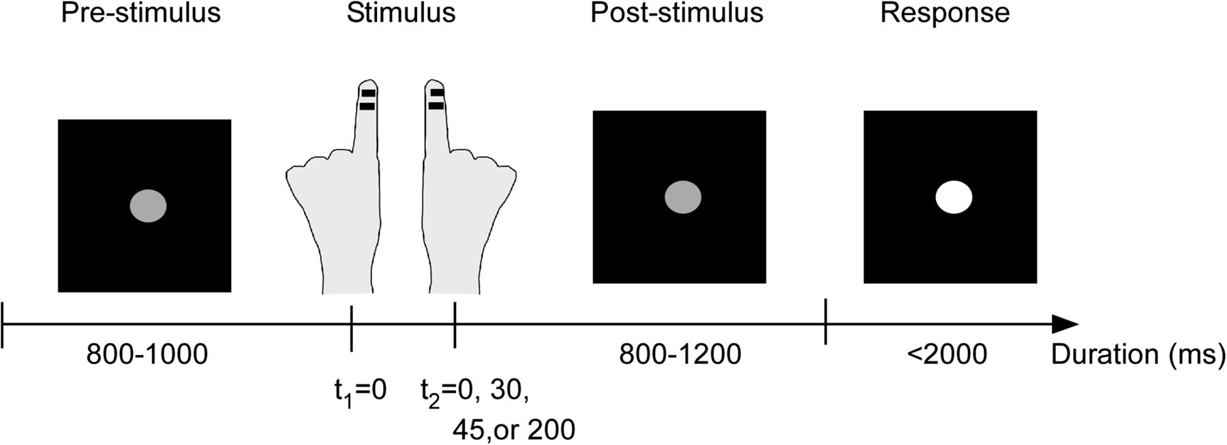
Figure 1. Schematic illustration of the paradigm. Subjects fixated a central gray dot throughout the entire trial. ...
Notes:
Figure 1. Schematic illustration of the paradigm. Subjects fixated a central gray dot throughout the entire trial. After 800–1000 ms, tactile stimulation was given to one index finger (right or left), followed by stimulation of the other finger after a randomized SOA (0, 30, 45, or 200 ms). After a jittered period (800–1200 ms), the luminance of the fixation dot increased, and subjects reported their subjective perception of simultaneity by pressing a button, upon which the next trial began (indicated by a luminance decrease of the fixation dot).
Unless provided in the caption above, the following copyright applies to the content of this slide: © The Author 2011. Published by Oxford University Press. All rights reserved. For permissions, please e-mail: journals.permissions@oup.com

Slide 2
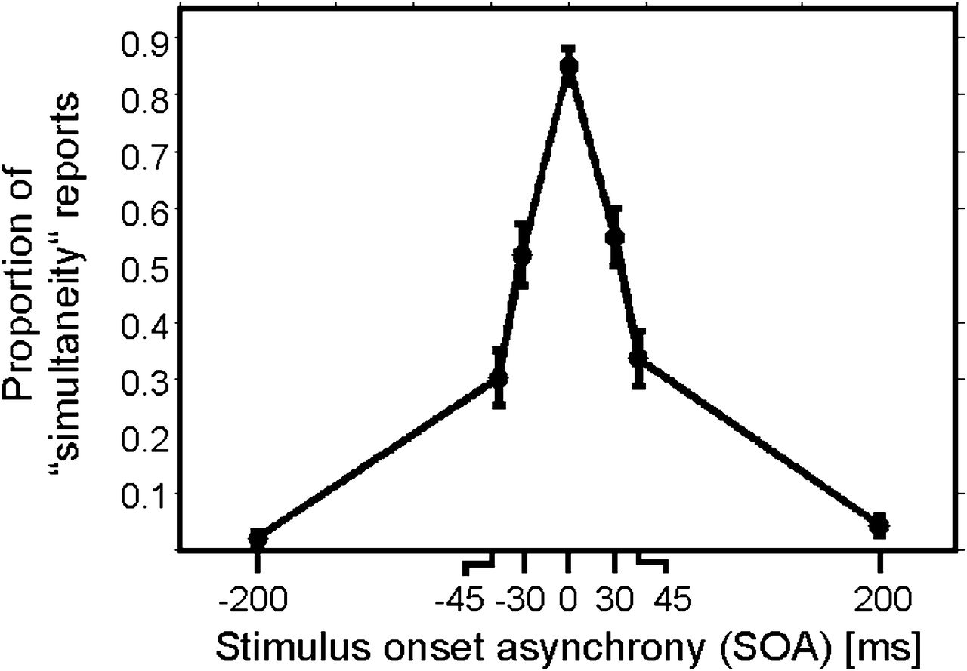
Figure 2. Behavioral results presented as proportion of simultaneity reports depending on SOA of left and right index ...
Notes:
Figure 2. Behavioral results presented as proportion of simultaneity reports depending on SOA of left and right index finger stimulations. Negative SOA indicate that stimulation was applied first to the left index finger. Data are presented as mean ± 1 SEM.
Unless provided in the caption above, the following copyright applies to the content of this slide: © The Author 2011. Published by Oxford University Press. All rights reserved. For permissions, please e-mail: journals.permissions@oup.com

Slide 3
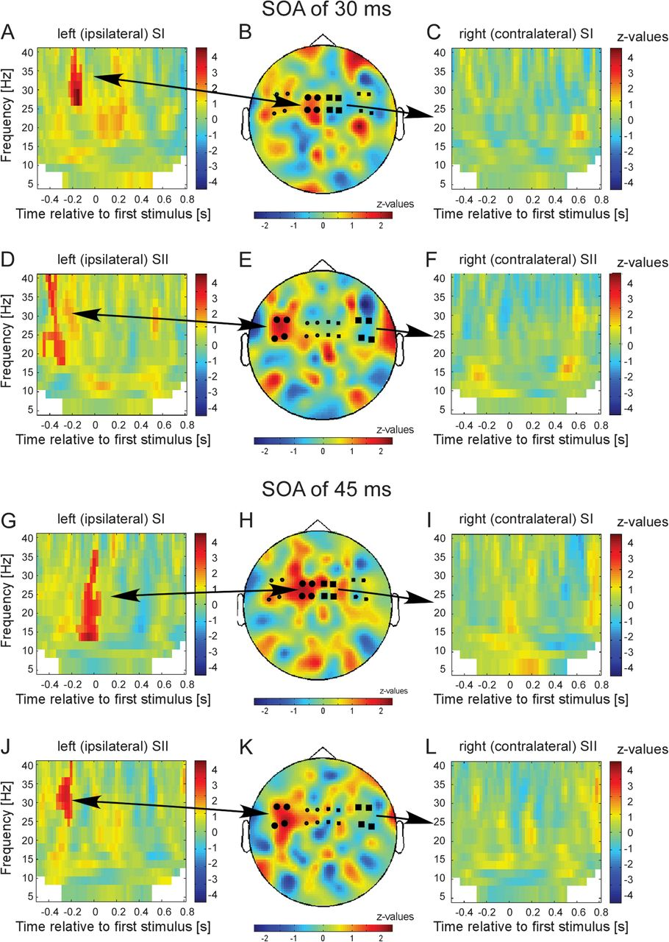
Figure 3. Results of the statistical comparison of trials with subjective simultaneity versus nonsimultaneity for ...
Notes:
Figure 3. Results of the statistical comparison of trials with subjective simultaneity versus nonsimultaneity for conditions SOA 30 ms (A–F) and SOA 45 ms (G–L) for different sensor groups: (A) TFR for the 4 sensors over the left (ipsilateral) primary somatosensory cortex (SI) as indicated by the larger black circles in B. z values in nonsignificant pixels are lowered by 60% in order to highlight significant clusters. Color bars represent z values. Positive z values indicate higher power if subsequent stimulation was misperceived as simultaneously. (B) Topographical representation of the significant cluster as highlighted in A. Only time–frequency samples that correspond to the statistically significant time–frequency clusters in A were averaged to generate the topographical representation (for details, see Materials and Methods). (C) TFR for the 4 sensors over the right (contralateral) SI (as indicated by larger black squares). No significant clusters were found. (D) Same representation as in A but for 4 sensors over left (ipsilateral) secondary somatosensory cortex (SII). (E) Topographical representation for the significant cluster as highlighted in D. (F) TFR for the 4 sensors over the right (contralateral) SII (as indicated by larger black squares). (G–L) Same representation as in A–F but now for condition SOA of 45 ms.
Unless provided in the caption above, the following copyright applies to the content of this slide: © The Author 2011. Published by Oxford University Press. All rights reserved. For permissions, please e-mail: journals.permissions@oup.com

Slide 4
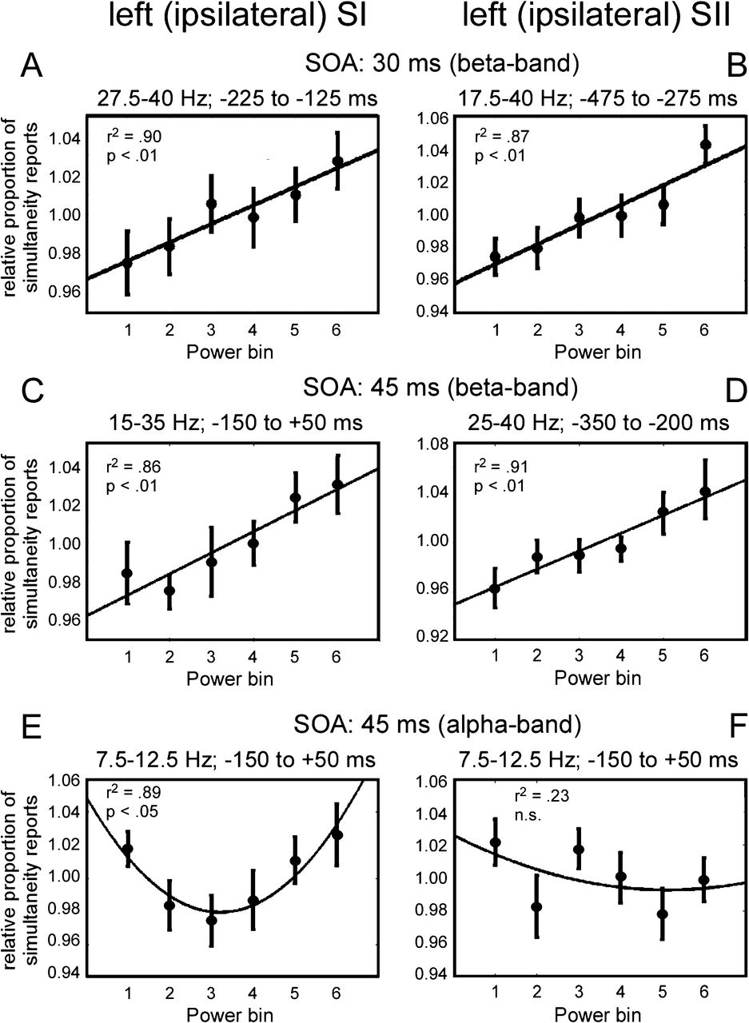
Figure 4. Regression analyses of the dependence of subjective perception on prestimulus oscillatory activity for the 4 ...
Notes:
Figure 4. Regression analyses of the dependence of subjective perception on prestimulus oscillatory activity for the 4 significant clusters in the beta band (as shown in Fig. 3) and for the alpha band. The exact time–frequency bands to determine averaged prestimulus power bins are based on significant clusters in Figure 3 and are presented at the top of each figure. (A) Results for the significant cluster in the beta band for condition SOA 30 ms in sensors over ipsilateral SI (as highlighted in Fig. 3A). (B) Same analysis as in A but for the significant cluster in sensors over SII (as highlighted in Fig. 3D). (C–D) Same analysis as in A,B but for the significant clusters in the beta band for condition SOA 45 ms (as highlighted in Fig. 3G,J). For all regression analyses, a significant linear relationship was found (P < 0.01). (E) Same analysis for the alpha band for condition SOA 45 ms in sensors over ipsilateral SI. A significant quadratic relationship was found. (F) Same analyses as in E but for sensors over SII. No significant relationship was found.
Unless provided in the caption above, the following copyright applies to the content of this slide: © The Author 2011. Published by Oxford University Press. All rights reserved. For permissions, please e-mail: journals.permissions@oup.com

Slide 5
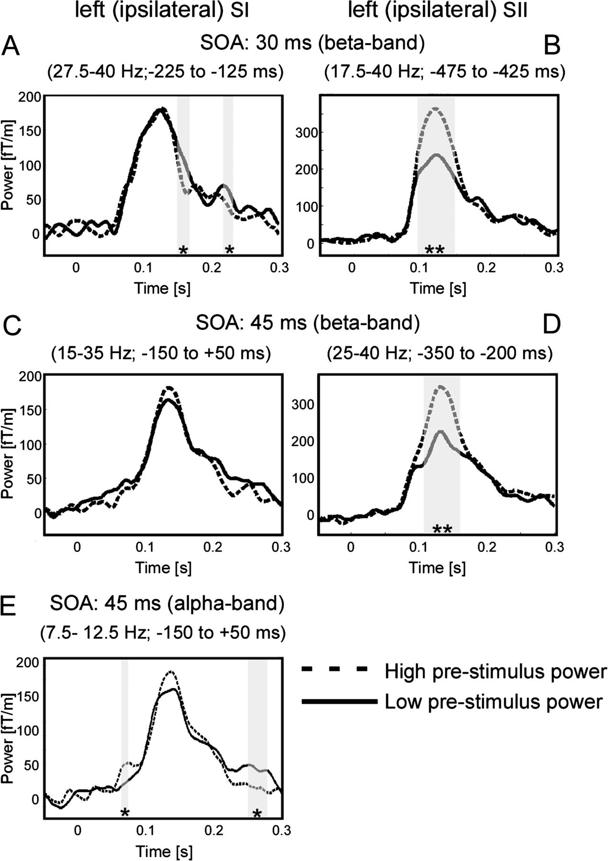
Figure 5. Dependence of poststimulus ERF amplitudes on prestimulus power for the 4 significant clusters in the beta ...
Notes:
Figure 5. Dependence of poststimulus ERF amplitudes on prestimulus power for the 4 significant clusters in the beta band (as shown in Fig. 3) and for the alpha band. The exact time–frequency bands to determine averaged prestimulus power bins are based on significant clusters in Figure 3 and are presented at the top of each figure. (A) Results for the significant cluster in the beta band for condition SOA 30 ms in sensors over ipsilateral SI (as highlighted in Fig. 3A). (B) Same analysis as in A, but for the significant cluster in sensors over SII (as highlighted in Fig. 3D). (C–D) Same analysis as in A,B but for the significant clusters in the beta band for condition SOA 45 ms (as highlighted in Fig. 3G,J). (E) Same analysis for the alpha band for condition SOA 45 ms in sensors over ipsilateral SI. Significant differences (*P < 0.05, **P < 0.01) are indicated by gray shaded areas.
Unless provided in the caption above, the following copyright applies to the content of this slide: © The Author 2011. Published by Oxford University Press. All rights reserved. For permissions, please e-mail: journals.permissions@oup.com

Slide 6
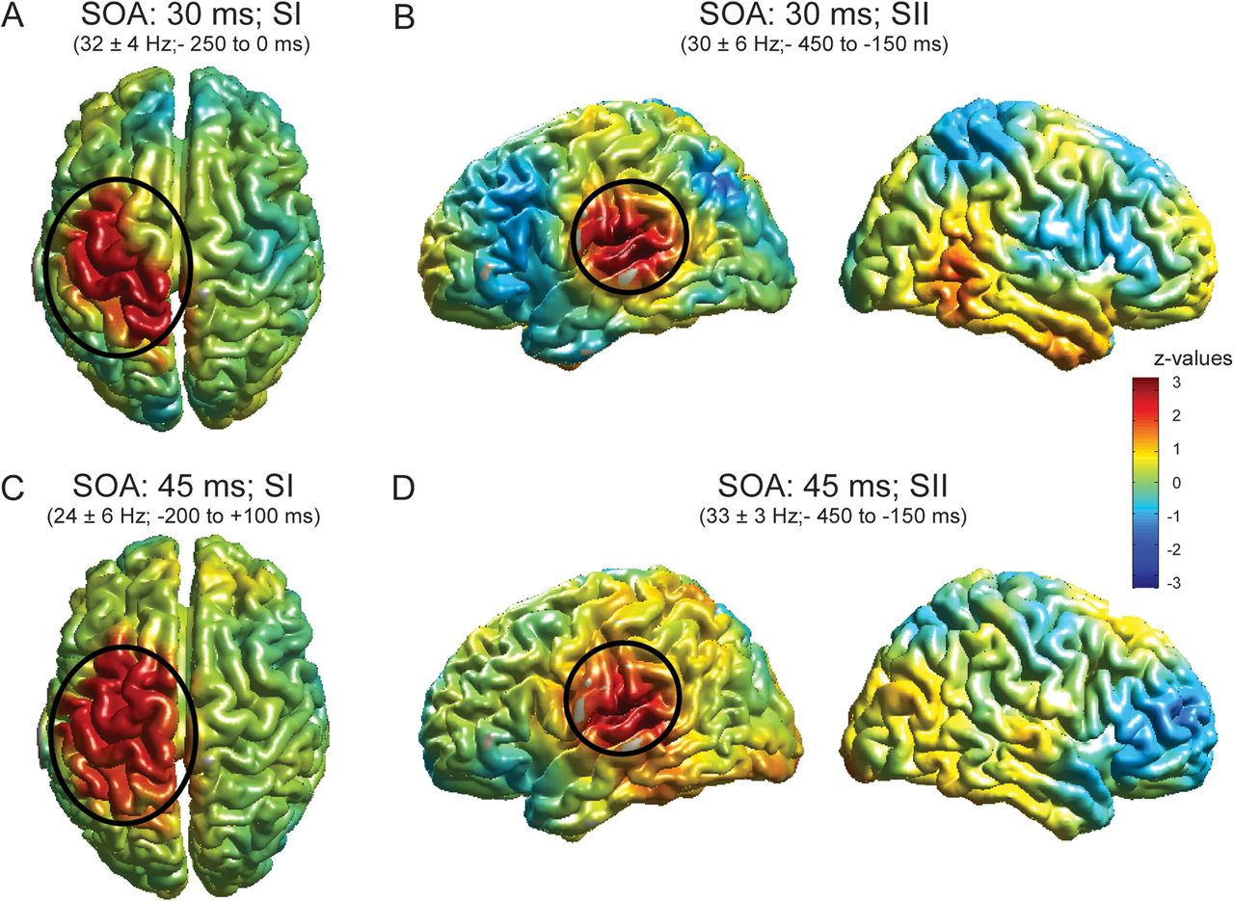
Figure 6. Source analysis of significant clusters as found in Figure 3. The exact time–frequency bands used for source ...
Notes:
Figure 6. Source analysis of significant clusters as found in Figure 3. The exact time–frequency bands used for source reconstruction are based on significant clusters in Figure 3 and are presented at the top of each figure. (A) Results for the significant cluster in the beta band for condition SOA 30 ms (as highlighted in Fig. 3A). z values in nonsignificant regions are lowered by 60% in order to highlight significant clusters. Additionally, significant clusters are highlighted by ovals. (B) Same as in A but for beta-band effect as highlighted in Figure 3D. Left column: view of the left hemisphere, right column: view of the right hemisphere. (C, D) Same as in A and B but for beta-band effect in SOA 45 ms (as highlighted in Fig. 3G,J). The color bar applies to all figures.
Unless provided in the caption above, the following copyright applies to the content of this slide: © The Author 2011. Published by Oxford University Press. All rights reserved. For permissions, please e-mail: journals.permissions@oup.com

