Slide 1
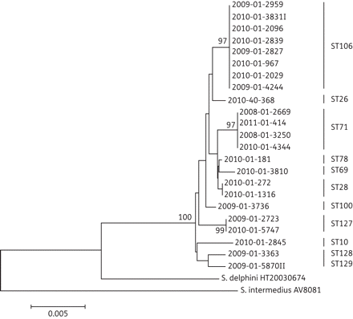
Figure 2. Neighbour-joining and bootstrapping analysis of concatenated sequence alignment consisting of the 16S rDNA, ...
Notes:
Figure 2. Neighbour-joining and bootstrapping analysis of concatenated sequence alignment consisting of the 16S rDNA, agrD, hsp60, pta and tuf gene sequences of all MRSP isolates included in the study. The total length of the sequence alignment was 1844 characters. Only bootstrap values larger than 75 are shown.
Unless provided in the caption above, the following copyright applies to the content of this slide: © The Author 2012. Published by Oxford University Press on behalf of the British Society for Antimicrobial Chemotherapy. All rights reserved. For Permissions, please e-mail: journals.permissions@oup.com

Slide 2
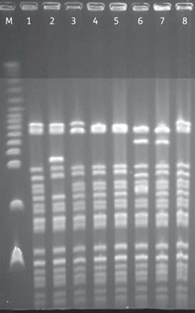
Figure 1. PFGE of eight MRSP isolates belonging to ST106. Lanes: M, lambda ladder; 1–8, MRSP ST106.
Notes:
Figure 1. PFGE of eight MRSP isolates belonging to ST106. Lanes: M, lambda ladder; 1–8, MRSP ST106.
Unless provided in the caption above, the following copyright applies to the content of this slide: © The Author 2012. Published by Oxford University Press on behalf of the British Society for Antimicrobial Chemotherapy. All rights reserved. For Permissions, please e-mail: journals.permissions@oup.com

Slide 3
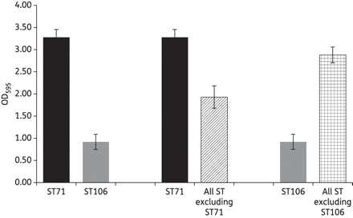
Figure 3. Average biofilm production of MRSP isolates. Results are given as the mean OD₅₉₅ and SEM based on ...
Notes:
Figure 3. Average biofilm production of MRSP isolates. Results are given as the mean OD595 and SEM based on three independent experiments. Left: all isolates belonging to ST71 and all isolates belonging to ST106. Middle: all isolates belonging to ST71 and all other MRSP isolates included in the study (striped column). Right: all isolates belonging to ST106 and all other MRSP isolates included in the study.
Unless provided in the caption above, the following copyright applies to the content of this slide: © The Author 2012. Published by Oxford University Press on behalf of the British Society for Antimicrobial Chemotherapy. All rights reserved. For Permissions, please e-mail: journals.permissions@oup.com

