Slide 1
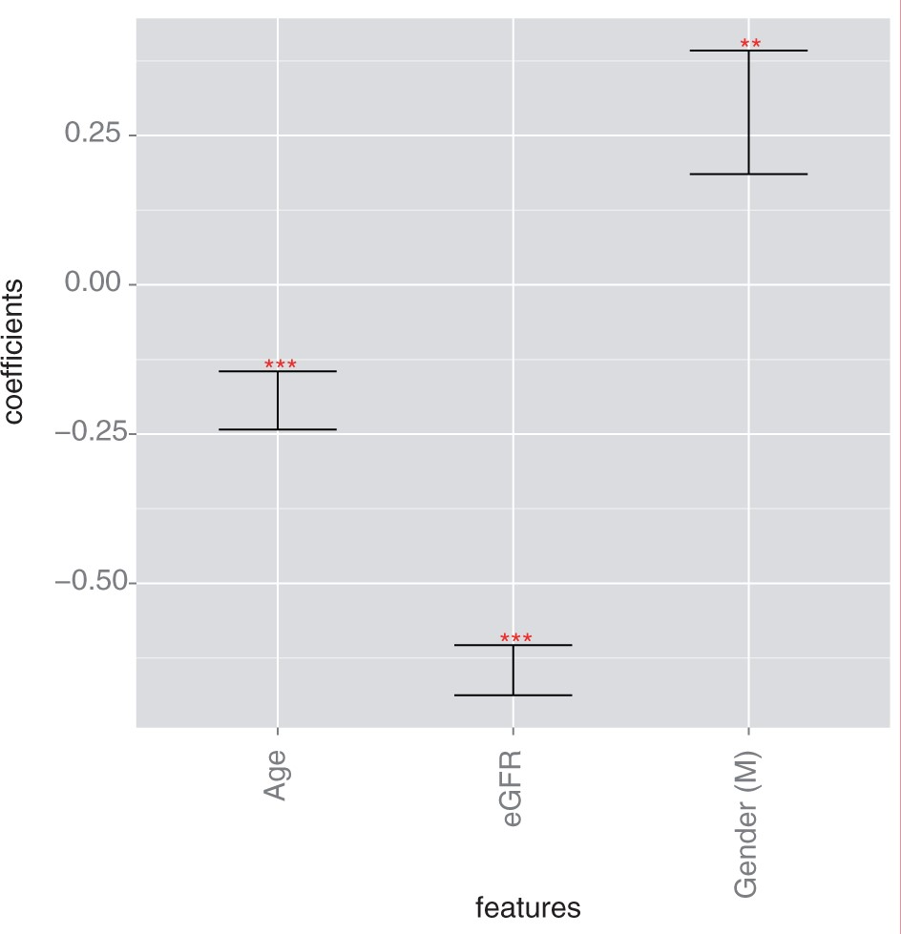
Figure 1: Log hazard ratios for the eGFR Model. Progression of CKD from stage III to stage IV in this model was ...
Notes:
Figure 1: Log hazard ratios for the eGFR Model. Progression of CKD from stage III to stage IV in this model was associated with low eGFR (P < .001), male gender (P = .0051), and younger age (P < .001). (* indicates P < .05, ** indicates P < .01, *** indicates P < .001).
Unless provided in the caption above, the following copyright applies to the content of this slide: © The Author 2015. Published by Oxford University Press on behalf of the American Medical Informatics Association.This is an Open Access article distributed under the terms of the Creative Commons Attribution Non-Commercial License (http://creativecommons.org/licenses/by-nc/4.0/), which permits non-commercial re-use, distribution, and reproduction in any medium, provided the original work is properly cited. For commercial re-use, please contact journals.permissions@oup.com

Slide 2
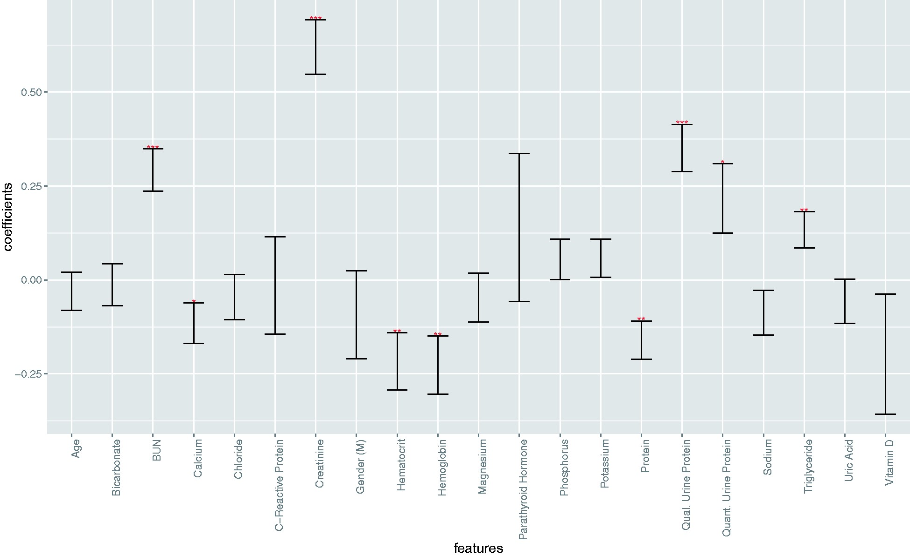
Figure 2. Log hazard ratios for the Recent Laboratory Tests Model. Progression of CKD from stage III to stage IV in ...
Notes:
Figure 2. Log hazard ratios for the Recent Laboratory Tests Model. Progression of CKD from stage III to stage IV in this model was associated with elevated levels of BUN (P < .001), creatinine (P < .001), triglycerides (P = .0061), and urine protein (quantitative, P = .019; qualitative, P < .001) as well as decreased levels of hematocrit (P = .0043), hemoglobin (P = .0034), calcium (P = .033), and serum protein (P = .0017). (* indicates P < .05, ** indicates P < .01, *** indicates P < .001).
Unless provided in the caption above, the following copyright applies to the content of this slide: © The Author 2015. Published by Oxford University Press on behalf of the American Medical Informatics Association.This is an Open Access article distributed under the terms of the Creative Commons Attribution Non-Commercial License (http://creativecommons.org/licenses/by-nc/4.0/), which permits non-commercial re-use, distribution, and reproduction in any medium, provided the original work is properly cited. For commercial re-use, please contact journals.permissions@oup.com

