Slide 1
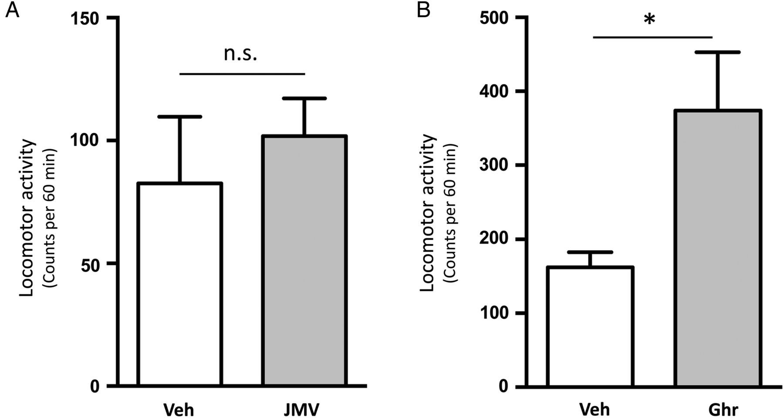
Fig. 1. Effects of sub-chronic ghrelin treatment and GHS-R1A antagonist treatment on locomotor activity in mice. (A) ...
Notes:
Fig. 1. Effects of sub-chronic ghrelin treatment and GHS-R1A antagonist treatment on locomotor activity in mice. (A) Sub-chronic GHR-R1A antagonist, JMV2959 (JMV), treatment (6 mg/kg iIP) has no effect on locomotor activity compared with vehicle treatment. (B) Sub-chronic ghrelin (Ghr) treatment (0.33 mg/kg IP) causes a locomotor sensitization compared with vehicle treatment. Data are presented as mean ± SEM (*P 0.05).
Unless provided in the caption above, the following copyright applies to the content of this slide: © The Author 2015. Medical Council on Alcohol and Oxford University Press. All rights reserved

Slide 2
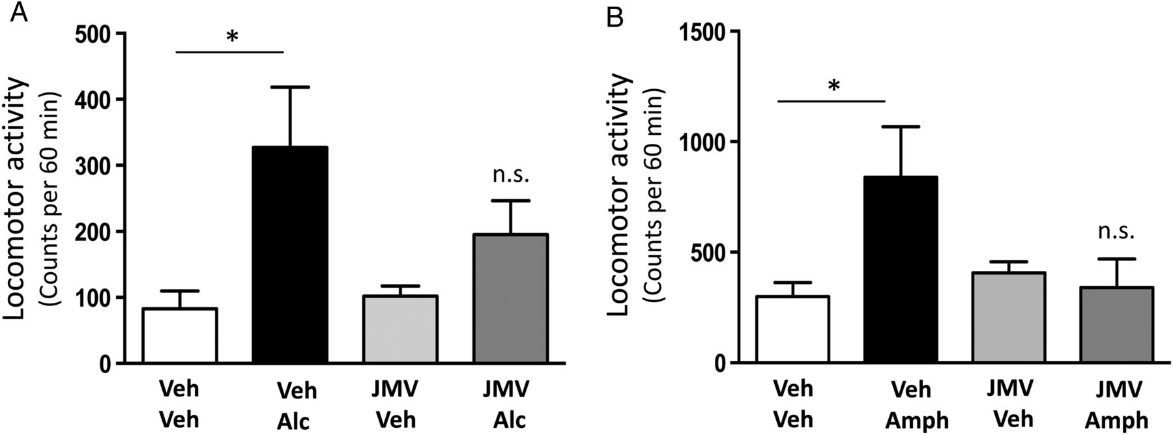
Fig. 2. Effects of sub-chronic GHS-R1A antagonist treatment on acute alcohol- and amphetamine-induced locomotor ...
Notes:
Fig. 2. Effects of sub-chronic GHS-R1A antagonist treatment on acute alcohol- and amphetamine-induced locomotor stimulation in mice. (A) Sub-chronic GHR-R1A antagonist, JMV2959 (JMV), treatment (6 mg/kg IP) attenuates the ability of acute alcohol administration (Alc, 1.75 g/kg IP) to cause a locomotor stimulation in mice. (B) Sub-chronic GHR-R1A antagonist, JMV2959 (JMV), treatment (6 mg/kg IP) attenuates the ability of acute amphetamine administration (Amph, 2 mg/kg IP) to cause a locomotor stimulation in mice. Data are presented as mean ± SEM (*P 0.05).
Unless provided in the caption above, the following copyright applies to the content of this slide: © The Author 2015. Medical Council on Alcohol and Oxford University Press. All rights reserved

