Slide 1
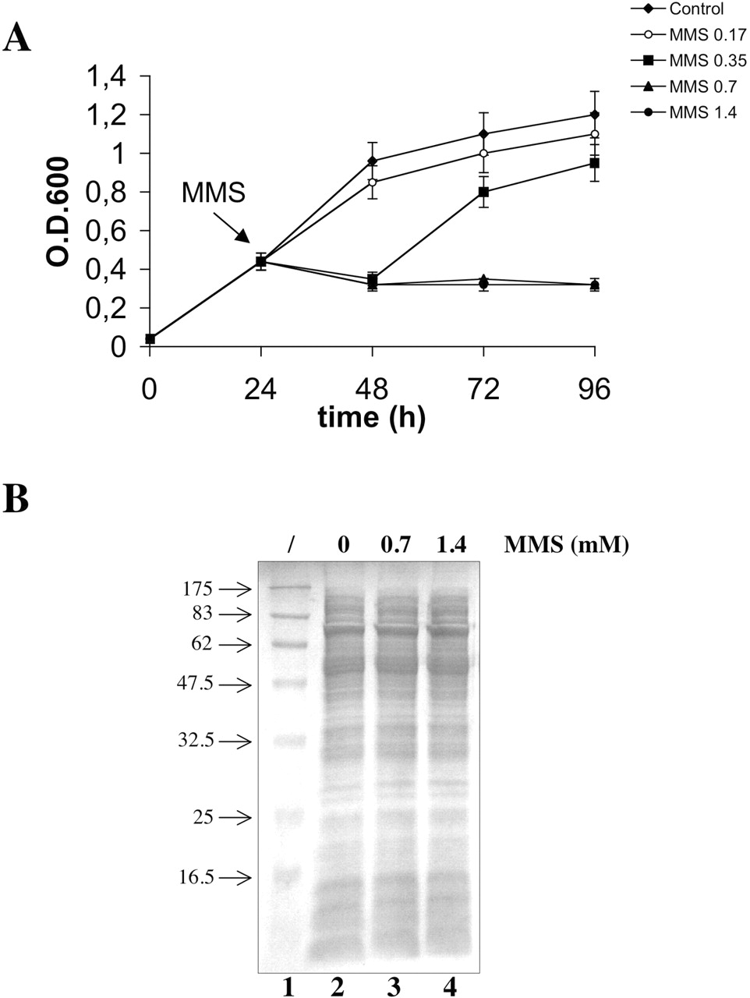
Figure 1 Effects of MMS treatment on S.solfataricus . ( A ) S.solfataricus P2 cultures were grown at 80°C until the ...
Notes:
Figure 1 Effects of MMS treatment on S.solfataricus . ( A ) S.solfataricus P2 cultures were grown at 80°C until the exponential phase; at the time indicated by the arrow, cultures were split and MMS was added to each aliquot at the indicated concentrations; one aliquot was mock-treated. Absorbance at 600 nm was measured at indicated time points. Values from five independent experiments are reported. ( B ) Coomassie-stained SDS–PAGE of total proteins (60 µg/lane) extracted 2 h after treatment with indicated MMS concentrations. Lane 1, molecular weight marker (kDa).
Unless provided in the caption above, the following copyright applies to the content of this slide: © The Author 2006. Published by Oxford University Press. All rights reserved The online version of this article has been published under an open access model. Users are entitled to use, reproduce, disseminate, or display the open access version of this article for non-commercial purposes provided that: the original authorship is properly and fully attributed; the Journal and Oxford University Press are attributed as the original place of publication with the correct citation details given; if an article is subsequently reproduced or disseminated not in its entirety but only in part or as a derivative work this must be clearly indicated. For commercial re-use, please contact journals.permissions@oxfordjournals.org

Slide 2
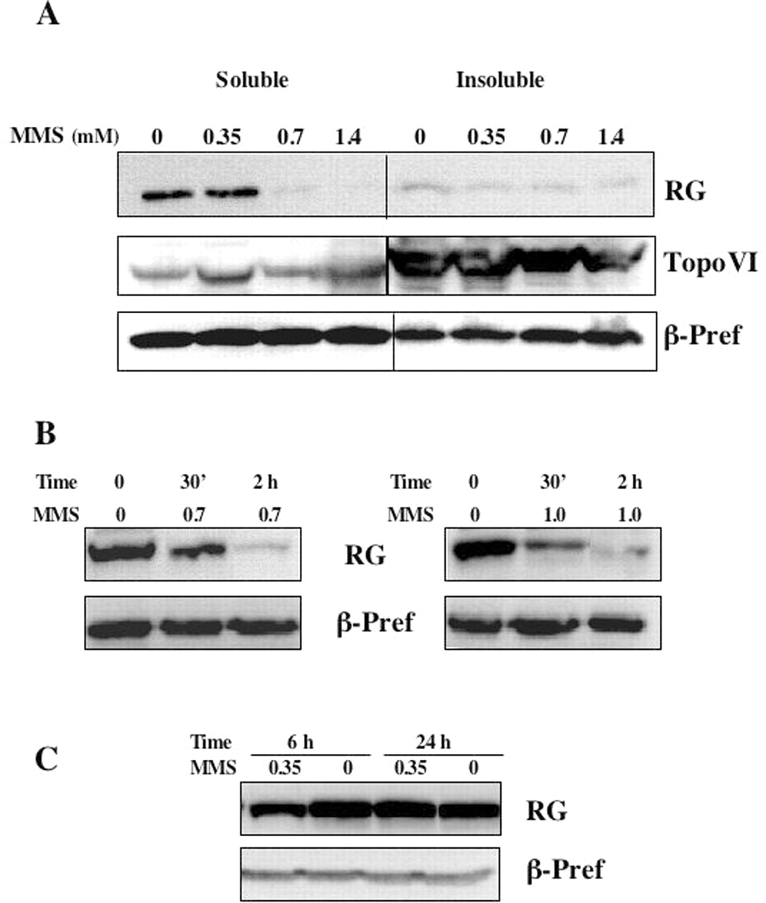
Figure 2 MMS treatment induces reverse gyrase loss. ( A ) Western blot of soluble and insoluble protein extracts (200 ...
Notes:
Figure 2 MMS treatment induces reverse gyrase loss. ( A ) Western blot of soluble and insoluble protein extracts (200 µg/lane) prepared from cultures treated with MMS at the indicated concentrations. Extracts were prepared 2 h after MMS or mock treatment. The same filter was stripped and probed with antibodies against the indicated proteins. ( B and C ) Reverse gyrase level in soluble extracts (200 µg/lane) prepared from controls and cultures treated with the indicated MMS concentrations (mM) at the indicated time points. The same filters were stripped and probed with the anti β-prefoldin antibody.
Unless provided in the caption above, the following copyright applies to the content of this slide: © The Author 2006. Published by Oxford University Press. All rights reserved The online version of this article has been published under an open access model. Users are entitled to use, reproduce, disseminate, or display the open access version of this article for non-commercial purposes provided that: the original authorship is properly and fully attributed; the Journal and Oxford University Press are attributed as the original place of publication with the correct citation details given; if an article is subsequently reproduced or disseminated not in its entirety but only in part or as a derivative work this must be clearly indicated. For commercial re-use, please contact journals.permissions@oxfordjournals.org

Slide 3
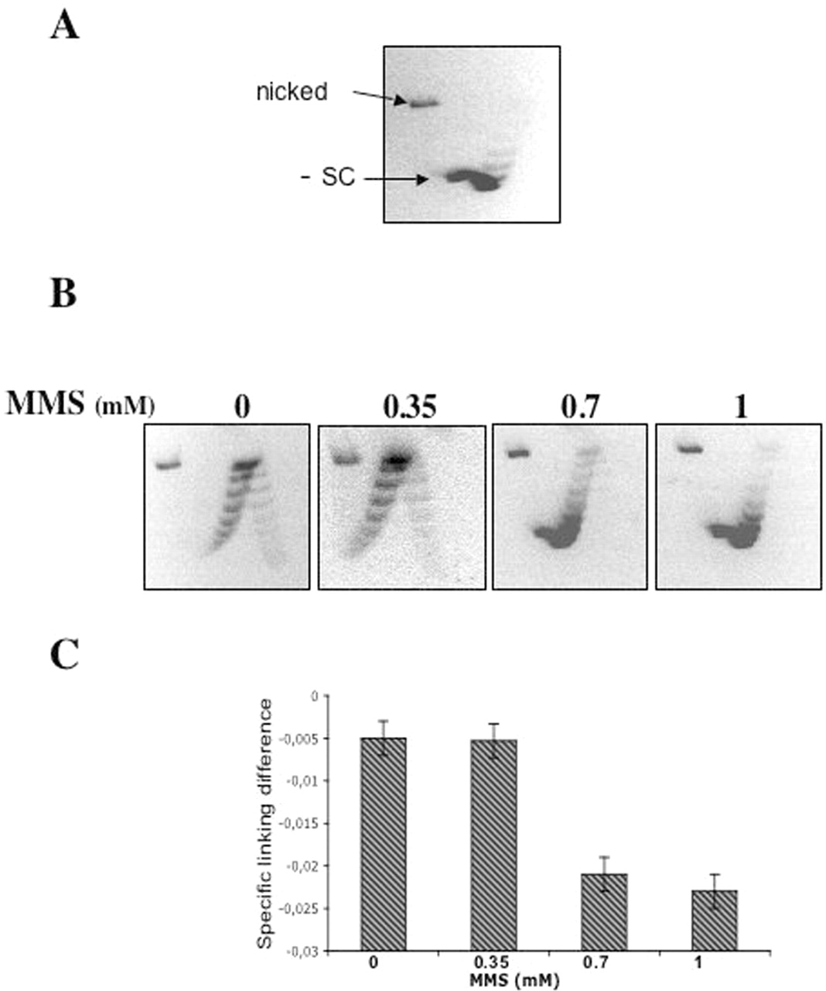
Figure 3 Reverse gyrase activity in cell extracts after MMS treatment. ( A ) 2D gel showing the migration of the ...
Notes:
Figure 3 Reverse gyrase activity in cell extracts after MMS treatment. ( A ) 2D gel showing the migration of the substrate, pGEM7 plasmid DNA; arrows indicate the position of the nicked and negatively supercoiled (−SC) plasmid forms. ( B ) Positive supercoiling activity in soluble cell extracts prepared from cultures treated with MMS at the indicated concentrations. Extracts were prepared 2 h after MMS or mock treatment. Each sample contained 5 µg of protein (final concentration 0.25 mg/ml). Negative and positive topoisomers migrate at the left and right part of the arc, respectively. Representative gel out of three independent assays is shown. ( C ) Quantification of reverse gyrase activity; the mean specific linking difference (mean σ) was calculated as described in Materials and Methods. Values are the mean of three independent experiments.
Unless provided in the caption above, the following copyright applies to the content of this slide: © The Author 2006. Published by Oxford University Press. All rights reserved The online version of this article has been published under an open access model. Users are entitled to use, reproduce, disseminate, or display the open access version of this article for non-commercial purposes provided that: the original authorship is properly and fully attributed; the Journal and Oxford University Press are attributed as the original place of publication with the correct citation details given; if an article is subsequently reproduced or disseminated not in its entirety but only in part or as a derivative work this must be clearly indicated. For commercial re-use, please contact journals.permissions@oxfordjournals.org

Slide 4
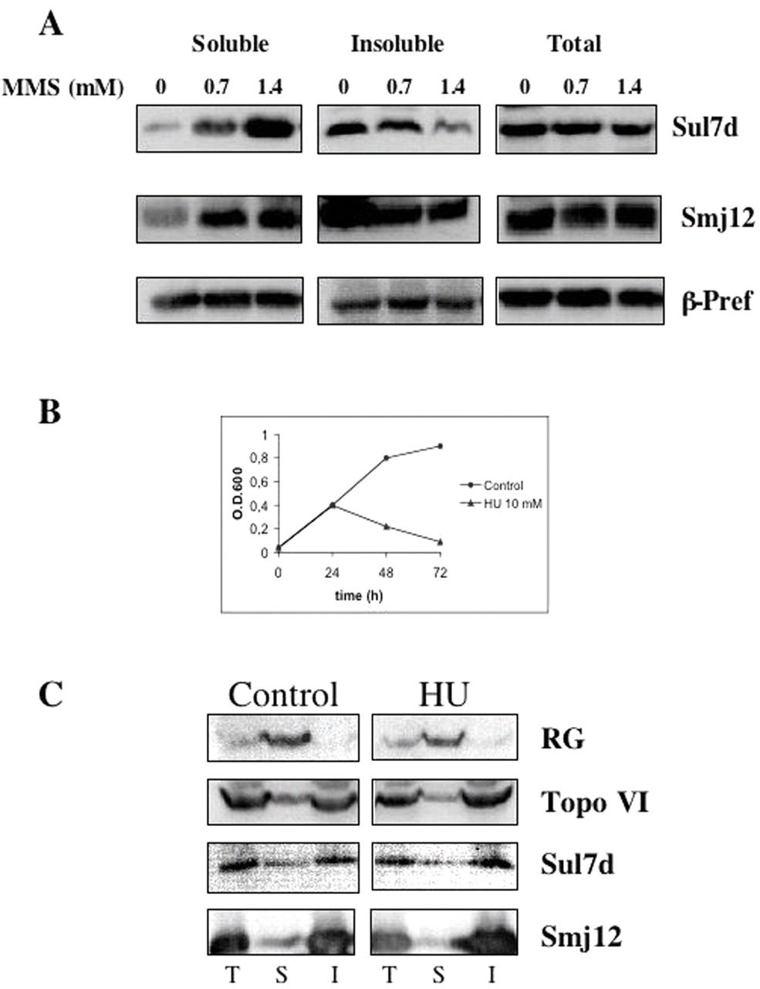
Figure 4 ( A ) Chromatin proteins are not depleted after MMS treatment. Western blot of total, soluble and insoluble ...
Notes:
Figure 4 ( A ) Chromatin proteins are not depleted after MMS treatment. Western blot of total, soluble and insoluble protein extracts (200 µg/lane) prepared from cultures treated with MMS at the indicated concentrations. Extracts were prepared 2 h after MMS or mock treatment. The same filter was stripped and probed with antibodies against the indicated proteins. ( B ) S.solfataricus P2 cultures were grown at 80°C until the exponential phase; at the time indicated by the arrow, cultures were split and 10 mM HU was added to one aliquot; absorbance at 600 nm was measured at indicated time points. ( C ) Western blot of total (T), soluble (S) and insoluble (I) protein extracts (200 µg/lane) prepared from cultures treated with 10 mM HU. Extracts were prepared 2 h after HU or mock treatment. The same filter was stripped and probed with antibodies against the indicated proteins.
Unless provided in the caption above, the following copyright applies to the content of this slide: © The Author 2006. Published by Oxford University Press. All rights reserved The online version of this article has been published under an open access model. Users are entitled to use, reproduce, disseminate, or display the open access version of this article for non-commercial purposes provided that: the original authorship is properly and fully attributed; the Journal and Oxford University Press are attributed as the original place of publication with the correct citation details given; if an article is subsequently reproduced or disseminated not in its entirety but only in part or as a derivative work this must be clearly indicated. For commercial re-use, please contact journals.permissions@oxfordjournals.org

Slide 5
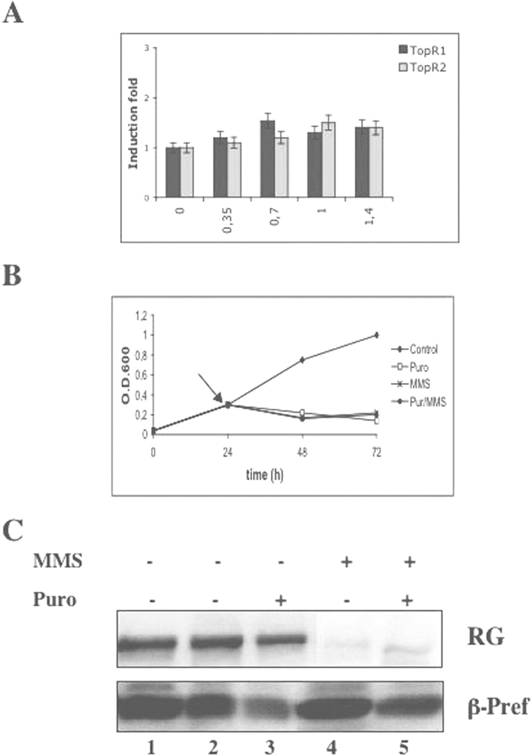
Figure 5 ( A ) Reverse gyrase loss is a post-translational event. Relative mRNA levels for TopR1 and TopR2 in cells ...
Notes:
Figure 5 ( A ) Reverse gyrase loss is a post-translational event. Relative mRNA levels for TopR1 and TopR2 in cells treated with the indicated MMS concentrations (mM) were determined using real-time RT–PCR. Total RNA was extracted after 2 h of treatment. Data were normalized to the expression level of 16S rRNA and expressed as the relative mRNA level compared with the average expression level in control cells. ( B ) S.solfataricus P2 cultures were grown at 80°C until the exponential phase; at the time indicated by the arrow, cultures were split and 50 µg/ml of puromycin was added to one aliquot at the time point indicated by the arrow. After 30 min, control and puromycin-treated aliquots were split again and 1 mM MMS was added to one half of each aliquot. Absorbance at 600 nm was measured at the indicated time points. ( C ) Western blot of soluble protein extracts (200 µg/lane) prepared from cultures treated with indicated drugs. Lane 1, extracts from controls before puromycin addition; lane 2, extracts from controls after 2.5 h of mock treatment; lane 3, extracts from cultures treated with puromycin for 2.5 h; lane 4, extracts from cultures treated with 1 mM MMS for 2 h; lane 5, extracts from cultures treated with puromycin for 30 min followed by 1 mM MMS for 2 h. The same filter was probed with antibodies against the indicated proteins.
Unless provided in the caption above, the following copyright applies to the content of this slide: © The Author 2006. Published by Oxford University Press. All rights reserved The online version of this article has been published under an open access model. Users are entitled to use, reproduce, disseminate, or display the open access version of this article for non-commercial purposes provided that: the original authorship is properly and fully attributed; the Journal and Oxford University Press are attributed as the original place of publication with the correct citation details given; if an article is subsequently reproduced or disseminated not in its entirety but only in part or as a derivative work this must be clearly indicated. For commercial re-use, please contact journals.permissions@oxfordjournals.org

Slide 6
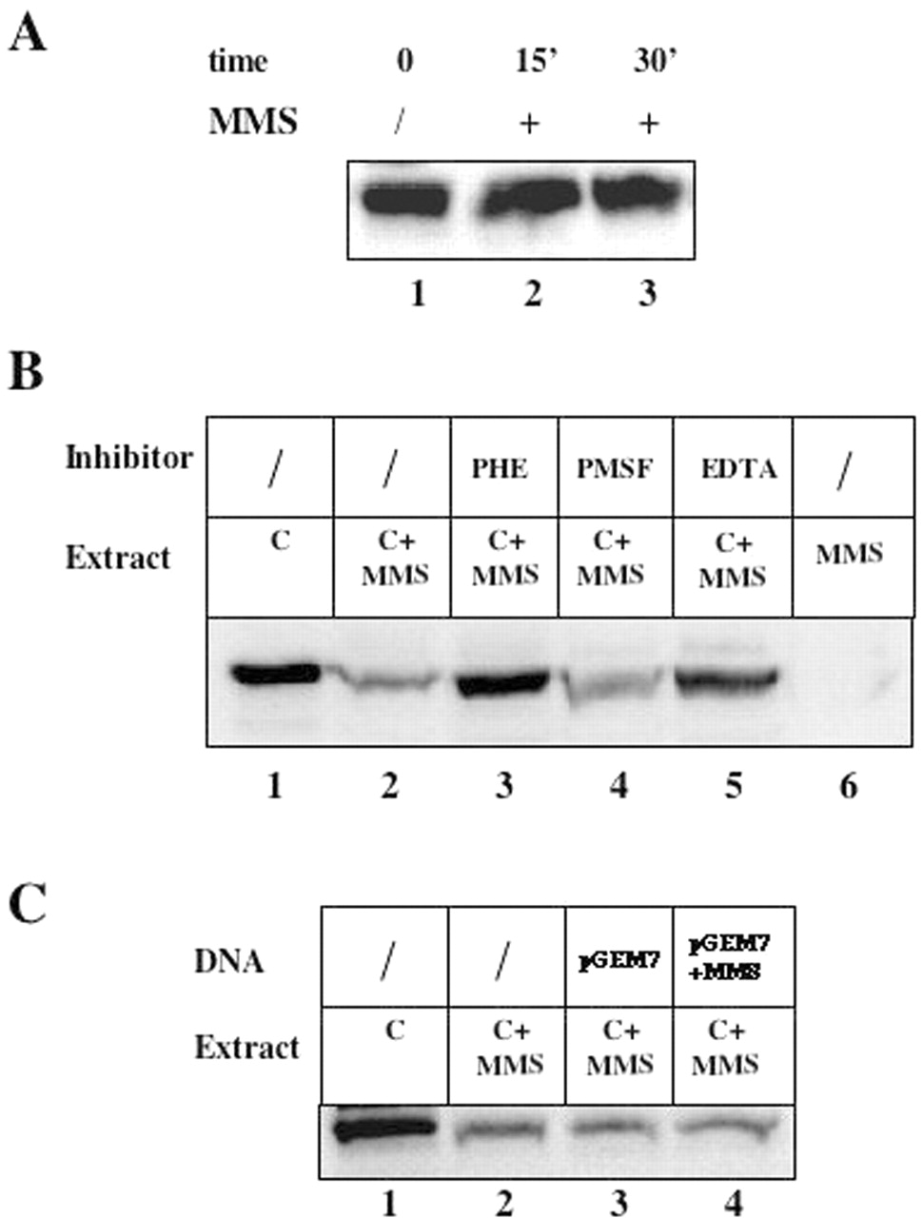
Figure 6 Reverse gyrase is degraded by a metal-dependent protease. ( A ) Soluble protein extracts (200 µg/lane) ...
Notes:
Figure 6 Reverse gyrase is degraded by a metal-dependent protease. ( A ) Soluble protein extracts (200 µg/lane) prepared form control cells were incubated at 80°C with 0 (lane 1) or 1 mM MMS for 15 min (lane 2) or 30 min (lane 3) and reverse gyrase amount was analysed by western blotting. ( B ) Extracts form control cells (200 µg/lane) and extracts from cultures treated with 1 mM MMS for 2 h (200 µg/lane), alone or mixed, were incubated at 70°C for 30 min. Lane 1, extract from control cells; lane 2, extract from control cells + extract from MMS-treated cells; lane 3, as lane 2 with 10 mM 1,10 PHE; lane 4, as lane 2 with 4 mM PMSF; lane 5, as lane 2 but with 5 mM EDTA; lane 6, extracts from MMS-treated cells. The residual reverse gyrase content was analysed by western blotting. ( C ) Extracts form control cells (200 µg/lane) and extracts from cultures treated with 1 mM MMS for 2 h (200 µg/lane) were mixed and incubated at 70°C for for 30 min with or without pGEM7 plasmid DNA (Promega). Lane 1, extract from control cells; lane 2, extract from control cells + extract from MMS-treated cells; lane 3, as lane 2 with 500 ng of untreated pGEM7 plasmid DNA; lane 4, as lane 2 with 500 ng of plasmid DNA pre-treated for 15 min with 1 mM MMS.
Unless provided in the caption above, the following copyright applies to the content of this slide: © The Author 2006. Published by Oxford University Press. All rights reserved The online version of this article has been published under an open access model. Users are entitled to use, reproduce, disseminate, or display the open access version of this article for non-commercial purposes provided that: the original authorship is properly and fully attributed; the Journal and Oxford University Press are attributed as the original place of publication with the correct citation details given; if an article is subsequently reproduced or disseminated not in its entirety but only in part or as a derivative work this must be clearly indicated. For commercial re-use, please contact journals.permissions@oxfordjournals.org

Slide 7
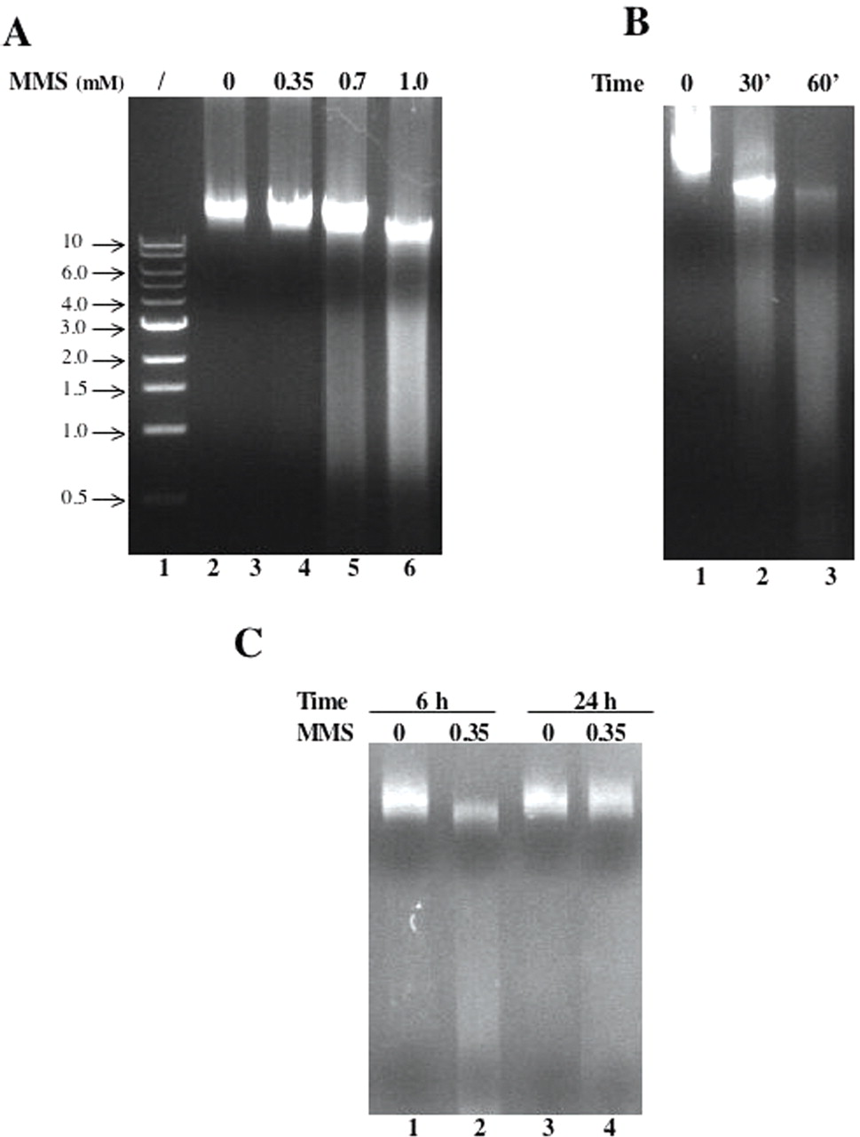
Figure 7 MMS induces degradation of genomic DNA. ( A ) Cultures were grown as in Figure 1 , MMS was added at the ...
Notes:
Figure 7 MMS induces degradation of genomic DNA. ( A ) Cultures were grown as in Figure 1 , MMS was added at the indicated concentrations (mM) and genomic DNA was extracted after 2 h of incubation at 80°C. Samples were run on 1% agarose gels in Tris–Acetate buffer. Lane 1, molecular weight marker (kb). ( B ) Cultures were treated with 1.4 mM MMS and DNA was extracted after indicated time spans of incubation at 80°C. ( C ) Cultures were treated with 0.35 mM MMS and DNA was extracted after 6 or 24 h of incubation at 80°C.
Unless provided in the caption above, the following copyright applies to the content of this slide: © The Author 2006. Published by Oxford University Press. All rights reserved The online version of this article has been published under an open access model. Users are entitled to use, reproduce, disseminate, or display the open access version of this article for non-commercial purposes provided that: the original authorship is properly and fully attributed; the Journal and Oxford University Press are attributed as the original place of publication with the correct citation details given; if an article is subsequently reproduced or disseminated not in its entirety but only in part or as a derivative work this must be clearly indicated. For commercial re-use, please contact journals.permissions@oxfordjournals.org

