Slide 1
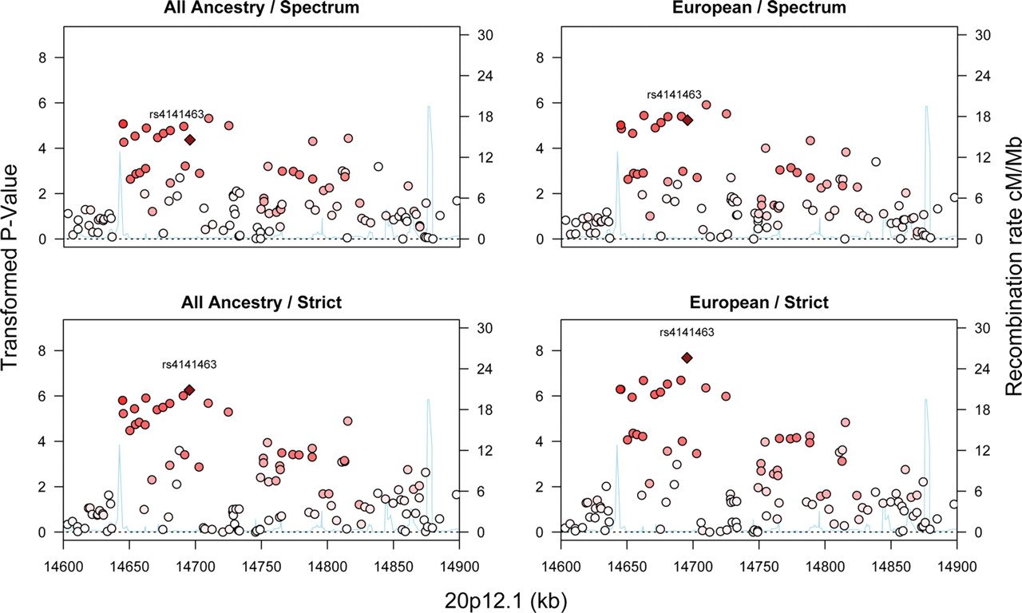
Figure 1. Association results, presented as the −log(base 10) of the P-values, for an intronic region of MACROD2 ...
Notes:
Figure 1. Association results, presented as the −log(base 10) of the P-values, for an intronic region of MACROD2 (20p12.1). The panels show the combinations of two diagnostic levels, strict versus spectrum and any versus European ancestry of the subjects. Recombination rates were calculated using Release 22 of the HapMap CEU Panel.
Unless provided in the caption above, the following copyright applies to the content of this slide: © The Author 2010. Published by Oxford University PressThis is an Open Access article distributed under the terms of the Creative Commons Attribution Non-Commercial License (http://creativecommons.org/licenses/by-nc/2.5), which permits unrestricted non-commercial use, distribution, and reproduction in any medium, provided the original work is properly cited.

