Slide 1
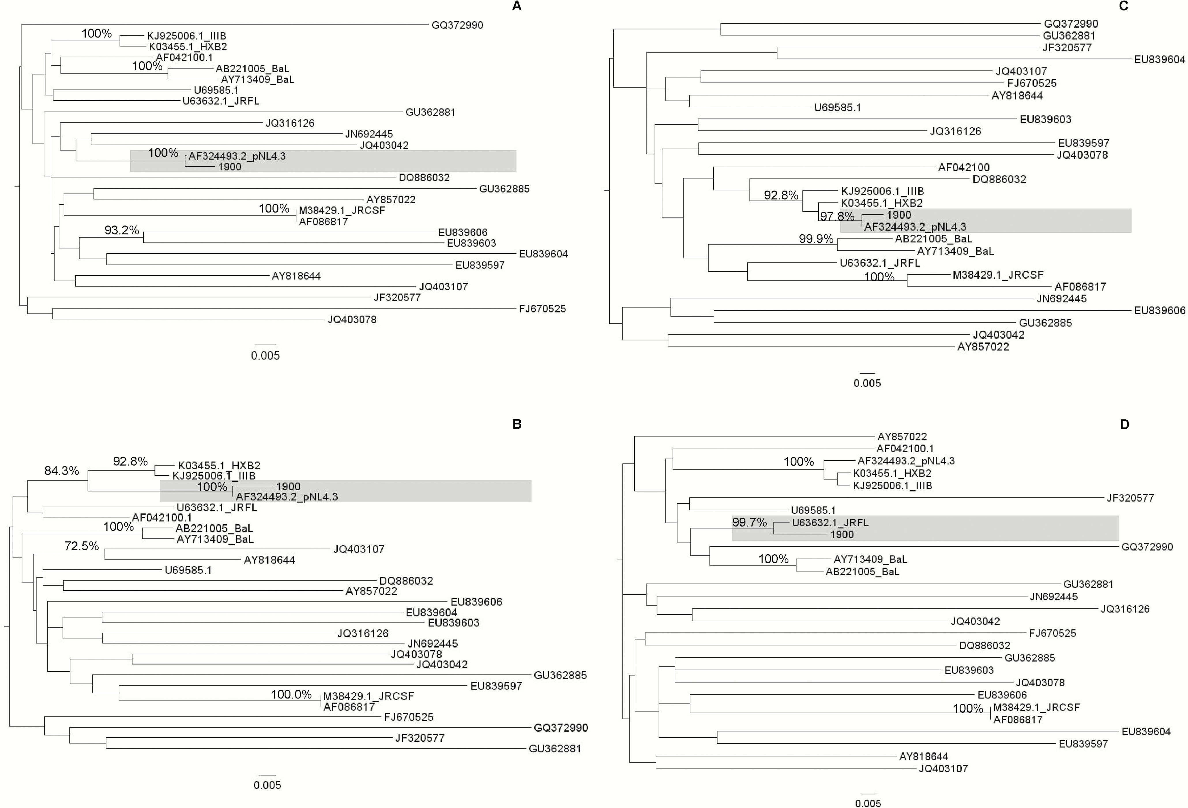
Figure 1. Phylogenetic trees. A, Full-length sequences encoding for the long terminal repeat (LTR)-5’ and the ...
Notes:
Figure 1. Phylogenetic trees. A, Full-length sequences encoding for the long terminal repeat (LTR)-5’ and the structural proteins Gag-Pol (nucleotide [nt] 5007), corresponding to nt 89 through nt 5096 in reference strain HXB2 (GenBank accession number K03455.1). B, Full-length sequences encoding for the regulatory proteins Vif, Vpr, Vpu, and Tat/Rev (first exon) (nt 1145), corresponding to nt 5097 through nt 6224 in reference strain HXB2 (GenBank accession number K03455.1). C, Full-length sequences encoding for the regulatory protein Nef and the LTR-3’ (nt 762), corresponding to nt 8797 through nt 9559 in reference strain HXB2 (GenBank accession number K03455.1). D, Full-length sequences encoding for the Env polyprotein (nt 2463), and Tat/Rev (second exon), corresponding to nt 6225 through nt 8796 in reference strain HXB2 (GenBank accession number K03455.1). The maximum likelihood tree was inferred by using the PhyML program. Only bootstrap supports >70% are shown. The tree was rooted using a midpoint rooting. Gray boxes define the cluster involving the patient’s virus, identified by the number 1900.
Unless provided in the caption above, the following copyright applies to the content of this slide: © The Author 2016. Published by Oxford University Press for the Infectious Diseases Society of America. All rights reserved. For permissions, e-mail: journals.permissions@oup.com

