Slide 1
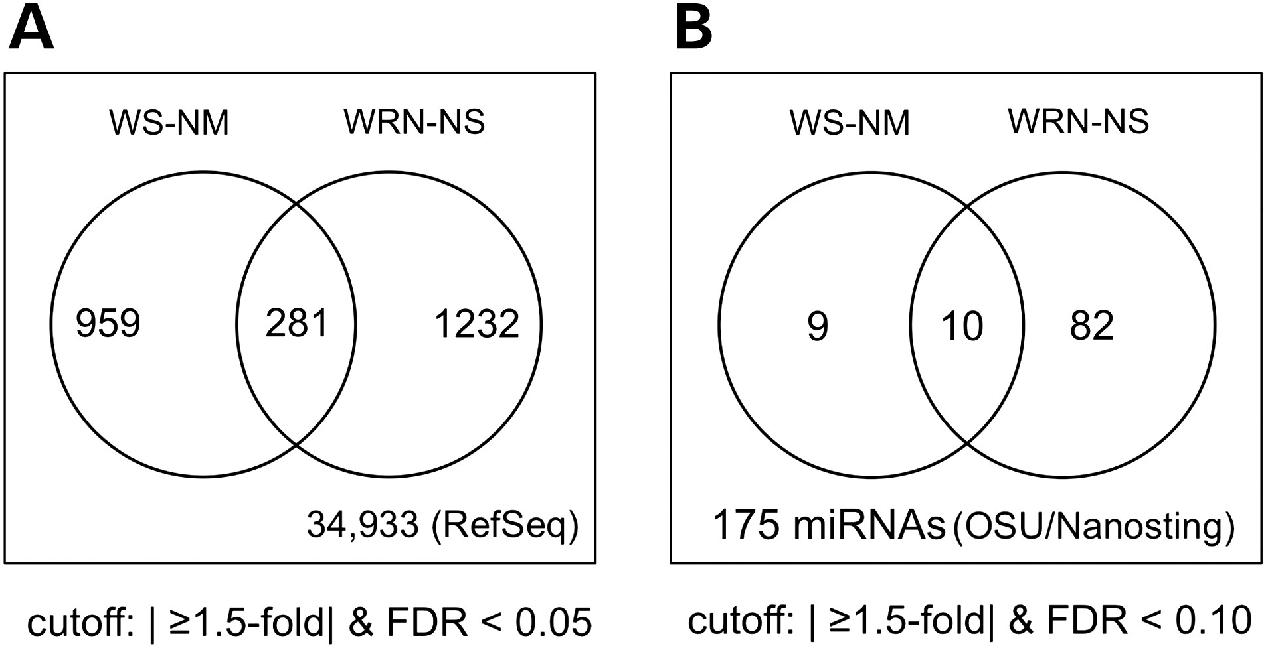
Figure 1. mRNA and miRNA expression patterns distinguish WS patient and WRN-depleted cells. Venn diagrams indicate the ...
Notes:
Figure 1. mRNA and miRNA expression patterns distinguish WS patient and WRN-depleted cells. Venn diagrams indicate the number of mRNAs (A) or miRNAs (B) whose expression was significantly altered in WS patient and/or WRN-depleted human primary fibroblasts.
Unless provided in the caption above, the following copyright applies to the content of this slide: © The Author 2016. Published by Oxford University Press. All rights reserved. For Permissions, please email: journals.permissions@oup.com

Slide 2
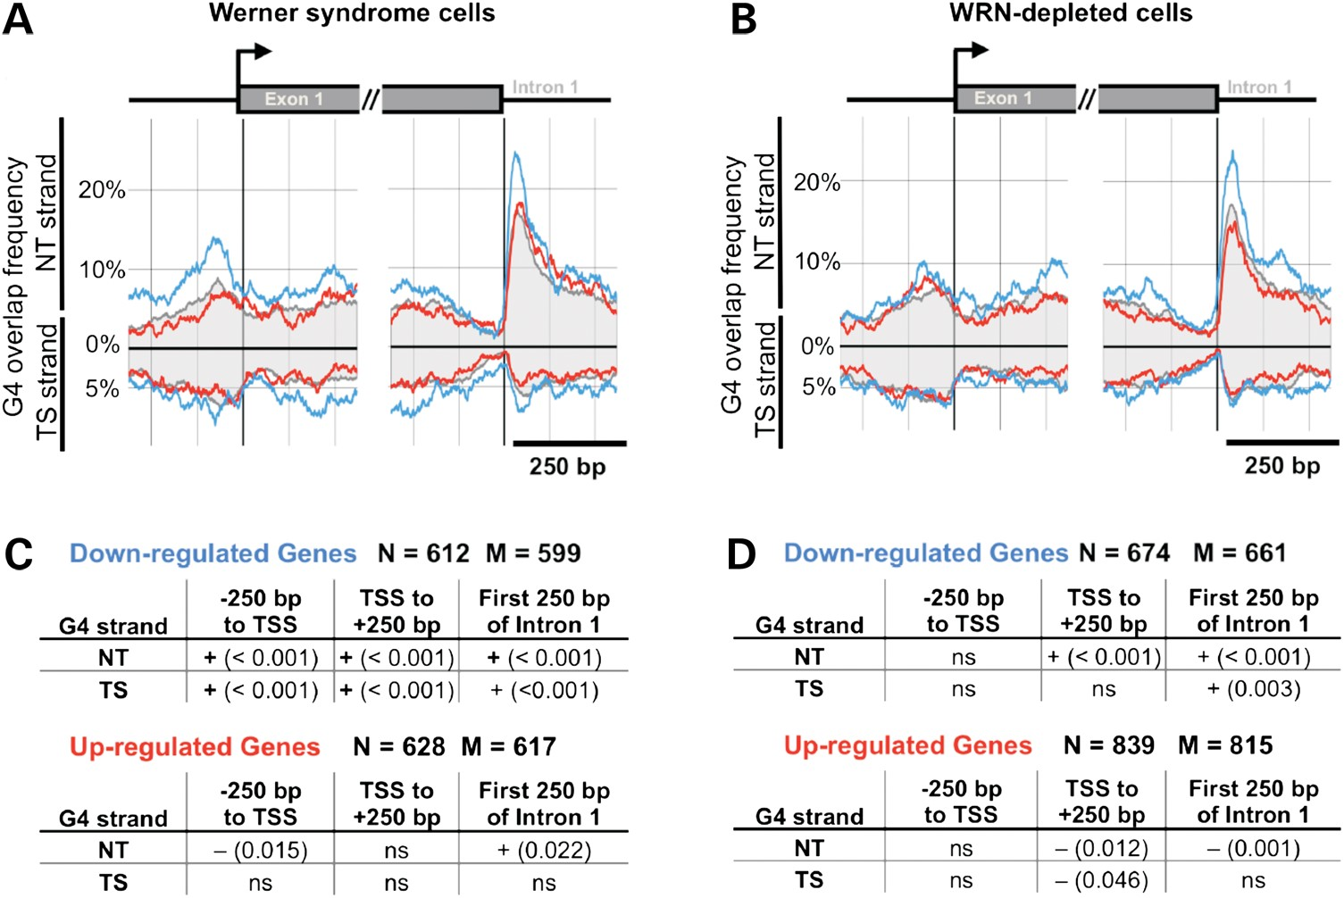
Figure 2. Enrichment of G4 motifs near TSSs and exon 1/intron 1 boundaries of genes exhibiting differential expression ...
Notes:
Figure 2. Enrichment of G4 motifs near TSSs and exon 1/intron 1 boundaries of genes exhibiting differential expression in WS patient or WRN-depleted human fibroblasts. (A and B) G4 motif frequencies as a function of location in genes exhibiting differential regulation in (A) WS patient or (B) WRN-depleted fibroblasts. G4 motif counts relative to the TSS are shown for the NT and transcribed (TS) strand of genes with decreased (blue line) or increased (red line) expression, versus average G4 motif frequencies (gray shaded area) for all genes surveyed. (C and D) Panels indicate FDRs of observed G4 motif frequencies versus randomly selected control gene sets for genes down-regulated or up-regulated in (C) WS patient or (D) WRN-depleted fibroblasts. N = gene accessions in DEG table; M = number of matching TSS locations from gene location tables; ns: non-significant (FDR > 0.05).
Unless provided in the caption above, the following copyright applies to the content of this slide: © The Author 2016. Published by Oxford University Press. All rights reserved. For Permissions, please email: journals.permissions@oup.com

Slide 3
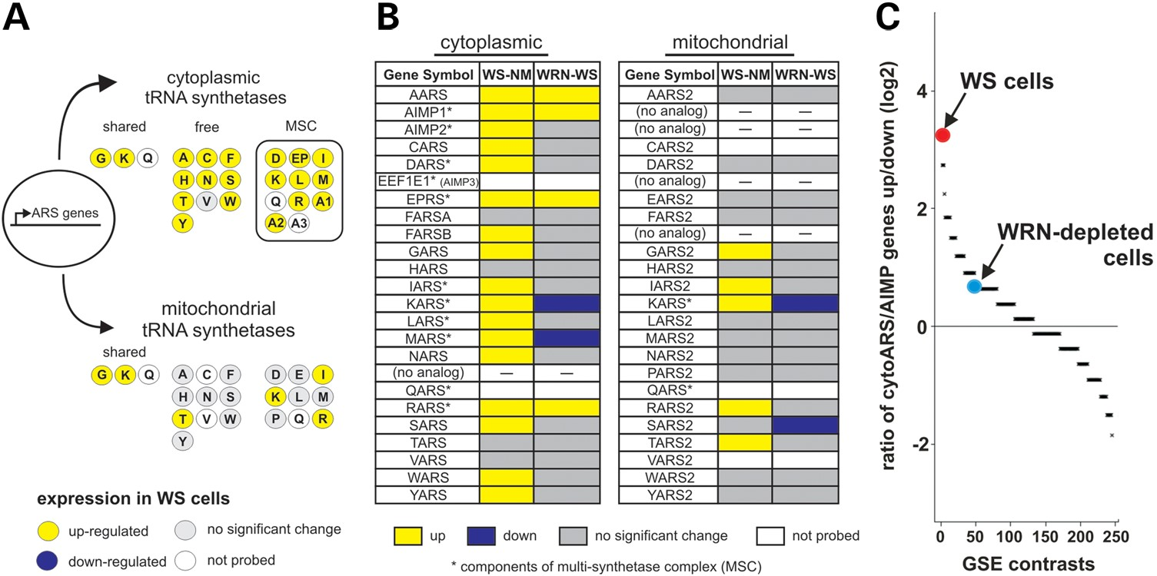
Figure 3. WS patient cells display coordinate increased expression of cytoplasmic tRNA synthetase and AIMP genes. (A) ...
Notes:
Figure 3. WS patient cells display coordinate increased expression of cytoplasmic tRNA synthetase and AIMP genes. (A) tRNA synthetase and AIMP proteins are nuclear-encoded and partitioned to the cytoplasm or mitochondria. Three tRNA synthetases are shared between these compartments: GARS, KARS and QARS. Eleven ARS and AIMP proteins form a large cytoplasmic multisynthase complex (MSC). Individual proteins are represented by circles with single letter amino acid or AIMP number labels. Shading indicates expression level in WS versus control fibroblasts. (B) ARS/AIMP expression in WS (WS-NM) and WRN-depleted (WRN-NS) cells, with directionality for each gene indicated by shading. (C) ARS + AIMP upregulation ratio in WS and WRN-depleted cells versus 56 GEO Series (GSE) data sets, analyzed using three different expression models (see Supplementary Material, Methods for additional detail).
Unless provided in the caption above, the following copyright applies to the content of this slide: © The Author 2016. Published by Oxford University Press. All rights reserved. For Permissions, please email: journals.permissions@oup.com

Slide 4
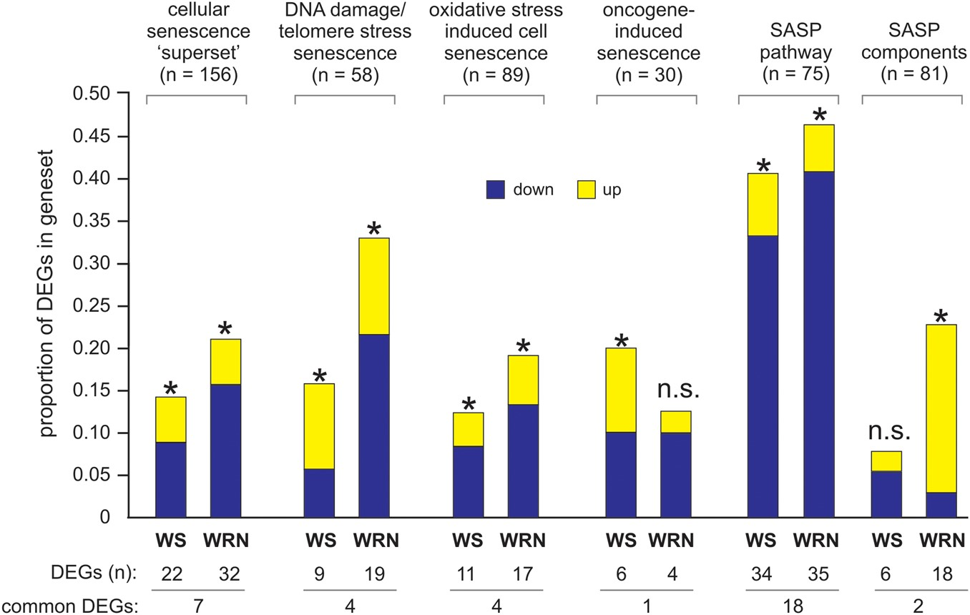
Figure 4. WRN loss perturbs senescence-associated genes and gene sets. Bar graphs indicate the proportion of genes in ...
Notes:
Figure 4. WRN loss perturbs senescence-associated genes and gene sets. Bar graphs indicate the proportion of genes in senescence-associated gene sets that were significantly DEGs in WS patient (WS) or WRN-depleted (WRN) cells. Gene sets and the number of genes in each are indicated over bars shaded to indicate increased (yellow) or decreased (blue) expression in WS or WRN-depleted fibroblasts. GSEA intersect P-values of <0.05 are indicated by asterisks. The number of DEGS/gene set by cell type and the number of DEGs common to both cell types are indicated below the bar graphs. All common (shared) DEGs were regulated in the same direction across all six gene sets.
Unless provided in the caption above, the following copyright applies to the content of this slide: © The Author 2016. Published by Oxford University Press. All rights reserved. For Permissions, please email: journals.permissions@oup.com

