Slide 1
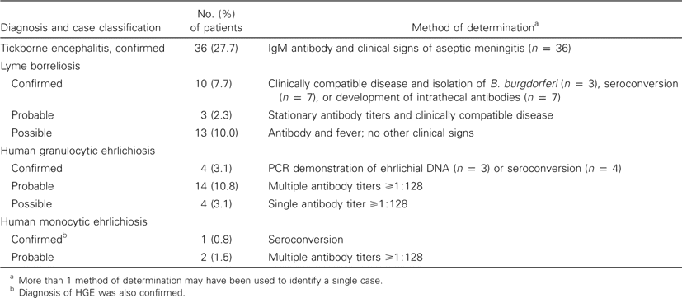
Table 1 Confirmed, probable, and possible etiologies of febrile illnesses following a tick bite for 130 individuals ...
Notes:
Table 1 Confirmed, probable, and possible etiologies of febrile illnesses following a tick bite for 130 individuals in Slovenia.
Unless provided in the caption above, the following copyright applies to the content of this slide: © 2001 by the Infectious Diseases Society of America

Slide 2
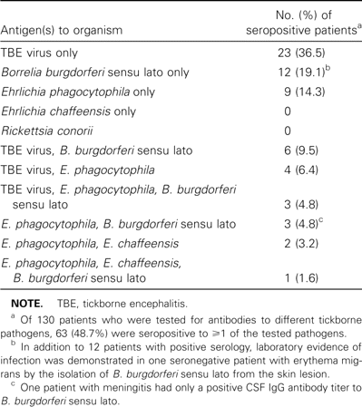
Table 2 Results of serological testing for multiple tickborne pathogens in 130 patients with an acute febrile illness ...
Notes:
Table 2 Results of serological testing for multiple tickborne pathogens in 130 patients with an acute febrile illness following a tick bite.
Unless provided in the caption above, the following copyright applies to the content of this slide: © 2001 by the Infectious Diseases Society of America

Slide 3
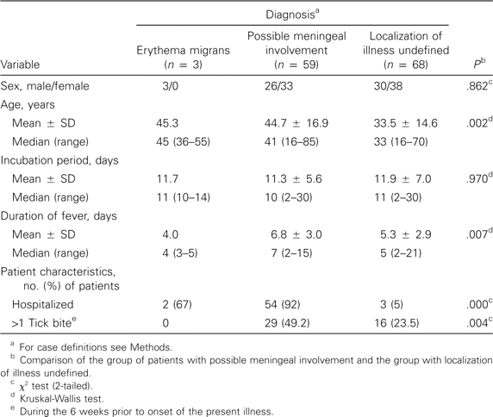
Table 3 Findings for patients with an acute febrile illness following a tick bite.
Notes:
Table 3 Findings for patients with an acute febrile illness following a tick bite.
Unless provided in the caption above, the following copyright applies to the content of this slide: © 2001 by the Infectious Diseases Society of America

Slide 4
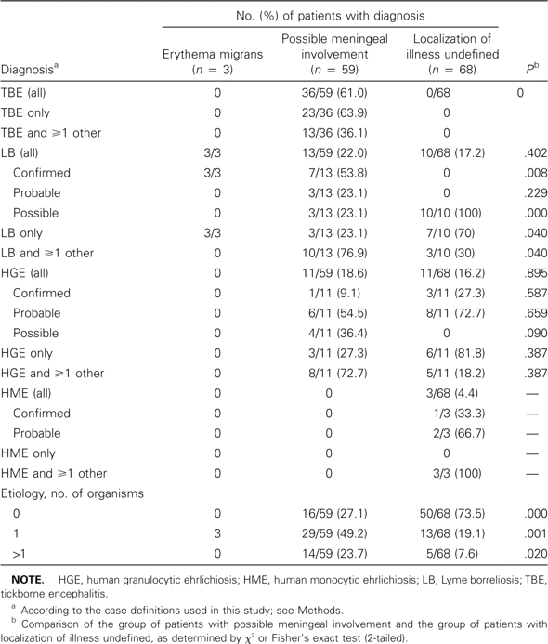
Table 4 Diagnosis according to case definitions of study for patients with an acute febrile illness following a tick ...
Notes:
Table 4 Diagnosis according to case definitions of study for patients with an acute febrile illness following a tick bite.
Unless provided in the caption above, the following copyright applies to the content of this slide: © 2001 by the Infectious Diseases Society of America

