Slide 1
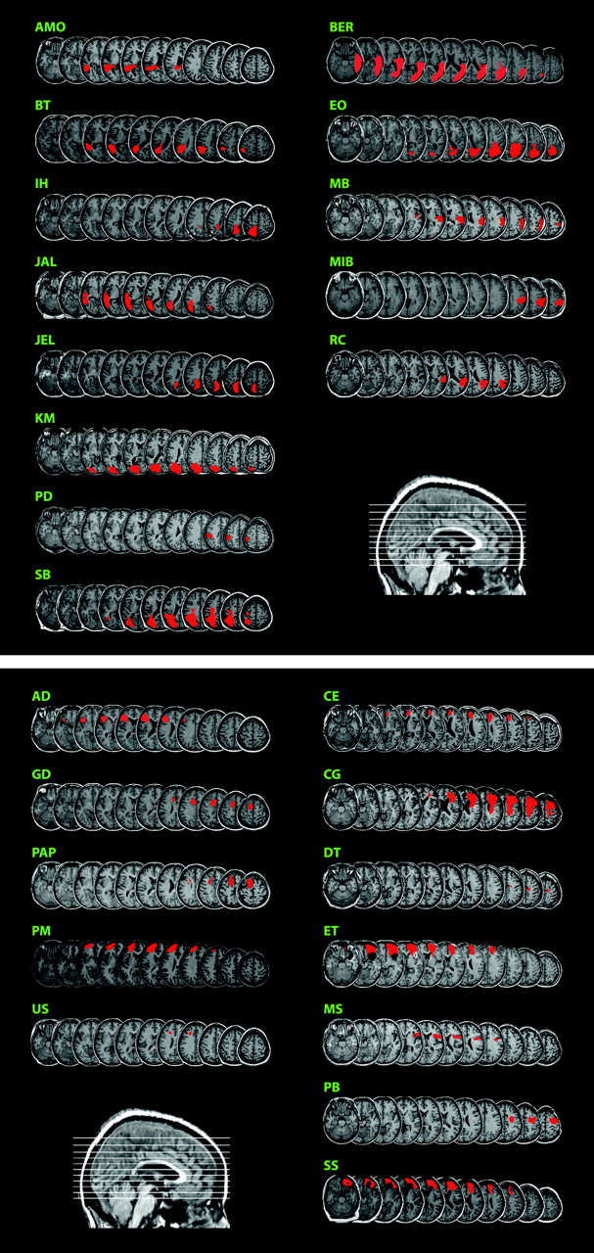
Figure 1. Parietal group lesion drawings. Each patient's lesion is shown in red on a structural MRI of their own brain, ...
Notes:
Figure 1. Parietal group lesion drawings. Each patient's lesion is shown in red on a structural MRI of their own brain, normalized using SPM99 to MNI space. For each patient, axial slices (left hemisphere to the left) are shown at MNI z-levels of −24, −16, −8, 0, 8, 16, 24, 32, 40, 50, and 60 mm (indicated on sagittal midline slice at bottom right of figure). There are eight patients with left hemisphere lesions (left column) and five with right hemisphere lesions (right column). Figure 2. Frontal group lesion drawings. Conventions as Figure 1. There are five patients with left hemisphere lesions (left column) and seven with right hemisphere lesions (right column).
Unless provided in the caption above, the following copyright applies to the content of this slide: © The Author 2005. Published by Oxford University Press. All rights reserved. For permissions, please e-mail: journals.permissions@oupjournals.org

Slide 2
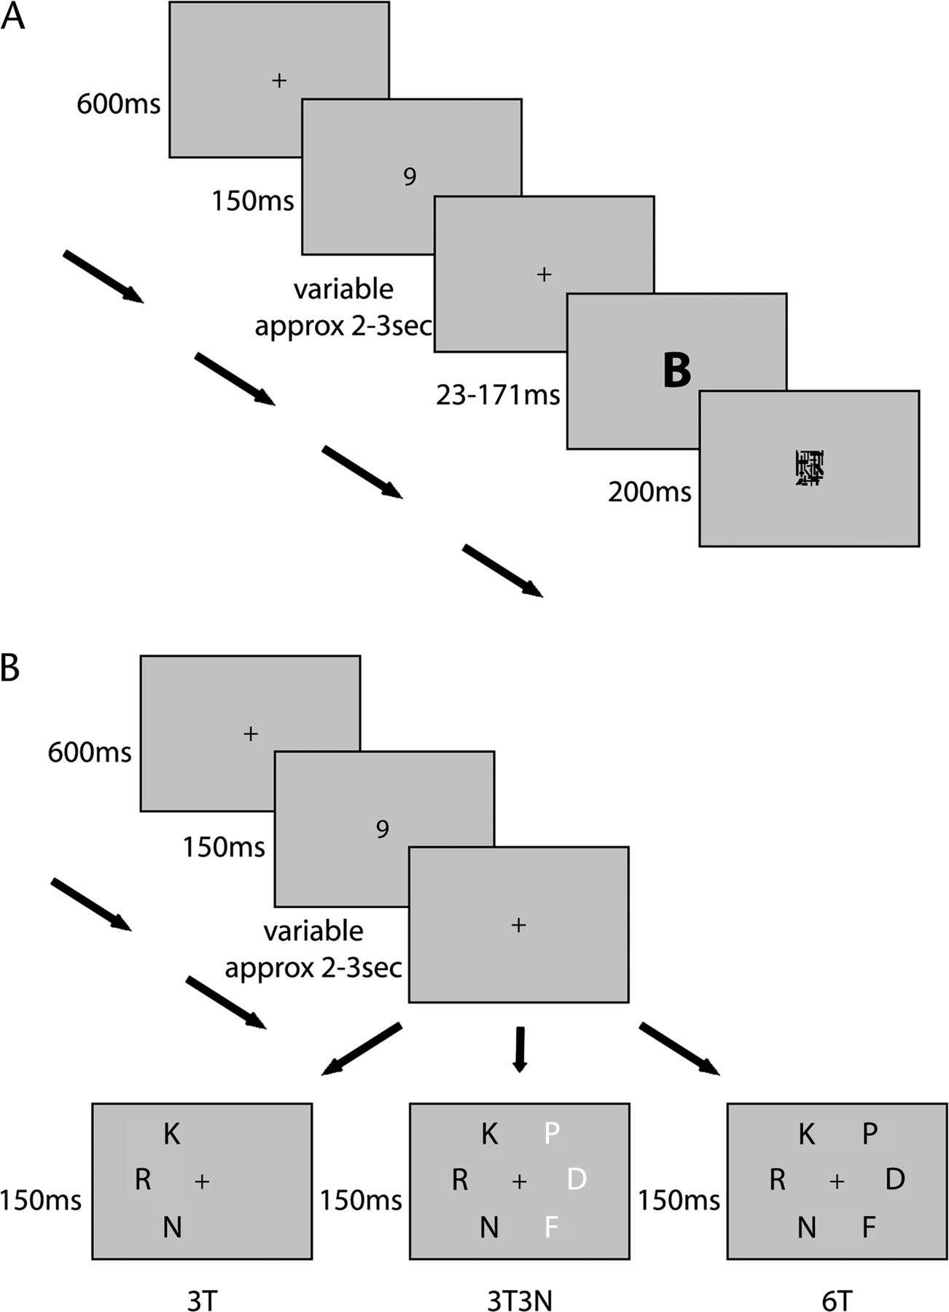
Figure 3. Diagrammatic representations of the experimental tasks. (A) Example trial of the single letter processing ...
Notes:
Figure 3. Diagrammatic representations of the experimental tasks. (A) Example trial of the single letter processing task. The first task on each trial was identify an unmasked digit. This task was included simply to ensure central fixation and was not scored. The second task was to identify a masked letter. (B) Example trials of the partial report task. The first task was unscored as before; the second task was to identify letters in a specified target color (here black), each display containing three targets (in either left or right hemifield, 3T), six targets (three on each side, 6T) or three targets in one hemifield with three different-color nontargets on the opposite side (3T3N).
Unless provided in the caption above, the following copyright applies to the content of this slide: © The Author 2005. Published by Oxford University Press. All rights reserved. For permissions, please e-mail: journals.permissions@oupjournals.org

Slide 3
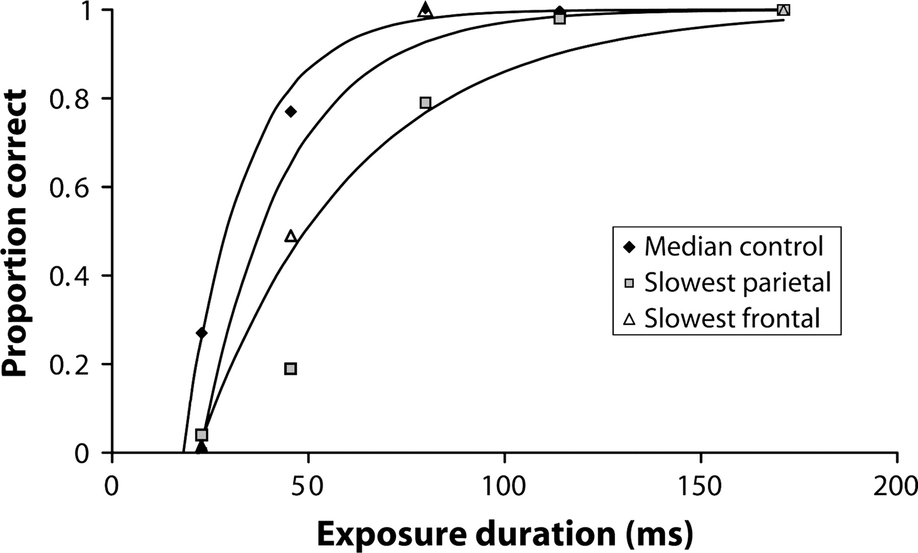
Figure 4. Data for three illustrative participants in the single letter task. The slowest (lowest v_{i}) ...
Notes:
Figure 4. Data for three illustrative participants in the single letter task. The slowest (lowest vi) patients from parietal (JA, grey squares) and frontal (MS, white triangles) groups are compared with the median control (HG, black diamonds). For each participant, solid curve shows theoretical fit to the data by equation (1).
Unless provided in the caption above, the following copyright applies to the content of this slide: © The Author 2005. Published by Oxford University Press. All rights reserved. For permissions, please e-mail: journals.permissions@oupjournals.org

Slide 4
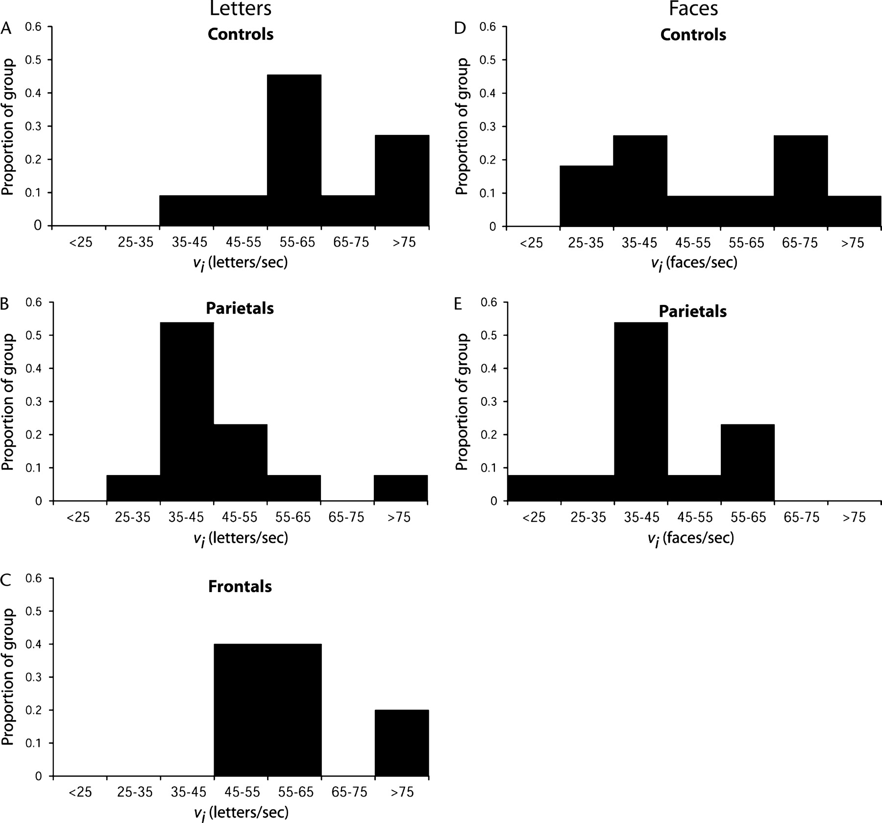
Figure 5. Distributions of the v_{i} parameter for both letters and faces for control participants (A letters, ...
Notes:
Figure 5. Distributions of the vi parameter for both letters and faces for control participants (A letters, D faces) patients with parietal lesions (B letters, E faces) and patients with frontal lobe lesions (C letters). Lower values of vi indicate slower visual processing.
Unless provided in the caption above, the following copyright applies to the content of this slide: © The Author 2005. Published by Oxford University Press. All rights reserved. For permissions, please e-mail: journals.permissions@oupjournals.org

Slide 5
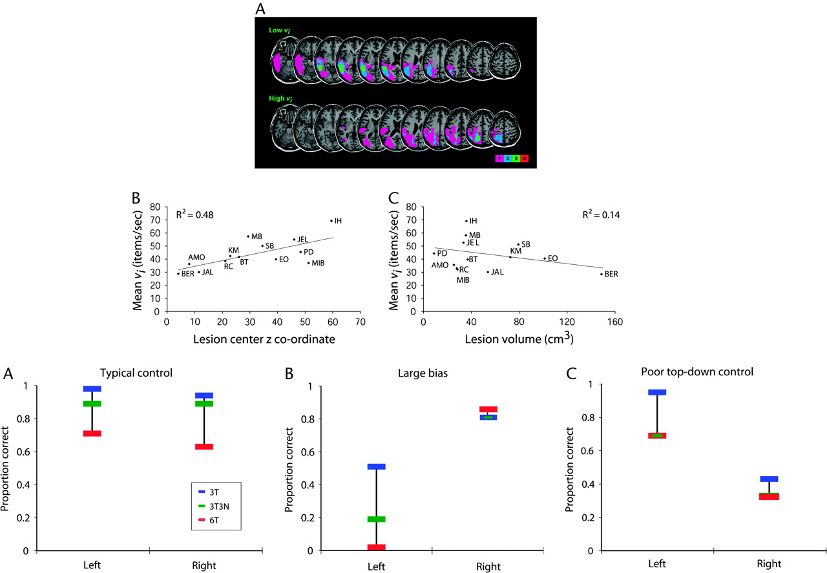
Figure 6. Processing speed in parietal patients. (A) Lesion overlay diagrams of the four slowest (lowest mean ...
Notes:
Figure 6. Processing speed in parietal patients. (A) Lesion overlay diagrams of the four slowest (lowest mean vi; upper panel) and the four fastest (highest mean vi; lower panel) patients. Right hemisphere lesions have been transposed so that all lesions appear on the left hemisphere. There are three left and one right hemisphere lesion patients in both the ‘slowest’ and ‘fastest’ groups. Slice selection as Figure 1. Purple, blue, green and red indicate regions damaged in respectively 1, 2, 3 and 4 patients. (B) Relationship between mean vi and z coordinate of lesion center of mass. (C) Relationship between mean vi and lesion volume. Figure 7. Data for 3 illustrative participants in partial report task. Proportions of letters identified in left and right visual fields, separately for 3T (blue), 6T (red) and 3T3N (green) displays. (A) Typical control (BBD). (B) Patient with strong spatial bias (parietal lesion, EO). (C) Patient with poor top-down control (parietal lesion, BT).
Unless provided in the caption above, the following copyright applies to the content of this slide: © The Author 2005. Published by Oxford University Press. All rights reserved. For permissions, please e-mail: journals.permissions@oupjournals.org

Slide 6
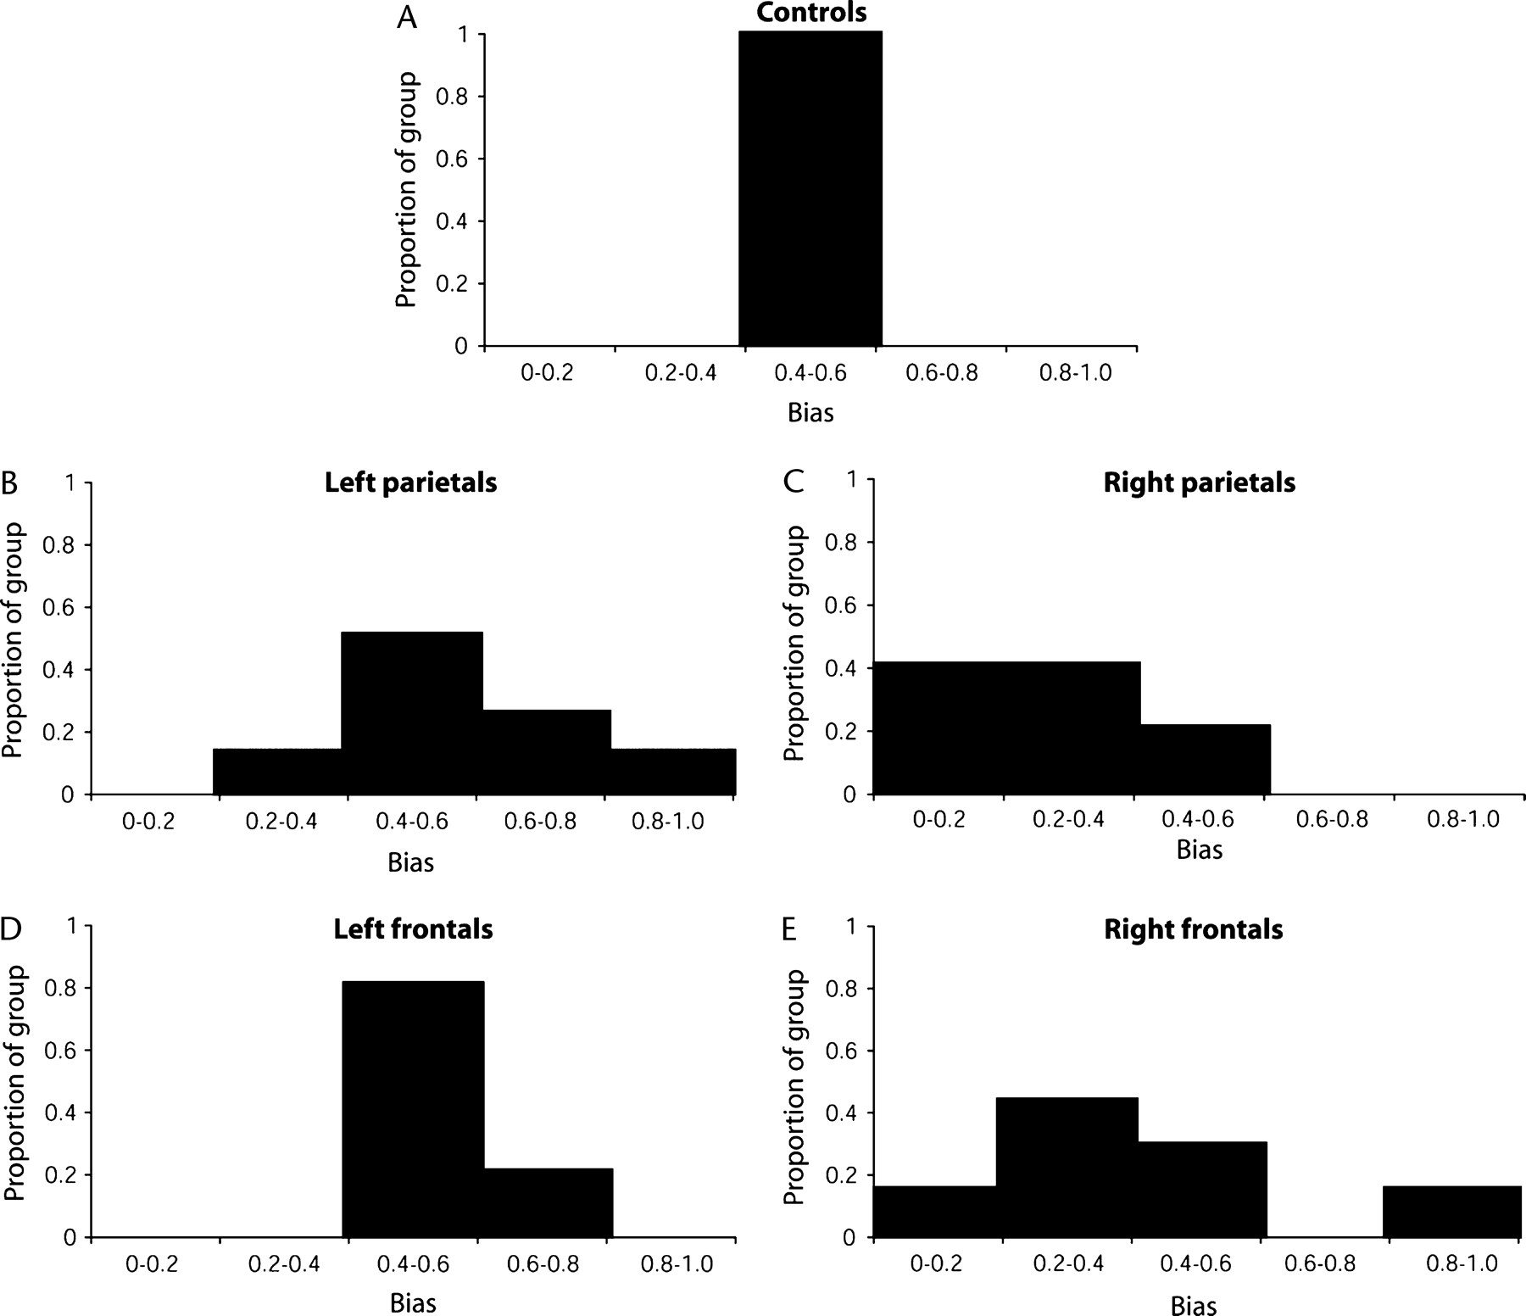
Figure 8. Distributions of spatial bias for (A) controls, (B) left parietals, (C) right parietals, (D) left frontals ...
Notes:
Figure 8. Distributions of spatial bias for (A) controls, (B) left parietals, (C) right parietals, (D) left frontals and (E) right frontals. Values 0.5 indicate bias to the right.
Unless provided in the caption above, the following copyright applies to the content of this slide: © The Author 2005. Published by Oxford University Press. All rights reserved. For permissions, please e-mail: journals.permissions@oupjournals.org

Slide 7
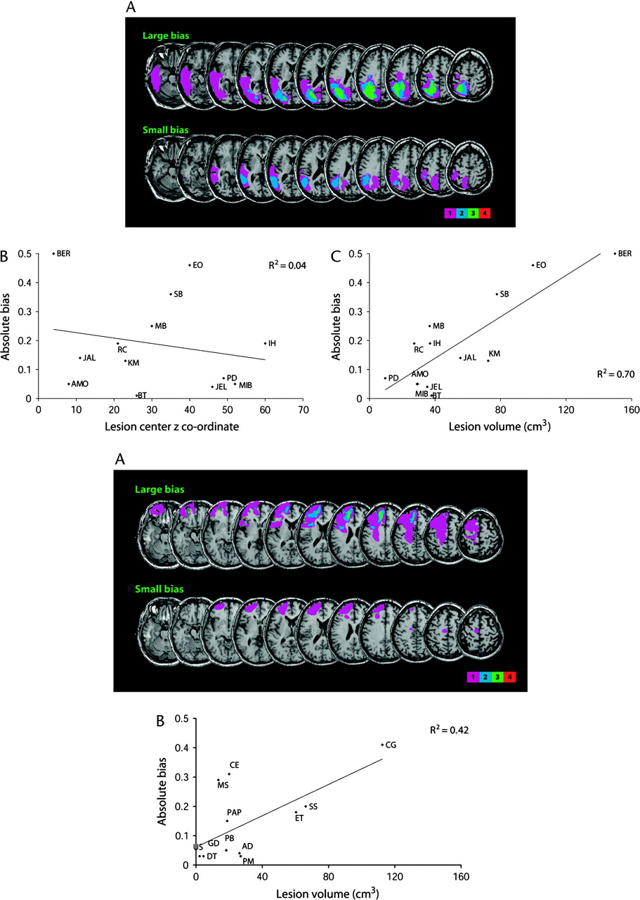
Figure 9. Absolute spatial bias in parietal patients. (A) Lesion overlay diagrams of the four patients with largest ...
Notes:
Figure 9. Absolute spatial bias in parietal patients. (A) Lesion overlay diagrams of the four patients with largest bias (upper panel) (three patients with right lesions and one with left lesion) and four patients with smallest bias (lower panel) (three patients with left lesions and one with right lesion). Conventions as Figure 6. (B) Relationship between absolute bias and z coordinate of lesion center of mass. (C) Relationship between absolute bias and lesion volume. Figure 10. Absolute spatial bias in frontal patients. (A) Lesion overlay diagrams of the four patients with largest bias (upper panel) (all four patients with right lesions) and four patients with smallest bias (lower panel) (three patients with left lesions and one with right lesion). Conventions as Figure 6. (B) Relationship between absolute bias and lesion volume.
Unless provided in the caption above, the following copyright applies to the content of this slide: © The Author 2005. Published by Oxford University Press. All rights reserved. For permissions, please e-mail: journals.permissions@oupjournals.org

Slide 8
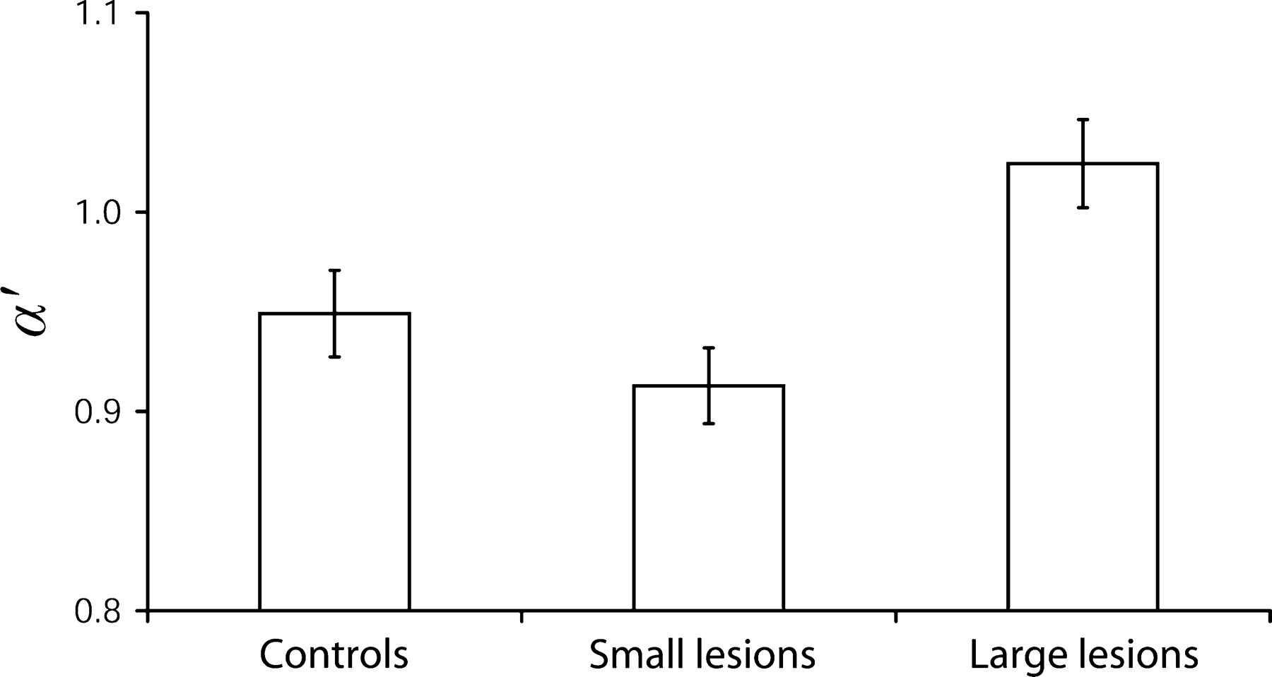
Figure 11. Mean (± SE) α′ for controls and combined parietal and frontal patients split by lesion size. The small-lesion ...
Notes:
Figure 11. Mean (± SE) α′ for controls and combined parietal and frontal patients split by lesion size. The small-lesion group has four parietal and nine frontal patients. The large-lesion group has nine parietal and three frontal patients.
Unless provided in the caption above, the following copyright applies to the content of this slide: © The Author 2005. Published by Oxford University Press. All rights reserved. For permissions, please e-mail: journals.permissions@oupjournals.org

Slide 9
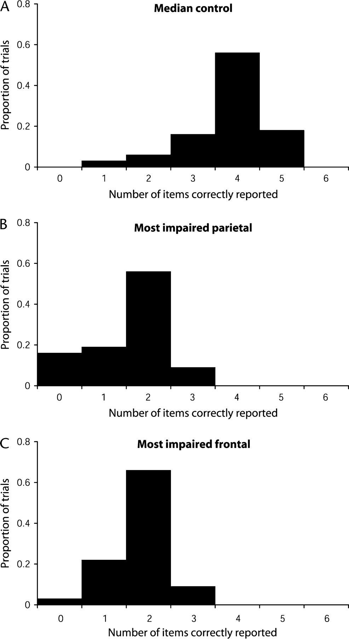
Figure 12. Data for three illustrative participants in six-target trials. (A) Control (AJ) with median K′. (B) Lowest K′ ...
Notes:
Figure 12. Data for three illustrative participants in six-target trials. (A) Control (AJ) with median K′. (B) Lowest K′ parietal patient (SB). (C) Lowest K′ frontal patient (CE). Each figure shows proportion of trials with 0, 1, 2, 3, 4, 5, 6 letters correctly reported.
Unless provided in the caption above, the following copyright applies to the content of this slide: © The Author 2005. Published by Oxford University Press. All rights reserved. For permissions, please e-mail: journals.permissions@oupjournals.org

Slide 10
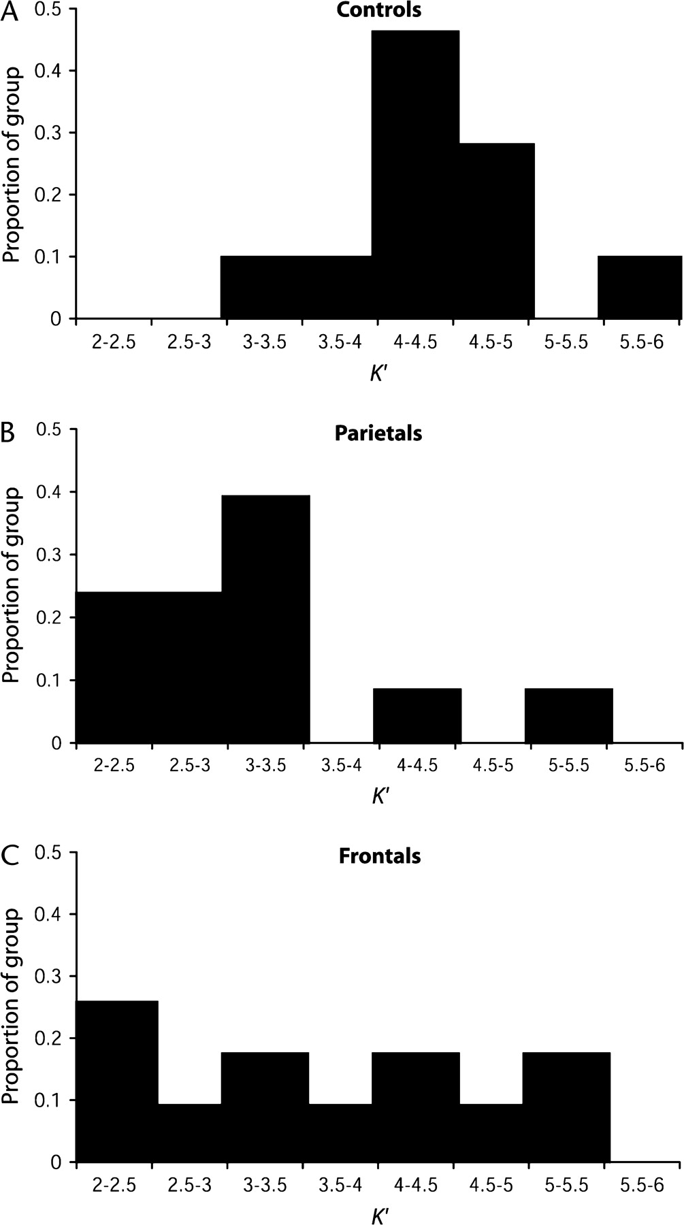
Figure 13. Distributions of K′ for control participants (A), patients with parietal lesions (B) and patients with ...
Notes:
Figure 13. Distributions of K′ for control participants (A), patients with parietal lesions (B) and patients with frontal lobe lesions (C).
Unless provided in the caption above, the following copyright applies to the content of this slide: © The Author 2005. Published by Oxford University Press. All rights reserved. For permissions, please e-mail: journals.permissions@oupjournals.org

Slide 11
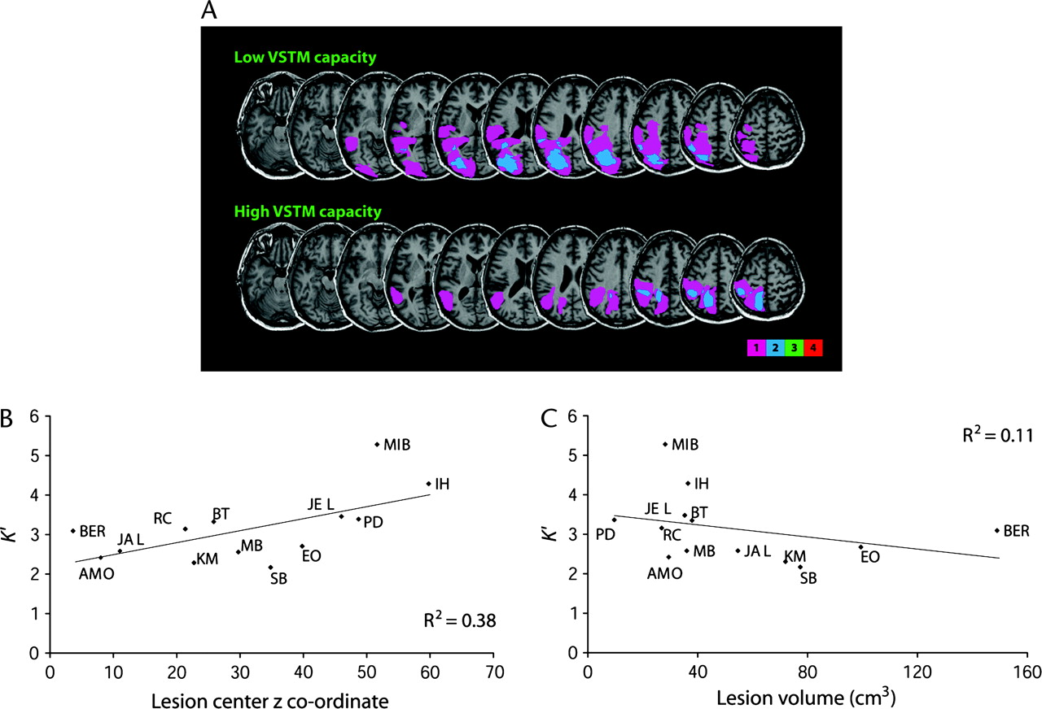
Figure 14. VSTM capacity in parietal patients. (A) Lesion overlay diagrams of the four patients with lowest K′ (upper ...
Notes:
Figure 14. VSTM capacity in parietal patients. (A) Lesion overlay diagrams of the four patients with lowest K′ (upper panel) (all patients had left lesions) and four patients with highest K′ (lower panel) (three left lesions and one right lesion). Conventions as Figure 6. (B) Relationship between K′ and z coordinate of lesion center of mass. (C) Relationship between K′ and lesion volume.
Unless provided in the caption above, the following copyright applies to the content of this slide: © The Author 2005. Published by Oxford University Press. All rights reserved. For permissions, please e-mail: journals.permissions@oupjournals.org

