Slide 1
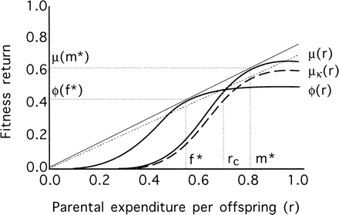
Figure 1 Fitness return for individual female and male offspring as a function of the amount of parental resources (r) ...
Notes:
Figure 1 Fitness return for individual female and male offspring as a function of the amount of parental resources (r) received. Given the female curve ϕ(r), any μκ(r) (dashed curve) for male offspring is not an evolutionarily stable strategy unless μ(m*)/m* = ϕ( f*)f*, m* and f* being the optimum r value for each sex. rc is the critical r value for sex change. A case has been chosen for which male fitness gains more than female fitness from parental resources, although this does not need to be so in all cases
Unless provided in the caption above, the following copyright applies to the content of this slide: Behavioral Ecology vol. 15 no. 2 © International Society for Behavioral Ecology 2004; all rights reserved

Slide 2
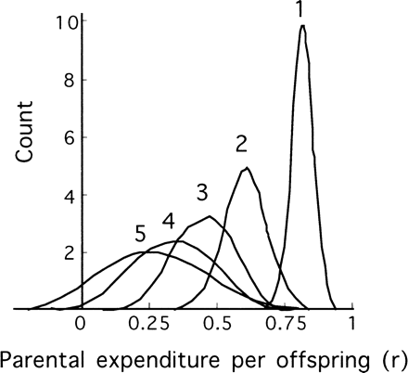
Figure 2 Hypothetical frequency distributions of parental expenditure (r) received by individual offspring at ...
Notes:
Figure 2 Hypothetical frequency distributions of parental expenditure (r) received by individual offspring at different positions within a brood. With decreasing rank, the mean of r decreases, but its standard deviation increases. Numbers over the curves indicate the rank positions within the brood
Unless provided in the caption above, the following copyright applies to the content of this slide: Behavioral Ecology vol. 15 no. 2 © International Society for Behavioral Ecology 2004; all rights reserved

Slide 3
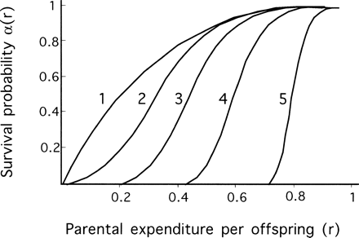
Figure 3 An example of how rank positions within a brood might affect the relationship between the parental ...
Notes:
Figure 3 An example of how rank positions within a brood might affect the relationship between the parental expenditure that an offspring receives and its survival probability α(r). Survival decreases more steeply for rearmost positions due to stochastic factors differentially affecting mortality of subordinate sibs. Numbers at the curves indicate the rank positions within the brood
Unless provided in the caption above, the following copyright applies to the content of this slide: Behavioral Ecology vol. 15 no. 2 © International Society for Behavioral Ecology 2004; all rights reserved

Slide 4
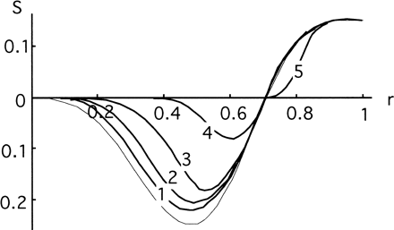
Figure 4 Selection component, S_{p}, corrected by survival probability, α_{p}(r) for positions within ...
Notes:
Figure 4 Selection component, Sp, corrected by survival probability, αp(r) for positions within the brood. Numbers at the curves indicate the rank positions within the brood. The outermost, light line indicates the selection component before it being corrected by the survival probability
Unless provided in the caption above, the following copyright applies to the content of this slide: Behavioral Ecology vol. 15 no. 2 © International Society for Behavioral Ecology 2004; all rights reserved

