Slide 1
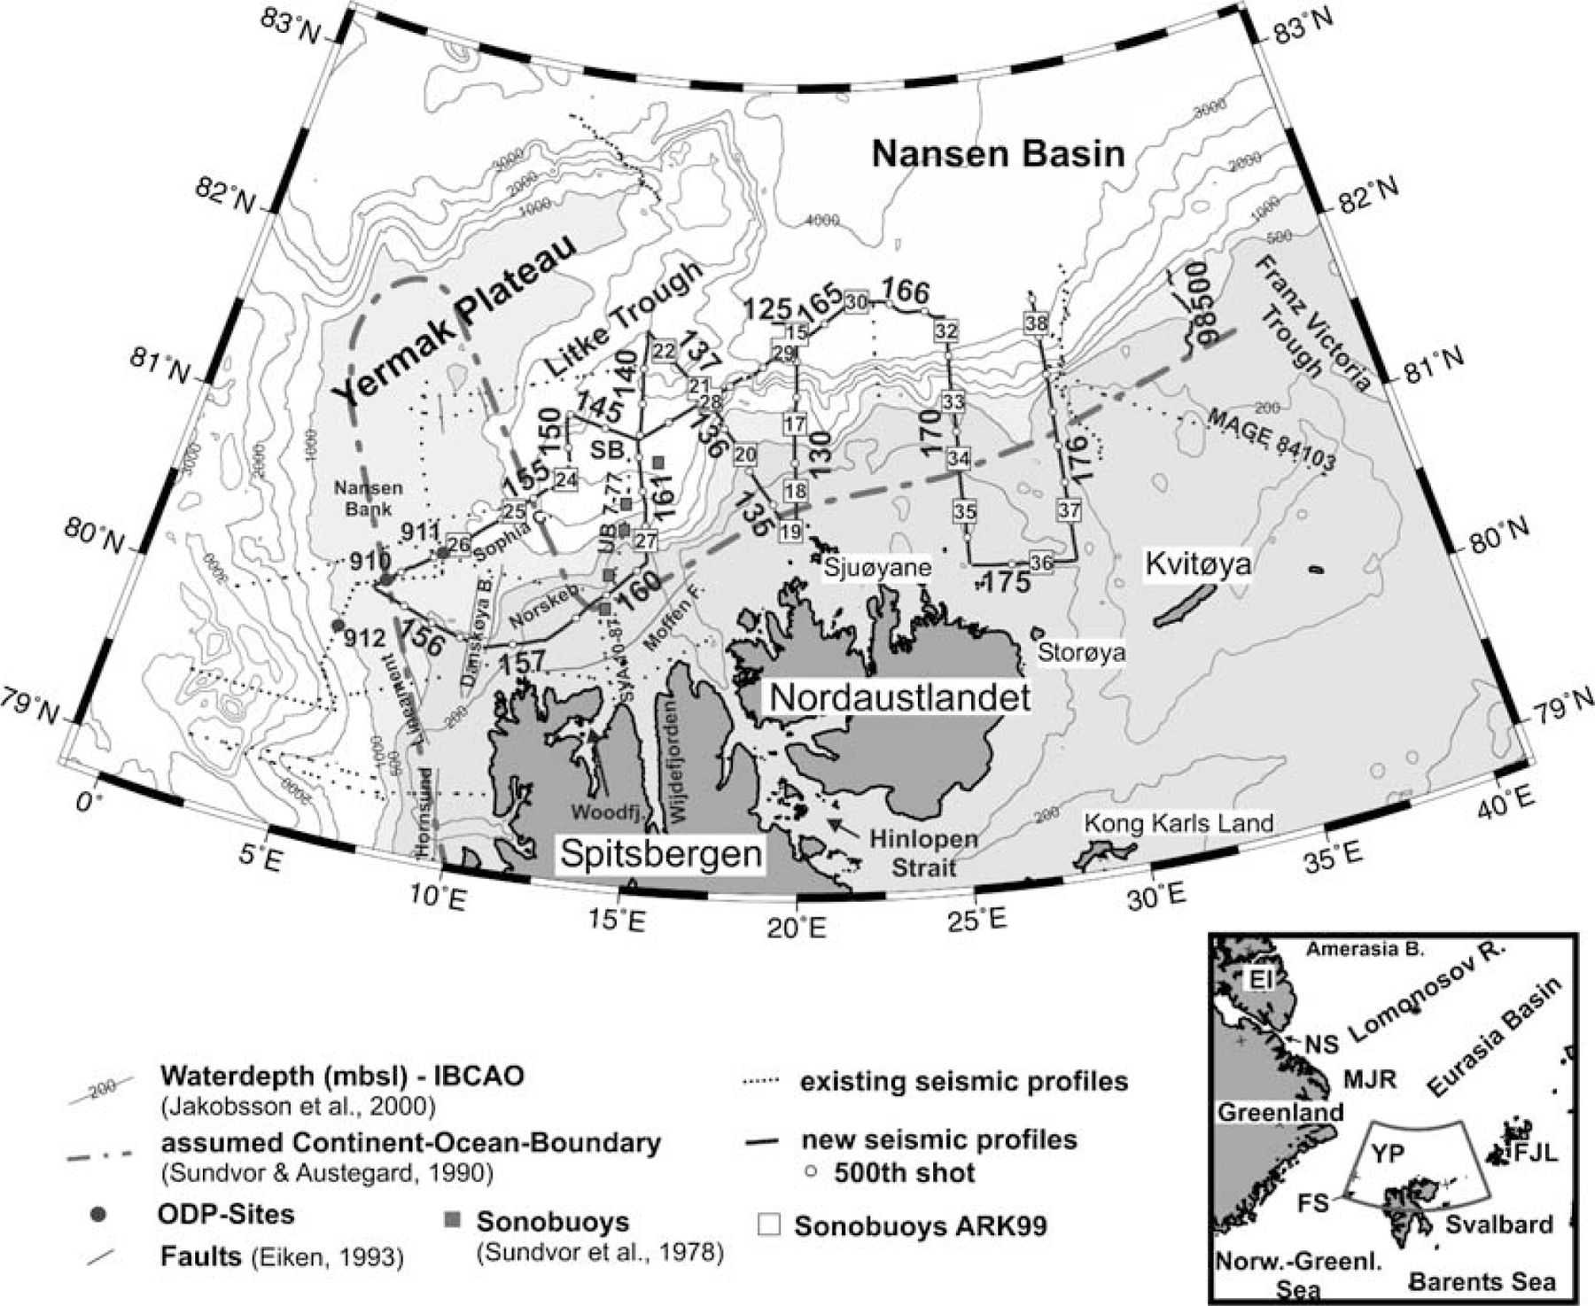
Figure 1 Map of the area investigated along the northern Svalbard continental margin. Bold lines display the profiles ...
Notes:
Figure 1 Map of the area investigated along the northern Svalbard continental margin. Bold lines display the profiles acquired during expedition ARKTIS‐XV/2 of RV Polarstern 1999. Some of the existing, older profiles (Jackson 1984; Eiken 1994; Weigelt 1998) are drawn as dotted lines. The names of the profiles were abbreviated to make the figure more readable (e.g. 166 denotes AWI‐99166). The same was done for the sonobuoys (e.g. 19 denotes SB9919). Black circles mark the ODP sites from Leg 151 (Myhre 1995). IBCAO bathymetry is taken from Jakobsson (2000). The dashed line represents the assumed continent–ocean boundary according to Sundvor & Austegard (1990). Danskøya B.—Danskøya Basin, EI—Ellesmere Island, FJL—Franz Josef Land, FS—Fram Strait, Moffen F.—Moffen Fault, MJR—Morris Jessup Rise, Norskeb.—Norskebanken, NS—Nares Strait, SB—Sophia Basin, Sophia C.—Sophia Canyon, Woodfj.—Woodfjorden, YP—Yermak Plateau.
Unless provided in the caption above, the following copyright applies to the content of this slide: © 2004 RAS

Slide 2
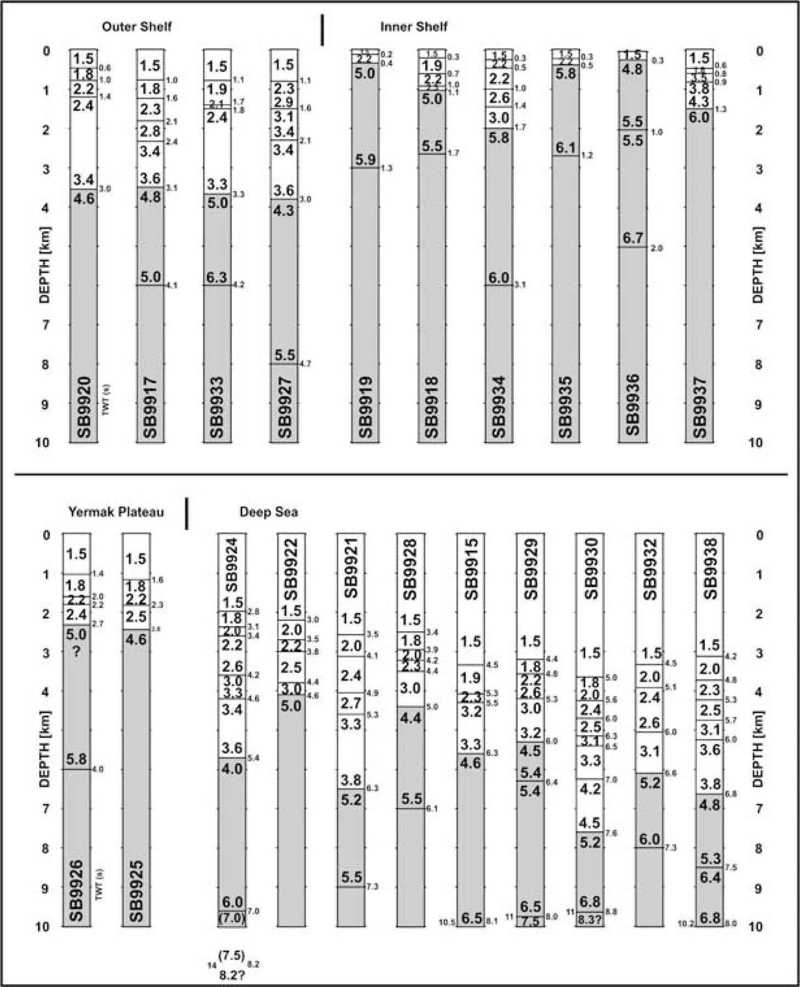
Figure 2 P‐wave velocity–depth functions (v_{p} in km s⁻¹) from sonobuoy measurements. Grey shading ...
Notes:
Figure 2 P‐wave velocity–depth functions (vp in km s−1) from sonobuoy measurements. Grey shading indicates the assumed basement velocities. In the reflection data near SB9924 and SB9927 we could not detect a clear basement reflector.
Unless provided in the caption above, the following copyright applies to the content of this slide: © 2004 RAS

Slide 3
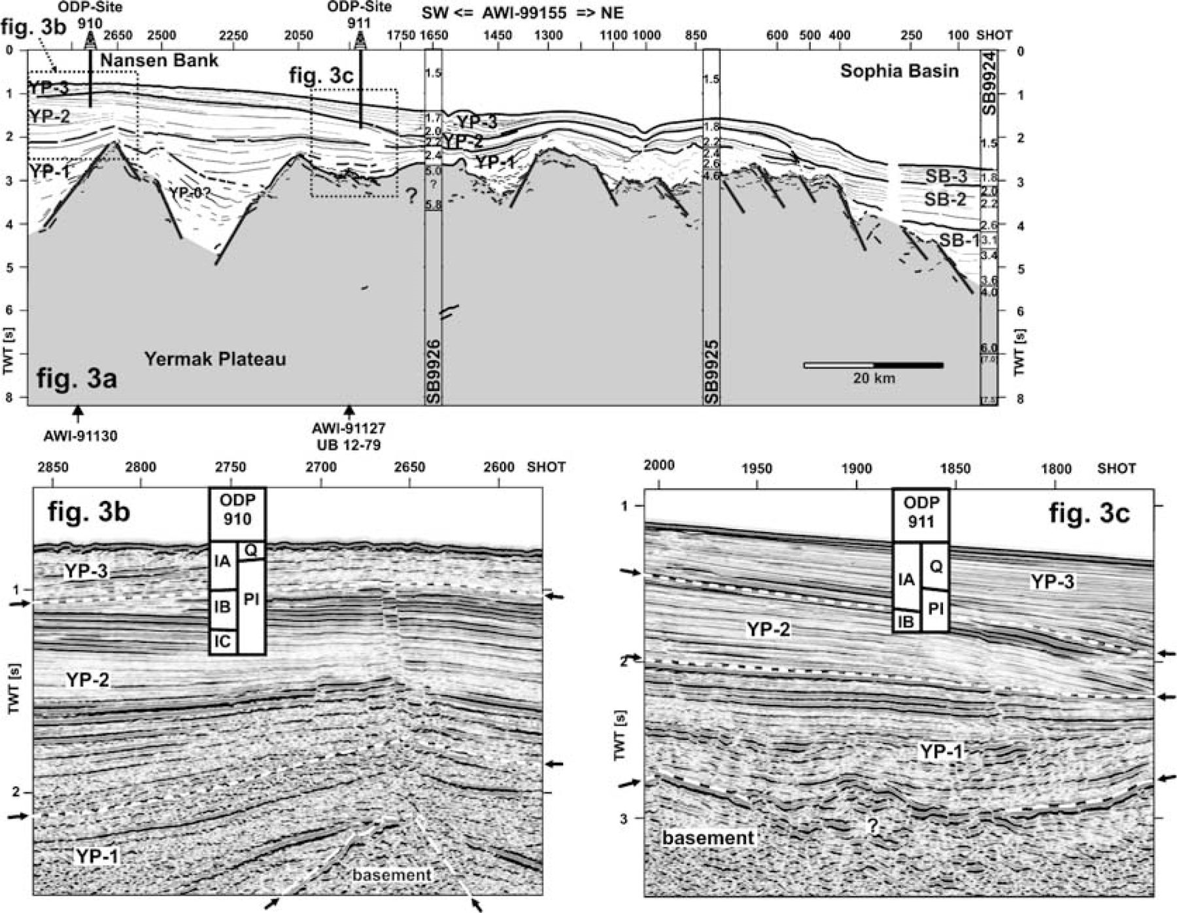
Figure 3 (a) Profile AWI‐99155 (line drawing) with seismic velocities from sonobuoys. Sedimentary rocks may be present ...
Notes:
Figure 3 (a) Profile AWI‐99155 (line drawing) with seismic velocities from sonobuoys. Sedimentary rocks may be present beneath the opaque basement reflector in the seismic reflection data. SB9924 to SB9926 show the seismic velocities (in km s−1) obtained by ray tracing of wide‐angle data. (b) Correlation of seismic units with the results of ODP‐910C. The information about the lithological boundaries is taken from Shipboard Sci. Party (1995a). The more transparent reflection character of YP‐3 compared with the underlying YP‐2 may be caused by coarser material within YP‐3. Bright reflections in the upper part of YP‐2 might indicate the presence of gas, observed in the drill‐hole (Stein 1995). (c) Correlation of the seismic units with the results of ODP‐911A. The lithological information about the drilled section is taken from Shipboard Sci. Party (1995b). Bright reflections in the upper part of YP‐2 might indicate the presence of gas (Stein 1995).
Unless provided in the caption above, the following copyright applies to the content of this slide: © 2004 RAS

Slide 4
Figure 4 Line drawing of the seismic profiles AWI‐99156‐99157‐99160 from the Hornsund lineament across Danskøya Basin ...
Notes:
Figure 4 Line drawing of the seismic profiles AWI‐99156‐99157‐99160 from the Hornsund lineament across Danskøya Basin to Norskebanken. Strong seafloor multiples mask the deeper sedimentary structure beneath Norskebanken. Values in parentheses are the interval velocities (in km s−1) obtained from stacking velocity analysis.
Unless provided in the caption above, the following copyright applies to the content of this slide: © 2004 RAS

Slide 5
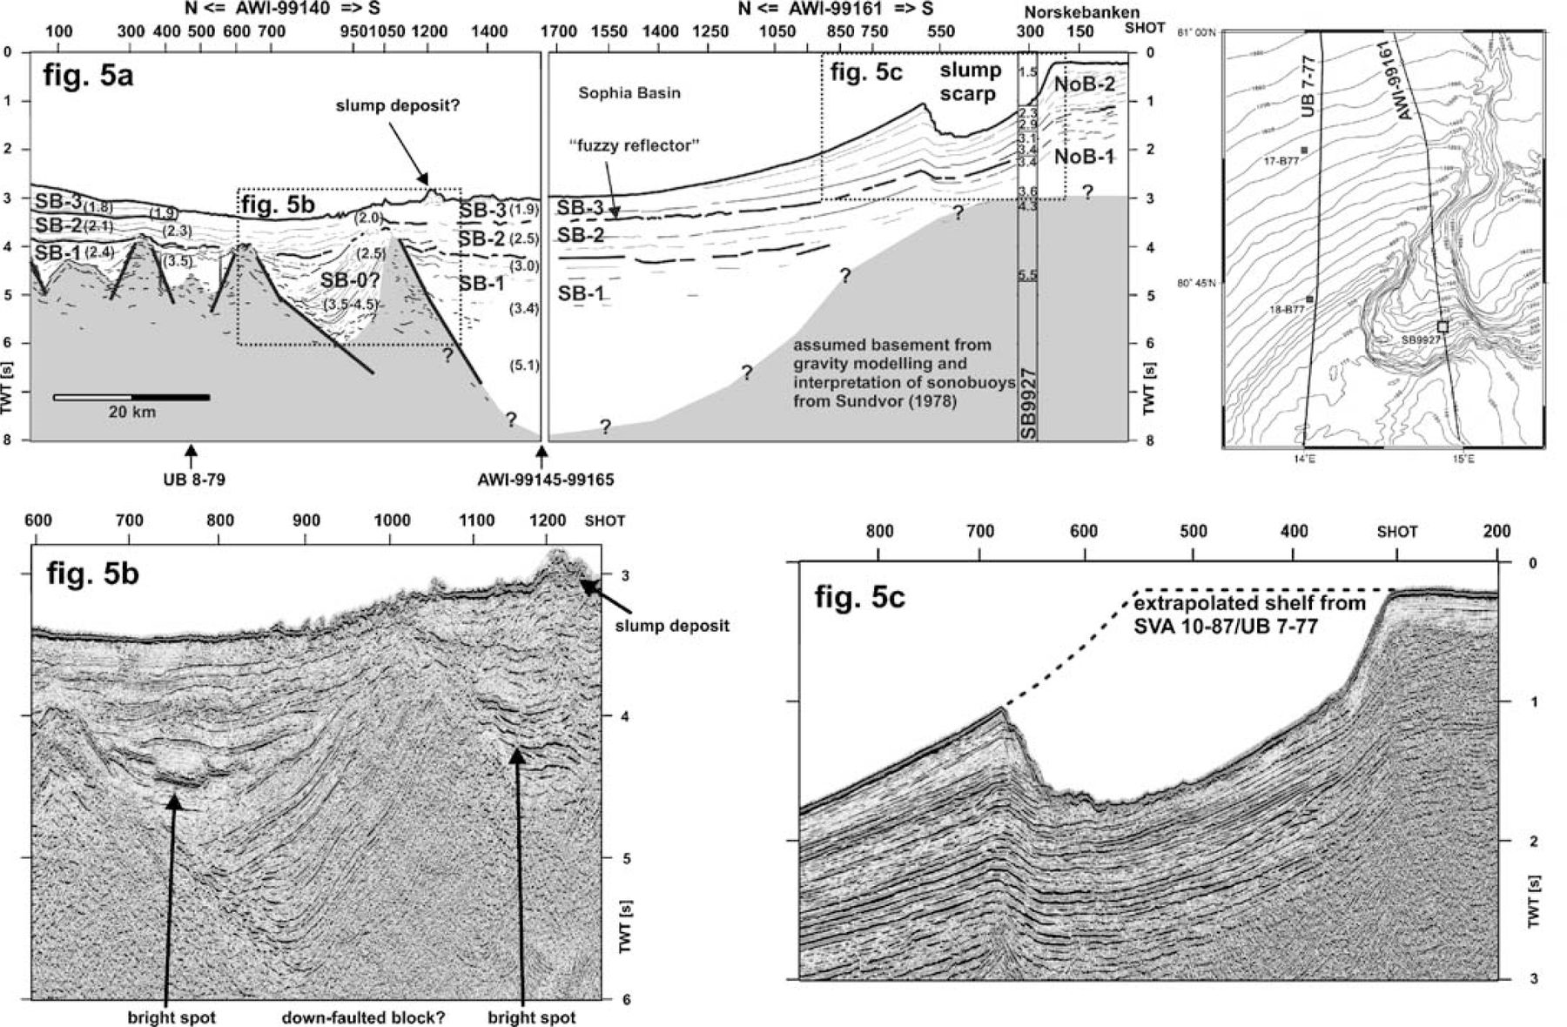
Figure 5 (a) Line drawing of the seismic profiles AWI‐99140‐99161 north of Spitsbergen. The basement in the southern ...
Notes:
Figure 5 (a) Line drawing of the seismic profiles AWI‐99140‐99161 north of Spitsbergen. The basement in the southern part is not imaged by the seismic reflection data, but inferred from gravity modelling and sonobuoy measurements of Sundvor (1978). SB9927 (at shot point 300 of line AWI‐99161) shows the seismic velocities (in km s−1) obtained by ray tracing of wide‐angle data. Values in parentheses are the interval velocities (in km s−1) obtained from stacking velocity analysis. For abbreviations see text. The inset map in the upper right corner shows the location of the seismic profile relative to the slump area. Bathymetry modified after Cherkis (1999). (b) Down‐faulted block at the northern rim of Sophia Basin. The irregular seafloor topography between shots 900 and 1200 is caused by deposits of large‐scale slumps. Several bright spots can be observed in the vicinity of Sophia Basin, possibly representing magmatic sills and/or accumulations of natural gases/fluids. (c) Slide scar at the outermost shelf north of Spitsbergen (part of profile AWI‐99161). The slump was directed to the east. The dotted line indicates the assumed original shape of the shelf break adopted from line SVA 10‐87/UB 7‐77.
Unless provided in the caption above, the following copyright applies to the content of this slide: © 2004 RAS

Slide 6
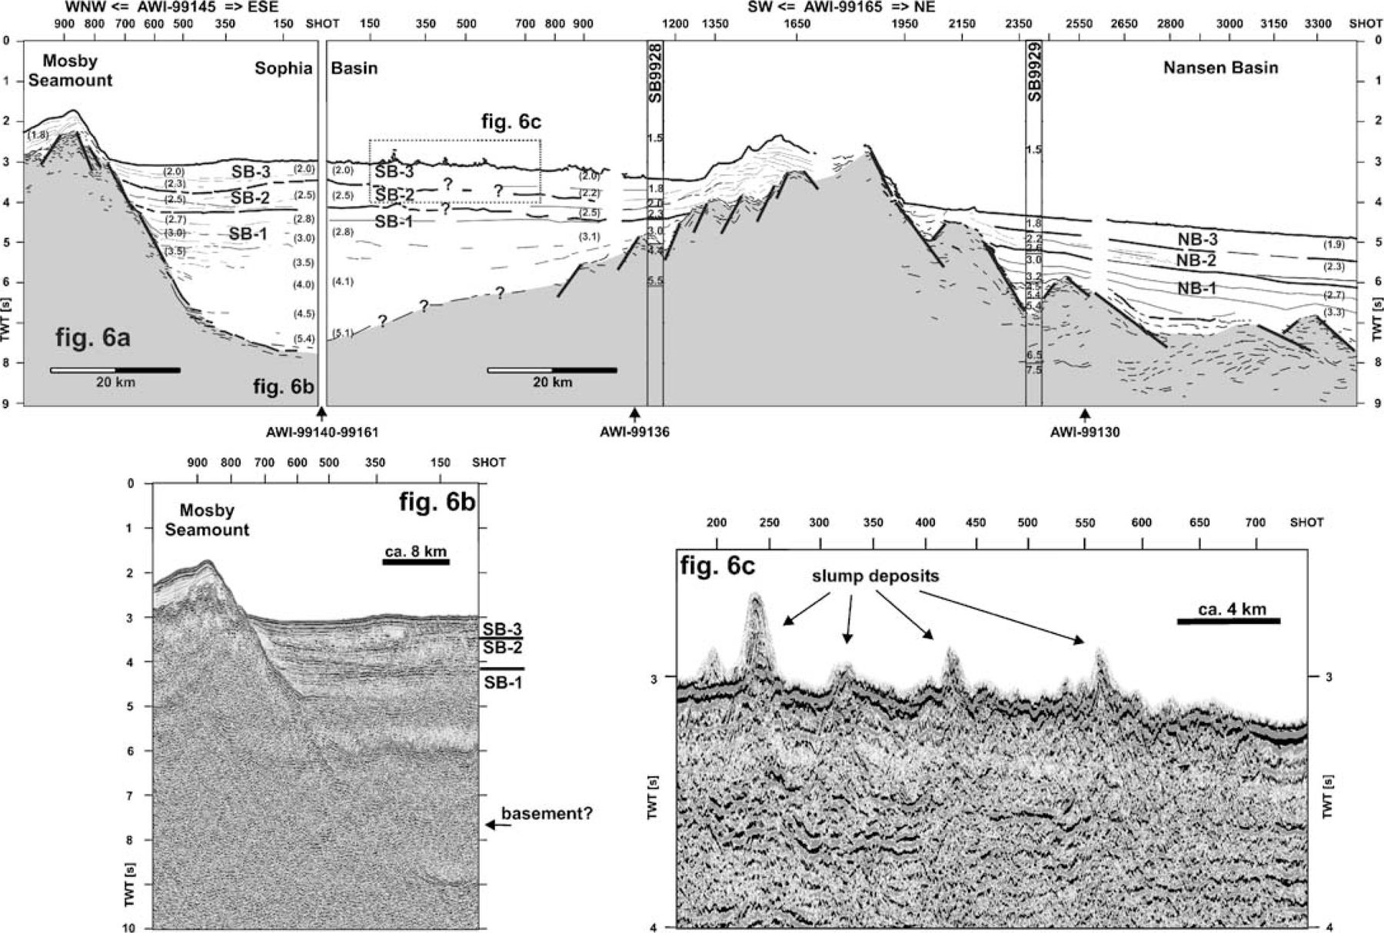
Figure 6 (a) Line drawing of the seismic profiles AWI‐99145‐99165 from the flank of Mosby Seamount across Sophia Basin ...
Notes:
Figure 6 (a) Line drawing of the seismic profiles AWI‐99145‐99165 from the flank of Mosby Seamount across Sophia Basin towards Nansen Basin. Values in parentheses are the interval velocities (in km s−1) obtained from stacking velocity analysis. (b) From the flank of Mosby Seamount we can follow the acoustic basement down to about 7.7 s TWT. Sophia Basin has up to 9 km infill of sediments. (c) Seafloor topography within the Sophia Basin/Litke Trough interpreted as slump deposits. Some of these structures rise to 200 m above the adjacent seafloor. The sedimentary structure beneath the seafloor is not well resolved due to strong diffractions.
Unless provided in the caption above, the following copyright applies to the content of this slide: © 2004 RAS

Slide 7
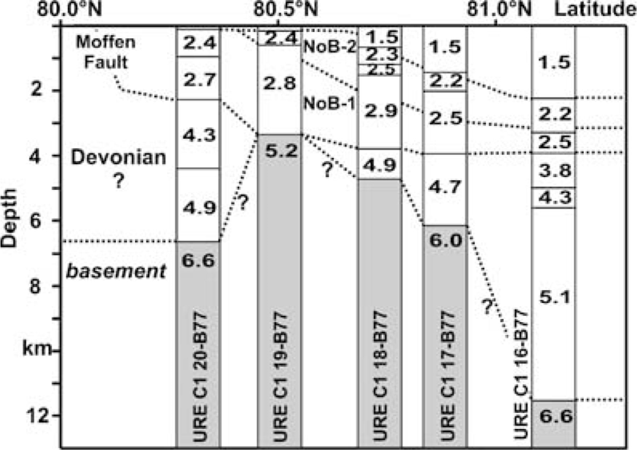
Figure 7 Interpretation of results of sonobuoy measurements from Sundvor (1978; in Jackson 2000) north of Spitsbergen ...
Notes:
Figure 7 Interpretation of results of sonobuoy measurements from Sundvor (1978; in Jackson 2000) north of Spitsbergen along the profiles SVA 10‐87/UB 7‐77 and AWI‐99161. For location of this sonobuoy profile see Fig. 1.
Unless provided in the caption above, the following copyright applies to the content of this slide: © 2004 RAS

Slide 8
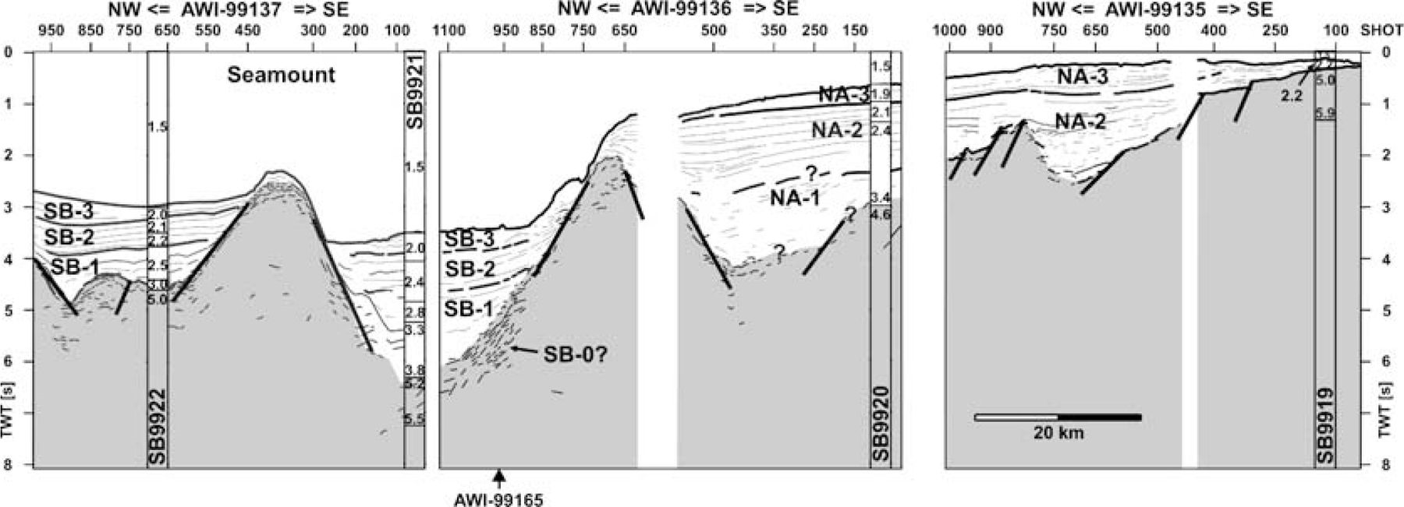
Figure 8 Line drawing of profiles AWI‐99135‐99136‐99137 from the southern rim of the northeastern Yermak Plateau ...
Notes:
Figure 8 Line drawing of profiles AWI‐99135‐99136‐99137 from the southern rim of the northeastern Yermak Plateau across the flank of a newly discovered seamount (Jokat 2000) towards the shelf north of Nordaustlandet. The channel between the seamount and the shelf is probably used by bottom water flows into Nansen Basin.
Unless provided in the caption above, the following copyright applies to the content of this slide: © 2004 RAS

Slide 9
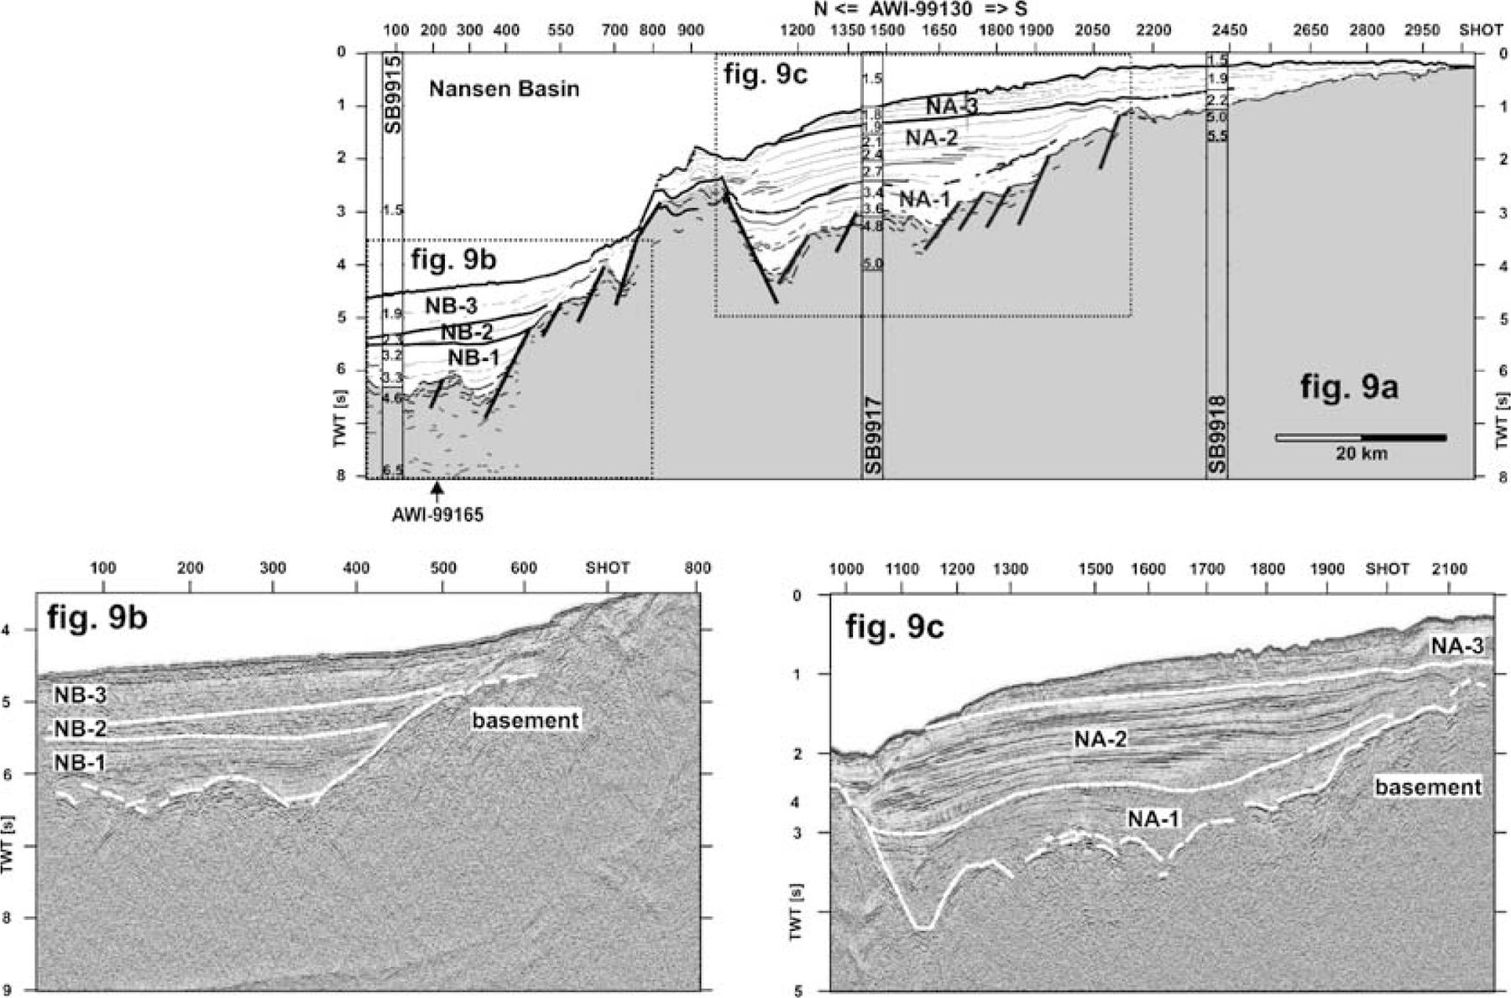
Figure 9 (a) Profile AWI‐99130 (line drawing) at 20°E north of Nordaustlandet. (b) The rim of Nansen Basin north of ...
Notes:
Figure 9 (a) Profile AWI‐99130 (line drawing) at 20°E north of Nordaustlandet. (b) The rim of Nansen Basin north of Nordaustlandet. The sediments were subdivided into seismic units based on the reflection character and P‐wave velocities. (c) Subdivision of seismic units beneath the outer shelf area north of Nordaustlandet.
Unless provided in the caption above, the following copyright applies to the content of this slide: © 2004 RAS

Slide 10
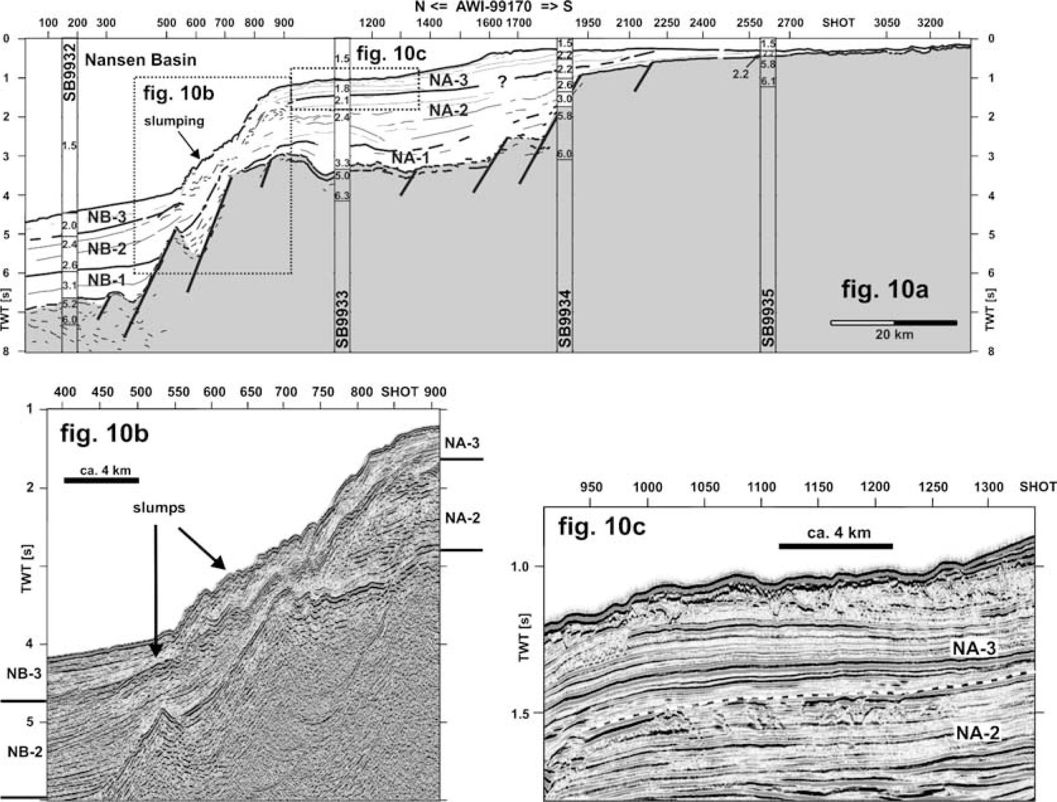
Figue 10 (a) Profile AWI‐99170 (line drawing) at 26°E north of Nordaustlandet. (b) Intensive slumping at the ...
Notes:
Figue 10 (a) Profile AWI‐99170 (line drawing) at 26°E north of Nordaustlandet. (b) Intensive slumping at the continental slope north of Nordaustlandet. (c) Subdivision of seismic units beneath the outer shelf area north of Nordaustlandet.
Unless provided in the caption above, the following copyright applies to the content of this slide: © 2004 RAS

Slide 11
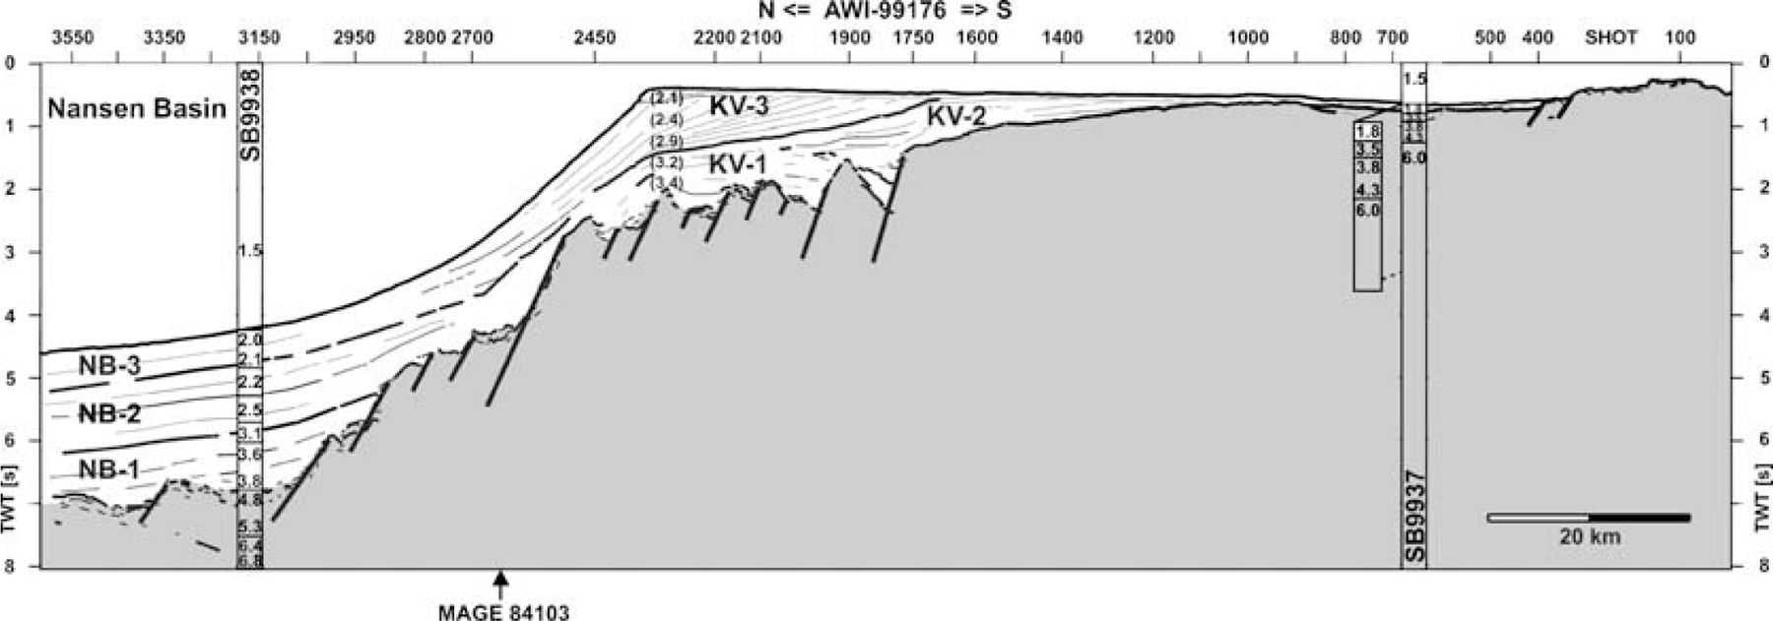
Figure 11 Line drawing of seismic profile AWI‐99176 at 30°E north of Nordaustlandet. Shelf progradation occurs in front ...
Notes:
Figure 11 Line drawing of seismic profile AWI‐99176 at 30°E north of Nordaustlandet. Shelf progradation occurs in front of a glacial trough between Nordaustlandet and Kvitøya.
Unless provided in the caption above, the following copyright applies to the content of this slide: © 2004 RAS

Slide 12
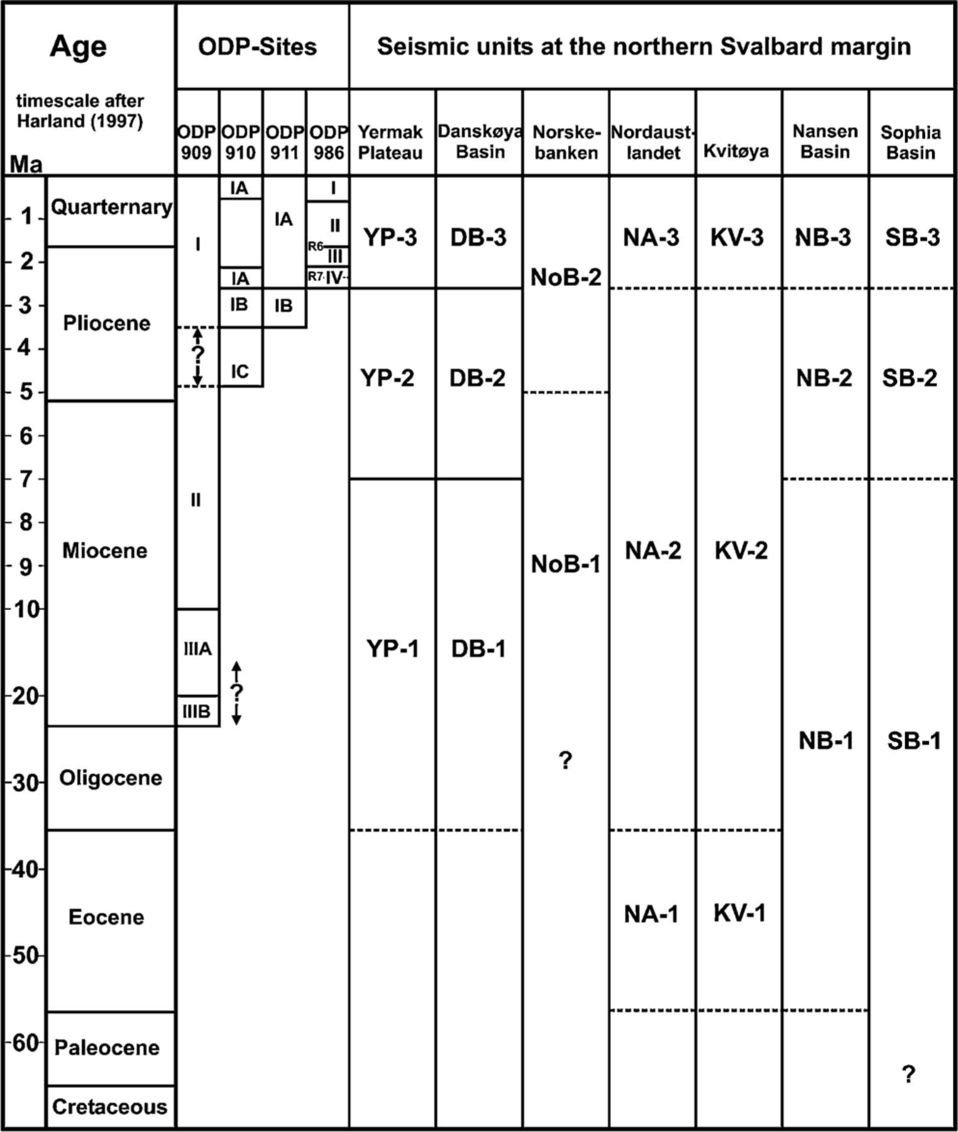
Figure 12 Stratigraphic models for the area investigated. Information on the ODP drill‐holes 909–911 and 986 was taken ...
Notes:
Figure 12 Stratigraphic models for the area investigated. Information on the ODP drill‐holes 909–911 and 986 was taken from Thiede (1995) and Forsberg (1999), respectively. Hull (1996) provided some age revisions, especially at site 909, based on biostratigraphy. Seismic reflectors R6 and R7, drilled by ODP‐986, are regional reflectors below the western Svalbard continental margin (Faleide 1996).
Unless provided in the caption above, the following copyright applies to the content of this slide: © 2004 RAS

Slide 13
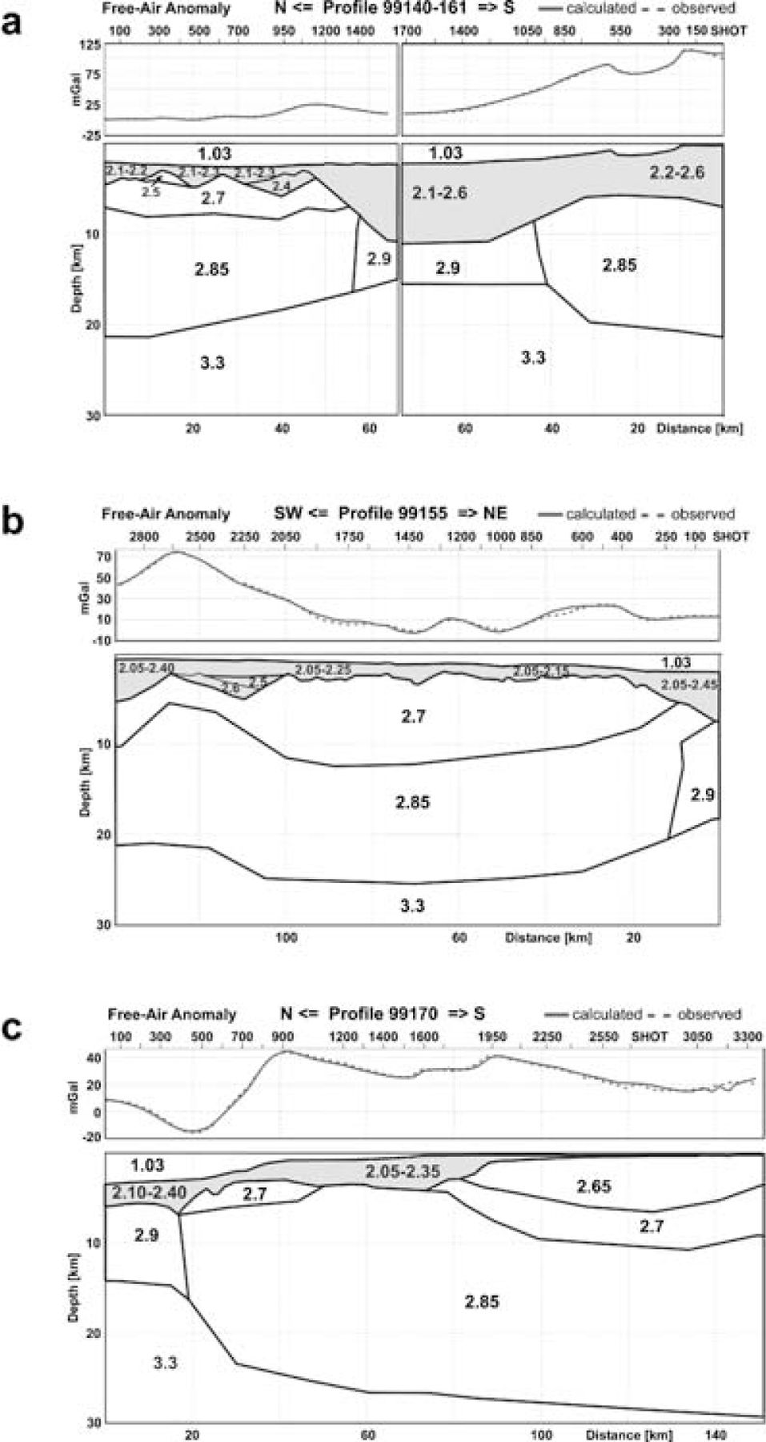
Figure 13 (a) Gravity model along lines AWI‐99140‐99161 (density in 10³ kg m⁻³). The free‐air ...
Notes:
Figure 13 (a) Gravity model along lines AWI‐99140‐99161 (density in 103 kg m−3). The free‐air anomaly (scale in mGal or 10−5 m s−2) was modelled for each profile individually. (b) Gravity model along line AWI‐99155 (density in 103 kg m−3). (c) Gravity model along line AWI‐99170 (density in 103 kg m−3).
Unless provided in the caption above, the following copyright applies to the content of this slide: © 2004 RAS

Slide 14
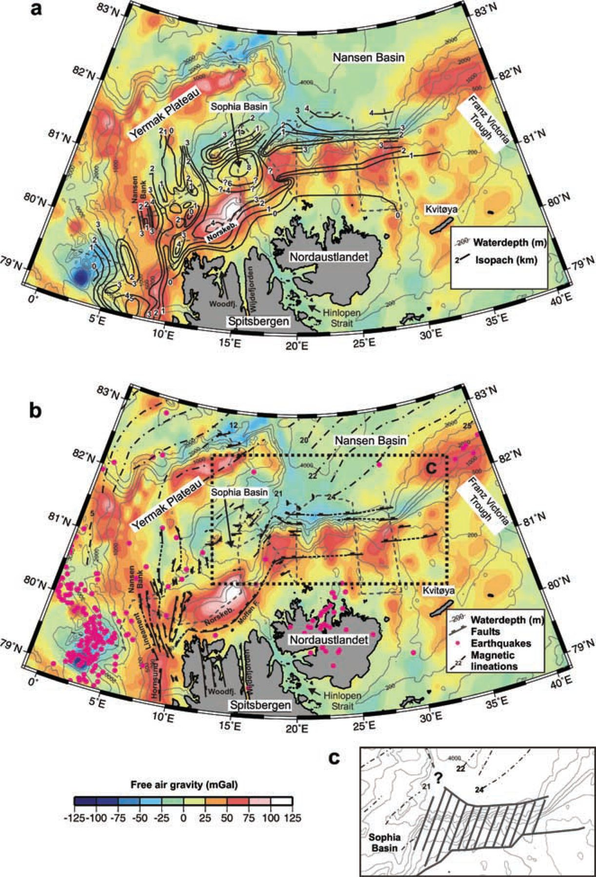
Figure 14 (a) Distribution of sediments below the northern Svalbard continental margin. Isopachs are in km. The map ...
Notes:
Figure 14 (a) Distribution of sediments below the northern Svalbard continental margin. Isopachs are in km. The map includes data from Austegard & Sundvor (1991). The Arctic gravity grid is plotted in colour (free‐air anomaly in mGal or 10−5 m s−2). (b) Simplified structural map of the northern Svalbard continental margin on the basis of Eiken (1993, 1994) and Weigelt (1998). The major faults are marked. The black lines represent the magnetic lineations (Vogt 1979). The Arctic gravity grid is plotted in colour to support our structural interpretation. The box marks the location of the inset (part c). (c) Location and width of the continent–ocean transition zone north of Nordaustlandet (hatched area). We did not extend our interpretation farther westwards, since no deep seismic data exist and therefore the nature of the crust is hypothetical.
Unless provided in the caption above, the following copyright applies to the content of this slide: © 2004 RAS

