Slide 1
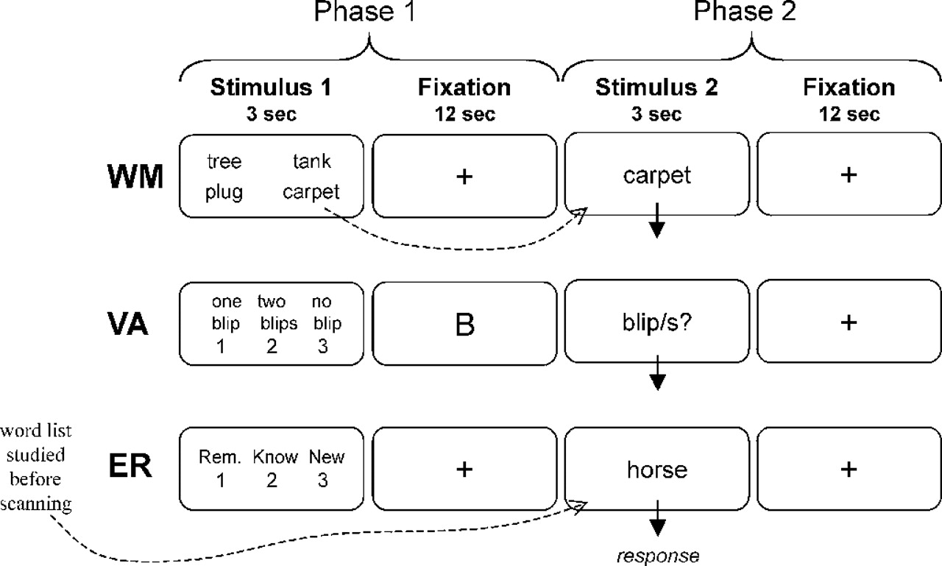
Figure 1. Behavioral paradigm. WM was investigated with a word delayed-response test, VA with a sustained ...
Notes:
Figure 1. Behavioral paradigm. WM was investigated with a word delayed-response test, VA with a sustained attention task, and ER with a word recognition task.
Unless provided in the caption above, the following copyright applies to the content of this slide:

Slide 2
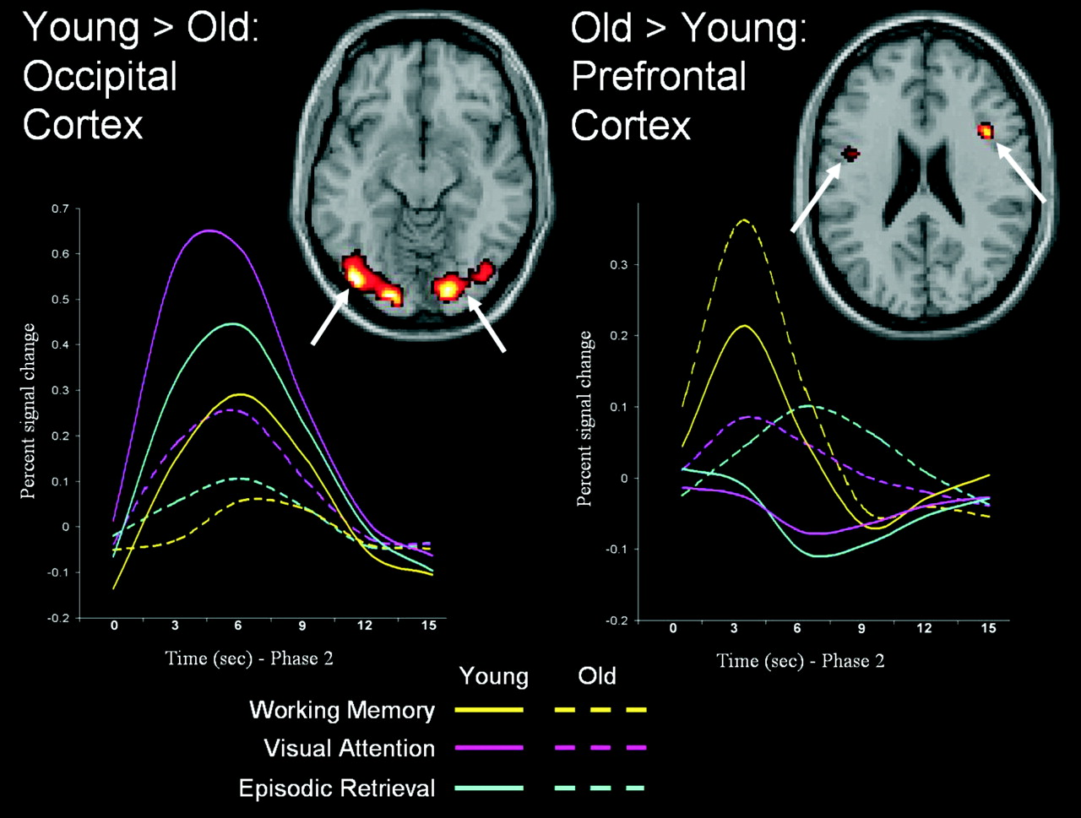
Figure 2. Task-independent age effects. Compared to younger adults, older adults showed weaker activity in ...
Notes:
Figure 2. Task-independent age effects. Compared to younger adults, older adults showed weaker activity in occipital cortex but greater activity in frontal regions. The time-course plots are from left BA19 (x, y, z = –23, –84, –8) and right BA45 (x, y, z = 41, 12, 21).
Unless provided in the caption above, the following copyright applies to the content of this slide:

Slide 3
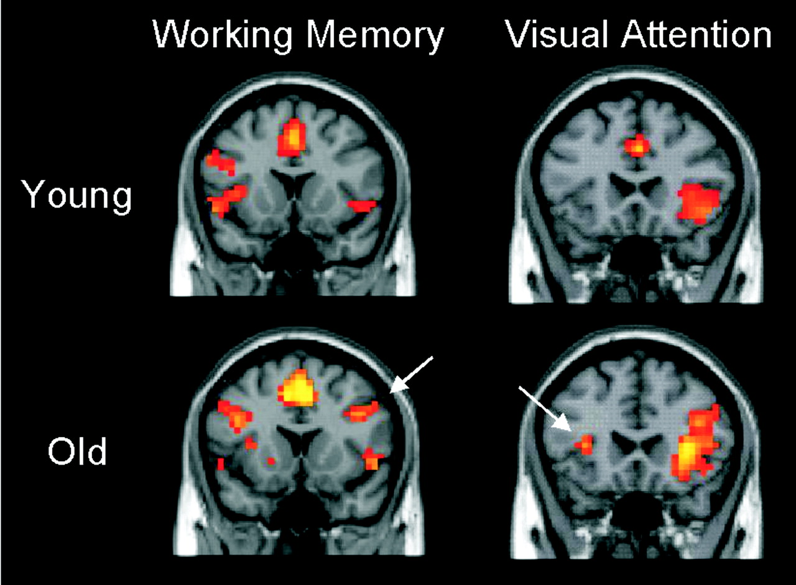
Figure 3. Task-specific age effects. Older adults showed contralateral recruitment in right PFC during WM and ...
Notes:
Figure 3. Task-specific age effects. Older adults showed contralateral recruitment in right PFC during WM and in left PFC during VA. As a result of these changes, activity in certain PFC regions was more bilateral in older than in younger adults (‘Hemispheric Asymmetry Reduction in Older Adults’ or HAROLD).
Unless provided in the caption above, the following copyright applies to the content of this slide:

Slide 4
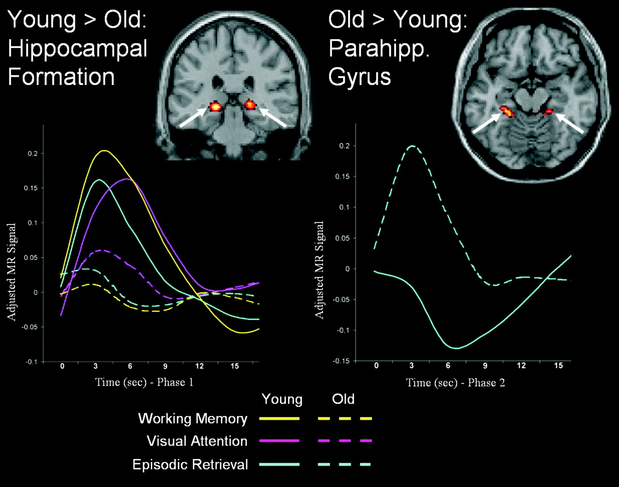
Figure 4. Dissociation between two medial temporal lobe regions. The hippocampal formation, bilaterally, was ...
Notes:
Figure 4. Dissociation between two medial temporal lobe regions. The hippocampal formation, bilaterally, was more activated in younger than in older adults during all tasks (task-independent age effect), whereas the parahippocampal gyrus, bilaterally, was more activated in older than in younger adults during the ER task (task-specific age effect). The time-course plots are from the left hippocampal formation (x, y, z = –19, –29, –2) and the left parahippocampal gyrus (x, y, z = –26, –34, –11).
Unless provided in the caption above, the following copyright applies to the content of this slide:

