Slide 1
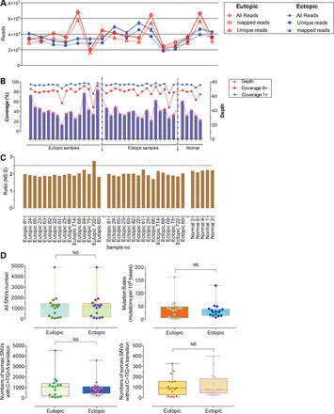
Figure 1. Sequencing characteristics and mutation number and type. (A) Exome-sequencing quality control. Total raw ...
Notes:
Figure 1. Sequencing characteristics and mutation number and type. (A) Exome-sequencing quality control. Total raw sequencing reads and enrichment for the targeted exome regions enrichments were similar across samples. (B) Coverage of the target coding regions analyzed at the indicated depth is plotted for each pair of eutopic and ectopic endometrium specimens, and normal endometrium. (C) Non-synonymous versus synonymous mutations in the endometrium samples (including eutopic endometrium and ectopic endometrium) were analyzed by whole-exome sequencing. (D) Plots demonstrating the number of somatic mutations (or the number of somatic mutations per megabase) in eutopic and ectopic endometrium samples from 16 individuals with endometriosis; plots also showing the fraction of somatic SNVs that were C>T/G>A transitions or other than C>T/G>A transitions in eutopic and ectopic endometrium from 16 endometriosis patients. The P-value indicates whether there was a significantly different mutation number in eutopic and ectopic endometrium and was calculated using the two-tailed Wilcoxon signed-rank test.
Unless provided in the caption above, the following copyright applies to the content of this slide: © The Author 2014. Published by Oxford University Press. All rights reserved. For Permissions, please email: journals.permissions@oup.com

Slide 2
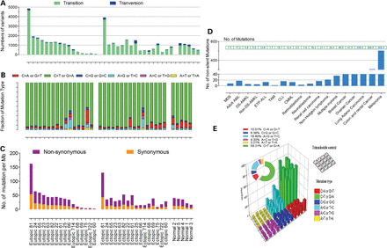
Figure 2. Mutation spectrum of whole-exome sequenced eutopic and ectopic endometrium from endometriosis. (A) For each ...
Notes:
Figure 2. Mutation spectrum of whole-exome sequenced eutopic and ectopic endometrium from endometriosis. (A) For each endometrium sample, the total number of SNVs, transition variants and transversion mutations is shown. (B and E) The mutation spectra of single base pair substitutions in endometriosis as assessed by whole-exome sequencing. The number of each of the six base substitution classes resulting in non-synonymous changes in the whole-exome screen is shown in B. Lego plots of mutation frequencies across 16 endometriosis samples from whole-exome sequencing. Base substitutions were divided into six categories to represent the six possible base changes (each category represented by a different color). Substitutions were further divided by the 16 possible flanking nucleotides surrounding the mutated base as listed in the trinucleotide context legend. Inserted pie charts indicate the distribution of all mutations for a given middle mutated base across the evaluated (as shown in E). (C) Somatic mutation rate per megabase of the covered target sequence in the 16 cases with endometriosis and five normal control cases. (D) Number of non-silent mutations across other cancer types and number of non-silent mutations for the indicated cancer types. MDS, myelodysplastic syndromes; ETP-ALL, early T-cell precursor acute lymphoblastic leukemia; CLL, chronic lymphocytic leukemia; CMML, chronic myelomonocytic leukemia.
Unless provided in the caption above, the following copyright applies to the content of this slide: © The Author 2014. Published by Oxford University Press. All rights reserved. For Permissions, please email: journals.permissions@oup.com

Slide 3
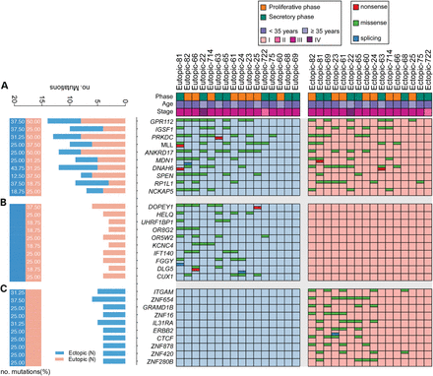
Figure 3. Genes with high mutation loads in endometriosis. A plot of genes with a high load of somatic non-synonymous ...
Notes:
Figure 3. Genes with high mutation loads in endometriosis. A plot of genes with a high load of somatic non-synonymous mutation load. Mutation subtypes are denoted by color. Associations between genetic alterations and clinicopathological characteristics of endometriosis are shown. The bars indicate nonsense mutations (red), missense mutations (green), and splice-site variants (blue) that lead to frame shifts and early chain termination. (A) Mutation distribution in recurrently mutated genes in both eutopic and ectopic endometrium samples; (B) distribution of mutations in genes recurrently mutated only in eutopic endometrium samples; (C) distribution of mutations in genes recurrently mutated only in ectopic endometrium samples; left, number and percentage of samples with mutations in a given gene.
Unless provided in the caption above, the following copyright applies to the content of this slide: © The Author 2014. Published by Oxford University Press. All rights reserved. For Permissions, please email: journals.permissions@oup.com

Slide 4
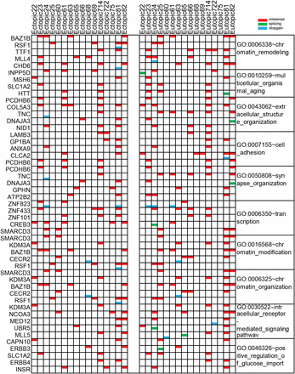
Figure 4. Integrative analysis of genomic alterations in endometriosis. The heatmap shows the pattern of case-specific, ...
Notes:
Figure 4. Integrative analysis of genomic alterations in endometriosis. The heatmap shows the pattern of case-specific, concurrent and mutually exclusive mutations in 16 eutopic endometrium and ectopic endometrium samples. Each column represents an individual affected case, and each row denotes a specific gene assigned to one of 10 functional categories (labeled on the right). Significant and selected endometriosis related somatic mutations, splicing and stop-gain in endometriosis are indicated. Mutation subtypes are denoted by color. If multiple mutations were found in a gene in a single sample, only one is shown.
Unless provided in the caption above, the following copyright applies to the content of this slide: © The Author 2014. Published by Oxford University Press. All rights reserved. For Permissions, please email: journals.permissions@oup.com

