Slide 1
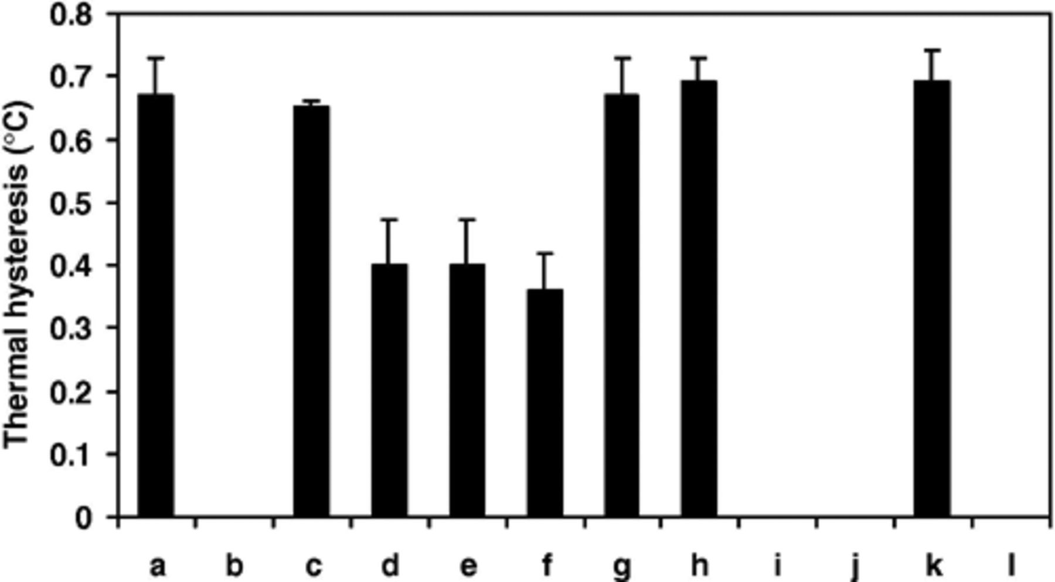
1 Effect of various conditions on MpAFP activity in crude lysate supernatant (error bars show standard ...
Notes:
1 Effect of various conditions on MpAFP activity in crude lysate supernatant (error bars show standard deviation): (a) control: ?6.5 mg ml−1 crude lysate supernatant; (b) exhaustive dialysis; (c) dialysate 10 mM Ca2+; (d) 10 mM EDTA; (e) 100 mM EDTA; (f) 10 mM EGTA; (g) 10 mM EDTA + 20 mM Ca2+; (h) 10 mM o-phenanthroline; (i) proteinase K (+ or −Ca2+); (j) pronase (−Ca2+); (k) trypsin (+ Ca2+); (l) trypsin (−Ca2+).
Unless provided in the caption above, the following copyright applies to the content of this slide: © 2005 Federation of European Microbiological Societies

Slide 2
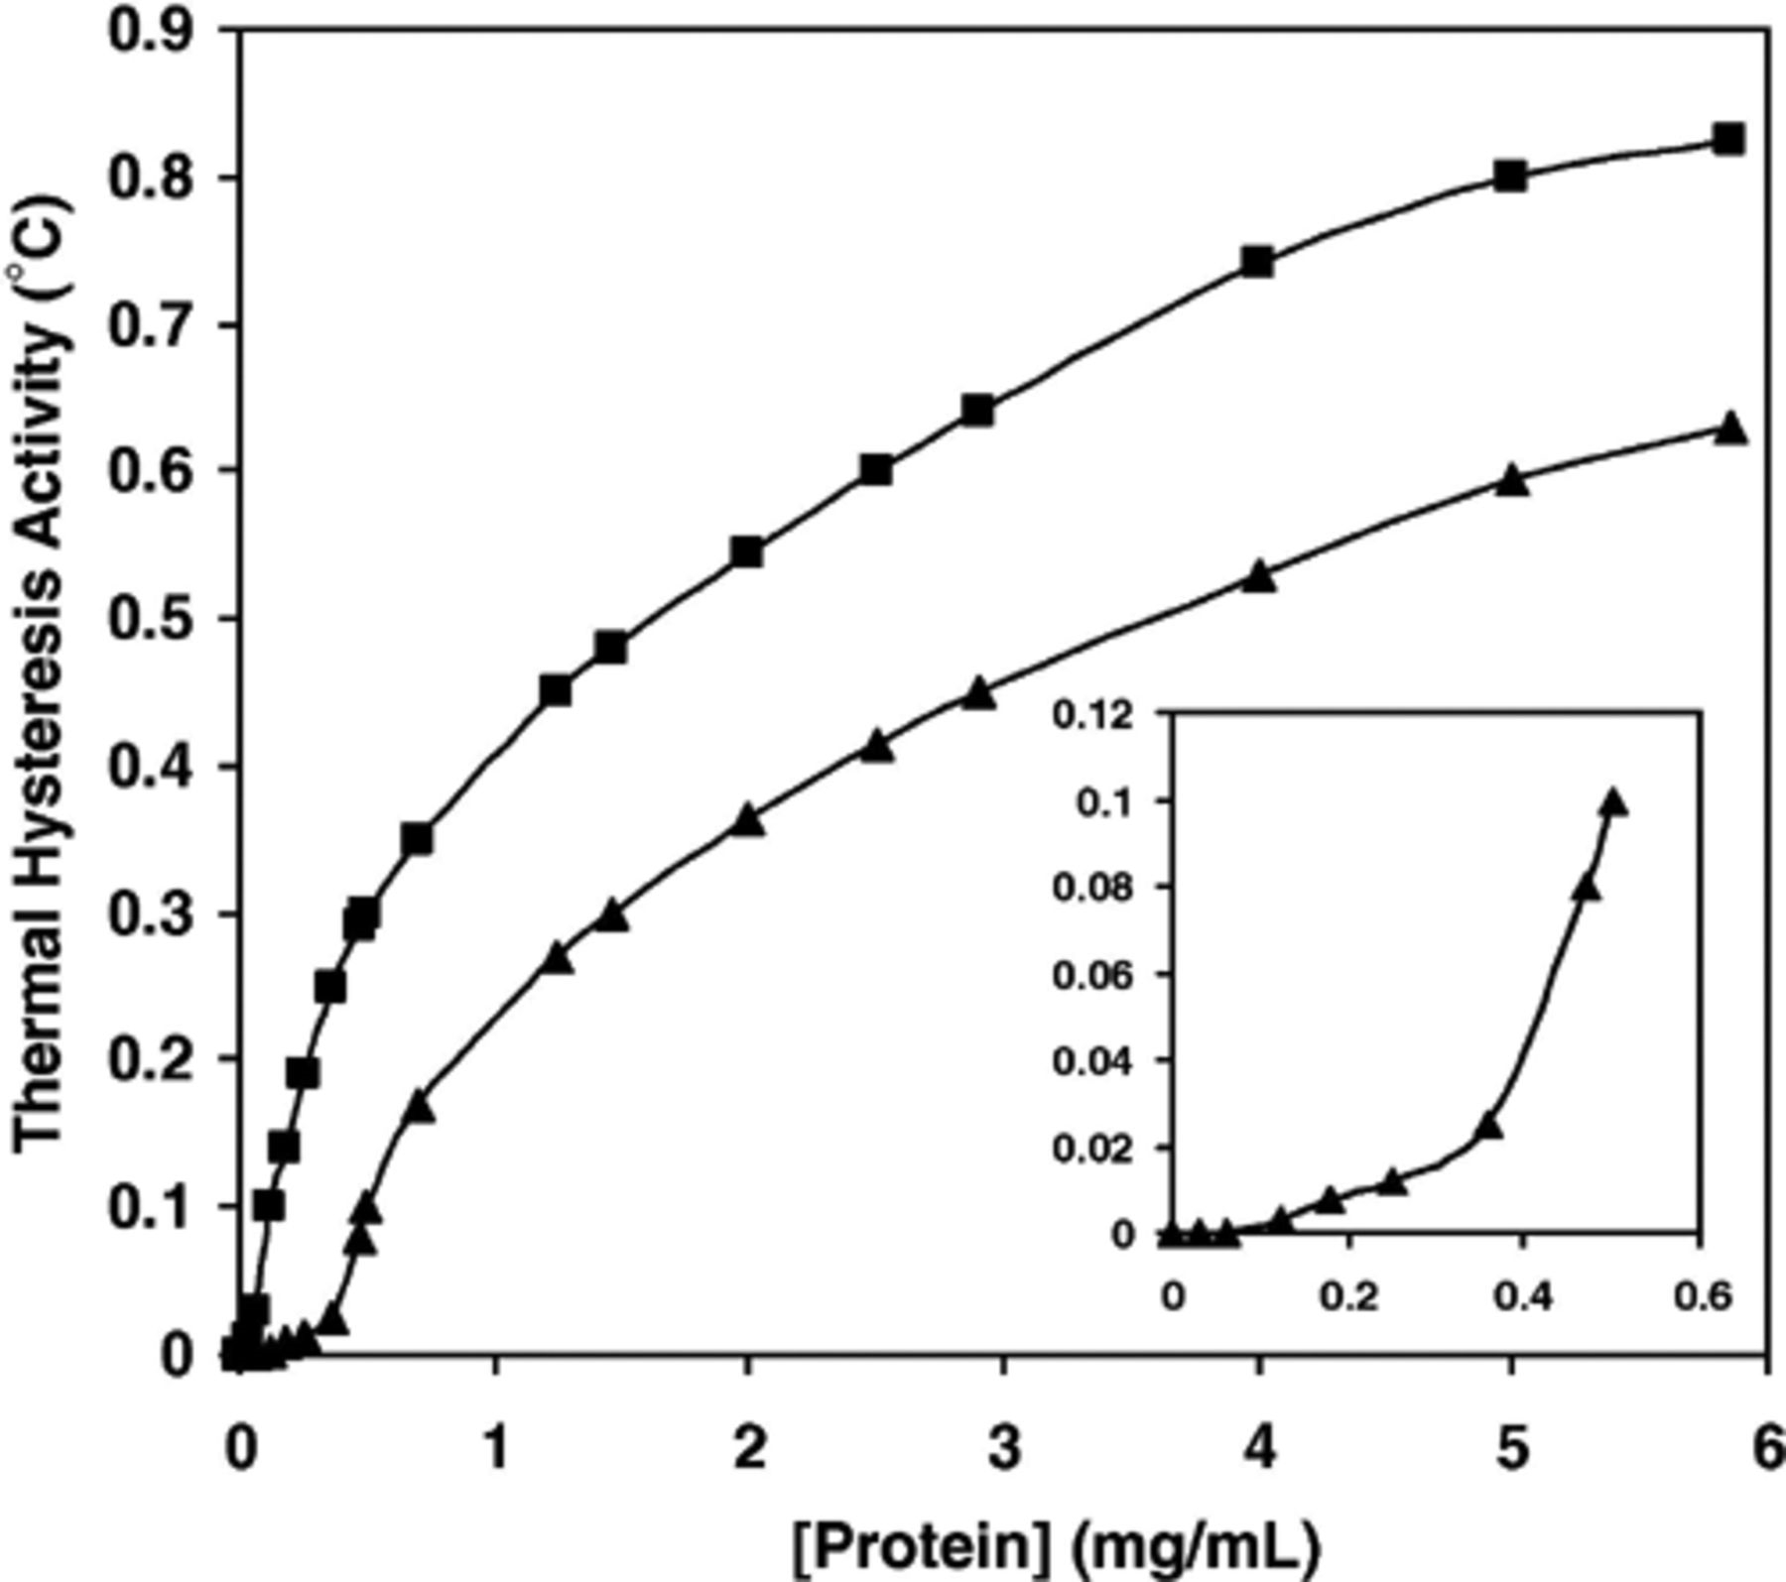
2 Thermal hysteresis activity versus protein concentration curves for pure fish type III AFP (♦) and crude ...
Notes:
2 Thermal hysteresis activity versus protein concentration curves for pure fish type III AFP (♦) and crude lysate supernatant of M. primoryensis (▲). The insert shows the sigmoidal nature of the M. protea curve at low protein concentrations.
Unless provided in the caption above, the following copyright applies to the content of this slide: © 2005 Federation of European Microbiological Societies

Slide 3
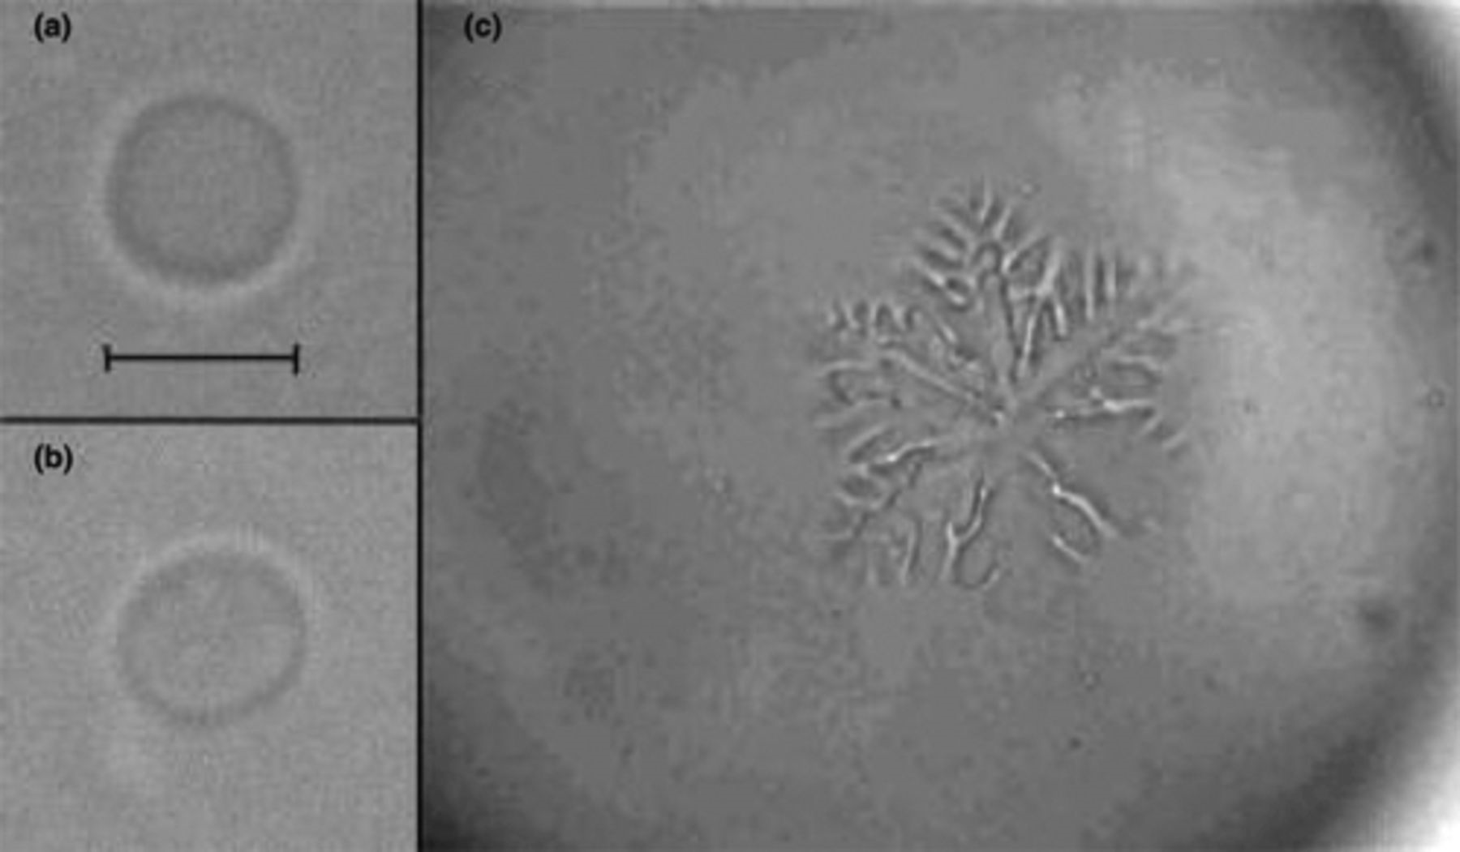
3 Ice crystal morphologies obtained with MpAFP. (a) and (b) two different ice crystals obtained in the presence ...
Notes:
3 Ice crystal morphologies obtained with MpAFP. (a) and (b) two different ice crystals obtained in the presence of M. primoryensis crude lysate supernatant at 0.3 °C of under-cooling. (c) a dendritic crystal growing extremely rapidly below the non-equilibrium freezing point. Size marker = 50 μm and relates to (a) and (b) only.
Unless provided in the caption above, the following copyright applies to the content of this slide: © 2005 Federation of European Microbiological Societies

