Slide 1
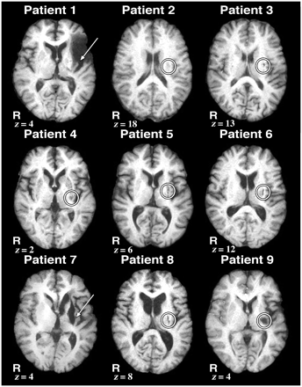
Figure 1 High-resolution structural MRI images showing the extent of the lesions in each patient. All nine patients ...
Notes:
Figure 1 High-resolution structural MRI images showing the extent of the lesions in each patient. All nine patients had ischaemic strokes with lesions encompassing the left putamen, indicated by an arrow or circle. Slice location is given as millimetres above the anterior–posterior commissure line in standard space in the z-axis. R = right.
Unless provided in the caption above, the following copyright applies to the content of this slide: © The Author (2011). Published by Oxford University Press on behalf of the Guarantors of Brain. All rights reserved. For Permissions, please email: journals.permissions@oup.com

Slide 2
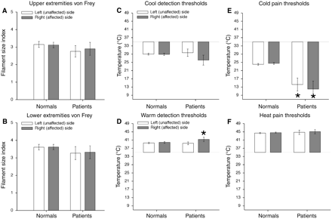
Figure 2 Tactile and thermal thresholds (mean ± SEM). Tactile threshold of patients with putamen lesions were not ...
Notes:
Figure 2 Tactile and thermal thresholds (mean ± SEM). Tactile threshold of patients with putamen lesions were not significantly different from healthy controls (normals) (A, B). Patients with putamen lesions displayed some disturbances in cold pain thresholds and warm detection thresholds while exhibiting normal heat pain and innocuous cool detection thresholds (C–F). Cool detection thresholds on both the left and right sides of patients were in the range of those of the healthy subjects (C). However, cold pain thresholds of patients were significantly lower than those of the healthy subjects on both sides (P < 0.01) (E). In addition, patients had higher warmth detection thresholds on their right (affected/contralesional) sides than did healthy control subjects (P = 0.05) (D). The left (unaffected/ipsilesional) and right (affected/contralesional) heat pain thresholds of patients appear completely normal and symmetric (F). Asterisk denotes statistical significance (P < 0.05).
Unless provided in the caption above, the following copyright applies to the content of this slide: © The Author (2011). Published by Oxford University Press on behalf of the Guarantors of Brain. All rights reserved. For Permissions, please email: journals.permissions@oup.com

Slide 3
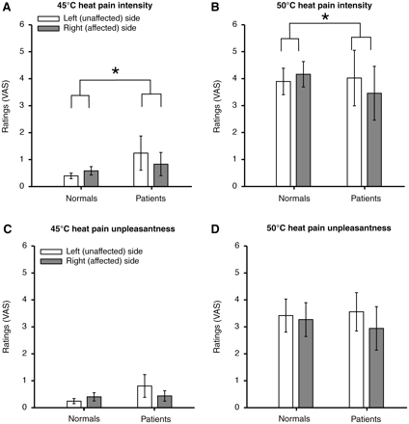
Figure 3 Pain intensity and unpleasantness visual analogue scale (VAS) ratings during the graded noxious stimulation ...
Notes:
Figure 3 Pain intensity and unpleasantness visual analogue scale (VAS) ratings during the graded noxious stimulation at 45 and 50°C (mean ± SEM). Patients retained the ability to discriminate noxious stimuli of graded intensities applied to the posterior aspect of the lower legs on both left (unaffected/ipsilesional) and right (affected/contralesional) sides. However, patients exhibited significantly lower visual analogue scale ratings of pain intensity during stimulation of the right (affected/contralesional) side than those of left (unaffected/ipsilesional) side when compared with healthy subjects (normals) (P < 0.01) (A, B). Although side-to-side differences in pain unpleasantness ratings between the patients and healthy subjects did not reach statistical significance, there was a strong trend towards a difference (P = 0.052) (C, D). Asterisk denotes statistical significance (P < 0.05). Please note that since visual analogue scale ratings of 35°C were zero, these values were not displayed on the bar graphs.
Unless provided in the caption above, the following copyright applies to the content of this slide: © The Author (2011). Published by Oxford University Press on behalf of the Guarantors of Brain. All rights reserved. For Permissions, please email: journals.permissions@oup.com

Slide 4
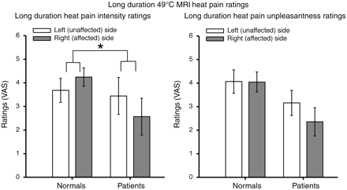
Figure 4 Pain intensity and unpleasantness visual analogue scale (VAS) ratings during long duration noxious ...
Notes:
Figure 4 Pain intensity and unpleasantness visual analogue scale (VAS) ratings during long duration noxious stimulation (mean ± SEM). Putamen lesions produced decreased pain sensitivity to long duration noxious stimuli on the right (affected/contralesional) body side in patients when compared with healthy subjects. Patients exhibited significantly lower visual analogue scale ratings of pain intensity during stimulation of the right (affected/contralesional) side than those of the left (unaffected/ipsilesional) side when compared with healthy subjects (P = 0.0058). Although, side-to-side differences of pain unpleasantness ratings between patients and healthy subjects did not reach statistical significance, there was a strong trend towards a difference (P = 0.0762). Asterisk denotes statistical significance (P < 0.05).
Unless provided in the caption above, the following copyright applies to the content of this slide: © The Author (2011). Published by Oxford University Press on behalf of the Guarantors of Brain. All rights reserved. For Permissions, please email: journals.permissions@oup.com

Slide 5
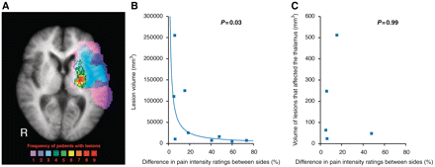
Figure 5 Focal lesions specific to the putamen are effective in producing large differences in pain ratings between ...
Notes:
Figure 5 Focal lesions specific to the putamen are effective in producing large differences in pain ratings between sides in patients. Voxels in colour represent the number of patients with lesions at a given locus (displayed on a structural MRI that has been averaged across all lesion patients, A). The patients’ lesions were concentrated within the left putamen (outlined in black) with a few subjects showing larger, more extensive lesions. The difference in pain intensity ratings between sides is inversely logarithmically related to lesion volume (B). However, in the five subjects where the lesion encroached into the thalamus, there was no relationship between the difference in pain intensity ratings between sides and volume of thalamus that was affected by the lesion (C). R = right.
Unless provided in the caption above, the following copyright applies to the content of this slide: © The Author (2011). Published by Oxford University Press on behalf of the Guarantors of Brain. All rights reserved. For Permissions, please email: journals.permissions@oup.com

Slide 6
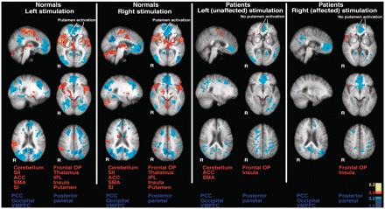
Figure 6 Pain-related brain activation in healthy subjects and patients. During long duration noxious stimulation of ...
Notes:
Figure 6 Pain-related brain activation in healthy subjects and patients. During long duration noxious stimulation of either body side in the healthy subjects (normals), brain activation was identified within the anterior cingulate cortex, supplementary motor area, secondary somatosensory cortex, insula, SI, frontal operculum, thalamus, putamen and cerebellum (left). Putamen activation was detected bilaterally during stimulation of either body side. Additionally, activation was identified within anterior areas of the thalamus during painful stimulation of either body side. In contrast, during painful stimulation of the left (unaffected/ipsilesional) body side in patients, pain-induced brain activation was identified within the anterior cingulate cortex, insula, frontal operculum, supplementary motor area and cerebellum (right). However, no secondary somatosensory cortex, thalamic or putamen activation was observed. Stimulation of the right (affected/contralesional) leg in patients activated the insula and frontal operculum. In general, brain activation during stimulation of the right (affected/contralesional) side was less pronounced than that during stimulation of the left (unaffected/ipsilesional) side in patients. In addition, pain-related brain activation during stimulation of either side in patients is less robust than that of healthy subjects. Anatomical images are the average of the structural MRIs of the healthy subjects and patients, respectively. ACC = anterior cingulate cortex; IPL = inferior parietal lobule; OP = operculum; PCC = posterior cingulate cortex; R = right; SI = primary somatosensory cortex; SMA = supplementary motor area; VMPFC = ventromedial prefrontal cortex.
Unless provided in the caption above, the following copyright applies to the content of this slide: © The Author (2011). Published by Oxford University Press on behalf of the Guarantors of Brain. All rights reserved. For Permissions, please email: journals.permissions@oup.com

Slide 7
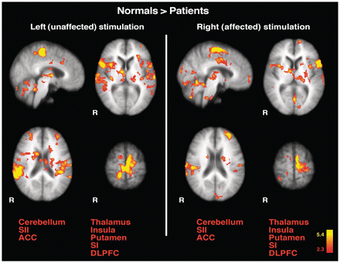
Figure 7 Direct comparison of pain-related brain activation between healthy subjects and patients. The activated areas ...
Notes:
Figure 7 Direct comparison of pain-related brain activation between healthy subjects and patients. The activated areas represent regions where healthy subjects (normals) exhibited greater pain-related brain activation than patients (healthy subjects > patients). When compared with healthy subjects, patients exhibited less activation in a number of areas involved in nociceptive processing including secondary somatosensory cortex, SI, anterior cingulate cortex, insula, thalamus, cerebellum, dorsolateral prefrontal cortex, and putamen during stimulation of both affected (right) and unaffected sides (left). Anatomical images are the average of the structural MRIs of the healthy controls. ACC = anterior cingulate cortex; R = right; SI = primary somatosensory cortex; SII = secondary somatosensory cortex; DLPFC = dorsolateral prefrontal cortex.
Unless provided in the caption above, the following copyright applies to the content of this slide: © The Author (2011). Published by Oxford University Press on behalf of the Guarantors of Brain. All rights reserved. For Permissions, please email: journals.permissions@oup.com

Slide 8
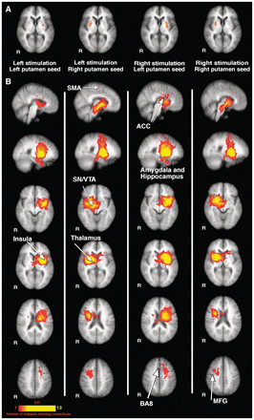
Figure 8 Putamen activation and structural connectivity of the putamen. The top row shows putamen activation during ...
Notes:
Figure 8 Putamen activation and structural connectivity of the putamen. The top row shows putamen activation during pain (A). The patterns of ipsilateral and contralateral putamen activation differed substantially regardless of side of stimulation. The ipsilateral putamen activation appears to be smaller when compared with that of contralateral putamen activation. These four putamen activation loci were used as seeds for structural connectivity analyses. Each of the four panels separated by white vertical lines displays structural (diffusion tensor imaging) connections of the corresponding seed mask (B). Structurally connected brain areas identified included: (i) nociceptive processing areas including anterior cingulate cortex, insula and thalamus; (ii) attention-related areas including middle frontal gyrus, BA8, anterior cingulate cortex and supplementary motor area; and (iii) memory processing areas including the amygdala and hippocampus. In addition, the substantia nigra/ventral tegmental area in the midbrain was also found to be structurally connected with the putamen. Note that the significance colour bar denotes the number of subjects displaying corresponding structural connections in the diffusion tensor image. Anatomical images are the average of the structural MRIs of the normal controls. ACC = anterior cingulate cortex; middle frontal gyrus = MFG; R = right; SI = primary somatosensory cortex; SMA = supplementary motor area; SN/VTA = substantia nigra/ventral tegmental area.
Unless provided in the caption above, the following copyright applies to the content of this slide: © The Author (2011). Published by Oxford University Press on behalf of the Guarantors of Brain. All rights reserved. For Permissions, please email: journals.permissions@oup.com

Slide 9
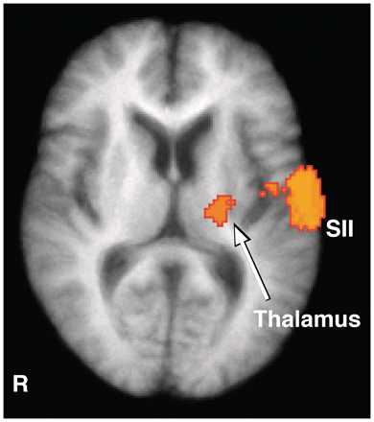
Figure 9 Integrity of thalamo-cortical connectivity in putamen-lesioned patients. Connections between the thalamus and ...
Notes:
Figure 9 Integrity of thalamo-cortical connectivity in putamen-lesioned patients. Connections between the thalamus and primary somatosensory cortex as assessed with diffusion tensor imaging probabilistic tractography analysis. Regions depicted in colour represent detectible connections in seven or more patients. These connections traversed the internal capsule and extended into the ventral/lateral region of the thalamus. Lateral to the thalamus, connections to the parietal operculum/secondary somatosensory cortex were also detected. The anatomical image is the average of the structural MRIs of the lesion patients. R = right SII = secondary somatosensory cortex.
Unless provided in the caption above, the following copyright applies to the content of this slide: © The Author (2011). Published by Oxford University Press on behalf of the Guarantors of Brain. All rights reserved. For Permissions, please email: journals.permissions@oup.com

