Slide 1
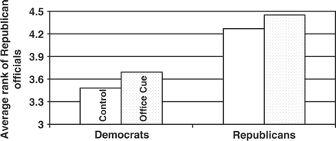
Figure 1 Partisan similarities in office cue use.
Notes:
Figure 1 Partisan similarities in office cue use.
Unless provided in the caption above, the following copyright applies to the content of this slide: © The Author 2008. Published by Oxford University Press on behalf of CSF Associates: Publius, Inc. All rights reserved. For permissions, please email: journals.permissions@oxfordjournals.org.

