Slide 1
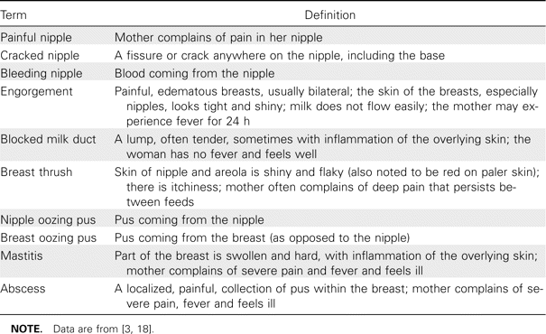
Table 1 Definitions of breast health conditions.
Notes:
Table 1 Definitions of breast health conditions.
Unless provided in the caption above, the following copyright applies to the content of this slide: © 2007 Infectious Diseases Society of America

Slide 2
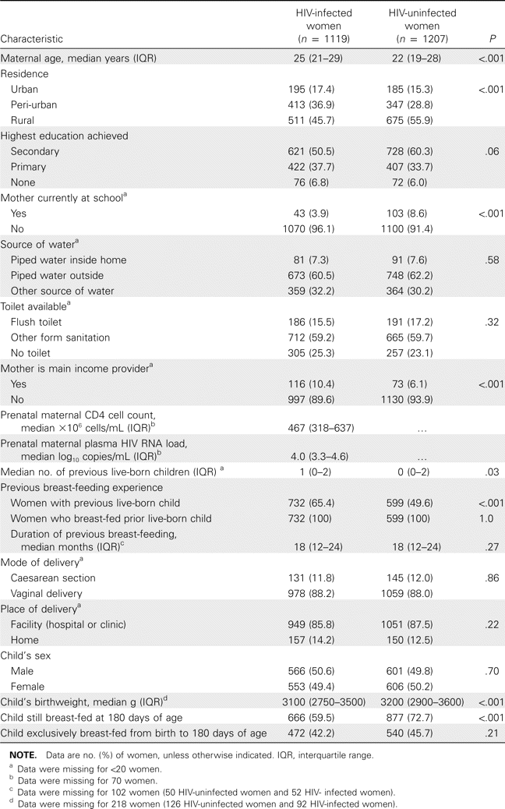
Table 2 Baseline characteristics of women and children, according to maternal HIV status.
Notes:
Table 2 Baseline characteristics of women and children, according to maternal HIV status.
Unless provided in the caption above, the following copyright applies to the content of this slide: © 2007 Infectious Diseases Society of America

Slide 3
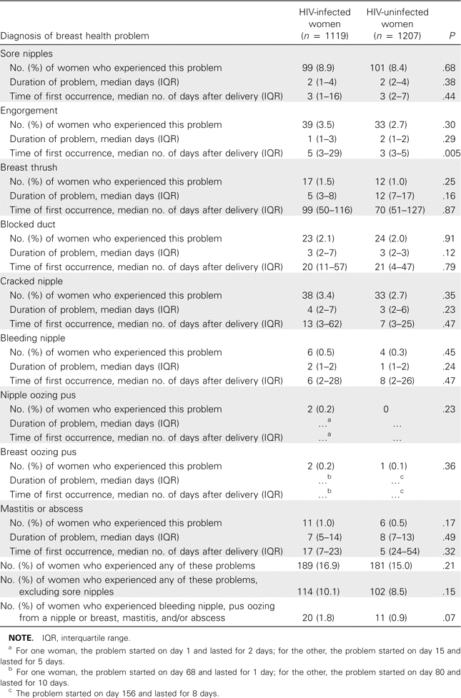
Table 3 Frequency and duration of breast health problems in the first 6 months after delivery, according to maternal ...
Notes:
Table 3 Frequency and duration of breast health problems in the first 6 months after delivery, according to maternal HIV status.
Unless provided in the caption above, the following copyright applies to the content of this slide: © 2007 Infectious Diseases Society of America

Slide 4
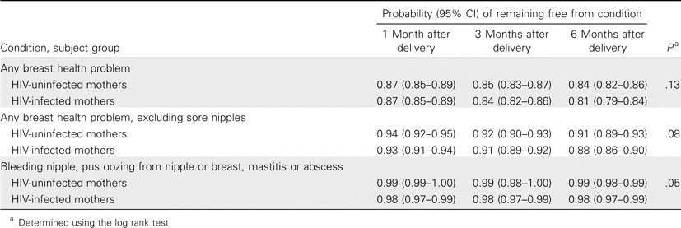
Table 4 Kaplan-Meier probability of remaining free from breast health problems, according to maternal HIV status
Notes:
Table 4 Kaplan-Meier probability of remaining free from breast health problems, according to maternal HIV status
Unless provided in the caption above, the following copyright applies to the content of this slide: © 2007 Infectious Diseases Society of America

Slide 5
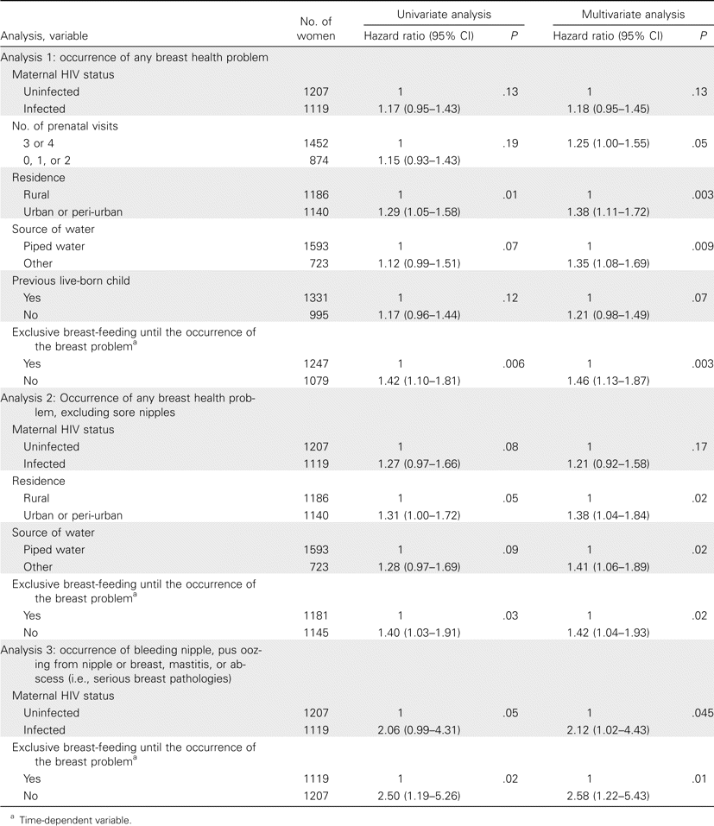
Table 5 Determinants of the occurrence of a breast health problems.
Notes:
Table 5 Determinants of the occurrence of a breast health problems.
Unless provided in the caption above, the following copyright applies to the content of this slide: © 2007 Infectious Diseases Society of America

