Slide 1
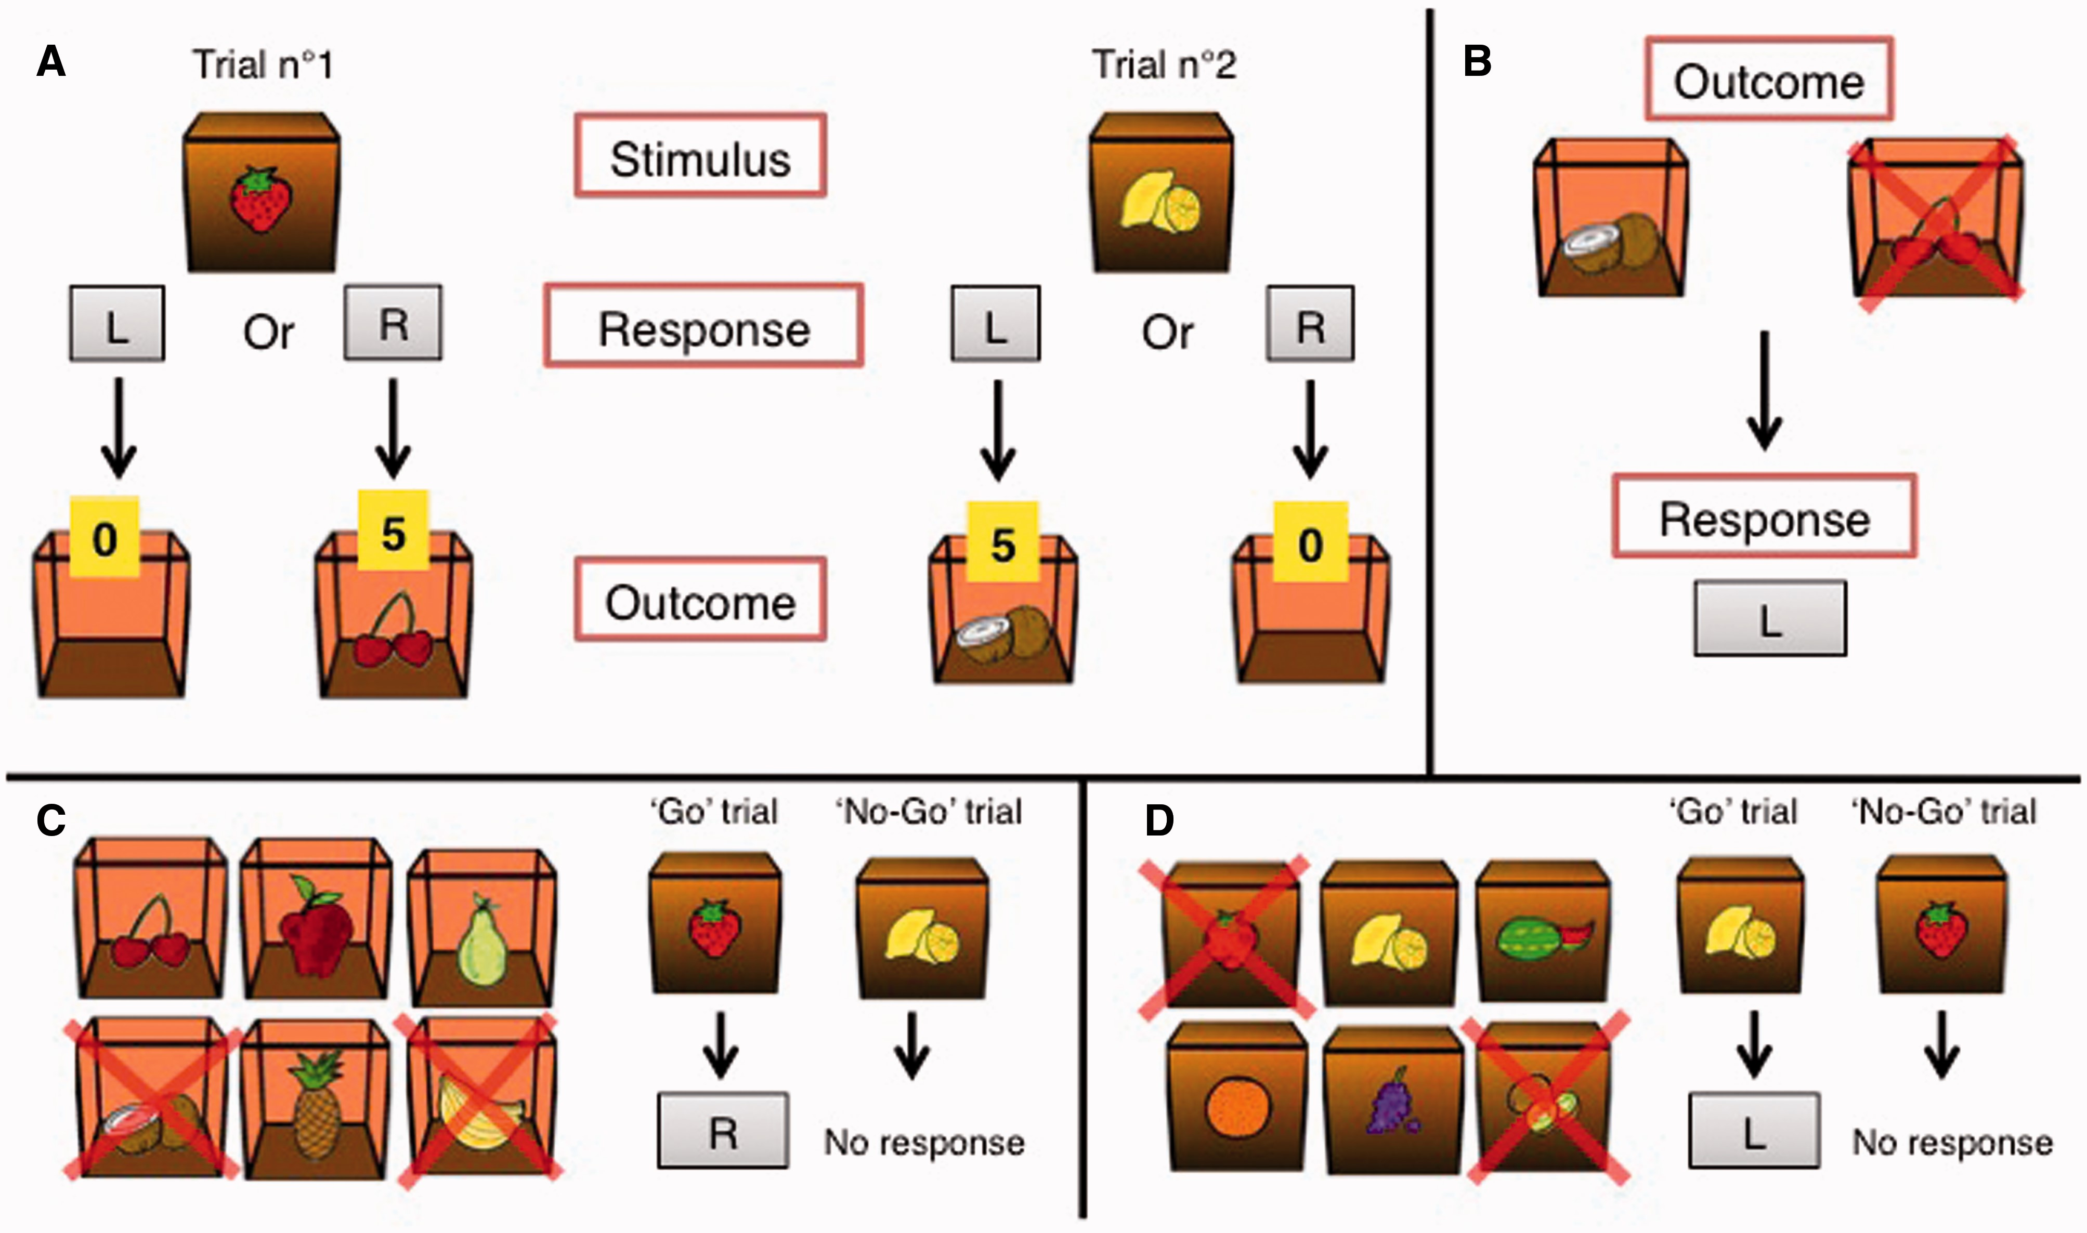
Figure 1 Task description. (A) Instrumental learning stage. In this example, in two different trials, participants are ...
Notes:
Figure 1 Task description. (A) Instrumental learning stage. In this example, in two different trials, participants are presented with a strawberry or a lemon on the outside of a box (stimuli). For each of the trials, if the correct key is pressed (R = right for strawberry and L = left for lemon), participants are rewarded with another fruit (outcome) on the inside of the box and points. If the incorrect key is pressed, an empty box is shown and no points are earned. (B) Outcome-devaluation stage: the participant is instructed to press the key that would bring the still-valuable outcome (the one that is not marked with a red cross) during the first stage. In this example, the subject should press the left key, as it was previously associated with the coconut picture. (C) Slips-of-action test. In this example, the initial screen indicates that the banana and the coconut outcomes are no longer valuable. The participant is then presented with a succession of stimulus pictures. He should press the correct key (R) to the strawberry stimulus but withhold his response to the lemon stimulus (which is associated with the devalued coconut). (D) Baseline test of response inhibition. In this example, the initial screen indicates that the strawberry and kiwi stimuli are devalued. The participant is then presented with a succession of stimulus pictures. He should press the correct key (L) to the lemon stimulus but withhold his response to the strawberry, which is a devalued stimulus.
Unless provided in the caption above, the following copyright applies to the content of this slide: © The Author (2015). Published by Oxford University Press on behalf of the Guarantors of Brain. All rights reserved. For Permissions, please email: journals.permissions@oup.comThis article is published and distributed under the terms of the Oxford University Press, Standard Journals Publication Model (https://academic.oup.com/journals/pages/about_us/legal/notices)

Slide 2
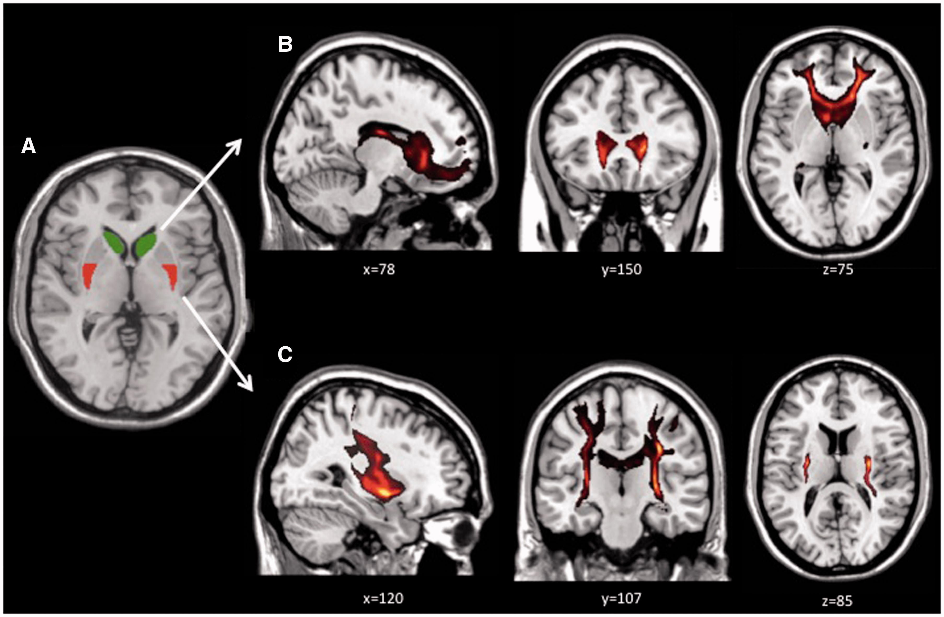
Figure 2 Regions of interest-seeded tractography. (A) Masks of the anterior caudate (green) and posterior putamen ...
Notes:
Figure 2 Regions of interest-seeded tractography. (A) Masks of the anterior caudate (green) and posterior putamen (red). (B) Tractography images seeded from the anterior caudate. (C) Tractography images seeded from the posterior putamen. Coordinates are shown in MNI.
Unless provided in the caption above, the following copyright applies to the content of this slide: © The Author (2015). Published by Oxford University Press on behalf of the Guarantors of Brain. All rights reserved. For Permissions, please email: journals.permissions@oup.comThis article is published and distributed under the terms of the Oxford University Press, Standard Journals Publication Model (https://academic.oup.com/journals/pages/about_us/legal/notices)

Slide 3
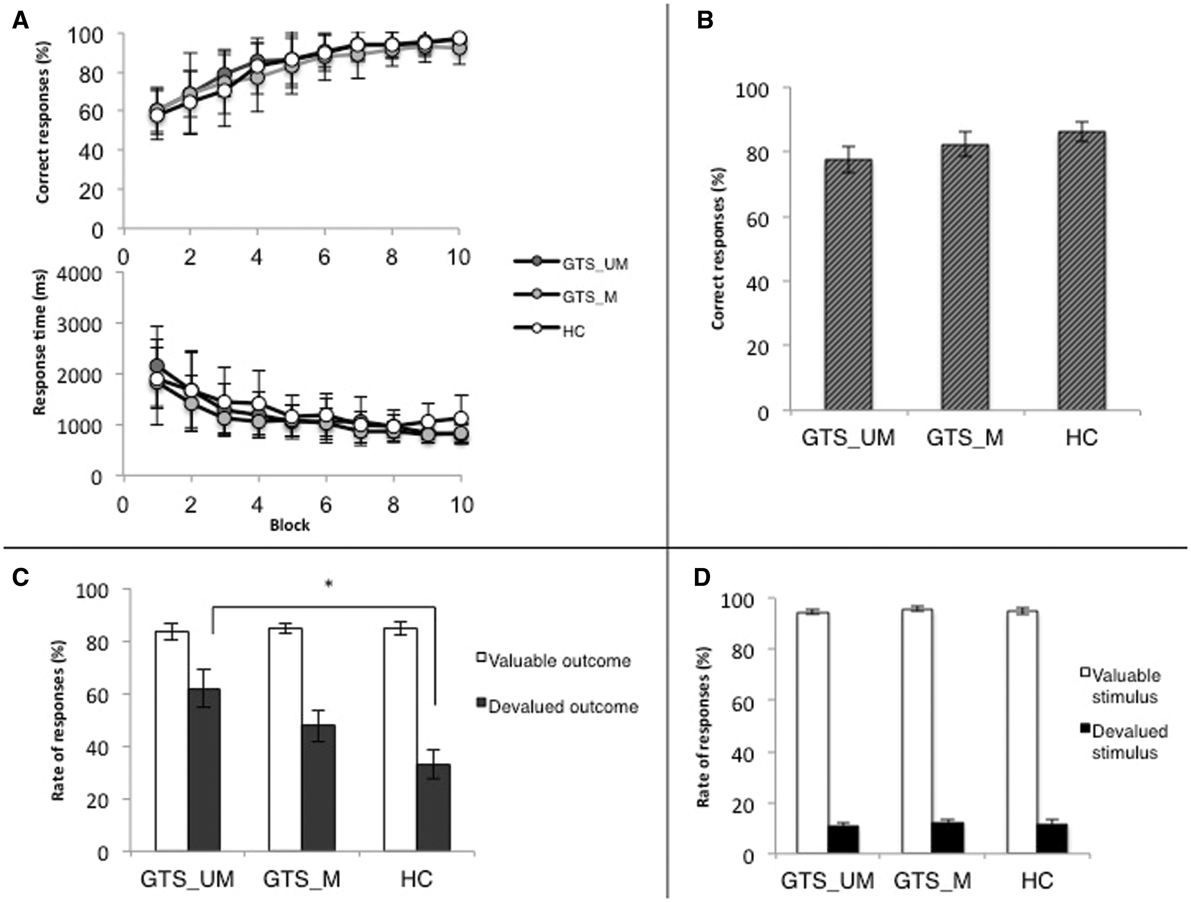
Figure 3 Results of the behavioural task. (A) Instrumental learning stage. (B) Outcome-devaluation stage. ...
Notes:
Figure 3 Results of the behavioural task. (A) Instrumental learning stage. (B) Outcome-devaluation stage. (C)’Slip-of-action’ stage. (D) Baseline stage. Error bars represent SEM. *P < 0.05.
Unless provided in the caption above, the following copyright applies to the content of this slide: © The Author (2015). Published by Oxford University Press on behalf of the Guarantors of Brain. All rights reserved. For Permissions, please email: journals.permissions@oup.comThis article is published and distributed under the terms of the Oxford University Press, Standard Journals Publication Model (https://academic.oup.com/journals/pages/about_us/legal/notices)

Slide 4
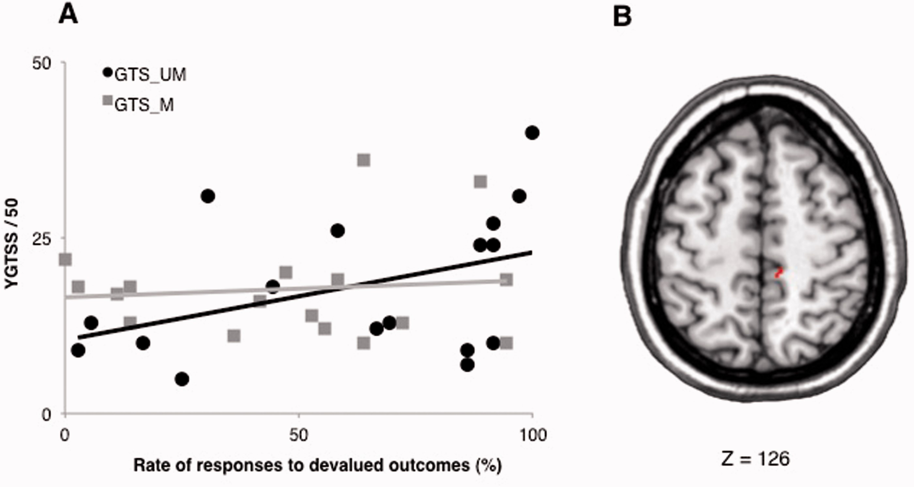
Figure 4 Correlation and regression analysis. (A) Correlation between the rate of response associated with devalued ...
Notes:
Figure 4 Correlation and regression analysis. (A) Correlation between the rate of response associated with devalued outcomes in the ‘slip-of-action’ stage and the YGTSS/50 in the two GTS groups: unmedicated patients with GTS (GTS_UM), and antipsychotic medicated patients with GTS (GTS_M). (B) Cortical cluster showing the connectivity from the posterior putamen, after regression with the rate of response towards devalued outcomes (P < 0.001); voxels = 16, peak coordinates: x = 80, y = 93, z = 126. Neurological convention (right is right) and MNI coordinates are used.
Unless provided in the caption above, the following copyright applies to the content of this slide: © The Author (2015). Published by Oxford University Press on behalf of the Guarantors of Brain. All rights reserved. For Permissions, please email: journals.permissions@oup.comThis article is published and distributed under the terms of the Oxford University Press, Standard Journals Publication Model (https://academic.oup.com/journals/pages/about_us/legal/notices)

