Slide 1
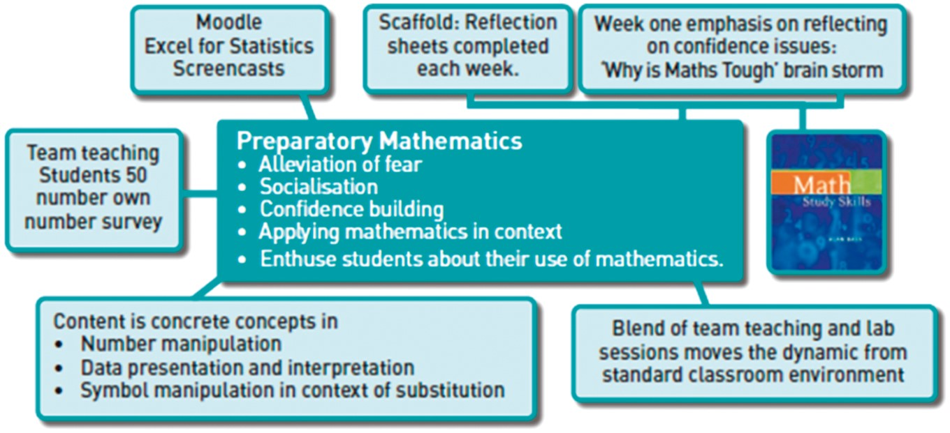
Fig. 1. Overview of Preparatory Mathematics intervention.
Notes:
Fig. 1. Overview of Preparatory Mathematics intervention.
Unless provided in the caption above, the following copyright applies to the content of this slide: © The Author 2017. Published by Oxford University Press on behalf of The Institute of Mathematics and its Applications. All rights reserved. For permissions, please email: journals.permissions@oup.com

Slide 2
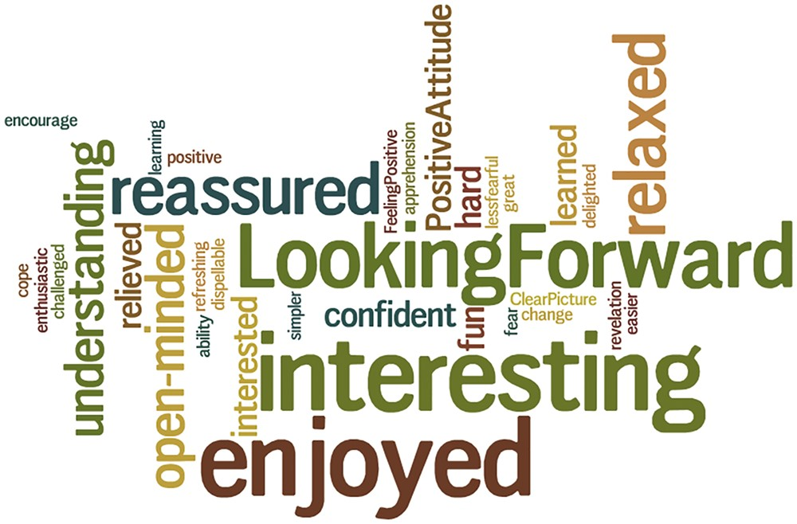
Fig. 2. Student feedback—first session.
Notes:
Fig. 2. Student feedback—first session.
Unless provided in the caption above, the following copyright applies to the content of this slide: © The Author 2017. Published by Oxford University Press on behalf of The Institute of Mathematics and its Applications. All rights reserved. For permissions, please email: journals.permissions@oup.com

Slide 3
Fig. 3. Student ‘overall’ feedback—after last session.
Notes:
Fig. 3. Student ‘overall’ feedback—after last session.
Unless provided in the caption above, the following copyright applies to the content of this slide: © The Author 2017. Published by Oxford University Press on behalf of The Institute of Mathematics and its Applications. All rights reserved. For permissions, please email: journals.permissions@oup.com

