Slide 1
Fig. 1 Schematic illustration of the paradigm for the fMRI experiment
Notes:
Fig. 1 Schematic illustration of the paradigm for the fMRI experiment
Unless provided in the caption above, the following copyright applies to the content of this slide: © The Author(s) (2013). Published by Oxford University Press.This is an Open Access article distributed under the terms of the Creative Commons Attribution Non-Commercial License (http://creativecommons.org/licenses/by-nc/4.0/), which permits non-commercial re-use, distribution, and reproduction in any medium, provided the original work is properly cited. For commercial re-use, please contact journals.permissions@oup.com

Slide 2
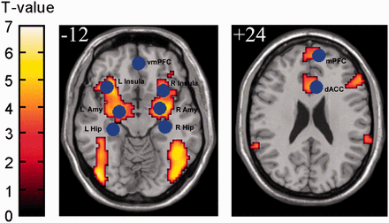
Fig. 2 Areas of brain activation in fear acquisition for the CS+ vs CS− condition. Based on functional result, we ...
Notes:
Fig. 2 Areas of brain activation in fear acquisition for the CS+ vs CS− condition. Based on functional result, we extract the ROI for resting analysis. The individual peak voxel within the group ROI was used for T-value and time course extraction for each subject.
Unless provided in the caption above, the following copyright applies to the content of this slide: © The Author(s) (2013). Published by Oxford University Press.This is an Open Access article distributed under the terms of the Creative Commons Attribution Non-Commercial License (http://creativecommons.org/licenses/by-nc/4.0/), which permits non-commercial re-use, distribution, and reproduction in any medium, provided the original work is properly cited. For commercial re-use, please contact journals.permissions@oup.com

Slide 3
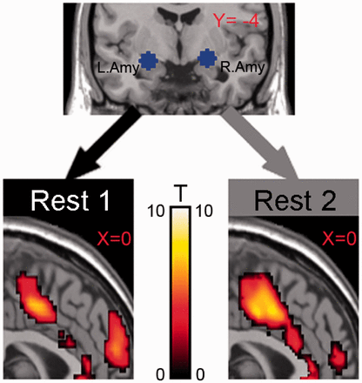
Fig. 3 Inter-regional functional coupling change over time. Sagittal views of inter-regional functional coupling ...
Notes:
Fig. 3 Inter-regional functional coupling change over time. Sagittal views of inter-regional functional coupling maps, focused on the amygdala coupling with dACC and the mPFC separately obtained from before fear acquisition (left) and after fear acquisition (right) (P = 0.01, Bonferroni corrected).
Unless provided in the caption above, the following copyright applies to the content of this slide: © The Author(s) (2013). Published by Oxford University Press.This is an Open Access article distributed under the terms of the Creative Commons Attribution Non-Commercial License (http://creativecommons.org/licenses/by-nc/4.0/), which permits non-commercial re-use, distribution, and reproduction in any medium, provided the original work is properly cited. For commercial re-use, please contact journals.permissions@oup.com

Slide 4
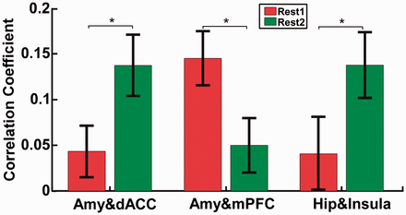
Fig. 4 The change in amygdala–dACC, amygdala–mPFC and Hippocampus–insula, functional coupling change over time ...
Notes:
Fig. 4 The change in amygdala–dACC, amygdala–mPFC and Hippocampus–insula, functional coupling change over time between REST1 and REST2; asterisk indicates P < 0.05.
Unless provided in the caption above, the following copyright applies to the content of this slide: © The Author(s) (2013). Published by Oxford University Press.This is an Open Access article distributed under the terms of the Creative Commons Attribution Non-Commercial License (http://creativecommons.org/licenses/by-nc/4.0/), which permits non-commercial re-use, distribution, and reproduction in any medium, provided the original work is properly cited. For commercial re-use, please contact journals.permissions@oup.com

Slide 5
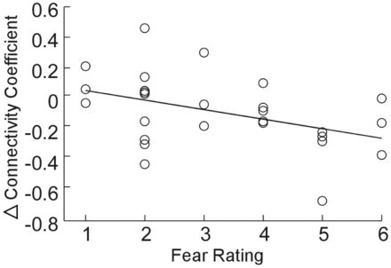
Fig. 5 Individual difference in the change (Δcorrelation coefficient) of amgydala–mPFC functional connectivity ...
Notes:
Fig. 5 Individual difference in the change (Δcorrelation coefficient) of amgydala–mPFC functional connectivity predicted individuals’ subjective fear ratings, r = −0.43, P = 0.03
Unless provided in the caption above, the following copyright applies to the content of this slide: © The Author(s) (2013). Published by Oxford University Press.This is an Open Access article distributed under the terms of the Creative Commons Attribution Non-Commercial License (http://creativecommons.org/licenses/by-nc/4.0/), which permits non-commercial re-use, distribution, and reproduction in any medium, provided the original work is properly cited. For commercial re-use, please contact journals.permissions@oup.com

Slide 6
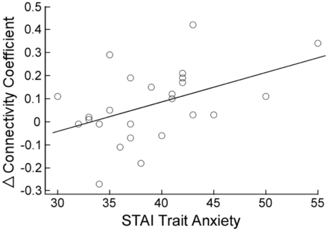
Fig. 6 High-trait anxiety was associated with enhanced functional connectivity between vmPFC and insula during fear ...
Notes:
Fig. 6 High-trait anxiety was associated with enhanced functional connectivity between vmPFC and insula during fear memory consolidation, r = 0.46, P = 0.02.
Unless provided in the caption above, the following copyright applies to the content of this slide: © The Author(s) (2013). Published by Oxford University Press.This is an Open Access article distributed under the terms of the Creative Commons Attribution Non-Commercial License (http://creativecommons.org/licenses/by-nc/4.0/), which permits non-commercial re-use, distribution, and reproduction in any medium, provided the original work is properly cited. For commercial re-use, please contact journals.permissions@oup.com

