Slide 1
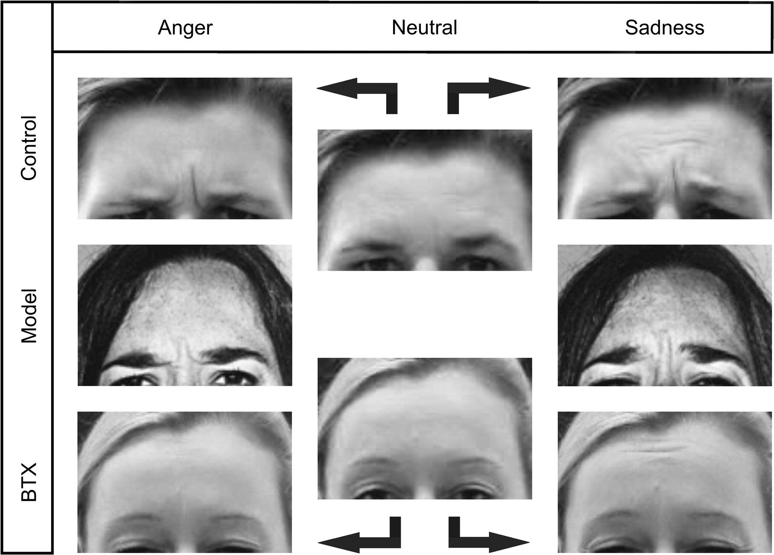
Figure 1. Effects of BTX treatment on frown muscle actions. Example of a BTX-naive (upper row) and BTX-treated subject ...
Notes:
Figure 1. Effects of BTX treatment on frown muscle actions. Example of a BTX-naive (upper row) and BTX-treated subject (bottom row) mimicking an angry (left column) and a sad expression (right column) of a face model (middle row, left and right column). The middle column shows both subjects with neutral expression. Note that unlike the BTX-naïve subject, the BTX-treated subject is unable to lower her eyebrows during imitation of both angry and sad expressions. Although whole-face expressions were mimicked, only the upper part of the faces is depicted where BTX treatment of the corrugator muscle was applied.
Unless provided in the caption above, the following copyright applies to the content of this slide: © The Author 2008. Published by Oxford University Press. All rights reserved. For permissions, please e-mail: journals.permissions@oxfordjournals.org

Slide 2
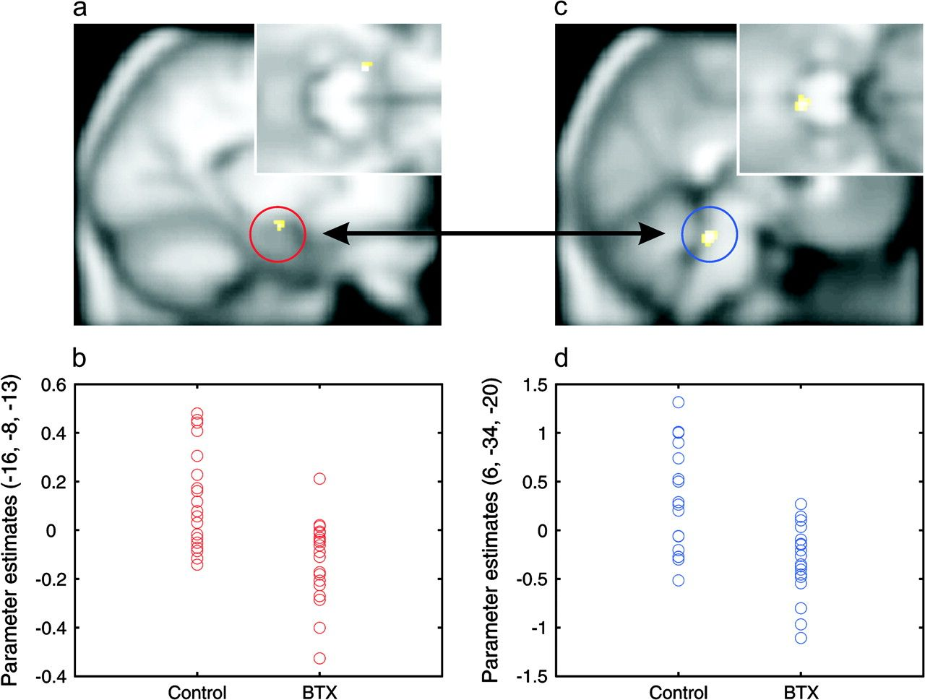
Figure 2. Effects of BTX treatment on amygdala activation and coupling with the dorsal brain stem. (a) Reduction of ...
Notes:
Figure 2. Effects of BTX treatment on amygdala activation and coupling with the dorsal brain stem. (a) Reduction of left amygdala activation (−16, −8, −13; t = 4.16, P < 0.05 SVC corrected) in BTX-treated subjects during imitation versus observation of angry expressions, plotted on parasagittal and coronal (upper right corner) sections of the averaged T1 anatomical image of the 38 participants. (b) Individual parameter estimates (arbitrary units) of left amygdala response as a function of BTX treatment. (c) Decrease in functional coupling between the left amygdala and dorsal brain stem (6, −34, −20; t = 4.40, P < 0.05 SVC corrected) in BTX-treated subjects. (d) Individual parameter estimates (arbitrary units) of amygdala–brain stem coupling as a function of BTX treatment. Here, the parameter estimates denote the “strength” of the connection between the left amygdala and dorsal brain stem. Note that paralysis-related effects were not influenced by structural alterations following BTX treatment as revealed by an additional structural imaging study using voxel-based morphometry (see Supplementary Methods and Results online).
Unless provided in the caption above, the following copyright applies to the content of this slide: © The Author 2008. Published by Oxford University Press. All rights reserved. For permissions, please e-mail: journals.permissions@oxfordjournals.org

Slide 3
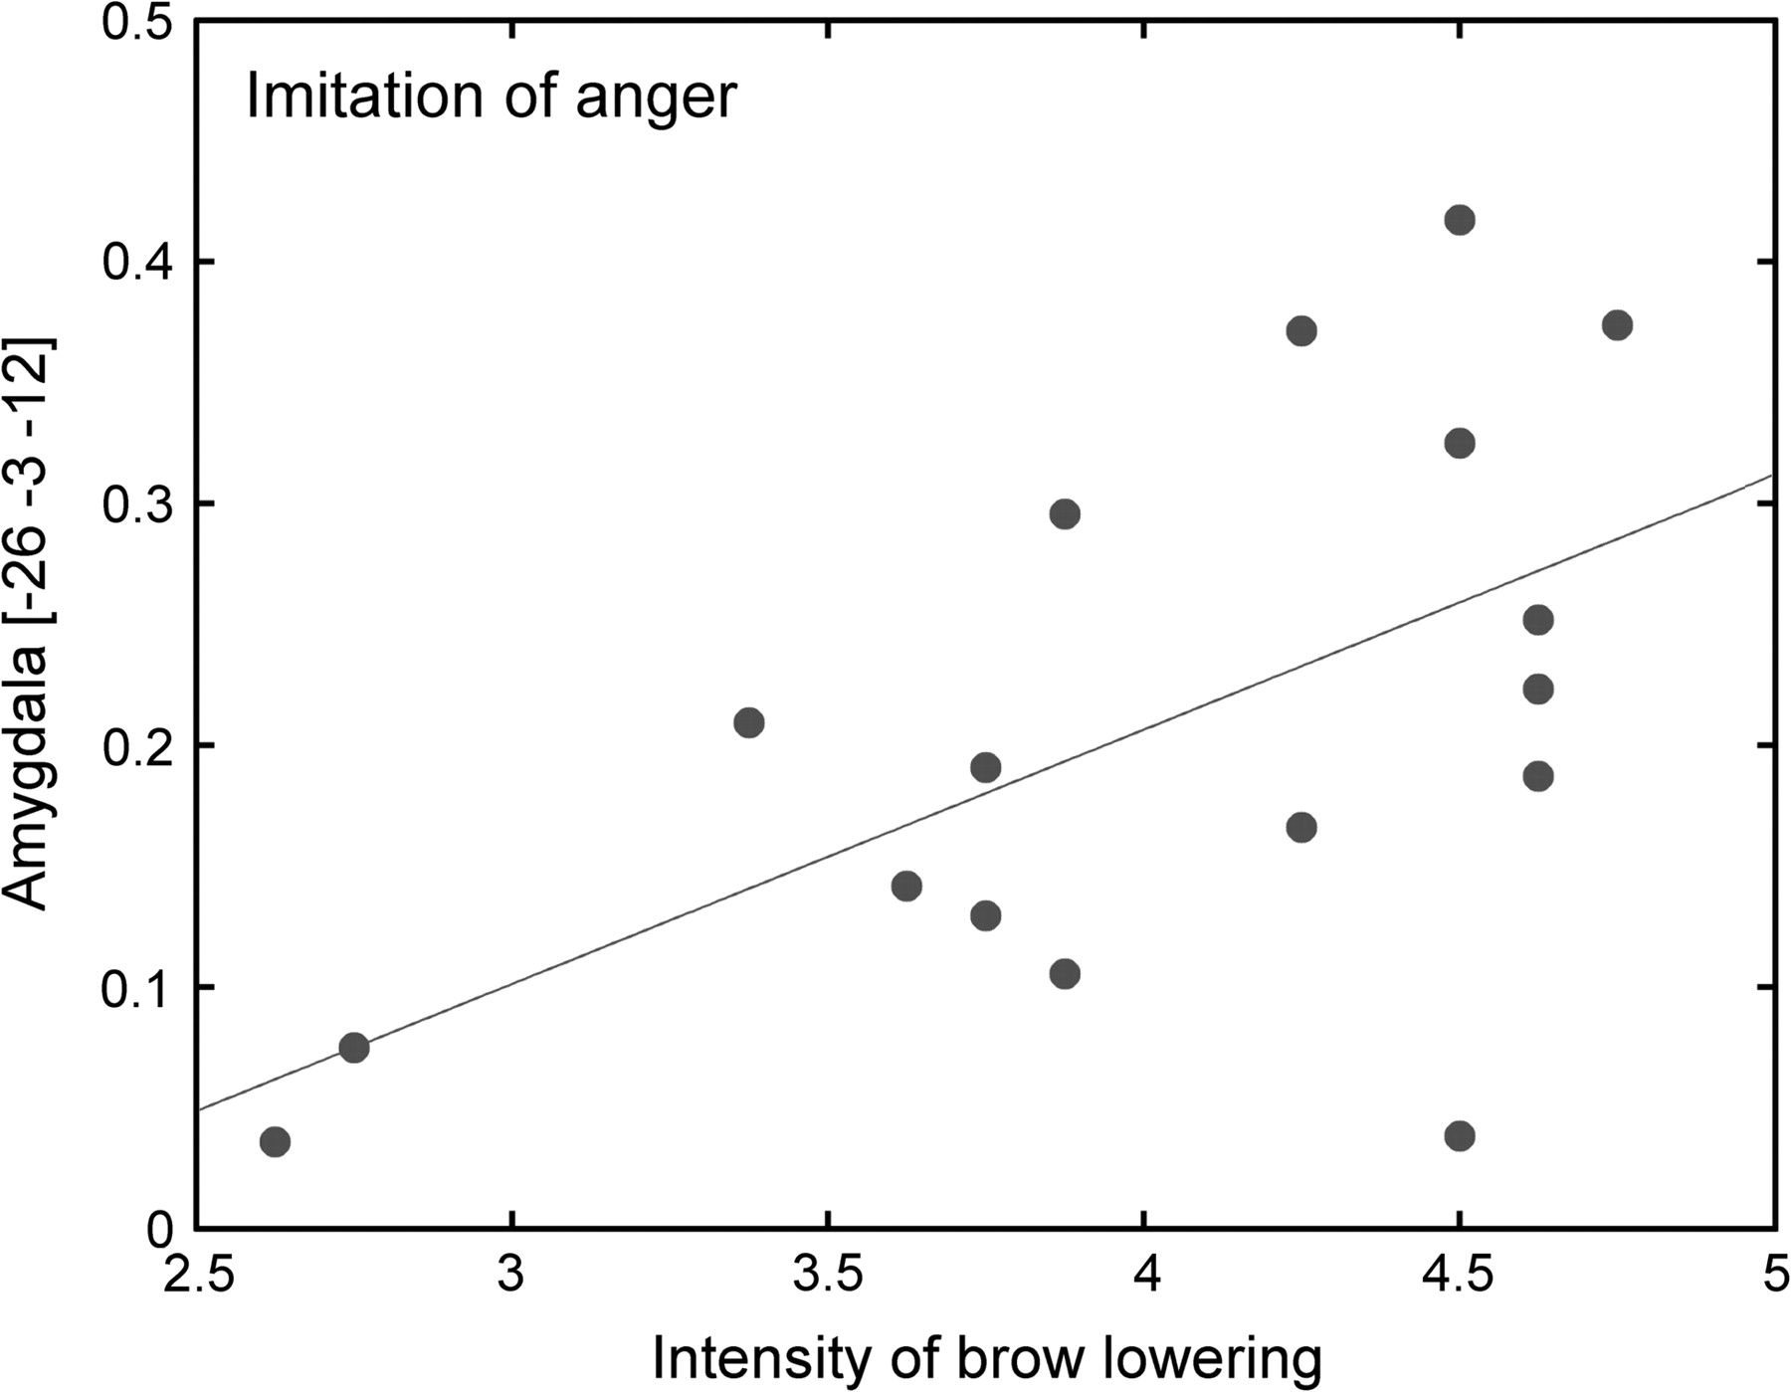
Figure 3. Correlation between amygdala activation and brow lowering in BTX-naive subjects. Significant correlation (r = ...
Notes:
Figure 3. Correlation between amygdala activation and brow lowering in BTX-naive subjects. Significant correlation (r = 0.58, P < 0.05) of left amygdala activation (parameter estimates), elicited during imitation versus observation of angry expressions, with individual differences in mean intensity of brow-lowering actions, as assessed after scanning using FACS (Ekman and Friesen 1978). The line represents the linear best fit.
Unless provided in the caption above, the following copyright applies to the content of this slide: © The Author 2008. Published by Oxford University Press. All rights reserved. For permissions, please e-mail: journals.permissions@oxfordjournals.org

