Slide 1
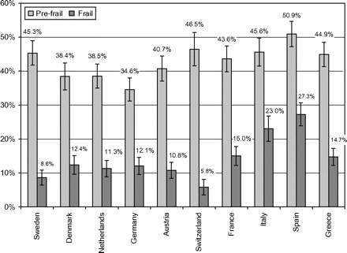
Figure 1. Percentage of the 65 years and older community-dwelling population classified as prefrail and frail by ...
Notes:
Figure 1. Percentage of the 65 years and older community-dwelling population classified as prefrail and frail by country (weighted results).
Unless provided in the caption above, the following copyright applies to the content of this slide: © The Author 2009. Published by Oxford University Press on behalf of The Gerontological Society of America. All rights reserved. For permissions, please e-mail: journals.permissions@oxfordjournals.org.

Slide 2
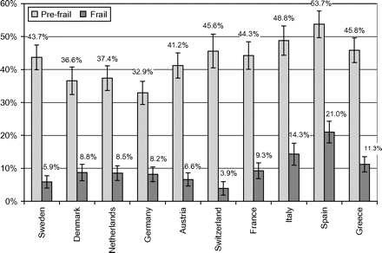
Figure 2. Percentage of the 65 years and older community-dwelling population without disability classified as prefrail ...
Notes:
Figure 2. Percentage of the 65 years and older community-dwelling population without disability classified as prefrail and frail by country (weighted results).
Unless provided in the caption above, the following copyright applies to the content of this slide: © The Author 2009. Published by Oxford University Press on behalf of The Gerontological Society of America. All rights reserved. For permissions, please e-mail: journals.permissions@oxfordjournals.org.

