Slide 1
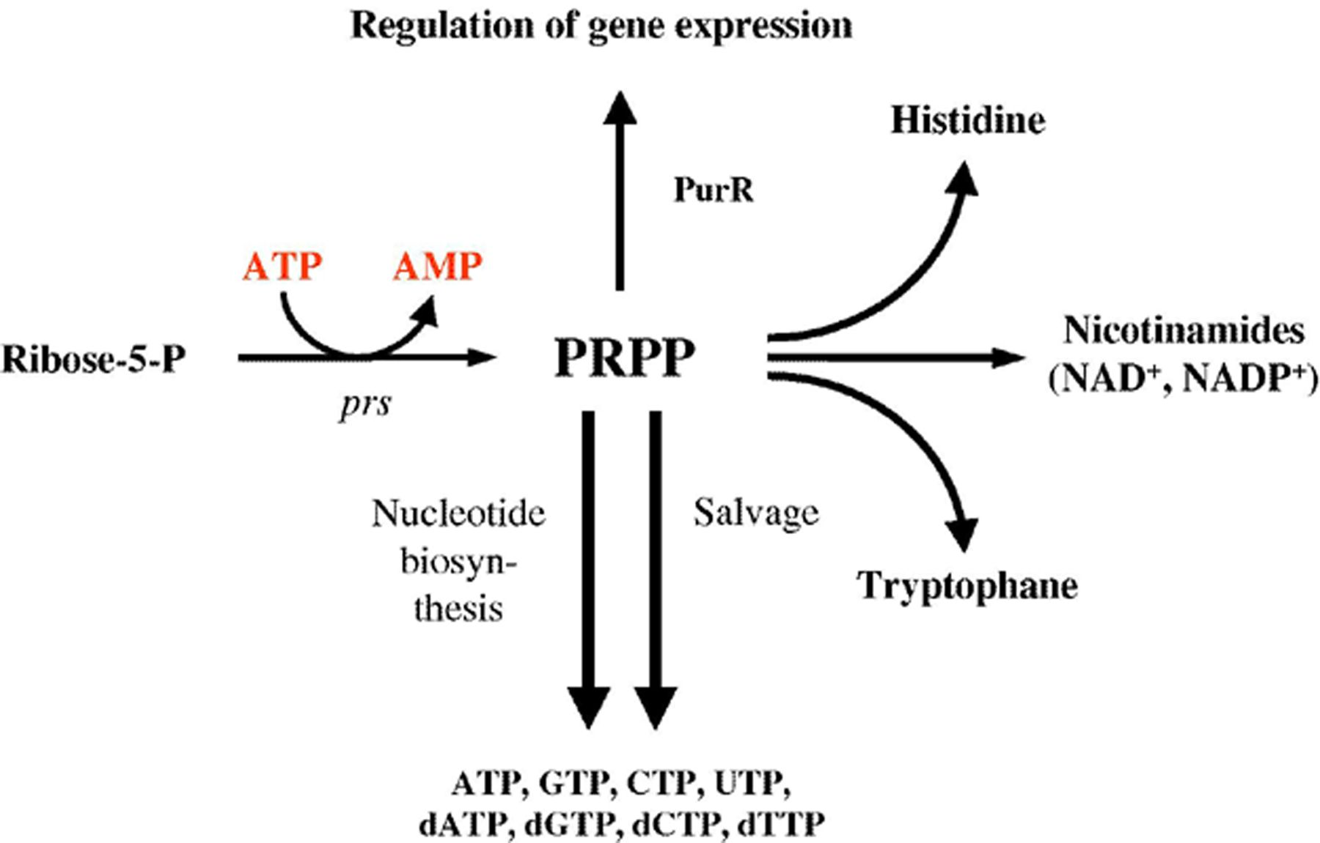
1 5-Phosphoribosyl-α-1-pyrophosphate (PRPP) synthesis and utilization. PRPP is synthesized by addition of a ...
Notes:
1 5-Phosphoribosyl-α-1-pyrophosphate (PRPP) synthesis and utilization. PRPP is synthesized by addition of a pyrophosphate group from ATP to ribose-5-phosphate. The reaction is catalyzed by the PRPP synthase, encoded by the prsA and prsB genes. PRPP is utilized in both biosynthesis and salvage of purines and pyrimidines, biosynthesis of the amino acids histidine and tryptophane, and production of nicotinamides used as prosthetic groups in a number of different enzymes. Finally, PRPP is an effector molecule in PurR-mediated gene regulation.
Unless provided in the caption above, the following copyright applies to the content of this slide: © 2005 Federation of European Microbiological Societies. Published by Elsevier B.V. All rights reserved.

Slide 2
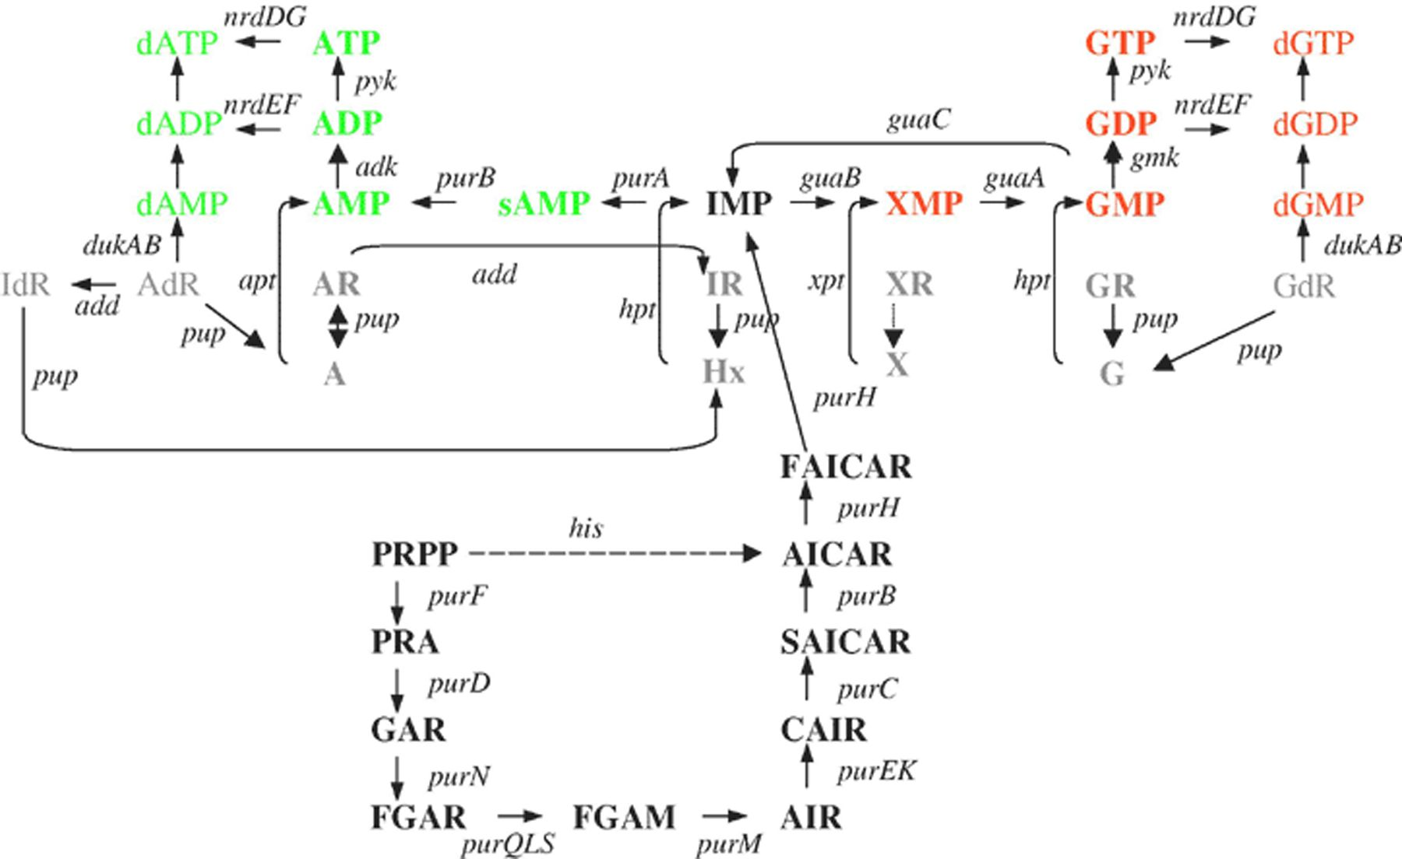
2 The pathways of purine biosynthesis and salvage in L. lactis. The individual enzymes are presented by their ...
Notes:
2 The pathways of purine biosynthesis and salvage in L. lactis. The individual enzymes are presented by their gene symbols. Arrows indicate the direction of reactions observed in vivo in wild-type cells grown in defined medium. The following abbreviations are used: PRPP, Phosphoribosyl pyrophosphate; PRA, phosphoribosyl amine; GAR, glycinamide ribonucleotide; FGAR, formylglycinamide ribonucleotide; FGAM, formylglycinamidine ribonucleotide; AIR, aminoimidazole ribonucleotide; CAIR, phosphoribosyl carboxyaminoimidazole; SAICAR, succinocarboxyamide carboxyaminoimidazole ribonucleotide; AICAR, aminoimidazole carboxamide ribonucleotide; FAICAR, formaminoimidazole carboxamide ribonucleotide; A, adenine; Hx, hypoxanthine; X, xanthine; G, guanine; IdR, deoxyinosine; AdR, deoxyadenosine; AR, adenosine; IR, inosine; XR, xanthosine; GR, guanosine; GdR, dexyguanosine; sAMP, adenylsuccinate; IMP, inosine monophosphate; XMP, xanthosine monophosphate. Enzymes encoded by the genes in alphabetical order, add, adenosine deaminase; adk, adenylate kinase (AMP kinase); apt, adenine phosphoribosyltransferase; dukAB, deoxynucleoside kinase; gmk, guanylate kinase (GMP kinase); guaA, GMP synthase; guaB, IMP dehydrogenase; guaC, GMP reductase; hpt, hypoxanthine/guanine phosphoribosyltransferase; nrdDG, anaerobic ribonucleotide triphosphate reductase; nrdEF, aerobic ribonucleotide diphosphate reductase; pup, purine nucleoside phosphorylase; purA, adenylosuccinate synthase; purB, adenylosuccinate lyase; purC, SAICAR synthase; purD, GAR synthase; purEK, CAIR synthase; purF, PRPP amidotransferase; purH, bifunctional AICAR transformylase/IMP cyclohydrolase; purM, AIR synthase; purN, GAR transformylase; purQSL, FGAM synthase; pyk, pyruvate kinase; and xpt, xanthine phosphoribosyltransferase.
Unless provided in the caption above, the following copyright applies to the content of this slide: © 2005 Federation of European Microbiological Societies. Published by Elsevier B.V. All rights reserved.

Slide 3
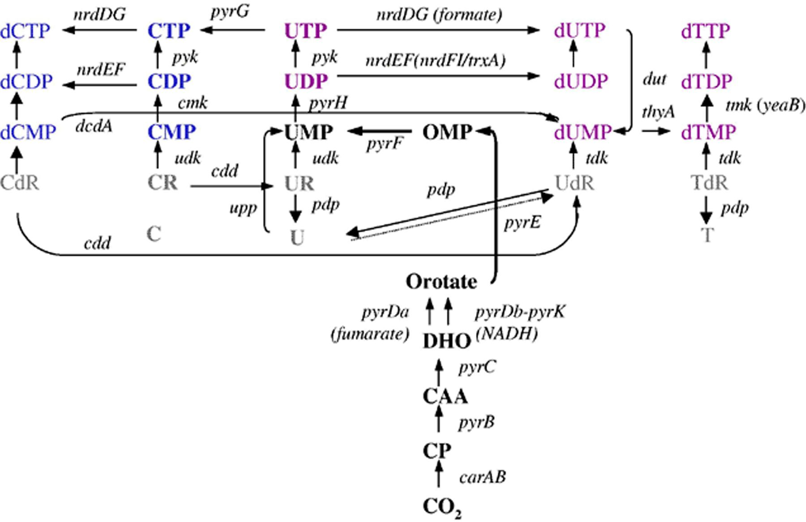
3 The pathways of pyrimidine biosynthesis and salvage in L. lactis. The individual enzymes are presented by ...
Notes:
3 The pathways of pyrimidine biosynthesis and salvage in L. lactis. The individual enzymes are presented by their gene symbols. Arrows indicate direction of reactions observed in vivo in wild-type cells grown in defined medium. The following abbreviations are used: CP, carbamoylphosphate; CAA, carbamoylaspartate; DHO, dihydroorotate; OMP, orotate monophosphate; C, cytosine; U, uracil; T, thymine; CR, cytidine; UR, uridine; CdR, deoxycytidine; UdR, deoxyuridine; and TdR, thymidine. Enzymes encoded by the genes in alphabetic order: carAB, carbamoylphosphate synthase; cdd, cytidine deaminase; cmk, CMP kinase; dcdA, dCMP deaminase; dut, dUTPase; nrdDG, anaerobic ribonucleotide triphosphate reductase; nrdEF, aerobic ribonucleotide diphosphate reductase; pdp, pyrimidine nucleoside phosphorylases; pyk, pyruvate kinase; pyrB, aspartate transcarbamoylase; pyrC, dihydroorotase; pyrDa, dihydroorotate dehydrogenase A; pyrDb/pyrK, dihydroorotate dehydrogenase B; pyrE, orotate phosphoribosyltransferase; pyrF, OMP decarboxylase; pyrG, CTP synthase; pyrH, UMP kinase; tdk, thymidine kinase; thyA, thymidylate synthase; tmk, (d)TMP kinase; udk, uridine kinase; and upp, uracil phosphoribosyltransferase.
Unless provided in the caption above, the following copyright applies to the content of this slide: © 2005 Federation of European Microbiological Societies. Published by Elsevier B.V. All rights reserved.

Slide 4
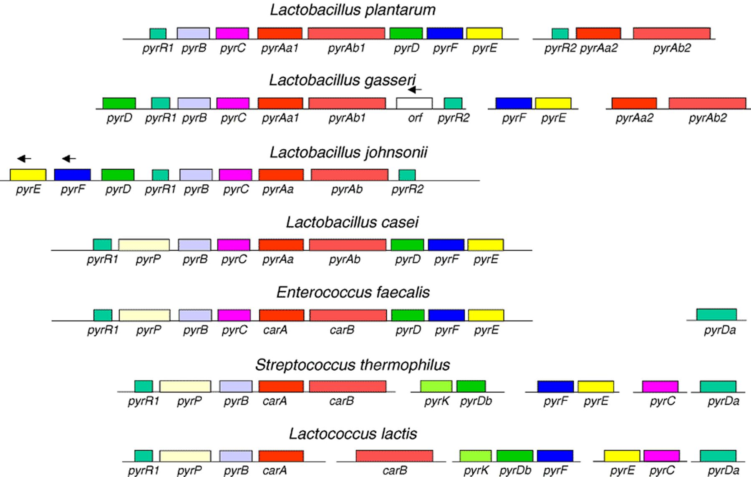
4 Organization of the genes for the pyrimidine de novo synthesis in lactic acid bacteria. The following ...
Notes:
4 Organization of the genes for the pyrimidine de novo synthesis in lactic acid bacteria. The following organisms are included: Lb. plantarum CCM1904, Lb. gasseri ATCC 33323, Lb. johnsonii NCC 533, Lb. casei ATCC 334, E. faecalis OG1RF, S. thermophilus CNRZ1066, and L. lactis subsp. cremoris MG1363. The genes encoding the following proteins are shown: pyrR, the pyrimidine regulatory protein PyrR; pyrAa, pyrimidine specific carbamoylphosphate synthase small subunit; pyrAb, pyrimidine specific carbamoylphosphate synthase large subunit; carA, carbamoylphosphate synthase small subunit; carB, carbamoylphosphate synthase large subunit; pyrB, aspartate transcarbamoylase; pyrC, dihydrorotase; pyrDa, dihydroorotate dehydrogenase A; pyrDb, dihydroorotate dehydrogenase B; pyrE, orotate phosphoribosyltransferase; pyrF, OMP decarboxylase; and pyrP, uracil permease. Gene names followed by the numbers 1 and 2 indicate that two different alleles encoding proteins with similar function are present in the organism. All genes are transcribed from left to right, except when indicated otherwise by an arrow.
Unless provided in the caption above, the following copyright applies to the content of this slide: © 2005 Federation of European Microbiological Societies. Published by Elsevier B.V. All rights reserved.

Slide 5
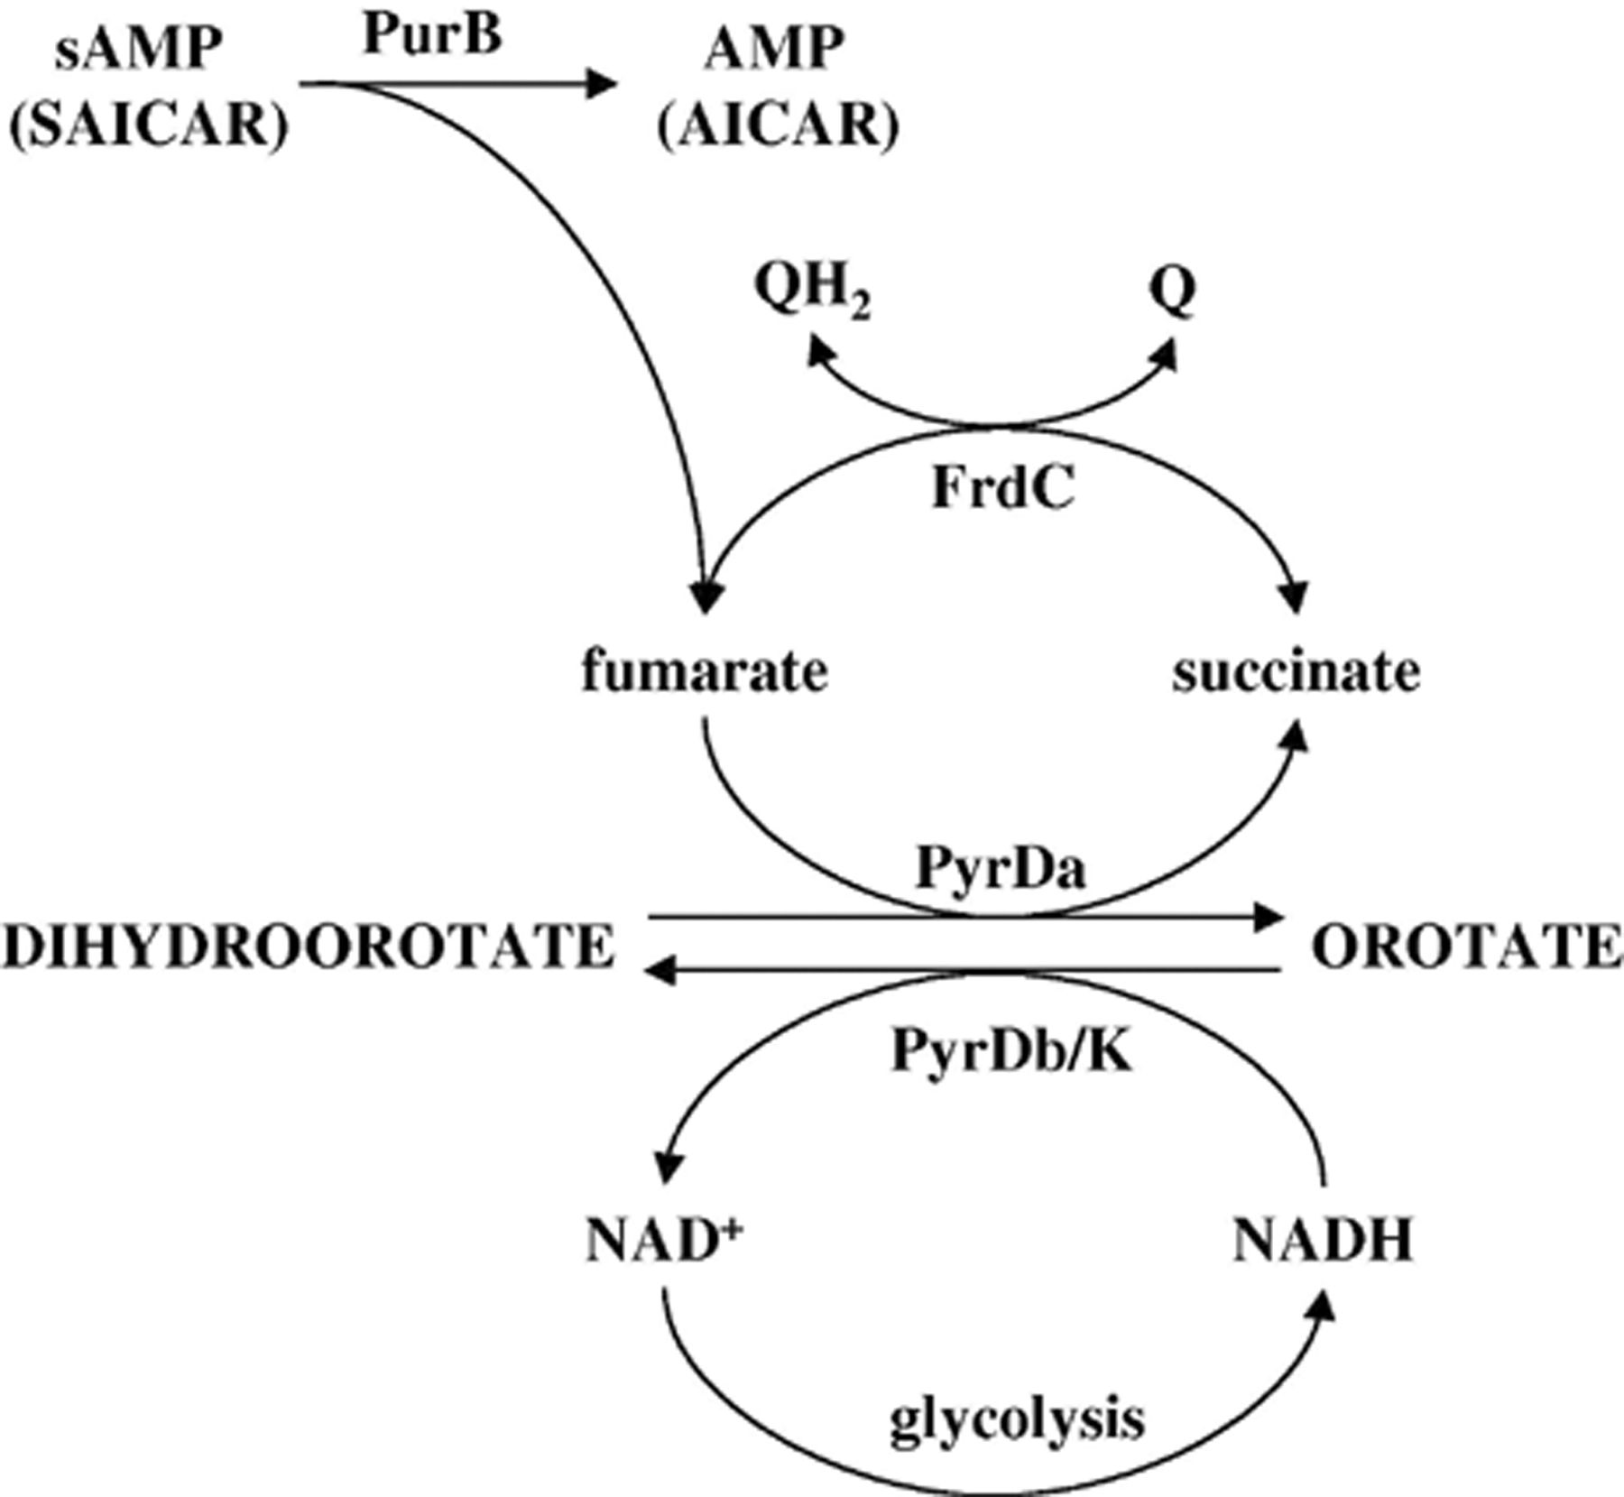
5 Reactions linking the purine and pyrimidine de novo pathways to glycolysis and redox potential in L. lactis. ...
Notes:
5 Reactions linking the purine and pyrimidine de novo pathways to glycolysis and redox potential in L. lactis. Fumarate is formed in two steps in the biosynthetic pathway leading to AMP (Fig. 2), both catalyzed by PurB; when SAICAR is converted to AICAR and when sAMP is converted to AMP. Fumarate can be used in the conversion of dihydroorotate to orotate catalyzed by PyrDa, thus linking the purine and pyrimidine de novo pathways. The two PyrD enzymes could theoretically function as a shuttle of electrons between the NADH and quinone pools by the aid of FrdC, the fumarate reductase.
Unless provided in the caption above, the following copyright applies to the content of this slide: © 2005 Federation of European Microbiological Societies. Published by Elsevier B.V. All rights reserved.

Slide 6
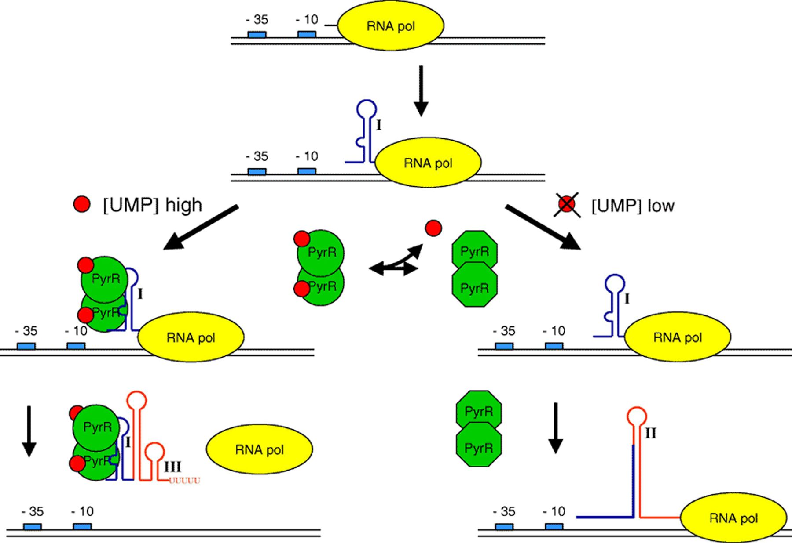
6 Model for PyrR-mediated regulation. The promoters of the pyrimidine biosynthetic genes constitutively ...
Notes:
6 Model for PyrR-mediated regulation. The promoters of the pyrimidine biosynthetic genes constitutively initiate transcription, and structure (I) is formed. The PyrR protein senses the UMP level in the cell: when pyrimidines are abundant, the UMP concentration is high, facilitating formation of the PyrR–UMP complex. This complex has the capability to bind to a specific sequence in the anti-antiterminator (structure I), thereby stabilizing it. Consequently, the formation of the anti-terminator (II) is prevented, favoring the formation of the terminator (III). RNA polymerase will preferentially terminate. At low UMP level, PyrR is unable to bind to the anti-antiterminator and the energetically more favorable anti-terminator is formed. The terminator cannot form and transcription will proceed beyond the terminator. The structural genes are expressed to a higher degree and more UMP is synthesized. Red circles represent UMP, the green circles represent PyrR in its RNA binding conformation. Green octagons represent PyrR unable to recognize the anti-antiterminator. −35 and −10 indicates the constitutive promoter.
Unless provided in the caption above, the following copyright applies to the content of this slide: © 2005 Federation of European Microbiological Societies. Published by Elsevier B.V. All rights reserved.

Slide 7
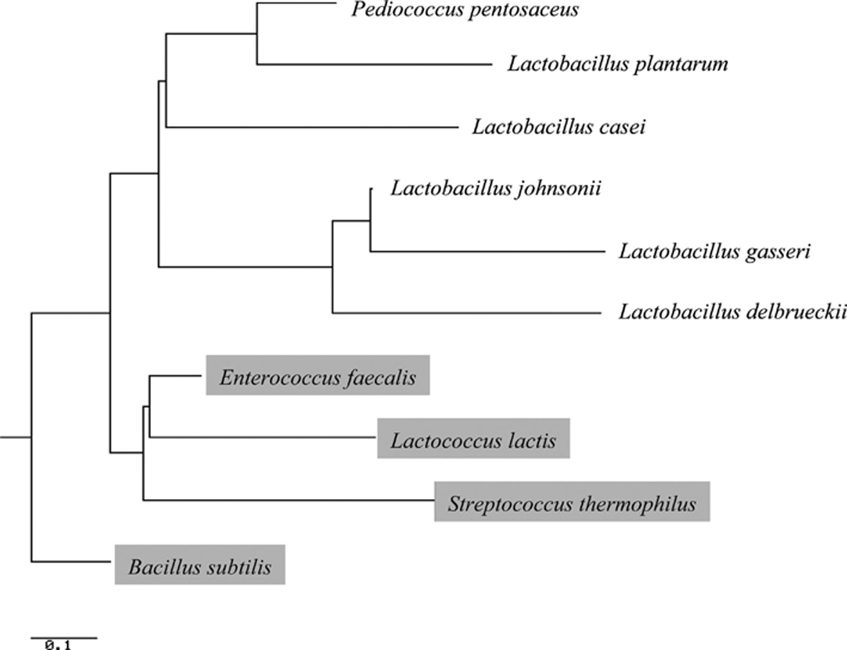
7 The phylogenetic tree of dihydroorotate dehydrogenase B enzymes (PyrDb) from different lactic acid bacteria ...
Notes:
7 The phylogenetic tree of dihydroorotate dehydrogenase B enzymes (PyrDb) from different lactic acid bacteria and B. subtilis. The construction is based on the cluster algorithm and performed at the TreeTop on-line service found at http://www.genebee.msu.su/services/phtree_reduced.html. The organisms in which a pyrK gene has been identified are indicated by shading. The following organisms are included: Pediococcus pentosaceus ATCC 25745, Lb. plantarum CCM1904, Lb. casei ATCC 334, Lb. johnsonii NCC 533, Lb. gasseri ATCC 33323, Lb. delbrueckii ATCC BAA-365, E. faecalis OG1RF, L. lactis subsp. cremoris MG1363, S. thermophilus CNRZ1066, and B. subtilis 168.
Unless provided in the caption above, the following copyright applies to the content of this slide: © 2005 Federation of European Microbiological Societies. Published by Elsevier B.V. All rights reserved.

Slide 8
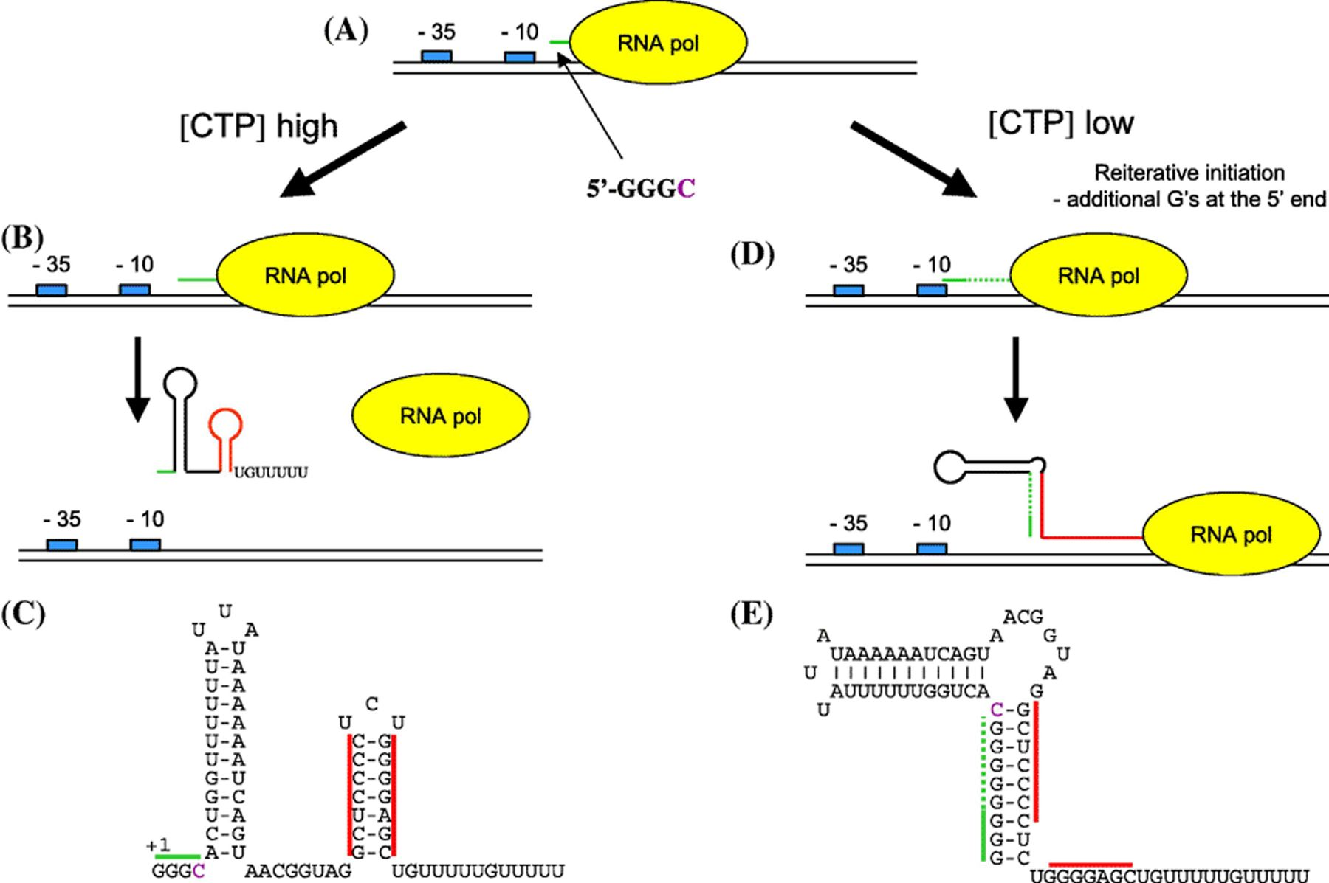
8 Model for pyrG regulation. (A) Transcription is initiated with a 5′-GGGC sequence (green line). (B) During ...
Notes:
8 Model for pyrG regulation. (A) Transcription is initiated with a 5′-GGGC sequence (green line). (B) During high CTP concentration, transcription proceeds and a terminator involving base-pairing in the region indicated by red is preferentially formed. (C) The secondary structure of the pyrG leader in the terminator configuration. (D) At CTP shortage the RNA polymerase pauses immediately in front of the purple C residue at position four in the 5′-GGGC sequence. Due to reiterative transcription or stuttering, additional G residues are incorporated in the extreme 5′ end of the RNA, indicated by a stippled green line. This stretch of G residues (green line) pairs with the left-hand side of the terminator stem (red line), thereby preventing formation of the terminator. Transcription proceeds resulting in expression of the pyrG open reading frame. (E) The secondary structure of the pyrG leader in the antiterminator configuration.
Unless provided in the caption above, the following copyright applies to the content of this slide: © 2005 Federation of European Microbiological Societies. Published by Elsevier B.V. All rights reserved.

Slide 9
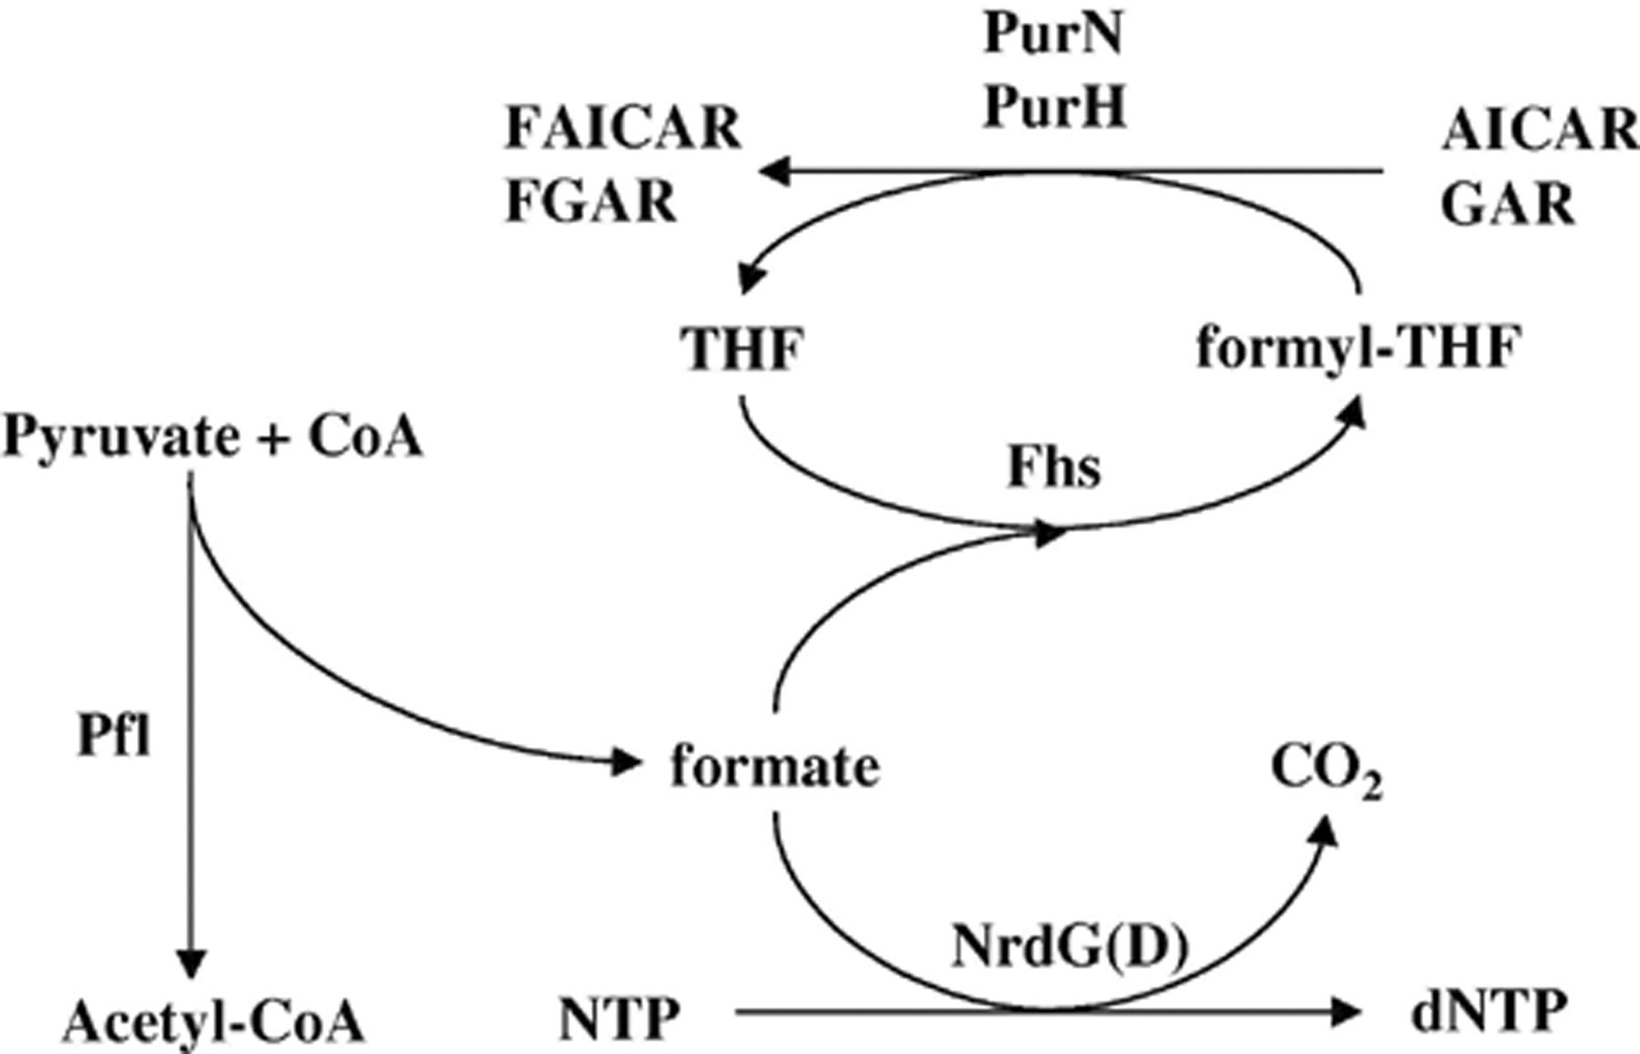
9 Formate production and utilization in L. lactis. The known pathways for formate metabolism are shown. The ...
Notes:
9 Formate production and utilization in L. lactis. The known pathways for formate metabolism are shown. The enzymes are shown by their genetically derived names as follows: Pfl, pyruvate formate lyase; Fsh, formate-tetrahydrofolate ligase; NrdGD, anaerobic ribonucleosidediphosphate reductase; PurH, AICAR transformylase; PurN, GAR transformylase.
Unless provided in the caption above, the following copyright applies to the content of this slide: © 2005 Federation of European Microbiological Societies. Published by Elsevier B.V. All rights reserved.

Slide 10
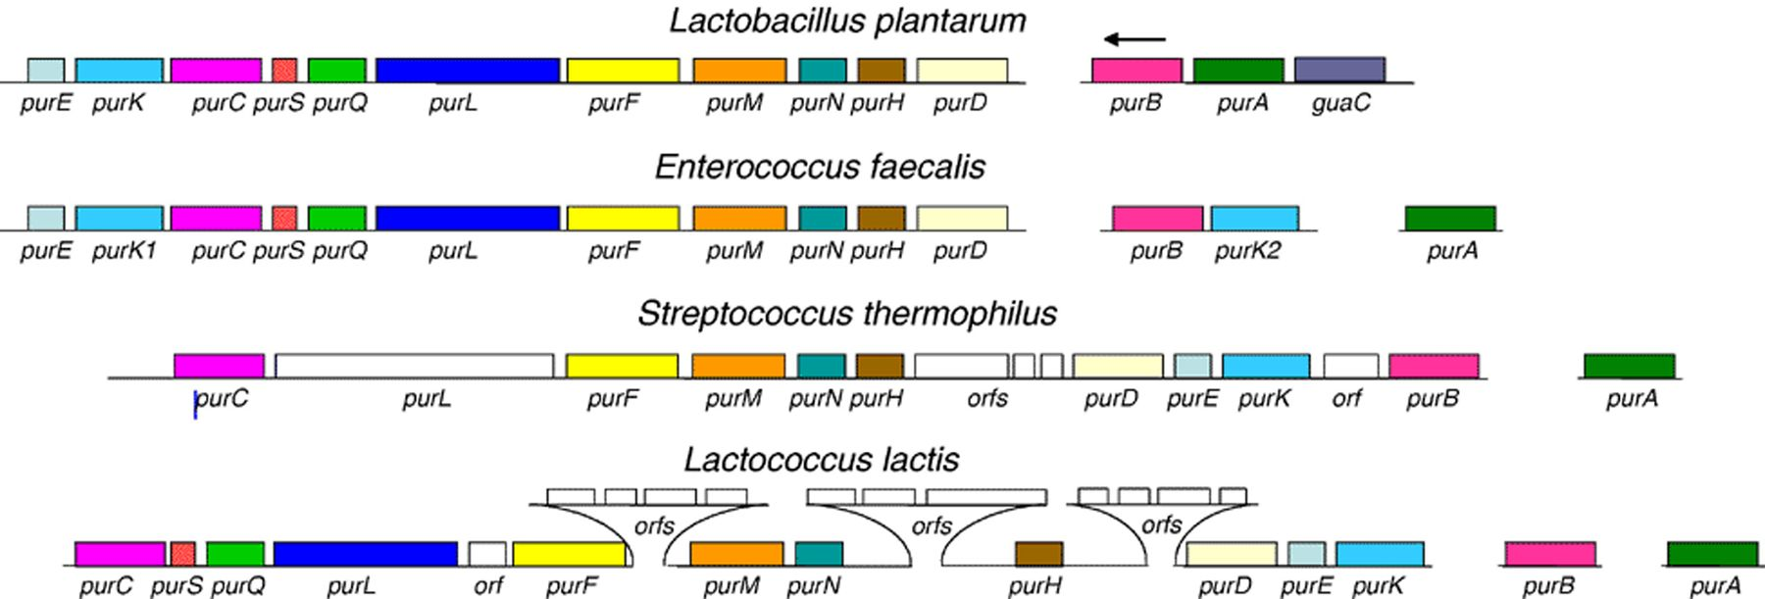
10 Organization of the genes for the purine de novo synthesis in lactic acid bacteria. The following organisms ...
Notes:
10 Organization of the genes for the purine de novo synthesis in lactic acid bacteria. The following organisms are included: Lb. plantarum CCM1904, E. faecalis OG1RF, S. thermophilus CNRZ1066, and L. lactis subsp. cremoris MG1363. The genes encoding the following proteins are shown: purA, adenylosuccinate synthase; purB, adenylosuccinate lyase; purC, SAICAR synthase; purD, GAR synthase; purEK, CAIR synthase; purF, PRPP amidotransferase; purH, bifunctional AICAR transformylase/IMP cyclohydrolase; purM, AIR synthase; purN, GAR transformylase; purQSL, FGAM synthase. Please note that purL in S. thermophilus is larger and most probably encompass all functions required for FGAM synthase activity. Gene names followed by the numbers 1 and 2 indicate that two different alleles encoding proteins with similar function are present in the organism. All genes are transcribed from left to right, except when indicated otherwise by an arrow.
Unless provided in the caption above, the following copyright applies to the content of this slide: © 2005 Federation of European Microbiological Societies. Published by Elsevier B.V. All rights reserved.

Slide 11
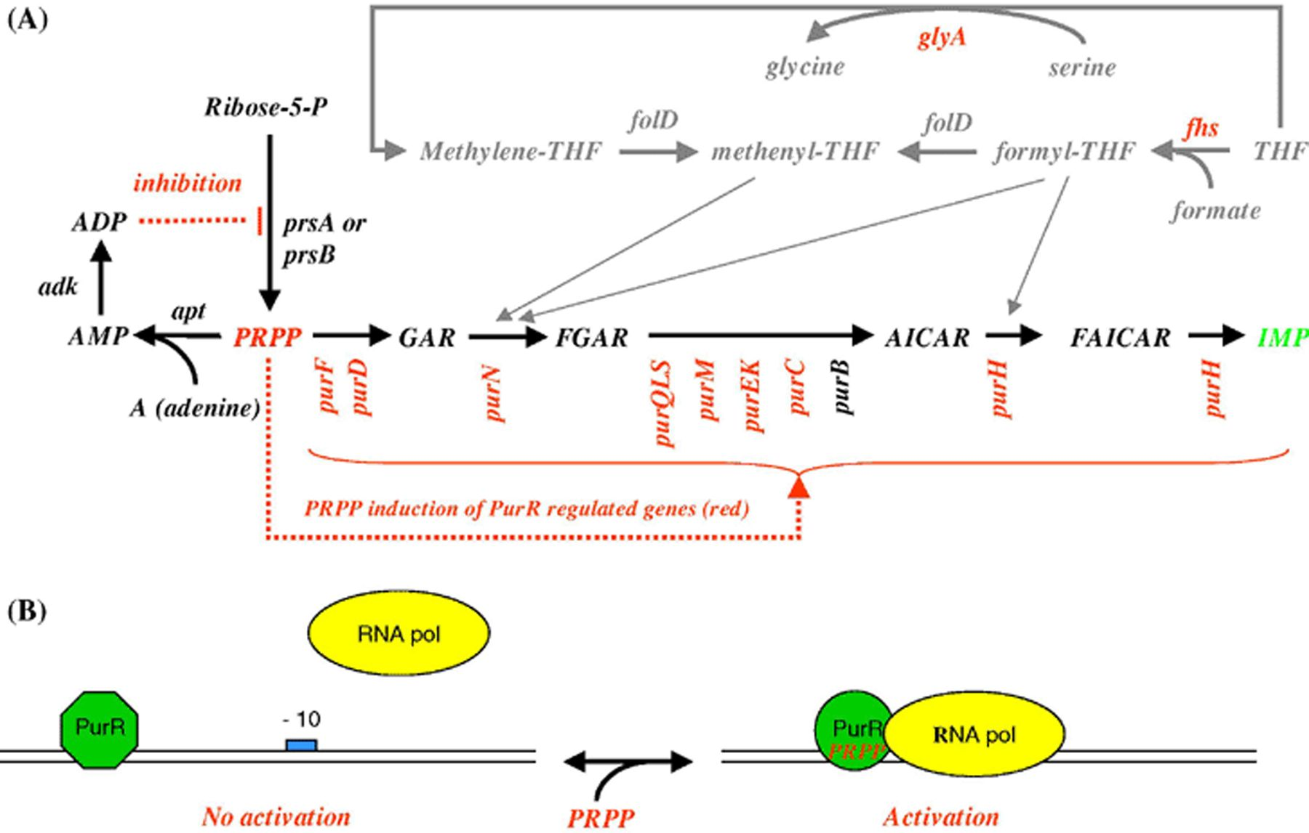
11 Model for PurR-mediated regulation in L. lactis. (A) Control of the PRPP pool and genetic feed-forward ...
Notes:
11 Model for PurR-mediated regulation in L. lactis. (A) Control of the PRPP pool and genetic feed-forward regulation of the IMP biosynthetic pathway. According to the model for control of the PRPP level in B. subtilis, the PRPP pool can be diminished by phosphoribosylation of nucleobases to NMPs (here represented by adenine), and by ADP inhibition of the PRPP synthase. Under conditions of high PRPP levels PurR activates the transcription of the genes in the IMP biosynthesis pathway (shown in red), as well as the glyA and fhs genes involved in incorporation of C1 units from formate and serine into THF (tetrahydrofolate). The C1 units of formyl-THF and methanyl-THF are incorporated into purine bases by the PurN and PurH transformylases. (B) Model of PRPP induced transcription activation by PurR. PurR is bound to PurBox'es on the DNA under all conditions. Binding of PRPP changes the PurR conformation to recognize and position the RNA polymerase correctly with respect to the −10 region of the promoter, resulting in transcription initiation.
Unless provided in the caption above, the following copyright applies to the content of this slide: © 2005 Federation of European Microbiological Societies. Published by Elsevier B.V. All rights reserved.

Slide 12
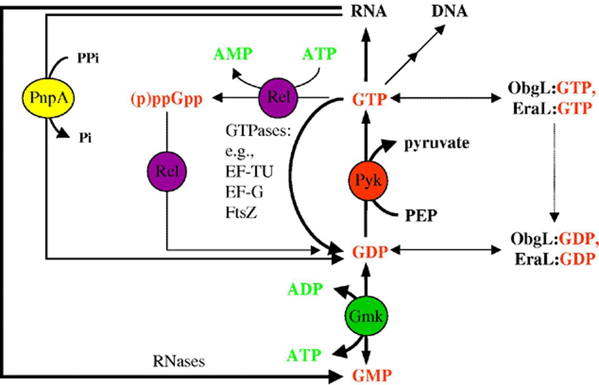
12 Guanine nucleotide interconversions in L. lactis. The different pathways for guanine nucleotide ...
Notes:
12 Guanine nucleotide interconversions in L. lactis. The different pathways for guanine nucleotide interconversions are shown. The enzymes are shown by their genetically derived names as follows: Pyk, pyruvate kinase; Gmk, guanylate kinase; Rel, (p)ppGpp synthase (ATP,GTP 3′ pyrophosphotransferase); PnpA, polyribonucleotide nucleotidyltransferase; ObgL, GTP-binding protein of the GTP1/OBG family; and EraL, GTP-binding protein of the Era/ThdF family. The expected importance of the pathways for the cellular GTP, GDP, and GMP concentrations is shown by the thickness of the arrows.
Unless provided in the caption above, the following copyright applies to the content of this slide: © 2005 Federation of European Microbiological Societies. Published by Elsevier B.V. All rights reserved.

Slide 13
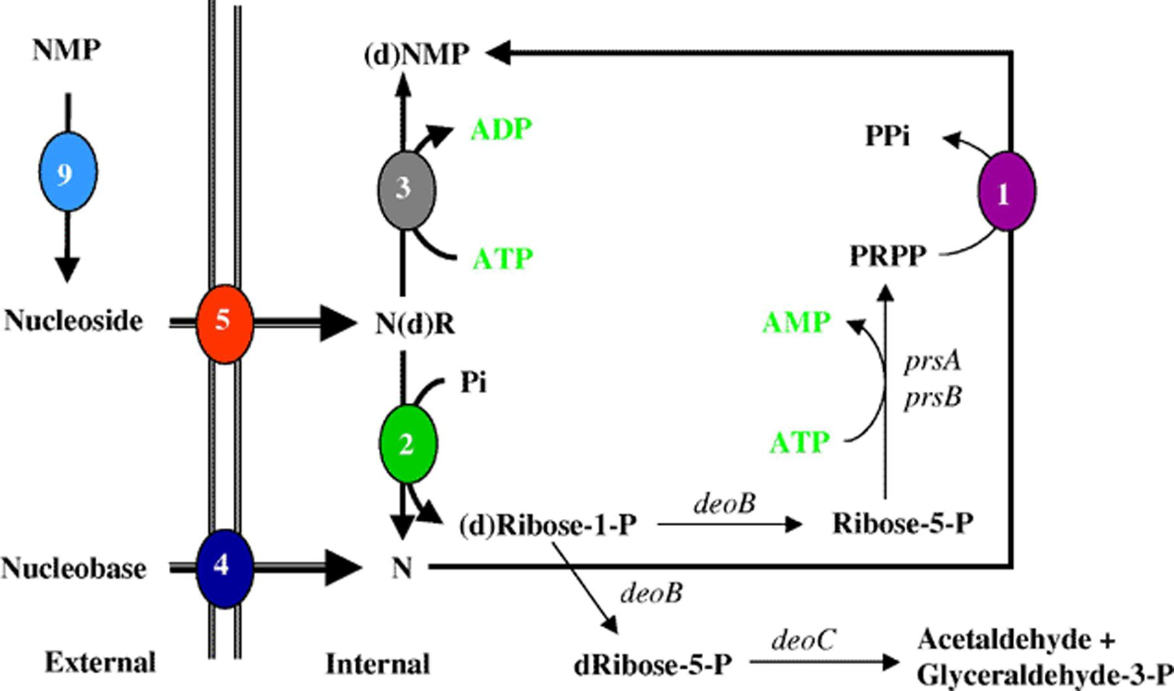
13 The salvage pathways of external nucleotides, nucleosides, and nucleobases in organisms with nucleoside ...
Notes:
13 The salvage pathways of external nucleotides, nucleosides, and nucleobases in organisms with nucleoside phosphorylases, e.g., in L. lactis. Nucleobases and nucleosides are taken up directly by dedicated transporters (4 and 5, respectively). External nucleotides are dephosphorylated by a phosphatase (9) and subsequently transported into the cell (5). Nucleobases are phosphoribosylated to the corresponding NMP by phosphoribosyltransferases (1). Nucleosides are either phosphorolytically cleaved to the nucleobase and a ribose or deoxyribose moiety by the purine or pyrimidine phosphorylase (2), or phosphorylated directly to the NMP or dNMP by the corresponding kinase (3). Ribose-1-phosphate obtained by action of the phosphorylases is converted to ribose-5-phosphate by (DeoB) and salvaged into PRPP (PrsA or PrsB) and used in nucleotide formation. The deoxyribose-1-phosphate (dRibose-1-P) formed from the phosphorolysis of the deoxynucleosides enters glycolysis after conversion to dRibose-5-P by DeoB to acetaldehyde and glyceraldehydes-3-phosphate by DeoC. Enzymes encoded by the genes in alphabetical order: deoB, phosphopentomutase; deoC, deoxyriboaldolase; prs, PRPP synthase.
Unless provided in the caption above, the following copyright applies to the content of this slide: © 2005 Federation of European Microbiological Societies. Published by Elsevier B.V. All rights reserved.

Slide 14
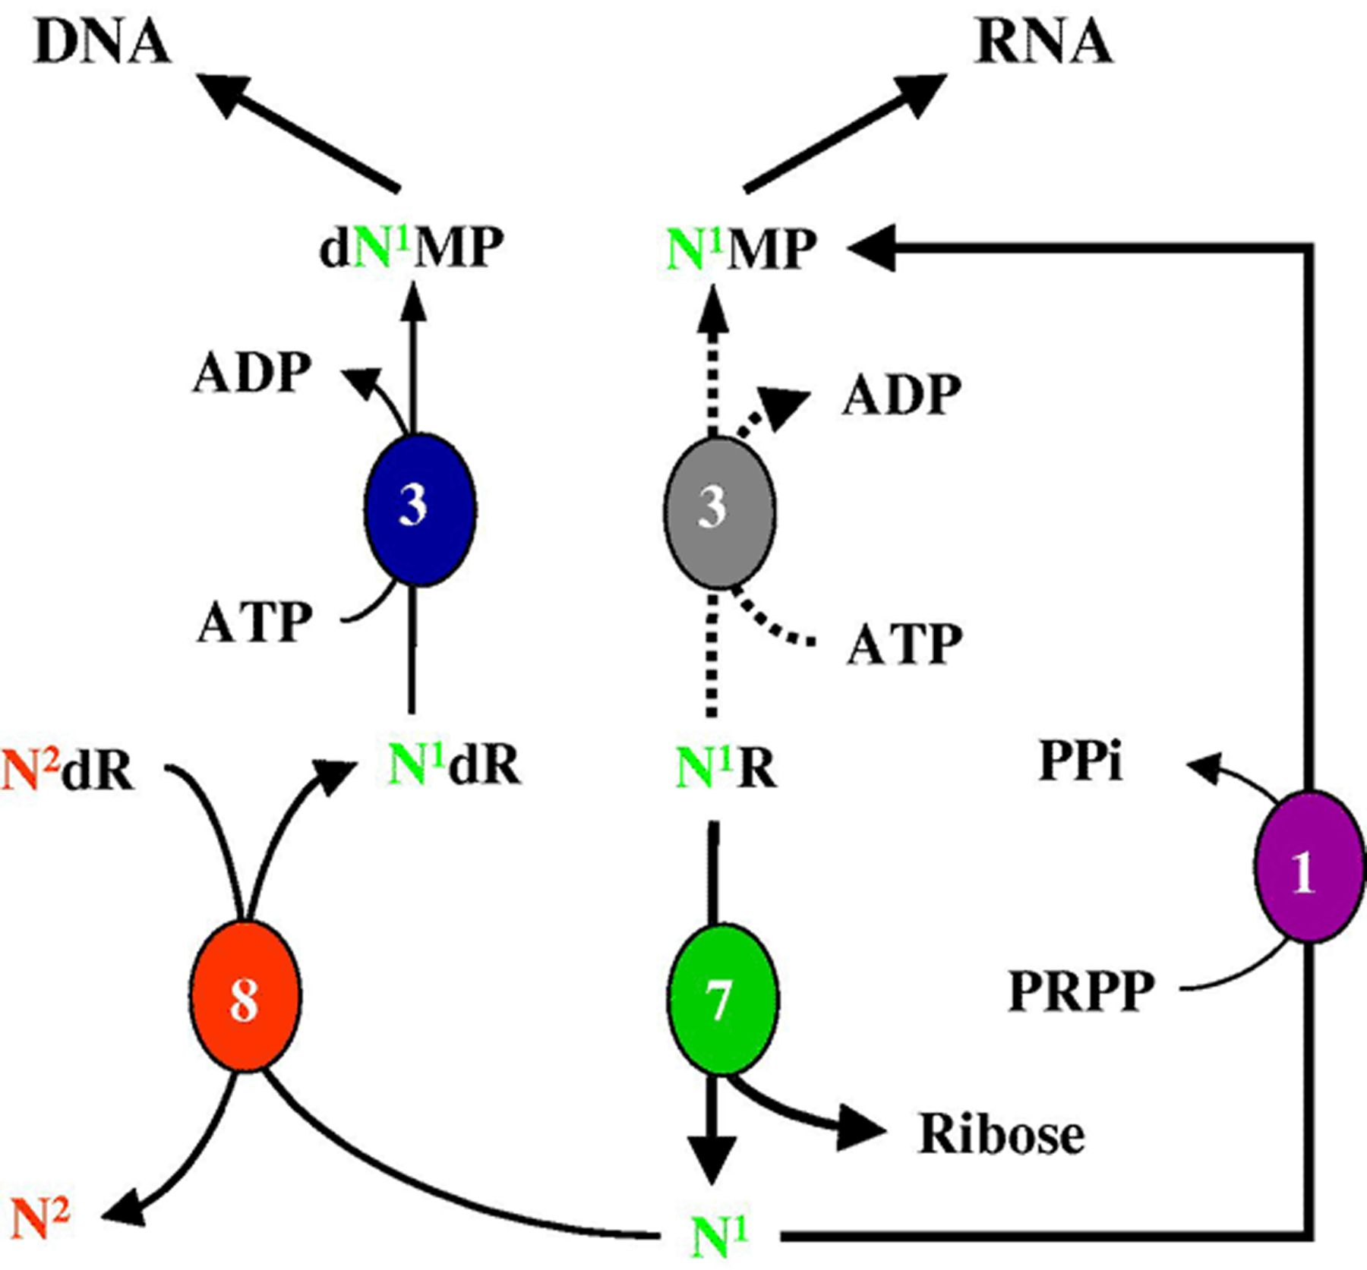
14 trans-N-Deoxyribosylase-dependent nucleotide synthesis in lactobacilli. The key reaction in organisms using ...
Notes:
14 trans-N-Deoxyribosylase-dependent nucleotide synthesis in lactobacilli. The key reaction in organisms using trans-N-deoxyribosylases (8) is the exchange of a nucleobase between a deoxyribonucleoside (N2dR) and a free nucleobase N1, resulting in the formation of a new product N1dR. The product is then phosphorylated (3) to the corresponding dN1TP. The free nucleobase N1 may be obtained by hydrolysis of the corresponding nucleoside N1R. This reaction (7) is catalyzed by a ribonucleoside hydrolase. The ribose moiety can be used in carbon metabolism. The base N2 produced during the action of trans-N-deoxyribosylase may be salvaged by a phosphoribosyl transferase (1) yielding the corresponding NMP. Also, ribonucleoside kinases may be present that phosphorylate ribonucleosides into NMP (also named 3; note that these enzymes are different from the deoxyribonucleoside kinases).
Unless provided in the caption above, the following copyright applies to the content of this slide: © 2005 Federation of European Microbiological Societies. Published by Elsevier B.V. All rights reserved.

