Slide 1
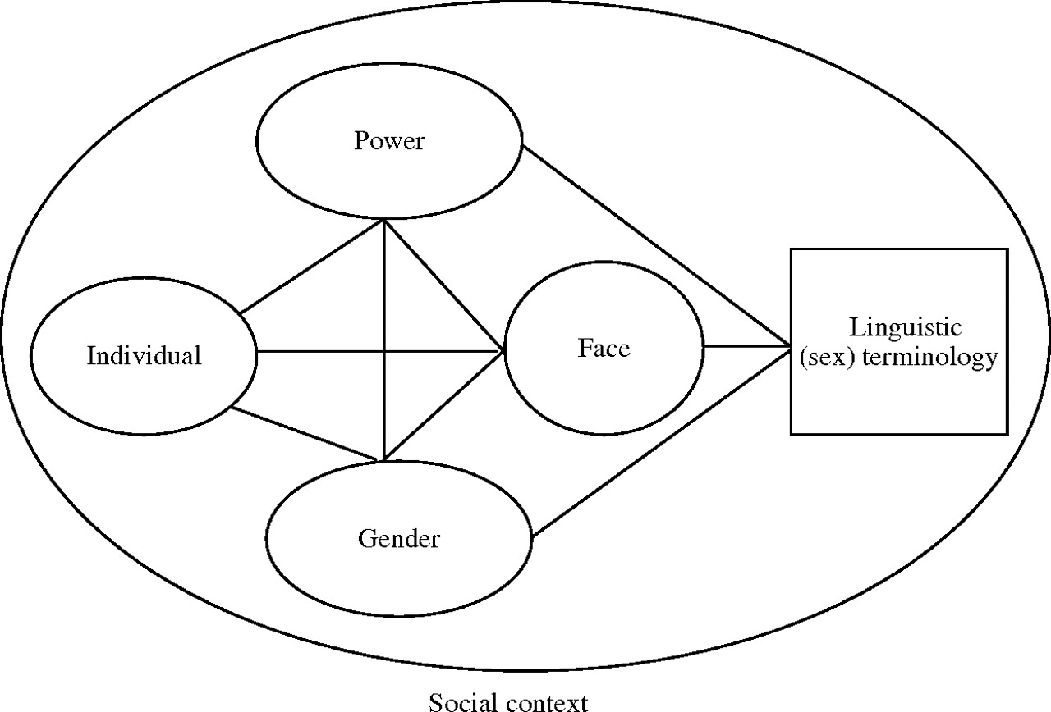
Fig. 1. A theoretical framework for exploring linguistic terminology choice in sexual communication.
Notes:
Fig. 1. A theoretical framework for exploring linguistic terminology choice in sexual communication.
Unless provided in the caption above, the following copyright applies to the content of this slide: © The Author 2010. Published by Oxford University Press. All rights reserved. For permissions, please email: journals.permissions@oup.com

