Slide 1
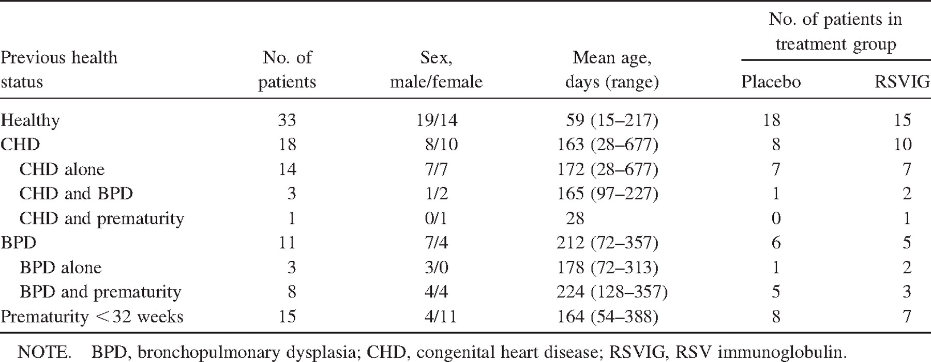
Table 1. Demographic characteristics of 77 infants hospitalized at Vanderbilt University with respiratory svncvtial ...
Notes:
Table 1. Demographic characteristics of 77 infants hospitalized at Vanderbilt University with respiratory svncvtial virus (RSV) bronchiolitis.
Unless provided in the caption above, the following copyright applies to the content of this slide: © 2002 by the Infectious Diseases Society of America

Slide 2
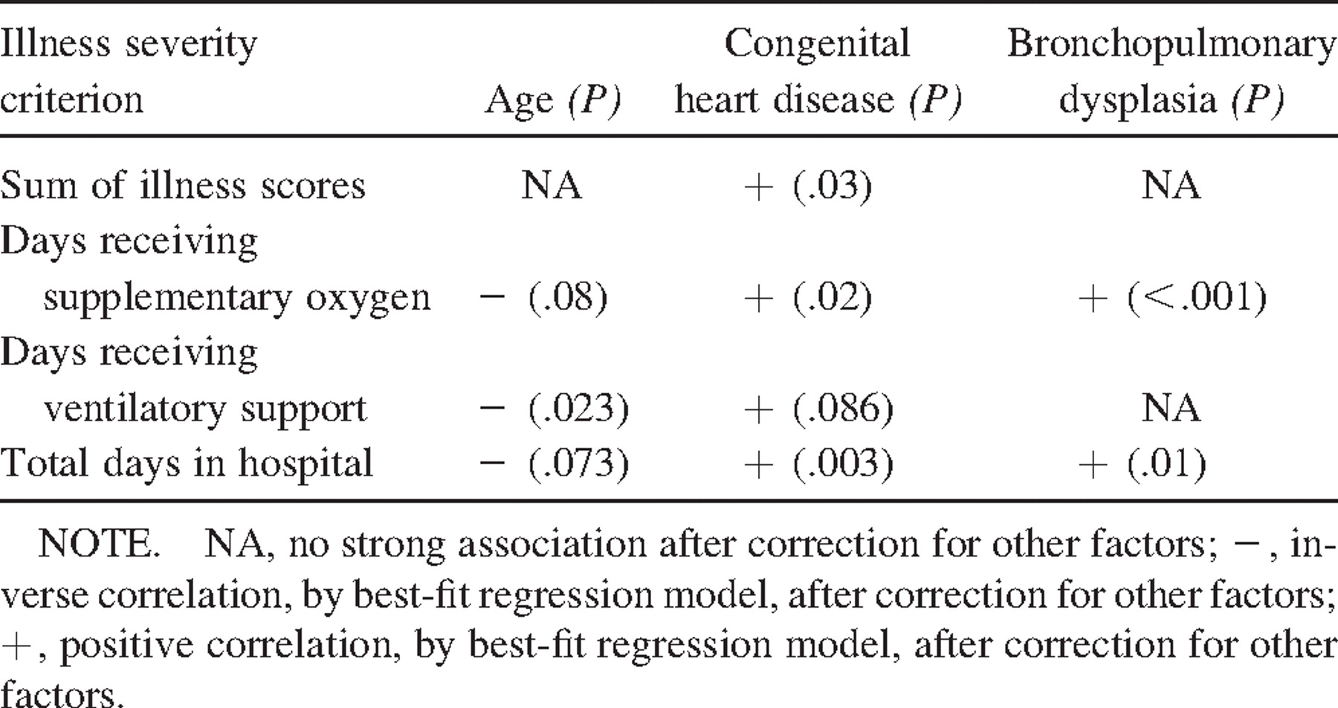
Table 2. Relationship between respiratory illness severity and host factors in 77 children hospitalized at Vanderbilt ...
Notes:
Table 2. Relationship between respiratory illness severity and host factors in 77 children hospitalized at Vanderbilt University with respiratory syncytial virus bronchiolitis.
Unless provided in the caption above, the following copyright applies to the content of this slide: © 2002 by the Infectious Diseases Society of America

Slide 3
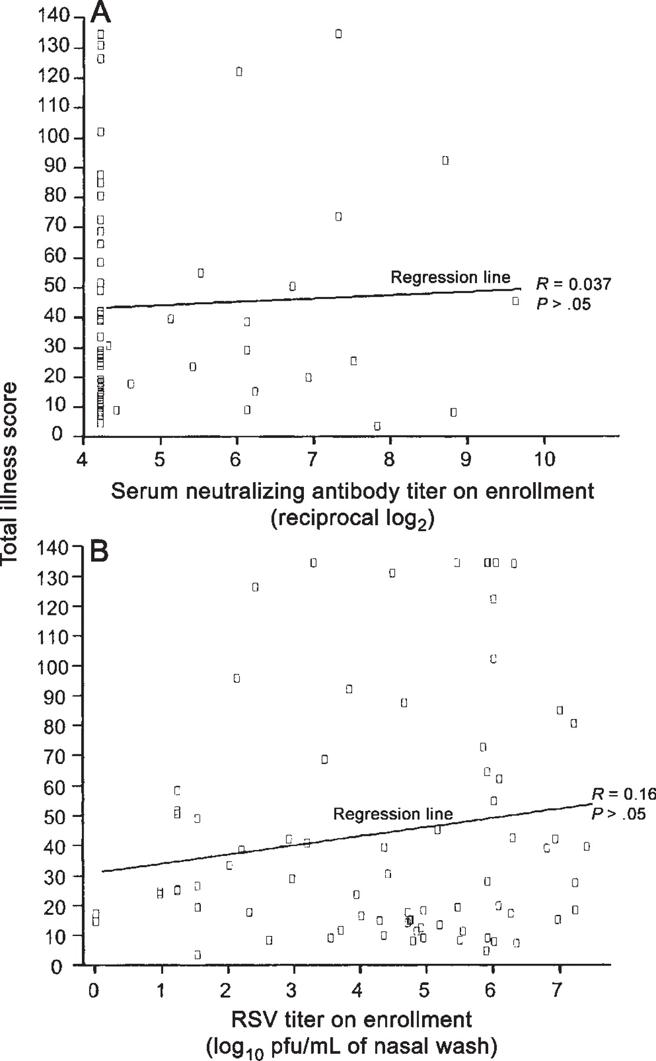
Figure 1. Relationships between total illness score (sum of twice daily scoring on a 1–5 scale [9], in which 5 is the ...
Notes:
Figure 1. Relationships between total illness score (sum of twice daily scoring on a 1–5 scale [9], in which 5 is the most severe [e.g., requiring intubation]), serum neutralizing antibody titer (A), and quantity of respiratory syncytial virus (RSV) recovered from nasal secretions (B) at enrollment. Illness was scored during hospitalization for up to 13 days.
Unless provided in the caption above, the following copyright applies to the content of this slide: © 2002 by the Infectious Diseases Society of America

Slide 4
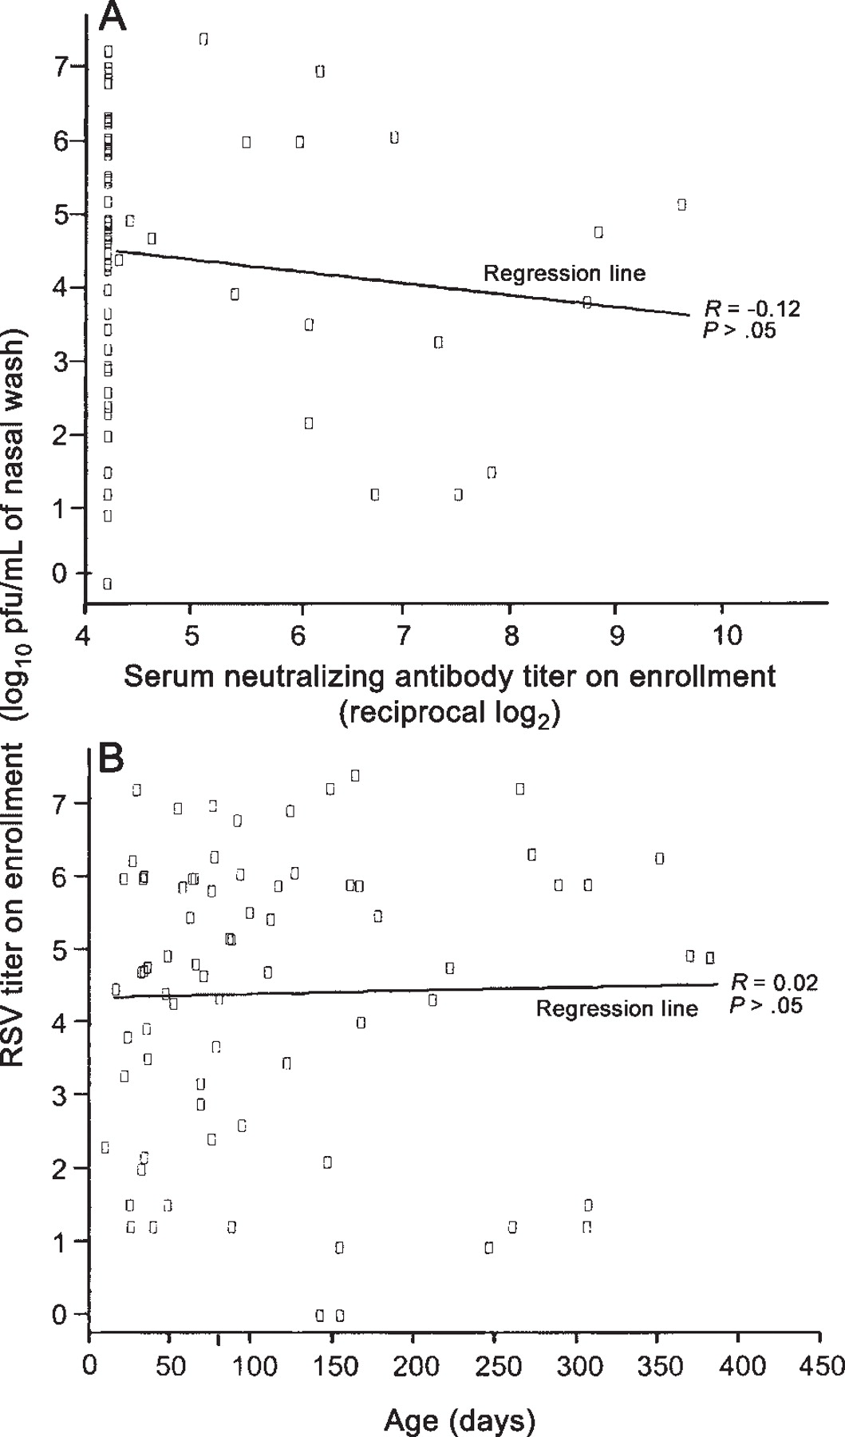
Figure 2. Relationships between quantity of respiratory syncytial virus (RSV) recovered, serum neutralizing antibody ...
Notes:
Figure 2. Relationships between quantity of respiratory syncytial virus (RSV) recovered, serum neutralizing antibody titer (A), and age in days (B) at enrollment. No significant interactions between these variables were seen.
Unless provided in the caption above, the following copyright applies to the content of this slide: © 2002 by the Infectious Diseases Society of America

Slide 5
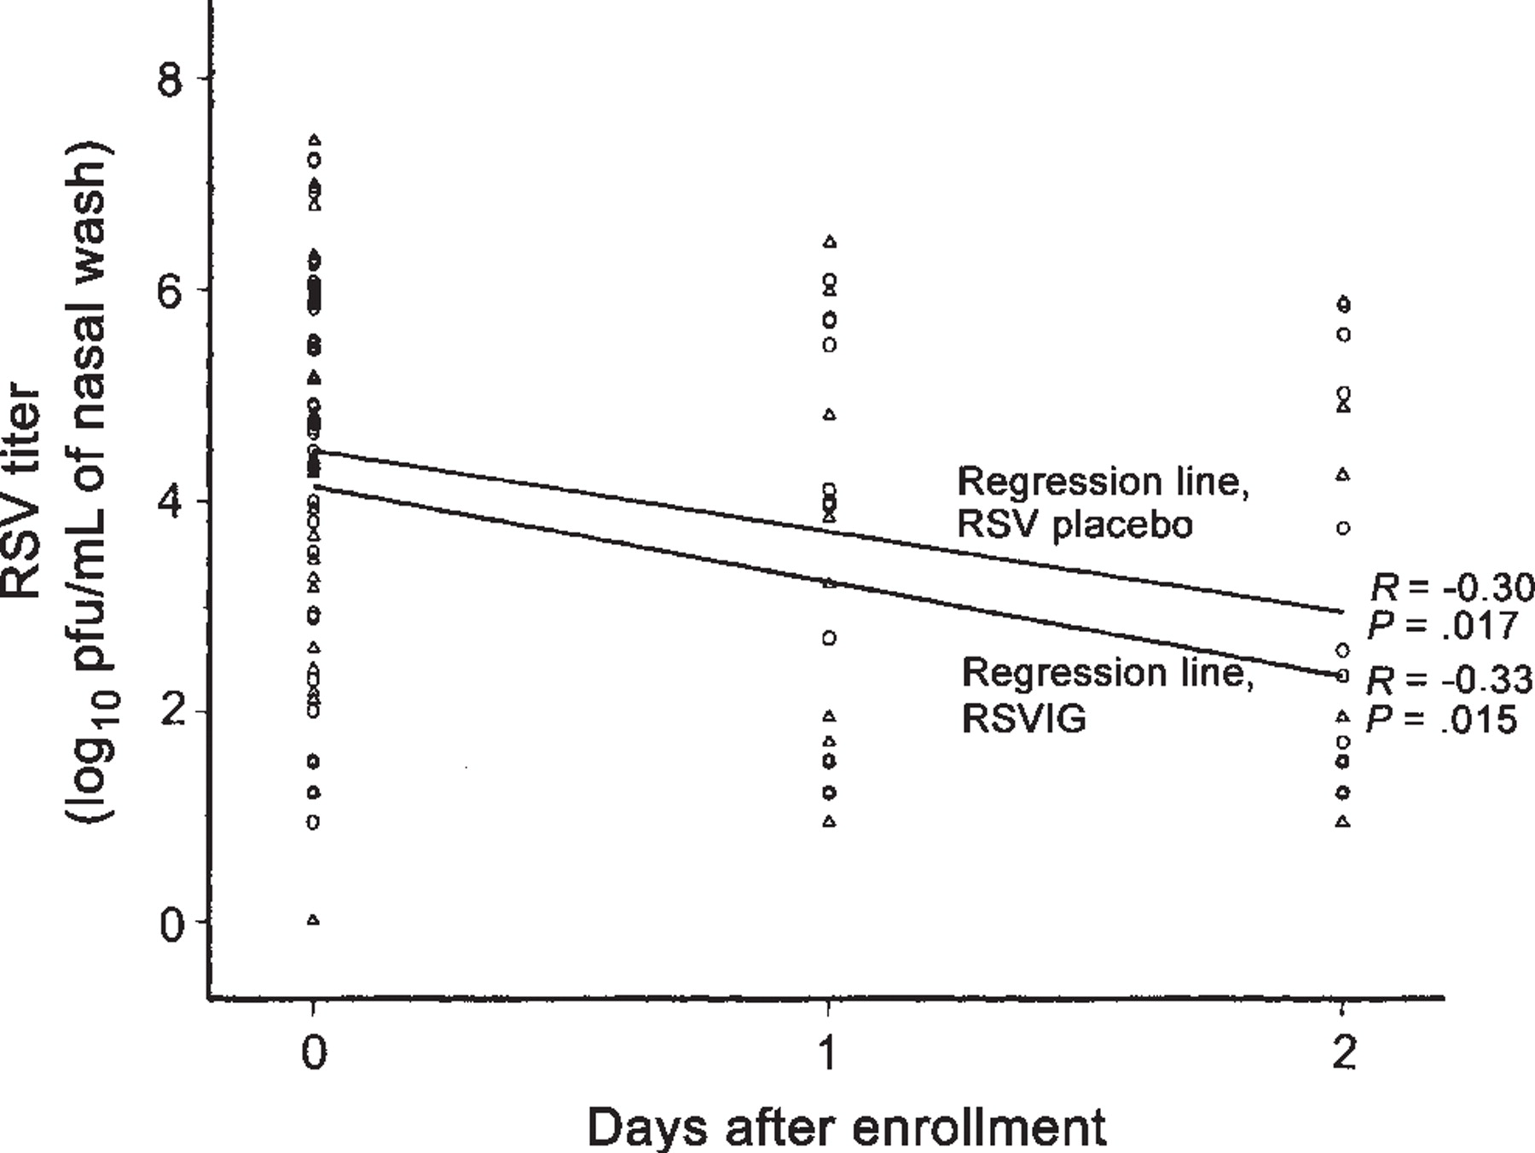
Figure 3. The quantity of respiratory syncytial virus (RSV) recovered from nasal secretions decreased significantly ...
Notes:
Figure 3. The quantity of respiratory syncytial virus (RSV) recovered from nasal secretions decreased significantly after enrollment in both placebo (○) and RSV immunoglobulin (RSVIG; Δ) groups. A significant decrease, by 1-way analysis of variance, was seen in the mean level between 0 and 1 and between 1 and 2 days after enrollment in both groups.
Unless provided in the caption above, the following copyright applies to the content of this slide: © 2002 by the Infectious Diseases Society of America

Slide 6
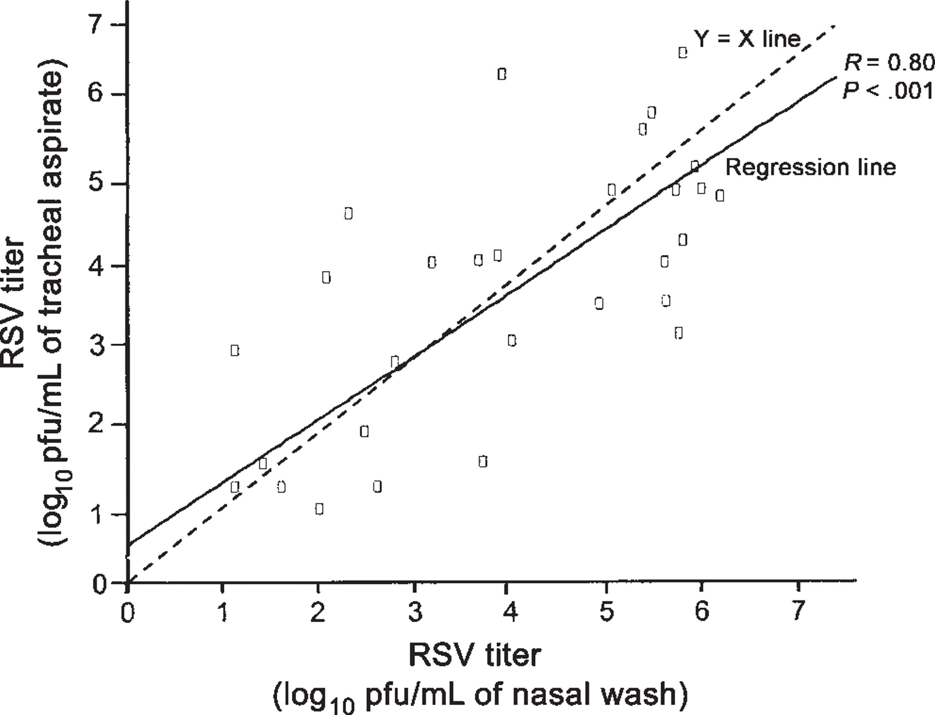
Figure 4. Equivalent amounts of respiratory syncytial virus (RSV) were recovered from nasal and endotracheal ...
Notes:
Figure 4. Equivalent amounts of respiratory syncytial virus (RSV) were recovered from nasal and endotracheal secretions. The amounts of virus shed by an infant in these 2 sites were highly correlated (R = 0.80; P < .001).
Unless provided in the caption above, the following copyright applies to the content of this slide: © 2002 by the Infectious Diseases Society of America

Slide 7
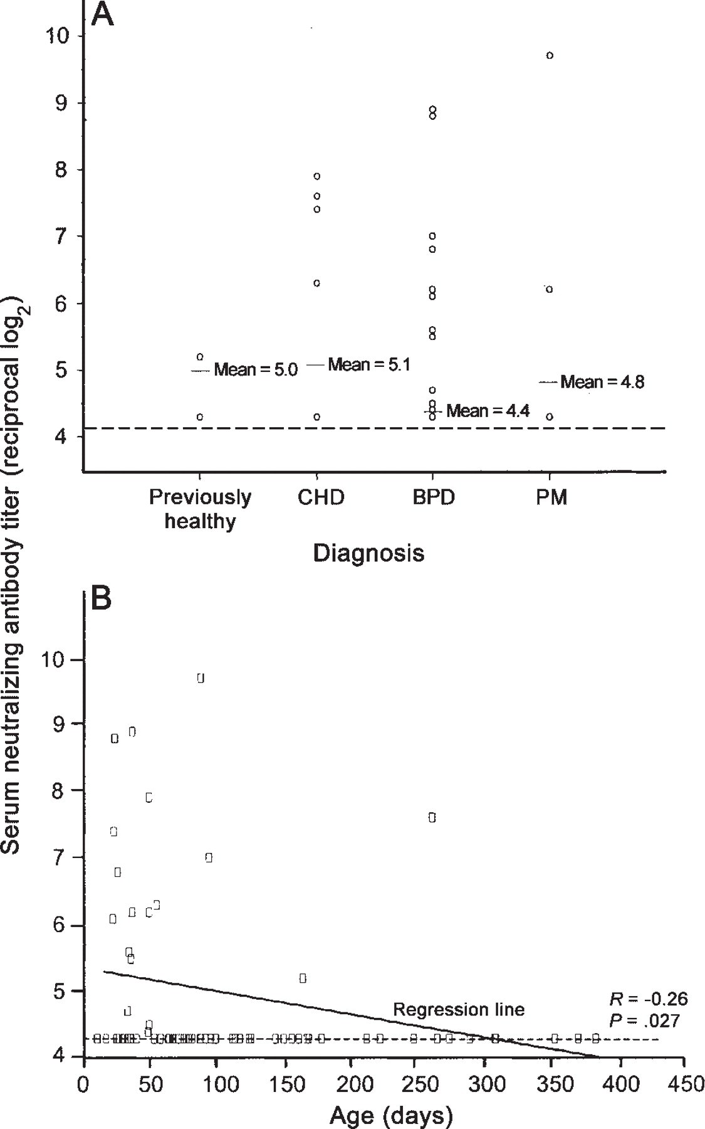
Figure 5. Relationships between respiratory syncytial virus neutralizing antibody titer, primary diagnosis (A), and age ...
Notes:
Figure 5. Relationships between respiratory syncytial virus neutralizing antibody titer, primary diagnosis (A), and age (B) at enrollment. Neutralizing antibody titer at admission was significantly positively correlated with age (P = .027). In panel A, a number of overlapping points appear at the seronegative log24.4 value. BPD, bronchopulmonary dysplasia; CHD, chronic heart disease; PM, prematurity. Dashed line, minimum detectable antibody level.
Unless provided in the caption above, the following copyright applies to the content of this slide: © 2002 by the Infectious Diseases Society of America

Slide 8
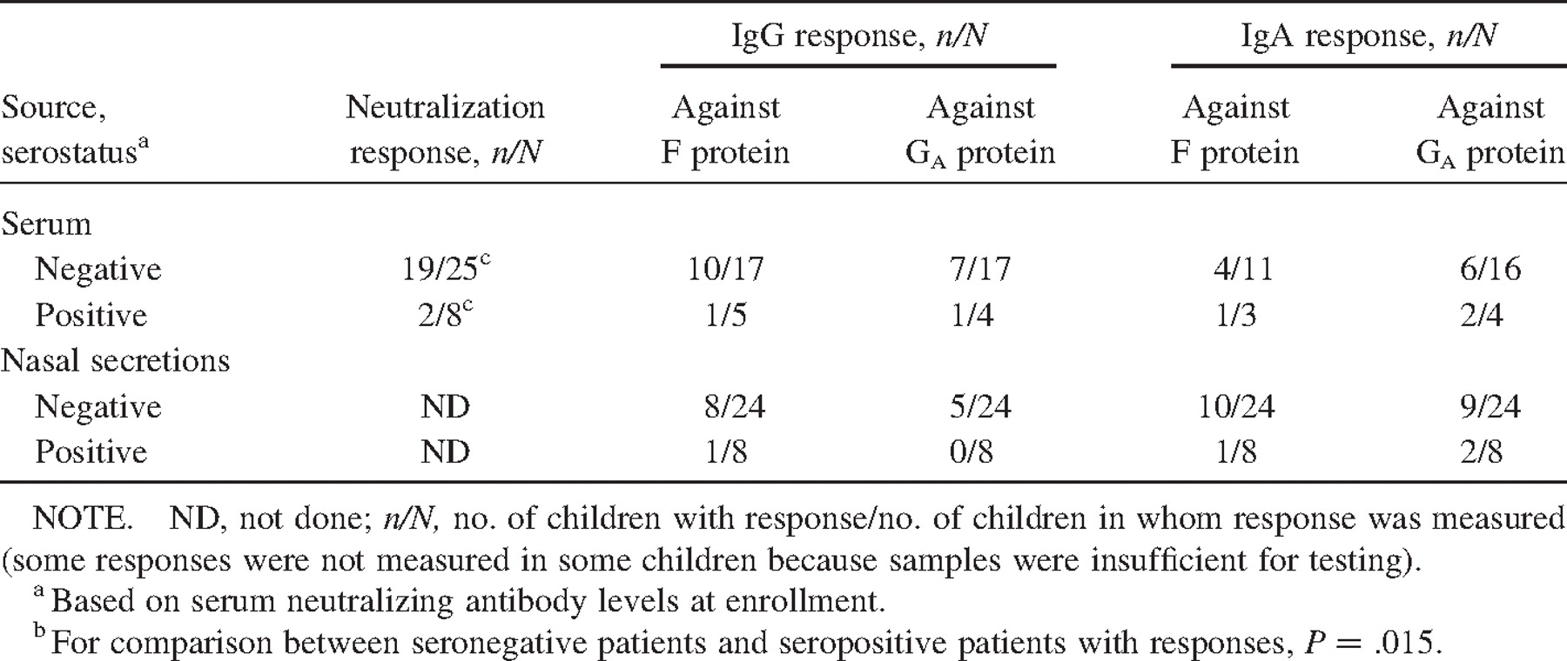
Table 3. Serum and mucosal antibody responses in placebo recipients 8 weeks after enrollment in a study in infants ...
Notes:
Table 3. Serum and mucosal antibody responses in placebo recipients 8 weeks after enrollment in a study in infants hospitalized with respiratory syncytial virus bronchiolitis.
Unless provided in the caption above, the following copyright applies to the content of this slide: © 2002 by the Infectious Diseases Society of America

