Slide 1
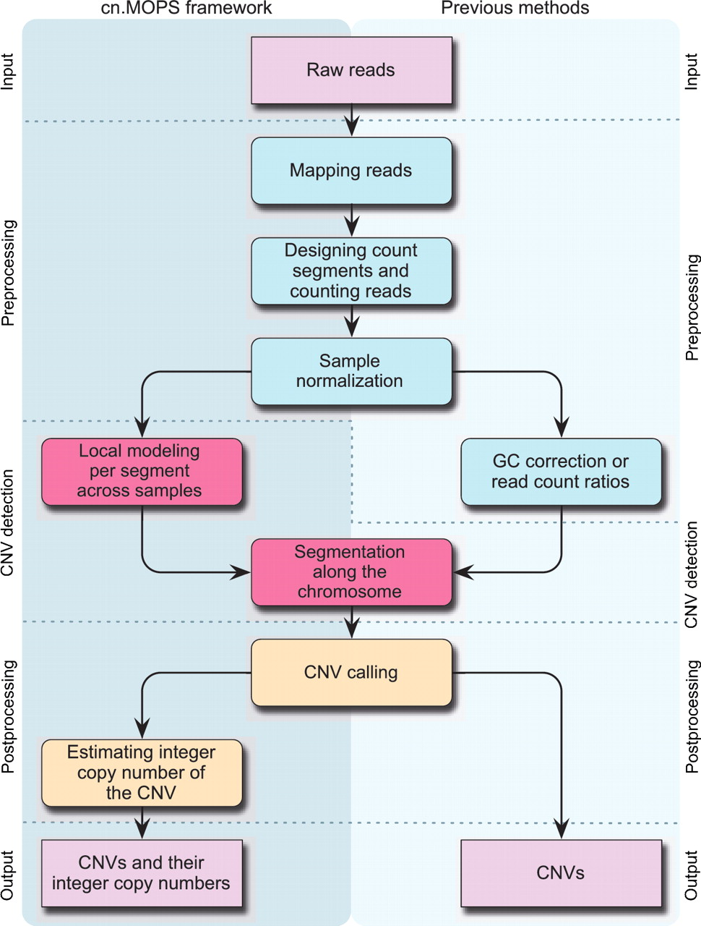
Figure 1. The processing pipelines for CNV detection in NGS data. Left column: modeling across samples and integer copy ...
Notes:
Figure 1. The processing pipelines for CNV detection in NGS data. Left column: modeling across samples and integer copy number estimation are unique to cn.MOPS. Right column: either GC correction [class (a) methods] or read count ratios [class (b) methods] are required for previous pipelines.
Unless provided in the caption above, the following copyright applies to the content of this slide: © The Author(s) 2012. Published by Oxford University Press.This is an Open Access article distributed under the terms of the Creative Commons Attribution Non-Commercial License (http://creativecommons.org/licenses/by-nc/3.0), which permits unrestricted non-commercial use, distribution, and reproduction in any medium, provided the original work is properly cited.

Slide 2
Figure 3. Definitions for the evaluation of copy number detection methods. A genome is split into equally sized ...
Notes:
Figure 3. Definitions for the evaluation of copy number detection methods. A genome is split into equally sized evaluation segments of a length shorter than the shortest CNV. Top panel: Knowing the true CNV regions (green), the evaluation segments are labeled as class 1 (CNV segment) or class −1 (non-CNV segment). Middle panel: A CNV detection method classifies each evaluation segment into CNV segments (blue, class 1) and non-CNV segments (class −1). Bottom panel: In the first line, positives (known CNV regions) are divided into true positives (TP, green) and false negatives (FN, red). In the second line, negatives (no overlap with known CNV regions) are divided into true negatives (TN, green) and false positives (FP, red). Segments partly overlapping with known or predicted CNV regions are not considered (‘na’).
Unless provided in the caption above, the following copyright applies to the content of this slide: © The Author(s) 2012. Published by Oxford University Press.This is an Open Access article distributed under the terms of the Creative Commons Attribution Non-Commercial License (http://creativecommons.org/licenses/by-nc/3.0), which permits unrestricted non-commercial use, distribution, and reproduction in any medium, provided the original work is properly cited.

Slide 3
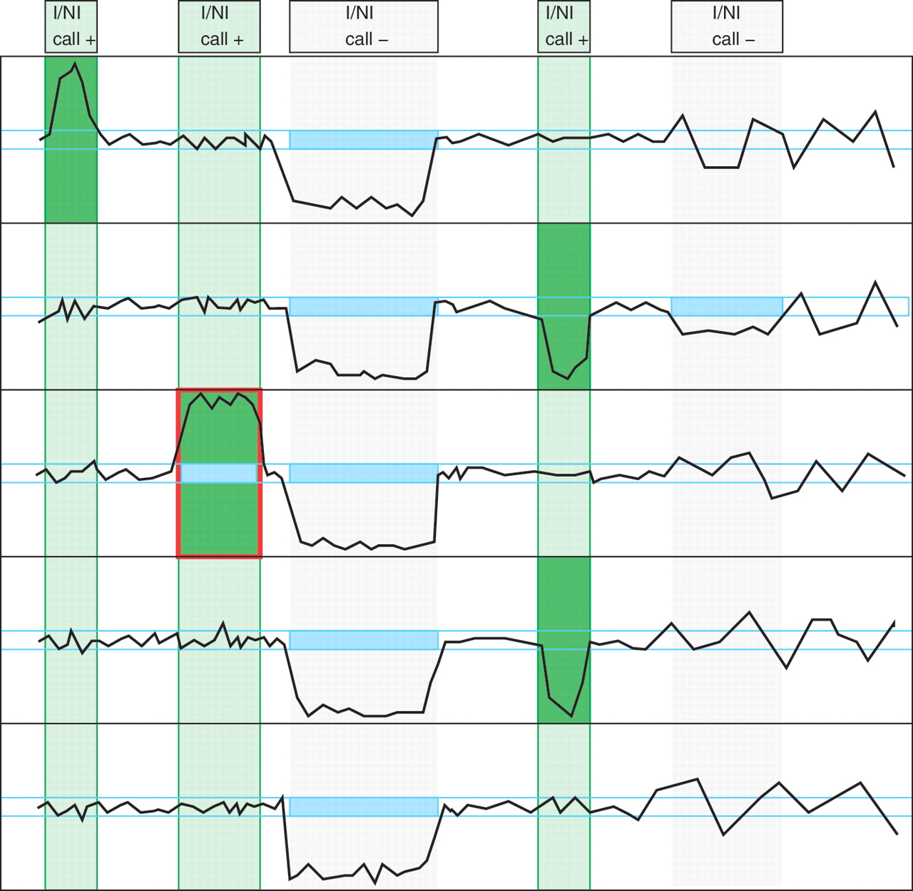
Figure 2. Illustration of the basic concept of cn.MOPS: a CNV call incorporates the detection of variation across ...
Notes:
Figure 2. Illustration of the basic concept of cn.MOPS: a CNV call incorporates the detection of variation across samples (I/NI call) and the detection of variation along a chromosome (segmentation). Curves show read counts along one chromosome for five samples. I/NI calls (green) detect variation across samples (green vertical boxes). A CNV (red box) is called if consecutive segments have high I/NI calls. Blue boxes mark segments that segmentation algorithm of class (a) methods (see the ‘Introduction’ section) would combine into a CNV. First vertical bar (from the left) and first sample: the I/NI call indicates variation across samples (‘I/NI call +’). However, too few adjacent segments show high I/NI calls. Second bar and third sample: the I/NI call indicates variation across samples (‘I/NI call +’) and sufficiently many adjacent segments show high I/NI calls, which leads to a CNV call (red box). Third bar: the read counts drop consistently and would thus be detected by a segmentation algorithm of class (a) methods (blue boxes). However, the read counts of the samples do not vary, which does not lead to an I/NI call (‘I/NI call −’). A CNV is not detected, which is correct as the copy number does not vary across samples. Fourth bar and samples numbers 2 and 4: I/NI call indicates variation across samples (‘I/NI call +’). As in the first bar, too few adjacent segments show high I/NI calls. Fifth bar and second sample: a segmentation algorithm of class (a) methods would combine adjacent read counts that are consistently small (blue box) into a CNV. However, the read counts are within the variation of the constant copy number at this location. Therefore, the I/NI call does not indicate variation across samples (‘I/NI call −’).
Unless provided in the caption above, the following copyright applies to the content of this slide: © The Author(s) 2012. Published by Oxford University Press.This is an Open Access article distributed under the terms of the Creative Commons Attribution Non-Commercial License (http://creativecommons.org/licenses/by-nc/3.0), which permits unrestricted non-commercial use, distribution, and reproduction in any medium, provided the original work is properly cited.

Slide 4
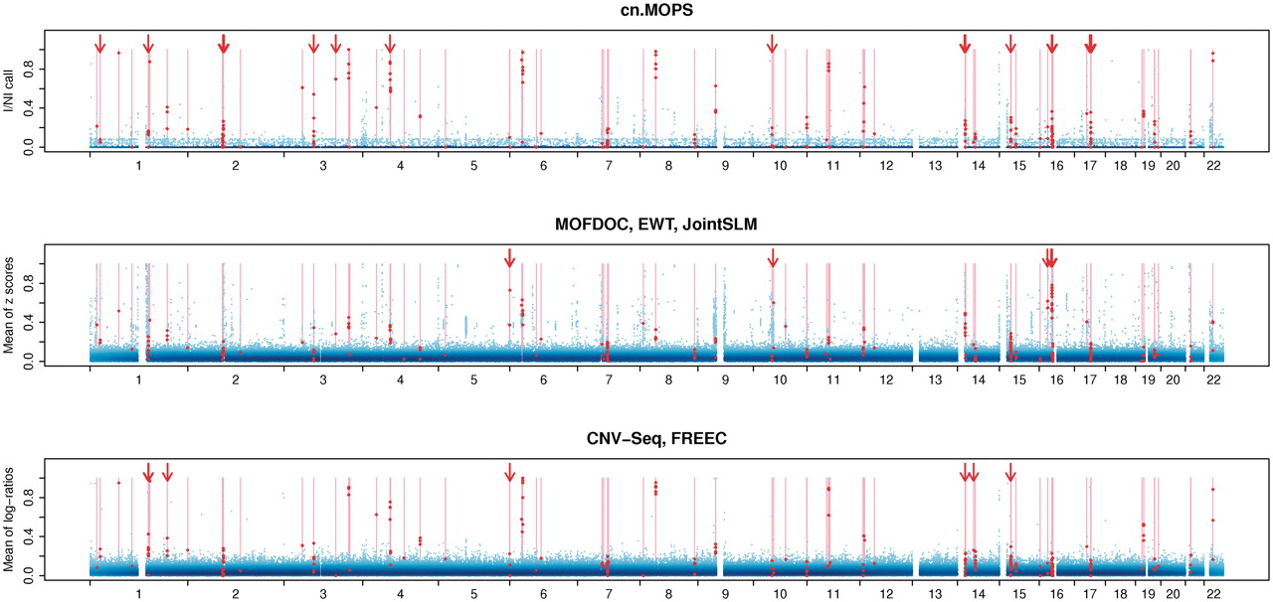
Figure 4. Whole-genome CNV calling plots that visualize the performance of cn.MOPS, MOFDOC, EWT, JointSLM, CNV-Seq, and ...
Notes:
Figure 4. Whole-genome CNV calling plots that visualize the performance of cn.MOPS, MOFDOC, EWT, JointSLM, CNV-Seq, and FREEC at rediscovering known CNVs of HapMap individuals. The plots visualize CNV calling values (vertical axis) along chromosomes 1–22 of the human genome without segmentation. The first panel shows the I/NI call used for cn.MOPS. The second panel provides mean z-scores used by EWT, JointSLM, while the last panel depicts mean log-ratios used by CNV-Seq and FREEC. We called the largest 0.5% of the CNV calling values (blue dots) and scaled them to maximum one. Darker shades of blue indicate a high density of calling values. True CNV regions are displayed as light red bars, and the corresponding CNV calls are indicated by red dots. Segments without calling values (white segments) correspond to assembly gaps in the reference genome. A perfect calling method would call all segments in true CNV regions (red dots) at maximum 1 and would call others (blue dots) at minimum 0. Arrows indicate segments in true CNV regions that are called by one method group but not by the other method groups. A threshold of 0.6 for log-ratios-based methods, namely CNV-Seq and FREEC, and a threshold of 0.8 for cn.MOPS would lead to the same true positive rate, while cn.MOPS yields fewer false discoveries (lower FDR). cn.MOPS is better at separating segments of true CNV regions from non-CNV segments than the other methods, as indicated by the lower variance of I/NI values (see blue area at the bottom of the first panel). The better separation by cn.MOPS results in FDRs lower than those of other methods, regardless of the calling thresholds.
Unless provided in the caption above, the following copyright applies to the content of this slide: © The Author(s) 2012. Published by Oxford University Press.This is an Open Access article distributed under the terms of the Creative Commons Attribution Non-Commercial License (http://creativecommons.org/licenses/by-nc/3.0), which permits unrestricted non-commercial use, distribution, and reproduction in any medium, provided the original work is properly cited.

Slide 5
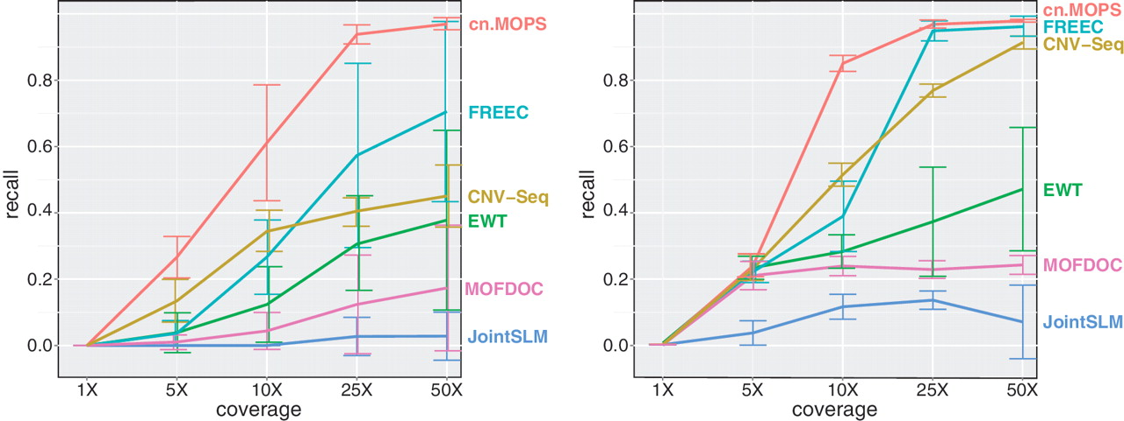
Figure 5. CNV detection performance for different levels of coverage. Each curve in the two panels corresponds to the ...
Notes:
Figure 5. CNV detection performance for different levels of coverage. Each curve in the two panels corresponds to the recall of one method at detecting short CNVs of lengths 1–5 kb (left panel: gains; right panel: losses). The FDR was fixed at 0.05.
Unless provided in the caption above, the following copyright applies to the content of this slide: © The Author(s) 2012. Published by Oxford University Press.This is an Open Access article distributed under the terms of the Creative Commons Attribution Non-Commercial License (http://creativecommons.org/licenses/by-nc/3.0), which permits unrestricted non-commercial use, distribution, and reproduction in any medium, provided the original work is properly cited.

