Slide 1
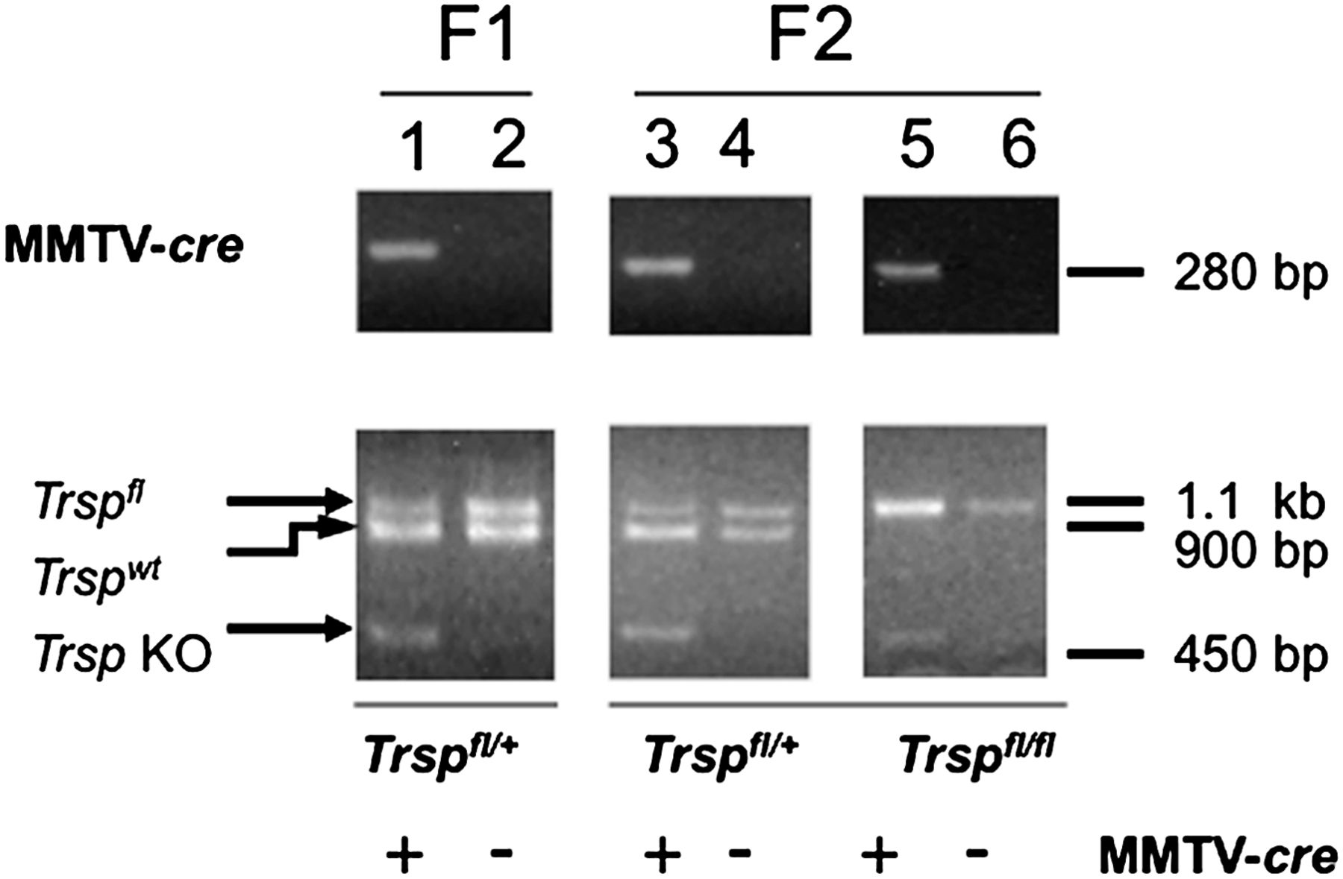
Fig. 1. Excision of floxed- Trsp alleles in the mammary glands of Trsp ^{fl/fl} ;MMTV- cre mice. Upper ...
Notes:
Fig. 1. Excision of floxed- Trsp alleles in the mammary glands of Trsp fl/fl ;MMTV- cre mice. Upper panel shows a 280 bp band for the MMTV- cre transgene in lanes 1, 3 and 5 as demonstrated by PCR. Lower panels show heterozygous and homozygous floxed Trsp mice wherein Trsp fl/+ is represented by a 1.1 kb band, Trsp wt by a 900 bp band and Trsp fl/fl by a 450 bp band. F1 and F2 generations are shown in lanes 1 and 2 and in lanes 3, 4, 5 and 6, respectively.
Unless provided in the caption above, the following copyright applies to the content of this slide: Published by Oxford University Press 2012.

Slide 2
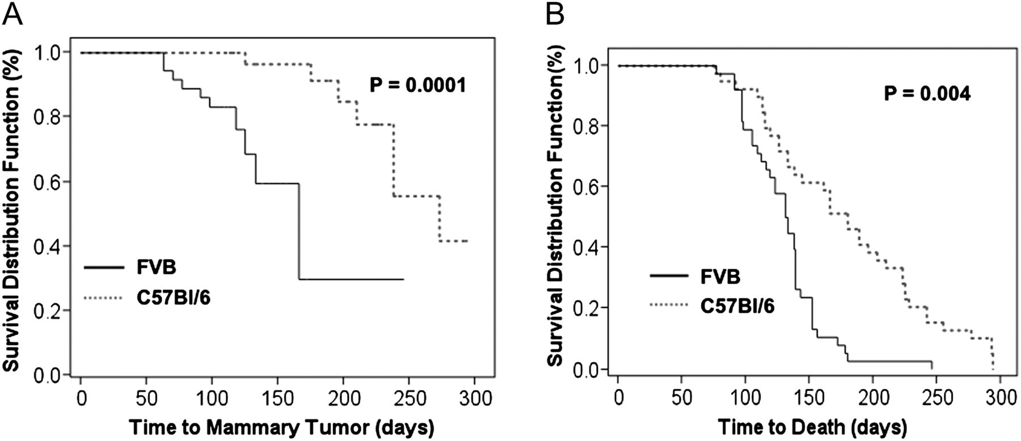
Fig. 2. Mammary tumor development and survival rates in FVB and C57Bl/6 control mice. ( A ) Time to mammary tumor ...
Notes:
Fig. 2. Mammary tumor development and survival rates in FVB and C57Bl/6 control mice. ( A ) Time to mammary tumor formation following DMBA exposure in control FVB (solid line) and C57Bl/6 mice (dotted line). Represents the percent of mice that develop mammary tumors over time. ( B ) Time to death of control FVB (solid line) and C57Bl/6 mice (dotted line) from all causes.
Unless provided in the caption above, the following copyright applies to the content of this slide: Published by Oxford University Press 2012.

Slide 3
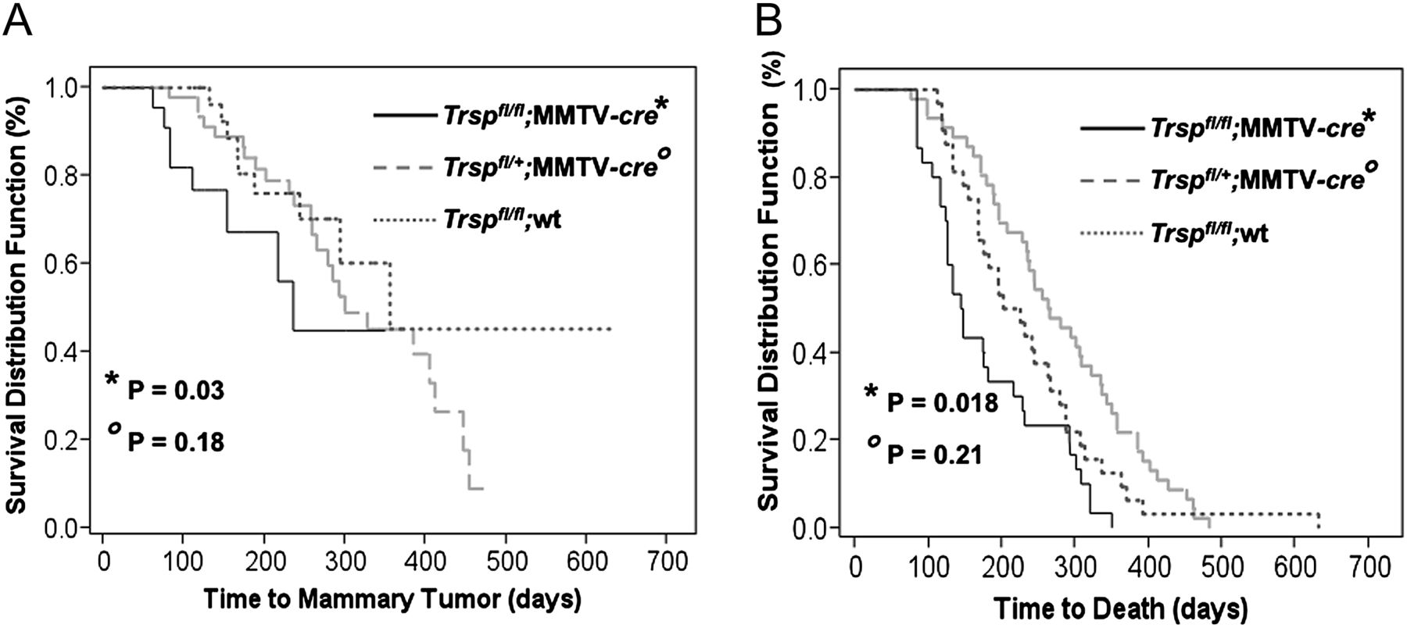
Fig. 3. Tumor development and survival rates in Trsp knockout and control mice. ( A ) Time to tumor formation in ...
Notes:
Fig. 3. Tumor development and survival rates in Trsp knockout and control mice. ( A ) Time to tumor formation in Trsp fl/fl ;MMTV- cre (solid line), Trsp fl/+ ;MMTV- cre (dashed line) and Trsp fl/fl ;wt mice (blue dashed line). Represents the percent of mice that develop mammary tumors over time. ( B ) Time to death of Trsp fl/fl ;MMTV- cre (solid line), Trsp fl/+ ;MMTV- cre (dashed line) and Trsp fl/fl ;wt mice (blue dashed line) from all causes. P values are compared with Trsp fl/fl ;wt and Trsp fl/+ ;wt mice. There was no significant differences between Trsp fl/fl ;wt and Trsp fl/+ ;wt mice. Only the Trsp fl/fl ;wt mice are graphed.
Unless provided in the caption above, the following copyright applies to the content of this slide: Published by Oxford University Press 2012.

Slide 4
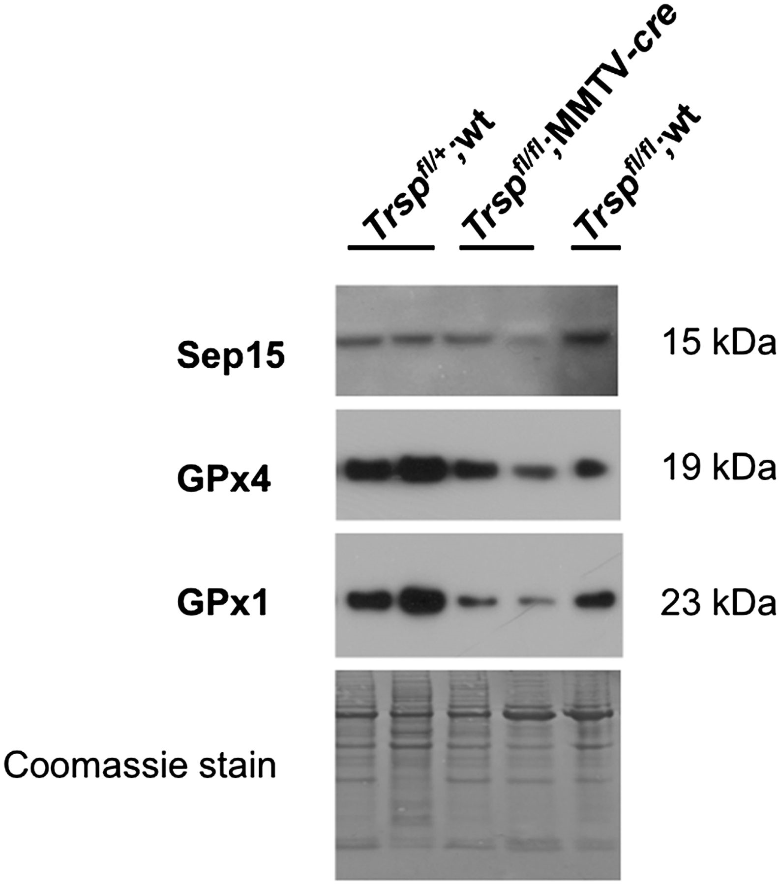
Fig. 4. Selenoprotein expression in DMBA-induced mammary tumors. Western blot analyses of protein extracts from ...
Notes:
Fig. 4. Selenoprotein expression in DMBA-induced mammary tumors. Western blot analyses of protein extracts from carcinogen-induced mouse mammary tumors showing Sep15, GPx4 and GPx1 protein levels are reduced in Trsp fl/fl ;MMTV- cre tumors compared with Trsp fl/+ ; wt and Trsp fl/fl ;wt tumors. Genotypes of tumors are indicated at the top of the figure.
Unless provided in the caption above, the following copyright applies to the content of this slide: Published by Oxford University Press 2012.

