Slide 1
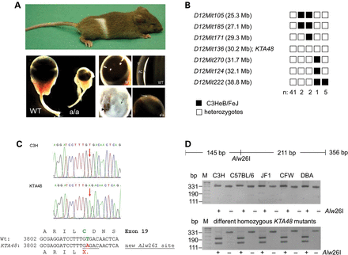
Figure 1. Genetics of the KTA048 mutant mouse. (A) The recessive KTA048 mutant was identified on C3HeB/FeJ background ...
Notes:
Figure 1. Genetics of the KTA048 mutant mouse. (A) The recessive KTA048 mutant was identified on C3HeB/FeJ background and showed a white spot at the belly and small eyes; the kinky tail is already lost. At adult (3 months), KTA048 mutant eyes exhibit smaller eyes, corneal opacity and absent or very shallow anterior chamber. (B) Haplotype analysis revealed a critical interval of 2.4 Mb between the markers D12Mit171 and D12Mit270 including the marker D12Mit136 and the candidate gene Pxdn. Black boxes illustrate the presence of two C3H marker alleles (recombination between microsatellite marker and KTA048); white boxes illustrate the presence of one copy of both alleles, C3H and B6 (lack of recombination). (C) Sequence analysis of the 3′ part of the Pxdn cDNA (PCR primer pair Pxdn-L5/R5; Table 1) revealed a T->C exchange at cDNA-position 3816 (red arrows) leading to a premature stop codon (X) in exon 19. The alignment of the DNA sequences together with the deduced amino acid sequences are given below; the new Alw26I restriction site in the mutant is underlined. (D) The Pxdn-mutation co-segregates within the mutant line. In the mutants, the Alw26I restriction enzyme cuts a genomic fragment of 356 bp into two fragments of 211 and 145 bp. DNA restriction analysis in different wild-type strains of mice showed the absence of T->A exchange. However, it is present in five homozygous (a/a) KTA048 mutant mice randomly collected from the actual running breeding. The wild-type strains investigated are given above the gel; M: DNA size marker.
Unless provided in the caption above, the following copyright applies to the content of this slide: © The Author 2014. Published by Oxford University Press.This is an Open Access article distributed under the terms of the Creative Commons Attribution License (http://creativecommons.org/licenses/by/4.0/), which permits unrestricted reuse, distribution, and reproduction in any medium, provided the original work is properly cited.

Slide 2
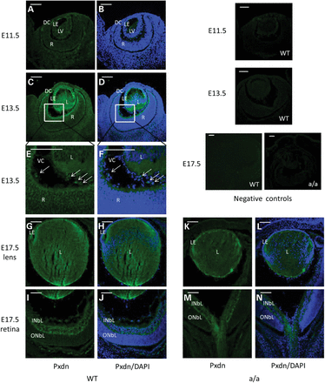
Figure 2. Peroxidasin during eye development. (A and B) Immunofluorescence studies showed weak Pxdn expression in the ...
Notes:
Figure 2. Peroxidasin during eye development. (A and B) Immunofluorescence studies showed weak Pxdn expression in the lens vesicle at E11.5. (C–F) At E13.5, it is highly expressed in the anterior lens epithelium, in the posterior lens fiber cells, in the inner limiting membrane (C and D) and in some mesenchymal cells in the vitreous (E and F, arrow); (E–F) are a close-up of (C) and (D). (G–J) At E17.5, Pxdn is mainly expressed in the lens epithelial cells, in the posterior part of the lens (G and H) and in inner neuroblastic layer (I and J). However, Pxdn is still expressed in the lens and in the inner neuroblastic layer and the expression pattern is similar to the wild-type eyes at E17.5 (K–N). Negative controls (without primary antibody) were shown in the most right panel. DC, developing cornea; L, lens; R, retina; LE, lens epithelium; LV, lens vesicle; INBL, inner neuroblast layer; ONBL, outer neuroblast layer; VC, vitreous cavity. Green: peroxidasin; blue: DAPI. Scale bar: 50 µm.
Unless provided in the caption above, the following copyright applies to the content of this slide: © The Author 2014. Published by Oxford University Press.This is an Open Access article distributed under the terms of the Creative Commons Attribution License (http://creativecommons.org/licenses/by/4.0/), which permits unrestricted reuse, distribution, and reproduction in any medium, provided the original work is properly cited.

Slide 3
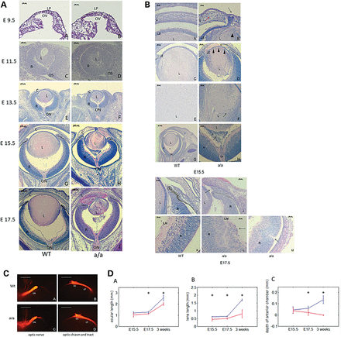
Figure 3. Anterior segment dysgenesis during eye development in KTA048 mutants. (A and B) (A, a–h) At E15.5, the mutant ...
Notes:
Figure 3. Anterior segment dysgenesis during eye development in KTA048 mutants. (A and B) (A, a–h) At E15.5, the mutant eyes exhibit obvious anterior segment dysgenesis. The details are shown in (B, a–h): corneal-lens adhesion (b, black arrow), disorganized corneal stroma (b, red arrow), loss of structural integrity of the lens (b, arrowhead), lens fibers in the anterior chamber (b), thinner lens epithelium (d, arrowheads), disorganized lens matrix (f, arrow) and retrolental tissue (h, arrow). (A, i and j) At E17.5, the anterior chamber is further filled by lens material. Retinal phenotypes occur in a few cases (32.1%) including a loss of structural integrity in the ILM (B, l) and rosette-like structure (B, m). C, cornea; L, lens; LP, lens placode; OV, optic vesicle; R, retina; V, vitreous cavity; LE, lens epithelium; ON, optic nerve; ICA, corneal-iris angle; ILM, inner limiting membrane. Scale bar: (A) a–d, 50 µm; e–j, 100 µm. (B) a–b, e–f, i–m, 20 µm; c and d, h, 50 µm; g, 200 µm. (C) At E15.5, the crossing and fasciculation of the optic nerve, optic chiasm and optic tract are not affected in mutants (N = 5) (c and d) compared with wild-types (N = 5) (a and b). ON, optic nerve; OC, optic chiasm; OT, optic tract. Scale bar: 100 µm. (D) Impaired ocular and lens growth in KTA048 mutants. (a–c) The ocular length, lens size and anterior chamber depth are significantly reduced in mutants compared with wild-types (P < 0.05). Blue line: wild-type; red line: mutants; asterisk: P < 0.05. Number: E15.5 (Wt 4, Mt 4); E17.5 (Wt 6, Mt 7); P21 (Wt 6, Mt 6).
Unless provided in the caption above, the following copyright applies to the content of this slide: © The Author 2014. Published by Oxford University Press.This is an Open Access article distributed under the terms of the Creative Commons Attribution License (http://creativecommons.org/licenses/by/4.0/), which permits unrestricted reuse, distribution, and reproduction in any medium, provided the original work is properly cited.

Slide 4
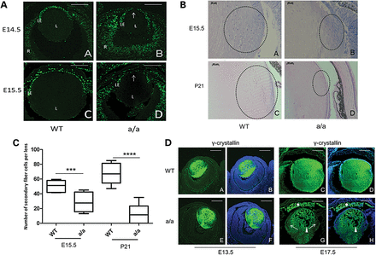
Figure 4. Reduced lens proliferation and disrupted lens differentiation in KTA048 mutant embryos. (A) (a and b) At ...
Notes:
Figure 4. Reduced lens proliferation and disrupted lens differentiation in KTA048 mutant embryos. (A) (a and b) At E14.5, wild-type lens epithelial cells (a) incorporated more BrdU than mutant lens cells in the central part of lens epithelium (b). (c and d) Similarly, also at E15.5, wild-type lens epithelial cells (c) incorporated more BrdU than mutant lens cells (d). L, lens; R, retina; LE, lens epithelium. The arrow points to the central epithelium. Scale bar: 50 µm. (B and C) The transition zone is disorganized and the number of secondary fiber cells is reduced in mutants (b) compared with wild-types (a) at E15.5 (C), ***P < 0.001. At P21, the epithelium cells in the transition zone are thinner and the number of fiber cells is obviously reduced in the mutants (d) compared with wild types (Cc, ****P < 0.0001). Scale bar: a and b, 20 µm; c and d, 50 µm. (D) (a–b and e–f) At E13.5, γ-crystallin is expressed in the whole wild-type lens (a and b); but there are no differences between wild-types (a and b) and mutants (e and f). (c–d, and g–h). However, the mutants showed reduced expression of γ-crystallin in the transition zone at E17.5 (g and h, arrow) compared with wild types (c and d), suggesting that the fiber cell differentiation is affected. Moreover, the expression of γ-crystallin was found in the anterior chamber of the mutants (g and h, white asterisk) accompanied by loss of lens fibers in the lens (g and h, arrowhead) due to the loss of structural integrity of the lens capsule and lens epithelium. Scale bar: a–h, 50 µm.
Unless provided in the caption above, the following copyright applies to the content of this slide: © The Author 2014. Published by Oxford University Press.This is an Open Access article distributed under the terms of the Creative Commons Attribution License (http://creativecommons.org/licenses/by/4.0/), which permits unrestricted reuse, distribution, and reproduction in any medium, provided the original work is properly cited.

Slide 5
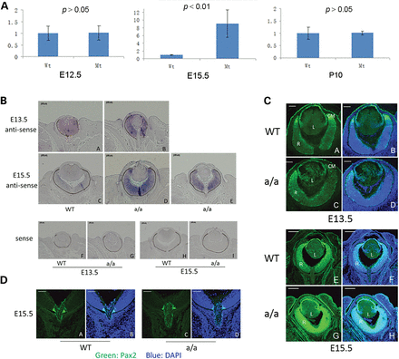
Figure 5. Pax6 expression pattern. (A) Real-time PCR showed that Pax6 expression is up-regulated in mutant eyes ...
Notes:
Figure 5. Pax6 expression pattern. (A) Real-time PCR showed that Pax6 expression is up-regulated in mutant eyes compared with wild-type eyes at E15.5, although there is no difference of Pax6 expression at E12.5 and P10. (B and C) At E13.5, Pax6 mRNA is mainly expressed in the retina and lens epithelium [in-situ hybridization (B, a) and immunofluorescence (C, a, b)]. In the mutants, Pax6 is not only expressed in the retina, but also expressed in the lens (A, b; C, c–d). At E15.5, Pax6 is expressed in the lens epithelial cells and in the retina of wild-types (B, c; C, e–f). However, it appears that Pax6 is up-regulated in the retina of the mutants (B, d–e). This result is also consistent with immunofluorescence data, demonstrating that the expression of Pax6 is stronger in the mutant eyes (C, g–h) at E15.5 compared with wild-types (C, e–f). (D) At E15.5, Pax2 is expressed in the optic nerve head especially in the junction between retina and the optic nerve head in wild-types (a and b). Compared with wild types, Pax2 expression is not affected in mutants (c and d). Scale bar: (B) a–i, 100 µm; (C) a–d, 50 µm; e–h, 200 µm; (D) a–d, 50 µm.
Unless provided in the caption above, the following copyright applies to the content of this slide: © The Author 2014. Published by Oxford University Press.This is an Open Access article distributed under the terms of the Creative Commons Attribution License (http://creativecommons.org/licenses/by/4.0/), which permits unrestricted reuse, distribution, and reproduction in any medium, provided the original work is properly cited.

Slide 6
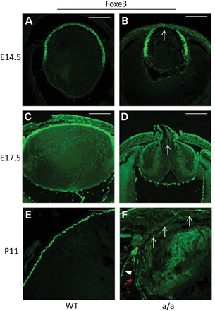
Figure 6. Aberrant expression of Foxe3 in mutants. (A–F) At E14.5, there is robust expression of Foxe3 in lens ...
Notes:
Figure 6. Aberrant expression of Foxe3 in mutants. (A–F) At E14.5, there is robust expression of Foxe3 in lens epithelial cells in wild-types (A), whereas in the anterior lens epithelium of the mutants the expression of Foxe3 is decreased (B, arrow). At E17.5, there is still strong expression of Foxe3 in lens epithelia cells in wild-types (C), but decreased expression of Foxe3 in mutants (D, arrow). At a later stage (P11), Foxe3 is only expressed in lens epithelium cells (E) while in mutants Foxe3 expression is completely absent in most lens epithelium cells (F, white arrow) and decreased expression of the other lens epithelium cells (F, red arrow) and it is ectopically expressed in some regions outside of the lens (F, arrowhead). Scale bar: 50 µm.
Unless provided in the caption above, the following copyright applies to the content of this slide: © The Author 2014. Published by Oxford University Press.This is an Open Access article distributed under the terms of the Creative Commons Attribution License (http://creativecommons.org/licenses/by/4.0/), which permits unrestricted reuse, distribution, and reproduction in any medium, provided the original work is properly cited.

Slide 7
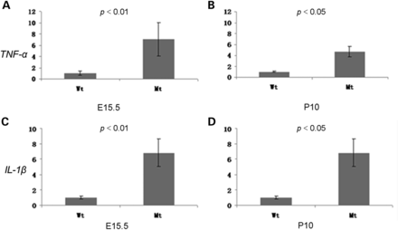
Figure 7. Ocular inflammation during eye development. Real-time PCR showed that the expression of inflammation marker ...
Notes:
Figure 7. Ocular inflammation during eye development. Real-time PCR showed that the expression of inflammation marker genes (TNF-α and IL-1β) are significantly up-regulated in mutant eyes at E15.5 and P10, which suggests that ocular inflammation occurs during embryonic eye development and continues at postnatal period. Mt: a/a; E15.5 (n(Wt) = 4; n(Mt) = 6); P10 (n(Wt) = 4; n (Mt) = 4).
Unless provided in the caption above, the following copyright applies to the content of this slide: © The Author 2014. Published by Oxford University Press.This is an Open Access article distributed under the terms of the Creative Commons Attribution License (http://creativecommons.org/licenses/by/4.0/), which permits unrestricted reuse, distribution, and reproduction in any medium, provided the original work is properly cited.

Slide 8
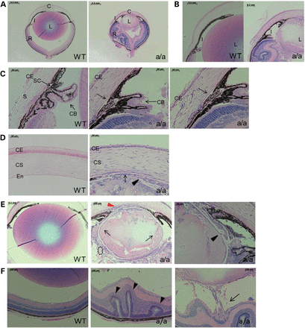
Figure 8. Anterior segment dysgenesis in KTA048 mutants at the age of 3 weeks. At P21, the mutants displayed remarkable ...
Notes:
Figure 8. Anterior segment dysgenesis in KTA048 mutants at the age of 3 weeks. At P21, the mutants displayed remarkable smaller eyes and lenses compared with wild-types (A) and severely anterior segment dysgenesis including iris hypoplasia and underdevelopment of ciliary body (B and C), lens-corneal adhesion (D and E), thinner corneal epithelium and disorganized corneal stromal keratocytes (D), disorganized lens matrix which leads to congenital cataract (E). The iris is attached to the cornea and lens (A, B and E), resulting in a block of aqueous humor flow into trabecular meshwork. Moreover, lens capsules are broken in mutants (black arrowhead, E) and the lens matrix is found around the lens in the vitreous cavity (black arrow, E). The lens equator in mutants is also totally destroyed and there are very few secondary fiber cells near the lens equator (black broken circle, E). In wild-types, the Schlemm's canal develops well and ciliary body is located between cornea and sclera (arrow, C, WT), whereas in mutants the Schlemm's canal is not obviously found and cornea extends to retina regions (C). (F) Retinal rossete-like structure (arrowhead) and retinal traction (arrow) occur in mutants compared with wild types. C, cornea; I, iris; L, lens; R, retina; CE, corneal epithelium; CS, corneal stroma; En, endothelium; CB, ciliary body. Scale bar: A–B, 500 µm; C–D, 50 µm; E (WT), 200 µm; E (a/a, left), 100 µm; E (a/a, right), 50 µm.
Unless provided in the caption above, the following copyright applies to the content of this slide: © The Author 2014. Published by Oxford University Press.This is an Open Access article distributed under the terms of the Creative Commons Attribution License (http://creativecommons.org/licenses/by/4.0/), which permits unrestricted reuse, distribution, and reproduction in any medium, provided the original work is properly cited.

Slide 9
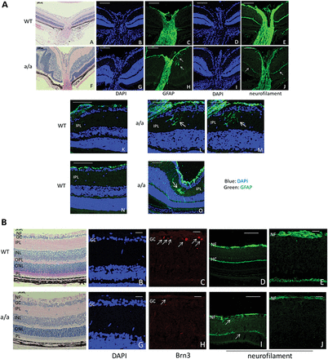
Figure 9. Retina and optic nerve head in KTA048 mutants. (A) (a–j) In the mutants, local retinal folds and rosettes ...
Notes:
Figure 9. Retina and optic nerve head in KTA048 mutants. (A) (a–j) In the mutants, local retinal folds and rosettes (arrow, f) and retinal detachment (arrowhead, f) are observed. Retinal glial cells are more activated in mutants around the optic nerve head (arrow, h) and in the local inner plexiform layers (h; l–m; o; arrow) and even in full retinal layers of some regions of the mutant retina (o) compared with wild-types (c, h, k and n). There is less staining for neurofilament in the neural fiber layer and optic nerve in mutants (j) compared with wild-types (e). Scale bar: a, f, 100 µm; b–e, g–j, 50 µm. (B) (a–c and h–j) There is no dramatic difference in the retinal morphology in well-developed retina of the mutants (f and g) compared with wild-types (a and b), but interestingly the expression of Brn3 is obviously decreased in mutants (h, arrow) compared with wild-types (c, arrow). Correspondingly, the RGC axons in mutants are thinner (i and j) than in wild-types (d and e) and both neural fiber layer and the axons of the horizontal cells are disrupted in mutants (i, arrow; j) compared with wild-types (d and e). GCL, retinal ganglion cell layer; HC, horizontal cells; INL, inner nuclear layer; IPL, inner plexiform layer; NF, nerve fiber layer; ONL, outer nuclear layer; OPL, outer plexiform layer; PL, photoreceptor layer; RGC, retinal ganglion cell. Scale bar: a, b, h, i, d, f, k, m, 50 µm; c, e, g, j, l, n, 20 µm.
Unless provided in the caption above, the following copyright applies to the content of this slide: © The Author 2014. Published by Oxford University Press.This is an Open Access article distributed under the terms of the Creative Commons Attribution License (http://creativecommons.org/licenses/by/4.0/), which permits unrestricted reuse, distribution, and reproduction in any medium, provided the original work is properly cited.

Slide 10
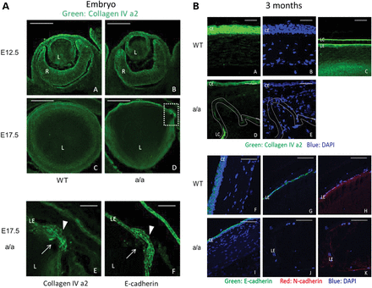
Figure 10. Decreased expression of extracellular matrix molecule and cell adhesion molecule in KTA048 mutants. (A) (a ...
Notes:
Figure 10. Decreased expression of extracellular matrix molecule and cell adhesion molecule in KTA048 mutants. (A) (a and b) Col4a2 is mainly expressed in the corneal epithelium, lens epithelium and inner limiting membrane in wild-types at E12.5; there is no difference in the expression pattern between wild-types and mutants. (c–e) Local disruption of Col4a2 expression was found in the lens epithelium and lens capsule in mutants (d, broken box: close up in e, f; e, arrow) compared with wild-types at E17.5 (c). E-cadherin immunofluorescence demonstrated less adhesion of lens epithelium cells (f); it appears that lowered cell adhesion of epithelial cells precedes loss of the structural identity of the lens capsule (bulging area, arrow and arrowhead). Scale bar: a–d, 50 µm; e–f, 20 µm. (B) (a–e) At 3 months, collagen IV is expressed in the corneal epithelium (a) and lens epithelium and the outer layer of lens capsule (c) in wild-types. The expression of E-cadherin is greatly decreased and disrupted in the cornea epithelium and lens epithelium in mutants (d) in association with disrupted corneal keratocytes (e). (f–k) E-cadherin is expressed in the corneal epithelium (f) and lens epithelium (g), and N-cadherin is expressed in the lens epithelium (h) in wild-types. The expression of E-cadherin and N-cadherin is greatly decreased and disrupted in the cornea epithelium and lens epithelium in mutants (i–k). Scale bar: a–e, 20 µm; f–k, 50 µm.
Unless provided in the caption above, the following copyright applies to the content of this slide: © The Author 2014. Published by Oxford University Press.This is an Open Access article distributed under the terms of the Creative Commons Attribution License (http://creativecommons.org/licenses/by/4.0/), which permits unrestricted reuse, distribution, and reproduction in any medium, provided the original work is properly cited.

