Slide 1
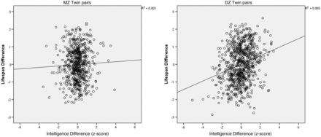
Figure 1. MZ (on left) and DZ (on right) twins. Regression of within-pair lifespan difference z-score on within-pair ...
Notes:
Figure 1. MZ (on left) and DZ (on right) twins. Regression of within-pair lifespan difference z-score on within-pair intelligence difference z-score (each datum = one within-pair difference score) in combined samples.
Unless provided in the caption above, the following copyright applies to the content of this slide: © The Author 2015; Published by Oxford University Press on behalf of the International Epidemiological Association This is an Open Access article distributed under the terms of the Creative Commons Attribution License ( http://creativecommons.org/licenses/by/4.0/ ), which permits unrestricted reuse, distribution, and reproduction in any medium, provided the original work is properly cited.

