Slide 1
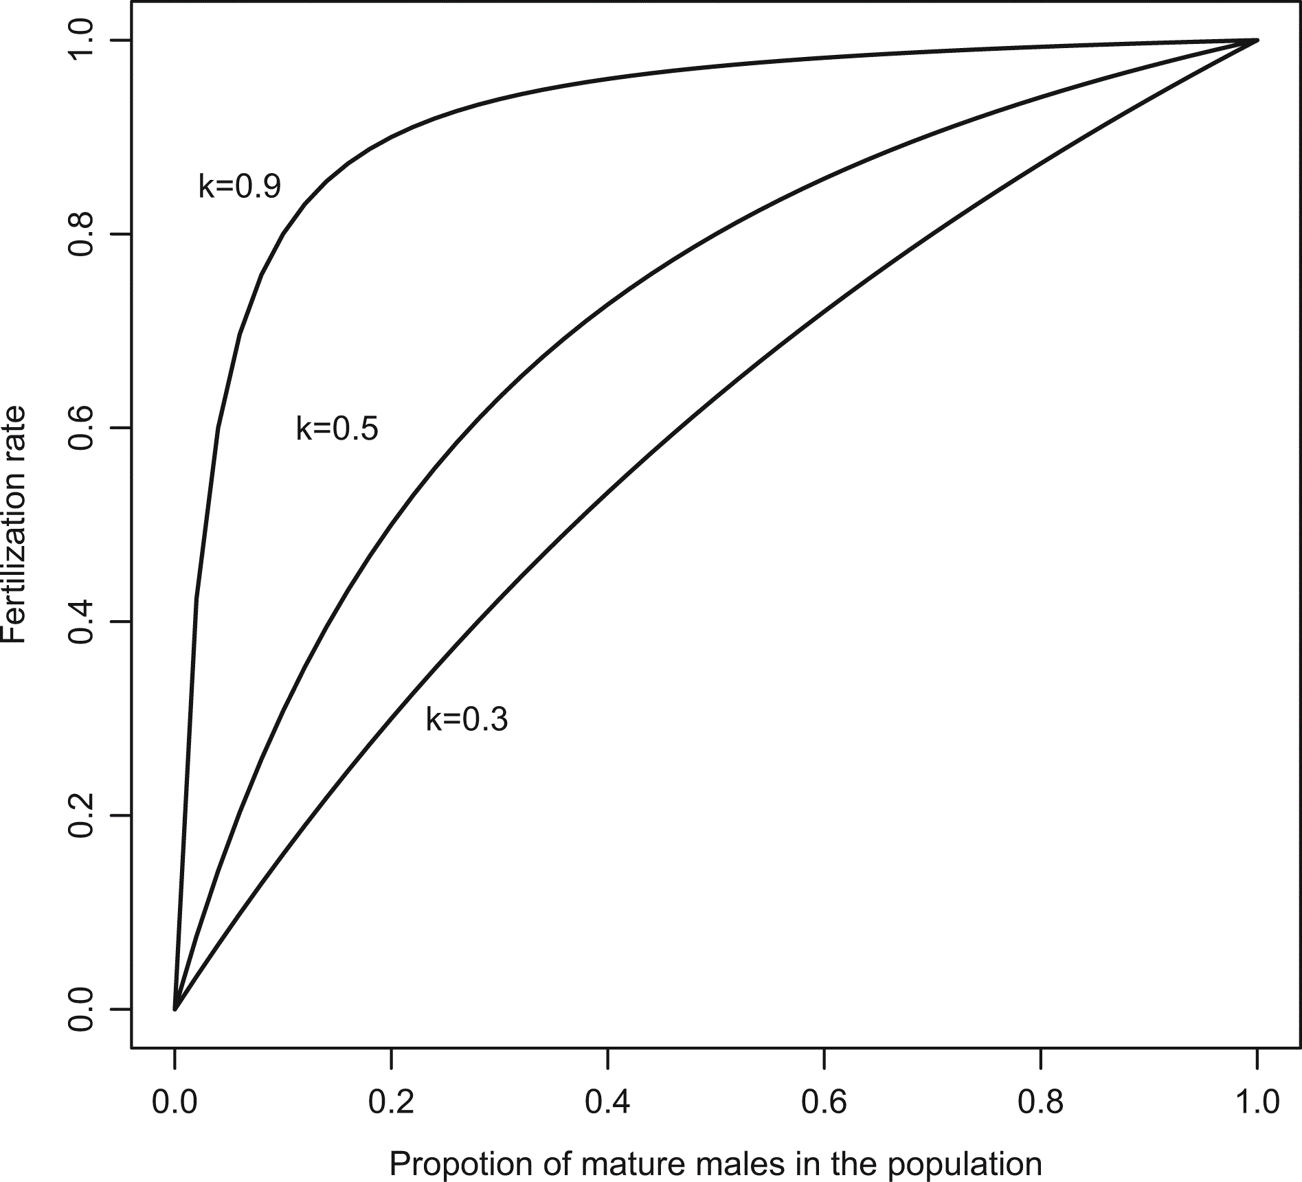
Figure 1 Fertilization rate as a function of the proportion of mature males in the population at varying levels of k, ...
Notes:
Figure 1 Fertilization rate as a function of the proportion of mature males in the population at varying levels of k, a stock specific parameter controlling the ability of the population to compensate for loss of males (equation 5). k = (0.3, 0.5, 0.9).
Unless provided in the caption above, the following copyright applies to the content of this slide: © International Council for the Exploration of the Sea 2016. All rights reserved. For Permissions, please email: journals.permissions@oup.comThis article is published and distributed under the terms of the Oxford University Press, Standard Journals Publication Model (https://academic.oup.com/journals/pages/open_access/funder_policies/chorus/standard_publication_model)

Slide 2
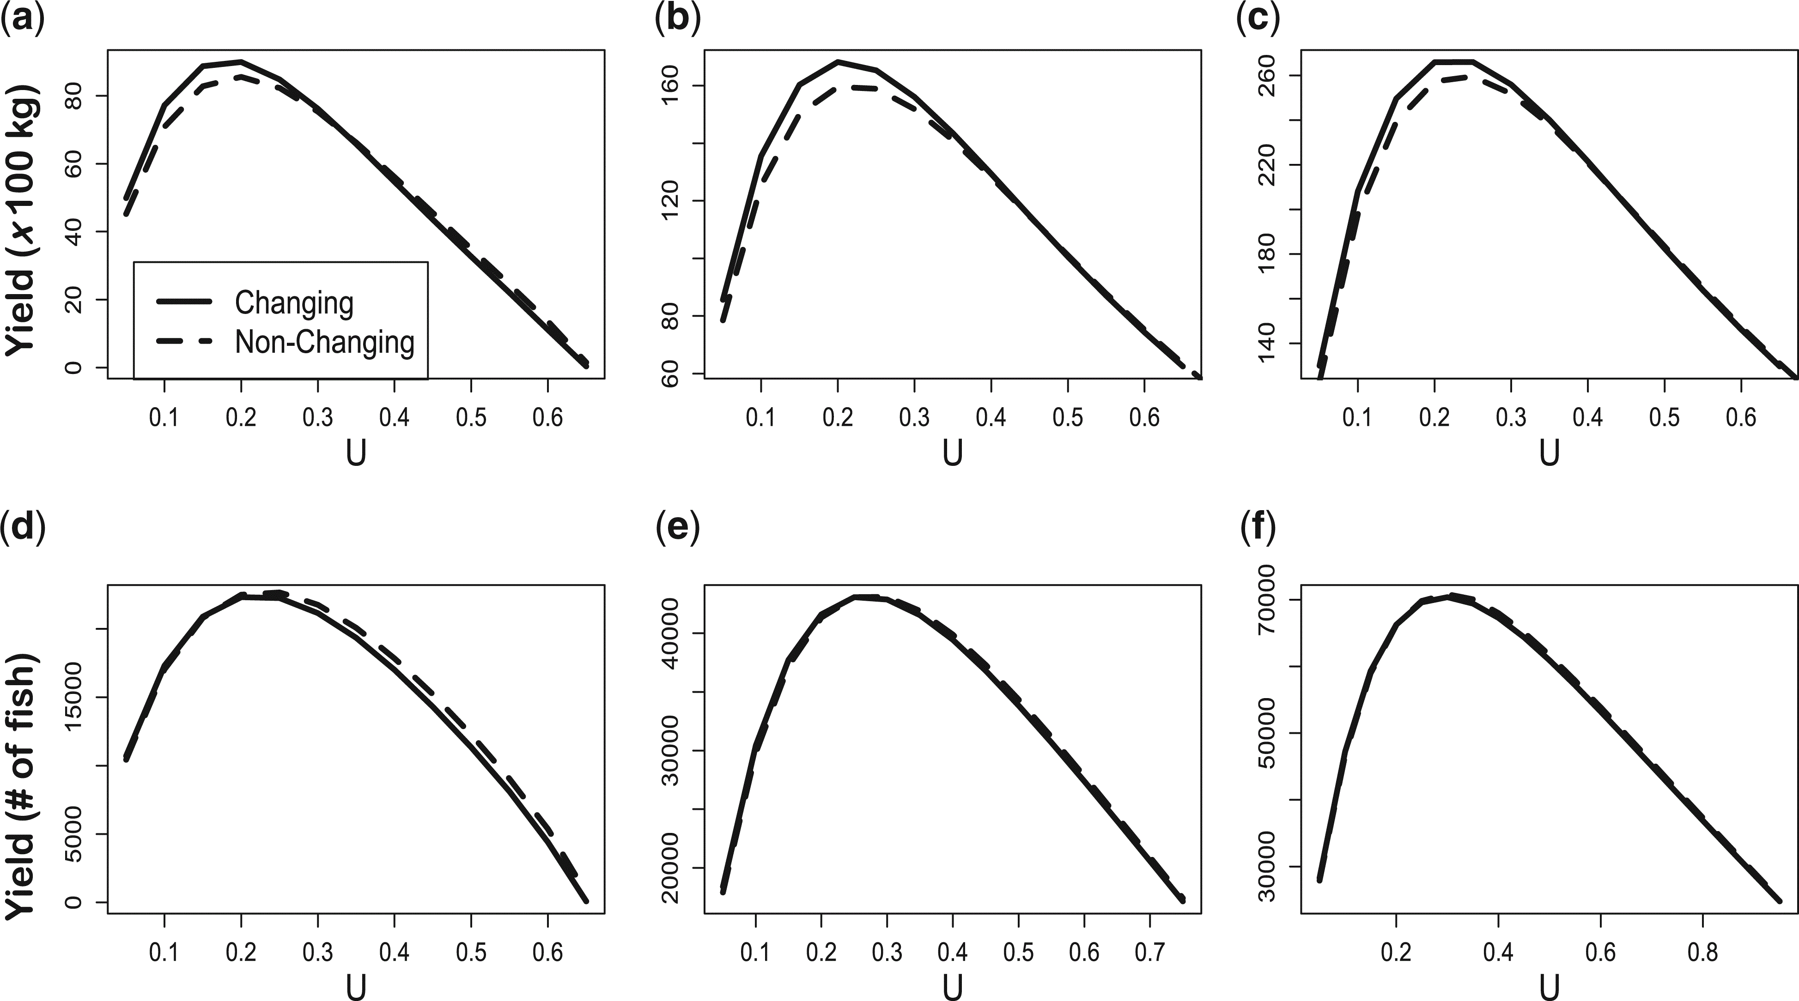
Figure 2 Biomass yield (a–c) and total yield in numbers of fish (d–f) at varying exploitation rates (U) for k = 0.3 (a ...
Notes:
Figure 2 Biomass yield (a–c) and total yield in numbers of fish (d–f) at varying exploitation rates (U) for k = 0.3 (a and d), k = 0.5 (b and e), and k = 0.9 (c and f). The solid line represents the values for the sex changing stock and the dashed line represents values for the non-sex changing stock in all graphs.
Unless provided in the caption above, the following copyright applies to the content of this slide: © International Council for the Exploration of the Sea 2016. All rights reserved. For Permissions, please email: journals.permissions@oup.comThis article is published and distributed under the terms of the Oxford University Press, Standard Journals Publication Model (https://academic.oup.com/journals/pages/open_access/funder_policies/chorus/standard_publication_model)

Slide 3
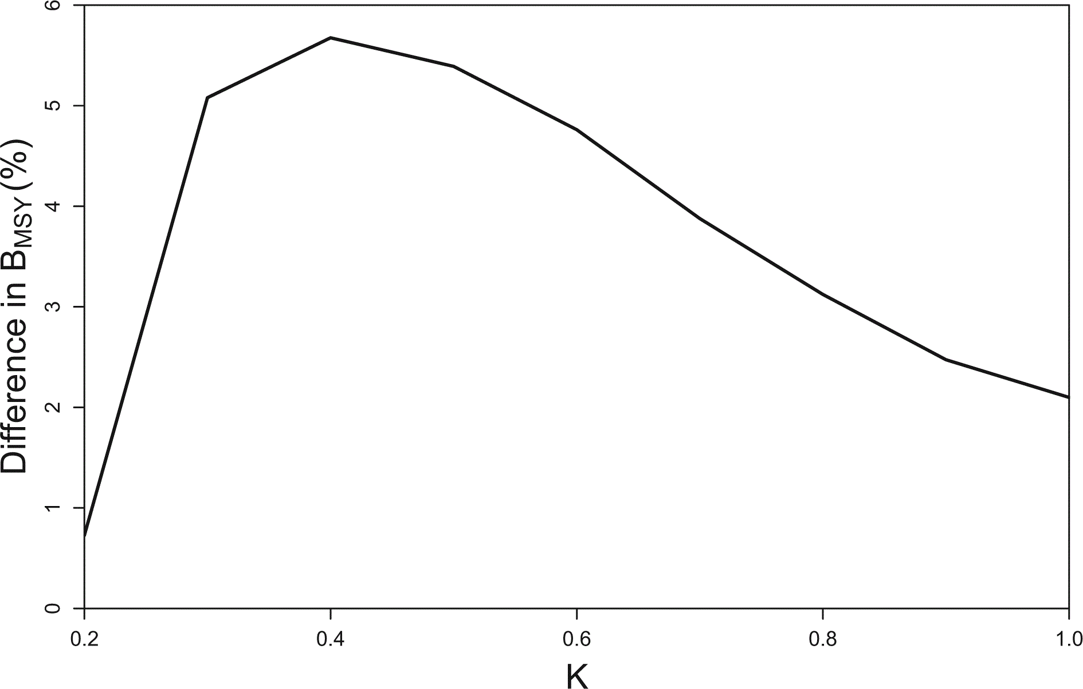
Figure 3 Difference in B_{MSY} as a percent of the total difference between B_{MSY} for a sex-chaning ...
Notes:
Figure 3 Difference in BMSY as a percent of the total difference between BMSY for a sex-chaning stock and BMSY for the non-sex changing stock at varying values of k.
Unless provided in the caption above, the following copyright applies to the content of this slide: © International Council for the Exploration of the Sea 2016. All rights reserved. For Permissions, please email: journals.permissions@oup.comThis article is published and distributed under the terms of the Oxford University Press, Standard Journals Publication Model (https://academic.oup.com/journals/pages/open_access/funder_policies/chorus/standard_publication_model)

Slide 4
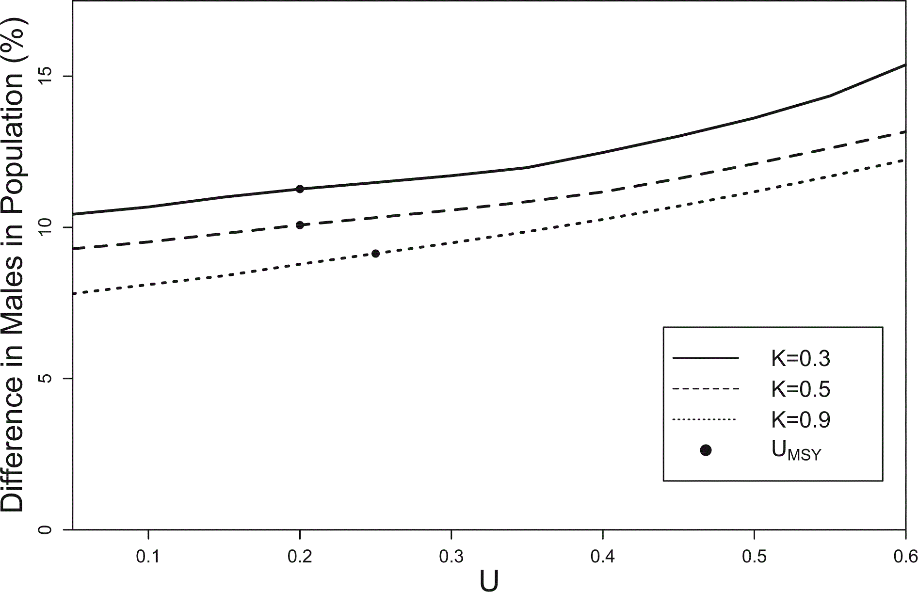
Figure 4 Difference in the proportion of males in the population of the sex changing stock and the non-sex changing ...
Notes:
Figure 4 Difference in the proportion of males in the population of the sex changing stock and the non-sex changing stock at varying exploitation rates (U). The solid line is for values when k = 0.3, the dashed line represents values when k = 0.5, and the dotted line represents values when k = 0.9.
Unless provided in the caption above, the following copyright applies to the content of this slide: © International Council for the Exploration of the Sea 2016. All rights reserved. For Permissions, please email: journals.permissions@oup.comThis article is published and distributed under the terms of the Oxford University Press, Standard Journals Publication Model (https://academic.oup.com/journals/pages/open_access/funder_policies/chorus/standard_publication_model)

Slide 5
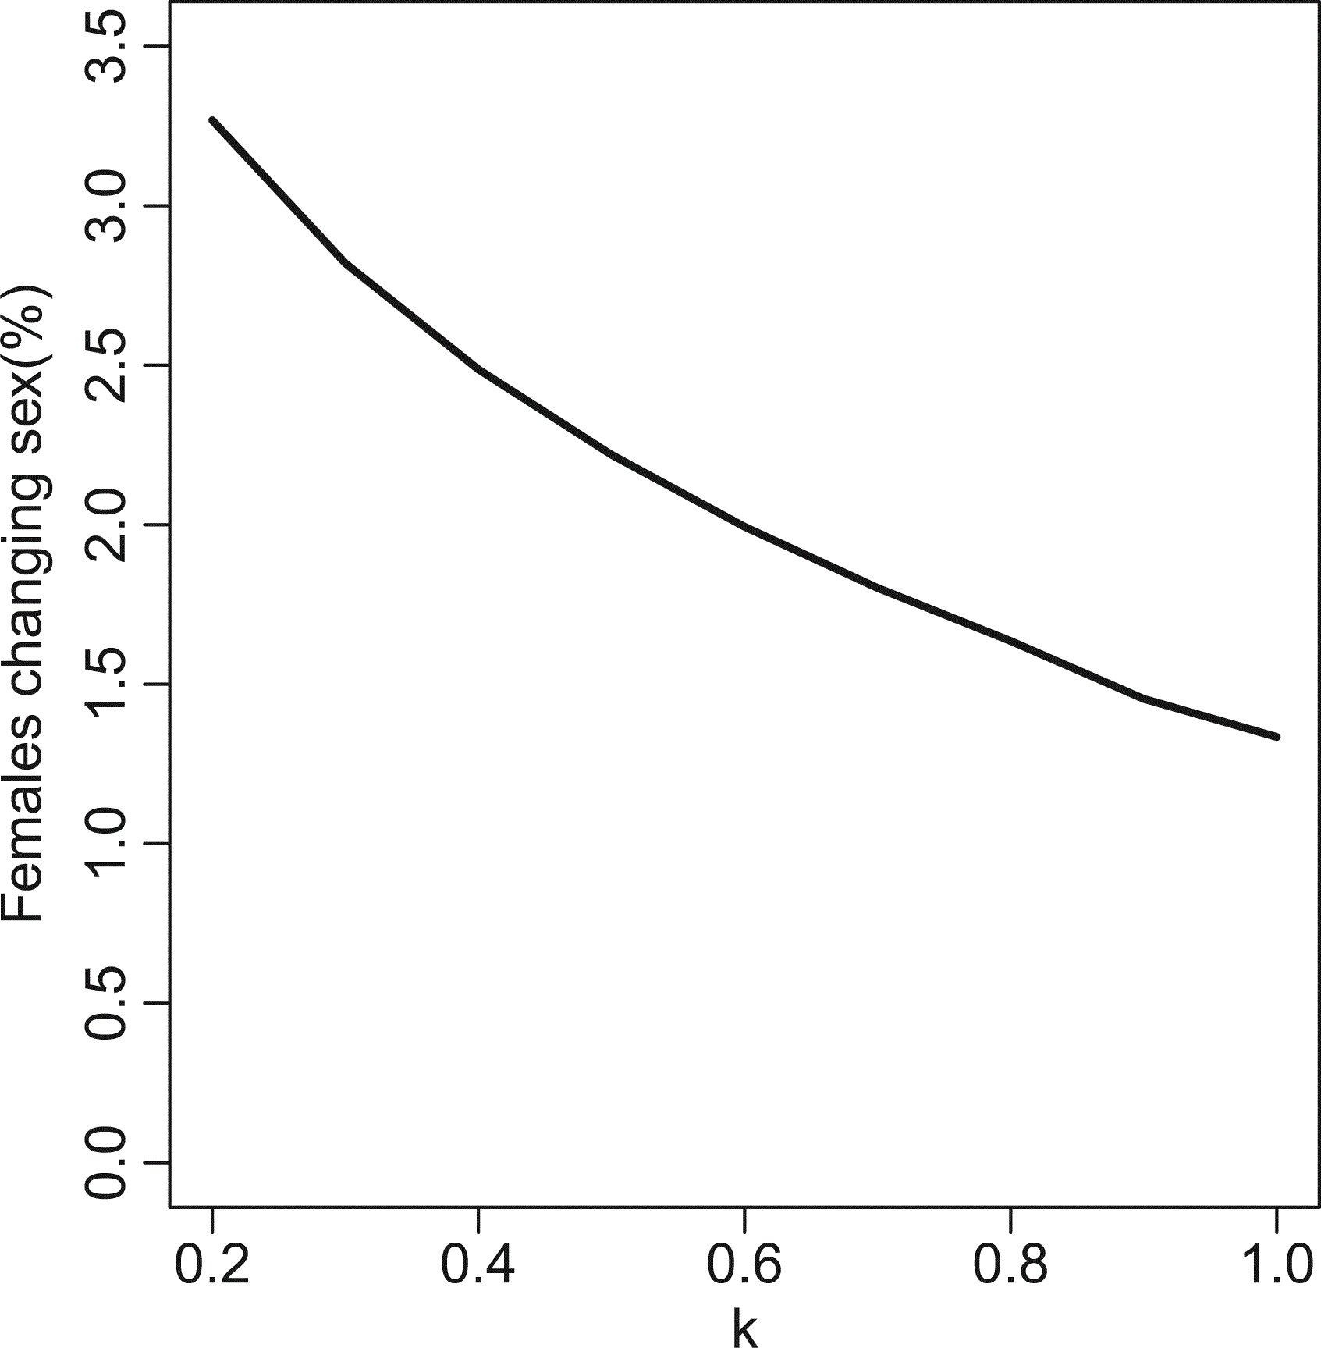
Figure 5 The percentage of females that changed sex in the sex changing population at varying values of k, calculated ...
Notes:
Figure 5 The percentage of females that changed sex in the sex changing population at varying values of k, calculated as the number of females that change sex divided by the number of mature females.
Unless provided in the caption above, the following copyright applies to the content of this slide: © International Council for the Exploration of the Sea 2016. All rights reserved. For Permissions, please email: journals.permissions@oup.comThis article is published and distributed under the terms of the Oxford University Press, Standard Journals Publication Model (https://academic.oup.com/journals/pages/open_access/funder_policies/chorus/standard_publication_model)

Slide 6
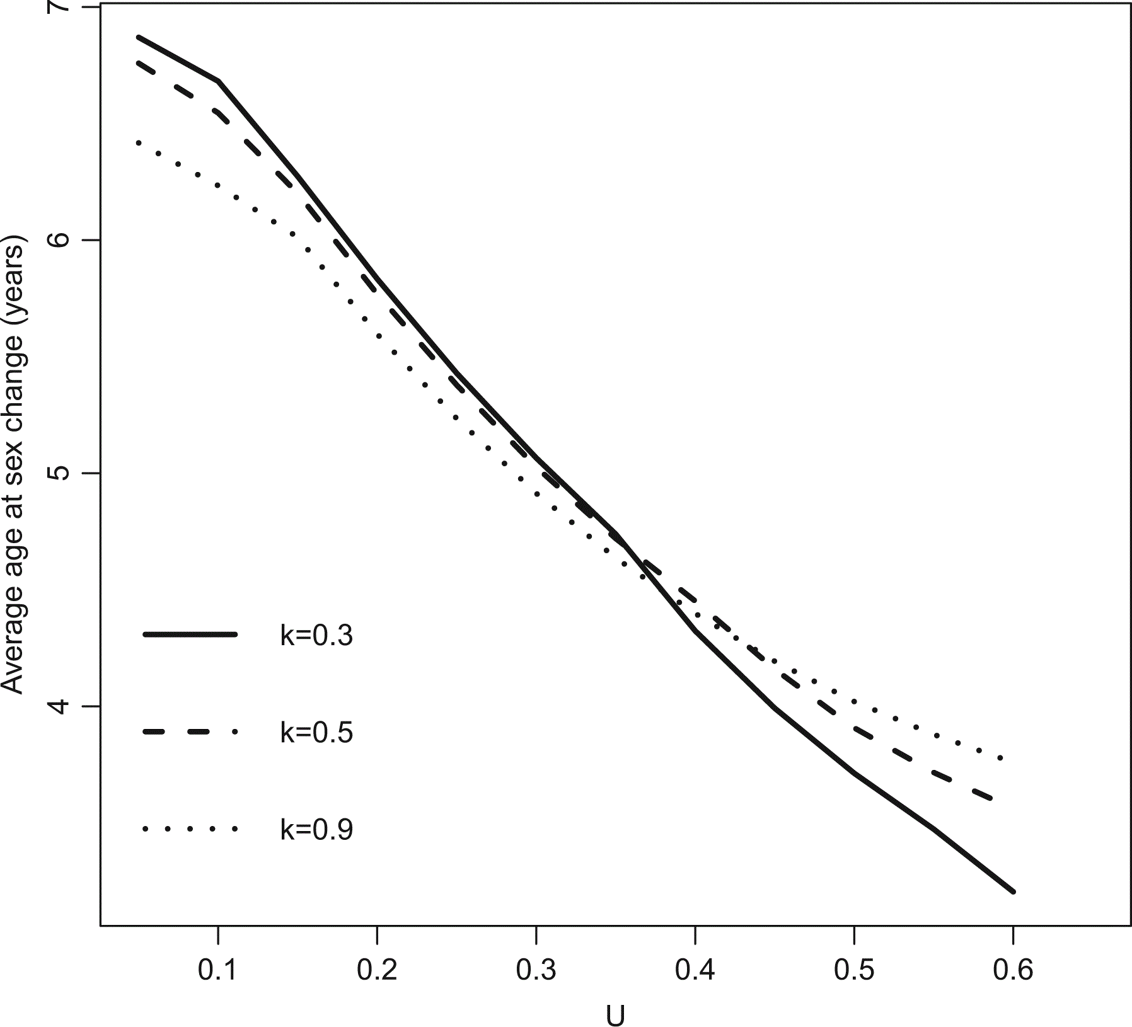
Figure 6 The average age at sex change for the sex changing stock at varying rates of exploitation (U). The solid line ...
Notes:
Figure 6 The average age at sex change for the sex changing stock at varying rates of exploitation (U). The solid line is for values when k = 0.3, the dashed line represents values when k = 0.5, and the dotted line represents values when k = 0.9.
Unless provided in the caption above, the following copyright applies to the content of this slide: © International Council for the Exploration of the Sea 2016. All rights reserved. For Permissions, please email: journals.permissions@oup.comThis article is published and distributed under the terms of the Oxford University Press, Standard Journals Publication Model (https://academic.oup.com/journals/pages/open_access/funder_policies/chorus/standard_publication_model)

