Slide 1
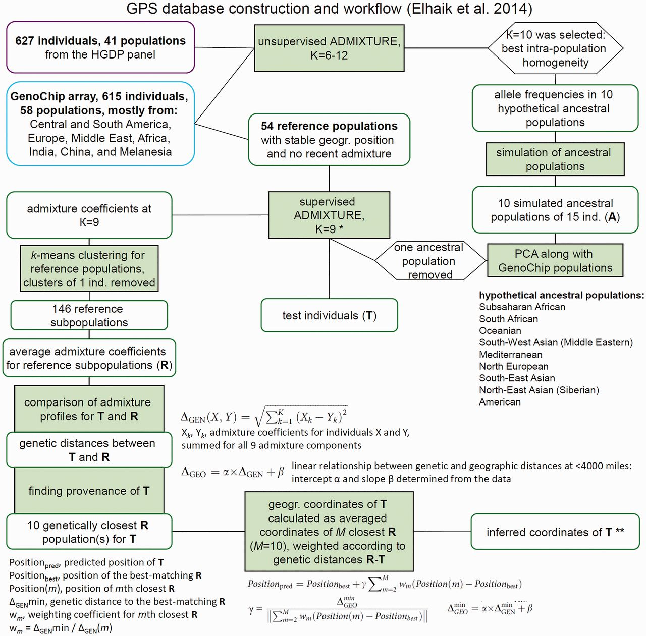
F ig . 1.— A diagram illustrating the GPS workflow. * Steps prior to the supervised ADMIXTURE run are used for the ...
Notes:
F ig . 1.— A diagram illustrating the GPS workflow. * Steps prior to the supervised ADMIXTURE run are used for the method optimization only, and a typical workflow starts with a supervised ADMIXTURE run. ** Coordinates of test individuals inferred by the GPS algorithm were interpreted by Das et al. (2016) as coordinates of ancestral populations (“primeval villages”) or as the last place where admixture has occurred.
Unless provided in the caption above, the following copyright applies to the content of this slide: © The Author 2016. Published by Oxford University Press on behalf of the Society for Molecular Biology and Evolution. This is an Open Access article distributed under the terms of the Creative Commons Attribution Non-Commercial License (http://creativecommons.org/licenses/by-nc/4.0/), which permits non-commercial re-use, distribution, and reproduction in any medium, provided the original work is properly cited. For commercial re-use, please contact journals.permissions@oup.com

Slide 2
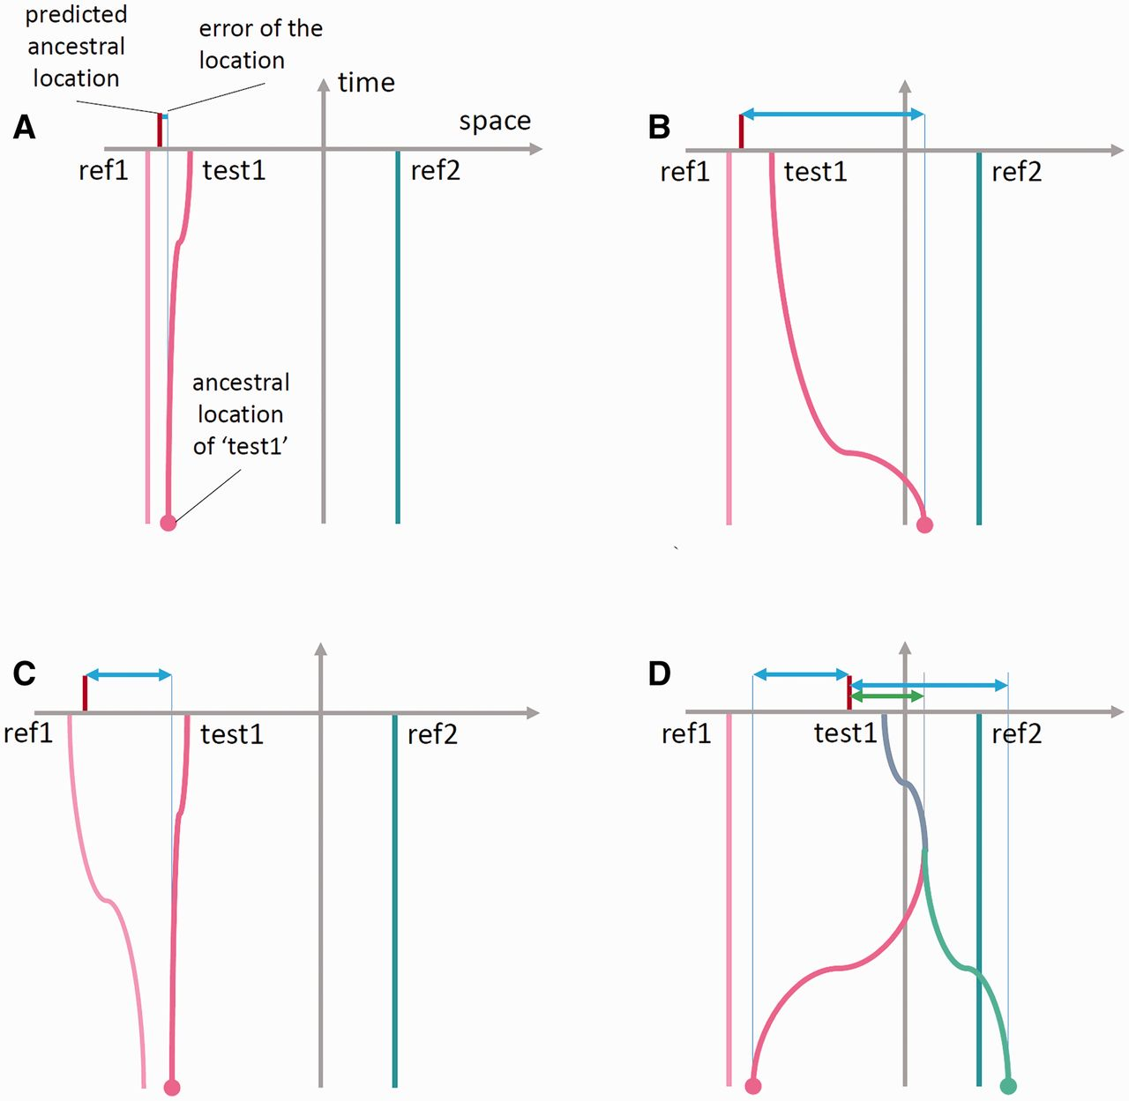
F ig . 2.— Space-time diagrams illustrating behavior of a very simple system of two reference populations (ref1 and ...
Notes:
F ig . 2.— Space-time diagrams illustrating behavior of a very simple system of two reference populations (ref1 and ref2) and one test population (test1). Genetically similar populations are depicted with similar colors; ancestral locations that would be predicted by the GPS algorithm are shown with dark-red vertical lines, and their distances from the true ancestral locations are shown with blue arrows. Spatial coordinates for the ancestral population of test1 would be accurately predicted by GPS only in the simplest scenario, when neither test nor references move much in space during a time window appropriate for the method ( A ). If test1 has moved considerably during its history ( B ), its ancestral location cannot be predicted without knowing coordinates of any ancient genomes along its “worldline”. In the scenario B, closely related populations ref1 and test1 occupied a large territory in the past, and then their range underwent considerable contraction. The Kets, a Yeniseian-speaking Siberian ethnic group, represent a good example of this scenario: Yeniseian tribes over the last 1000 years have moved a long distance from the south to the north, and their range underwent an extreme contraction under various pressures ( Flegontov et al. 2016 ). Thus, location of the Kets today is very far from their original homeland ∼1000 years ago. Similarly, if a reference moves over time, GPS would also make an error in estimating the ancestral location of test1 ( C ). If test1 is a one-to-one mixture of ref1 and ref2, single ancestral location is meaningless for this population ( D ), and GPS would place the ancestral location of test1 on the midpoint between ref1 and ref2. The statement “GPS predictions should therefore be interpreted as the last place that admixture has occurred, termed here geographical origin ” (Das et al. 2016) is invalid. Obviously, location of the mixture partners and of the mixed population can change over time, and GPS has no information to trace these past movements, producing an erroneous location of the last admixture event (the green arrow shows that the inferred last place of admixture is misplaced).
Unless provided in the caption above, the following copyright applies to the content of this slide: © The Author 2016. Published by Oxford University Press on behalf of the Society for Molecular Biology and Evolution. This is an Open Access article distributed under the terms of the Creative Commons Attribution Non-Commercial License (http://creativecommons.org/licenses/by-nc/4.0/), which permits non-commercial re-use, distribution, and reproduction in any medium, provided the original work is properly cited. For commercial re-use, please contact journals.permissions@oup.com

