Slide 1
Figure 1. Arrangement of the DNA elements at C.parapsilosis telomeres. The arrangement of the repeat units at ...
Notes:
Figure 1. Arrangement of the DNA elements at C.parapsilosis telomeres. The arrangement of the repeat units at both arms of the linear mitochondrial DNA of C.parapsilosis as described previously (33) is illustrated. Units are in base pairs.
Unless provided in the caption above, the following copyright applies to the content of this slide:

Slide 2
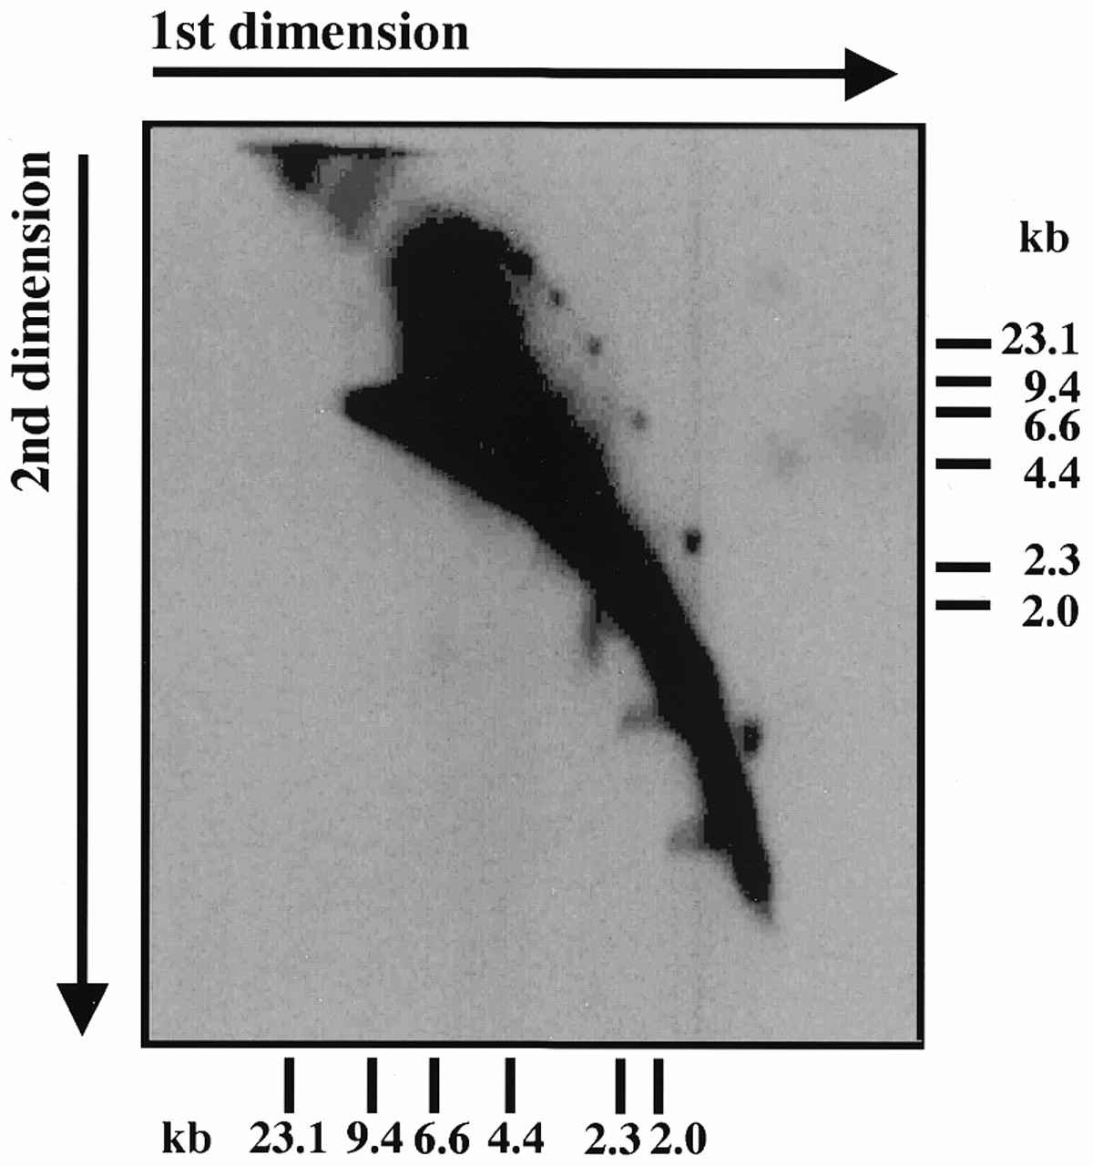
Figure 2. Neutral-neutral 2-D agarose gel electrophoresis of C.parapsilosis DNA reveals the presence of ...
Notes:
Figure 2. Neutral-neutral 2-D agarose gel electrophoresis of C.parapsilosis DNA reveals the presence of distinct classes of telomeric fragments. A BglII digest of total DNA of C.parapsilosis was separated by neutral-neutral 2-D electrophoresis (Materials and Methods) and hybridized with a radiolabeled probe containing the C.parapsilosis 738 bp telomeric repeat unit. The set of discrete spots of decreasing size are shown below to be circular multimers of the telomeric repeat.
Unless provided in the caption above, the following copyright applies to the content of this slide:

Slide 3
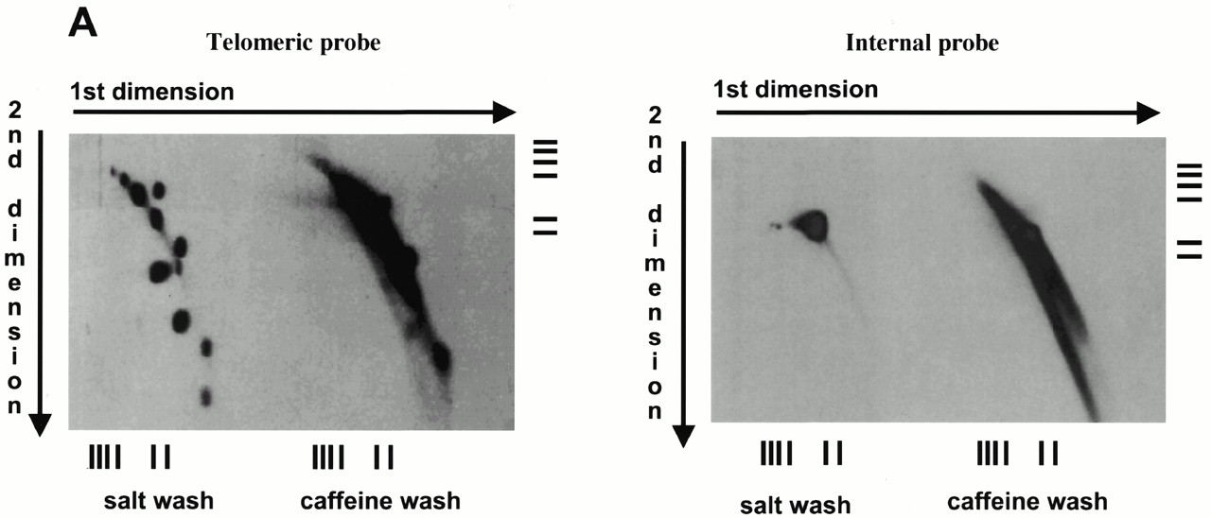
Figure 3. Telomeric fragments elute from BND–cellulose as duplex DNA and are present in the undigested ...
Notes:
Figure 3. Telomeric fragments elute from BND–cellulose as duplex DNA and are present in the undigested preparations of C.parapsilosis DNA. (A) Total DNA of C.parapsilosis digested with BglII was loaded on a BND–cellulose column and eluted first with 0.8 M NaCl (salt wash) followed by 1.8% caffeine in 1 M NaCl (caffeine wash). The eluted DNA was separated by neutral-neutral 2-D electrophoresis as in Figure 1, and hybridized with a radiolabeled 738 bp telomeric tandem repeat unit (telomeric probe) or a 2.9 kb BglII fragment of mtDNA of C.parapsilosis internal to the telomere (internal probe). The bars represent DNA marker fragments of 23.1, 9.4, 6.6, 4.4, 2.3 and 2.0 kb, respectively. (B) Undigested total DNA of C.parapsilosis (not subjected to BND–cellulose chromatography) was separated by neutral-neutral 2-D electrophoresis and hybridized with a radioactively-labeled 738 bp telomeric tandem repeat unit probe.
Unless provided in the caption above, the following copyright applies to the content of this slide:

Slide 4
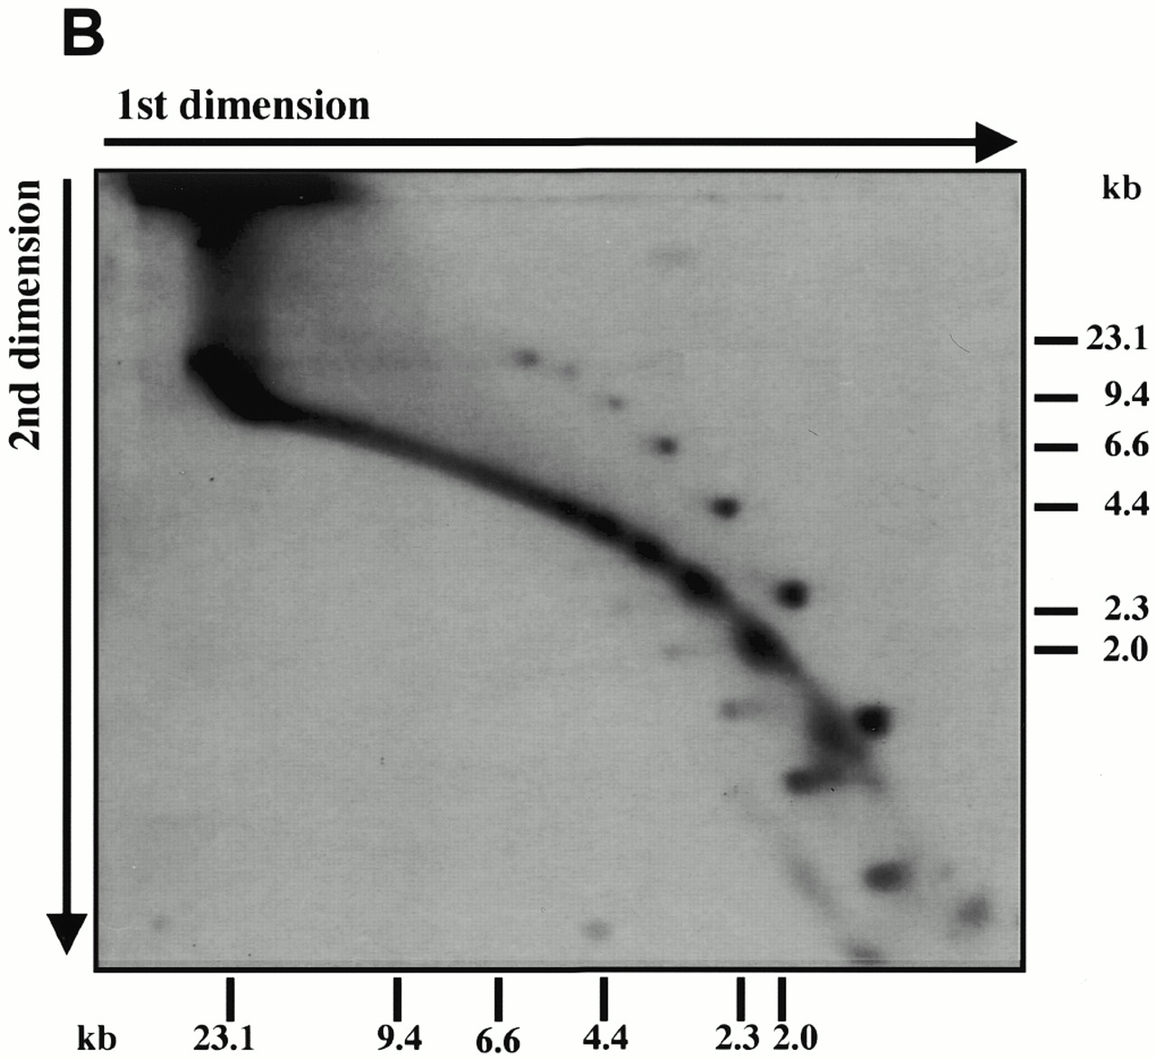
Figure 3. Telomeric fragments elute from BND–cellulose as duplex DNA and are present in the undigested ...
Notes:
Figure 3. Telomeric fragments elute from BND–cellulose as duplex DNA and are present in the undigested preparations of C.parapsilosis DNA. (A) Total DNA of C.parapsilosis digested with BglII was loaded on a BND–cellulose column and eluted first with 0.8 M NaCl (salt wash) followed by 1.8% caffeine in 1 M NaCl (caffeine wash). The eluted DNA was separated by neutral-neutral 2-D electrophoresis as in Figure 1, and hybridized with a radiolabeled 738 bp telomeric tandem repeat unit (telomeric probe) or a 2.9 kb BglII fragment of mtDNA of C.parapsilosis internal to the telomere (internal probe). The bars represent DNA marker fragments of 23.1, 9.4, 6.6, 4.4, 2.3 and 2.0 kb, respectively. (B) Undigested total DNA of C.parapsilosis (not subjected to BND–cellulose chromatography) was separated by neutral-neutral 2-D electrophoresis and hybridized with a radioactively-labeled 738 bp telomeric tandem repeat unit probe.
Unless provided in the caption above, the following copyright applies to the content of this slide:

Slide 5
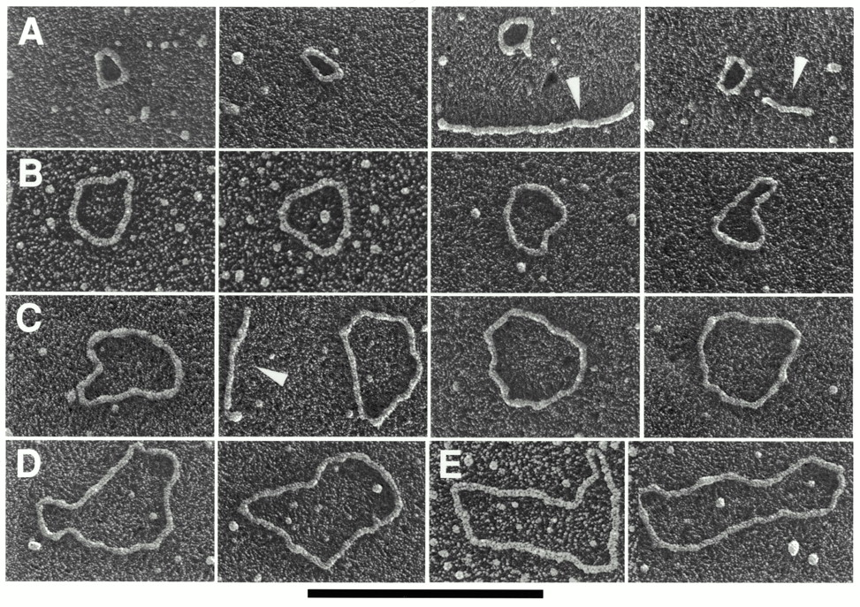
Figure 4. Mitochondrial telomeric minicircles of C.parapsilosis isolated by alkaline lysis of purified ...
Notes:
Figure 4. Mitochondrial telomeric minicircles of C.parapsilosis isolated by alkaline lysis of purified mitochondria. Mitochondrial telomeric minicircles of C.parapsilosis were isolated from purified mitochondria and relaxed with DNase I as described in Materials and Methods. Aliquots were prepared for EM by spreading on a denatured surface film of cytochrome C protein and rotary shadowcast with platinum-paladium (Materials and Methods). Circles with contour length classes of: 0.75 kb (A), 1.5 kb (B), 2.25 kb (C), 3.0 kb (D) and 3.75 kb (E), respectively, are shown. Shown in a reverse contrast. Bar represents 0.5 µm. (F) A histogram of circle lengths measured from micrographs as in A–E. (G) An aliquot of the purified minicircles was subjected to a Southern blot analysis using a 738 bp telomeric tandem repeat unit as a probe (C, lane 2). λDNA digested with PstI (C, lane 1).
Unless provided in the caption above, the following copyright applies to the content of this slide:

Slide 6
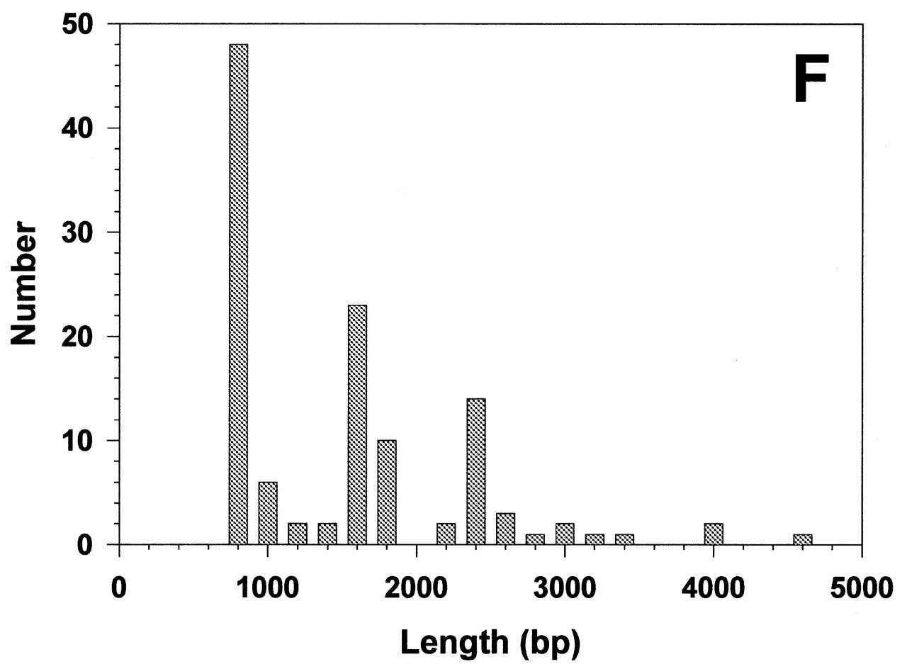
Figure 4. Mitochondrial telomeric minicircles of C.parapsilosis isolated by alkaline lysis of purified ...
Notes:
Figure 4. Mitochondrial telomeric minicircles of C.parapsilosis isolated by alkaline lysis of purified mitochondria. Mitochondrial telomeric minicircles of C.parapsilosis were isolated from purified mitochondria and relaxed with DNase I as described in Materials and Methods. Aliquots were prepared for EM by spreading on a denatured surface film of cytochrome C protein and rotary shadowcast with platinum-paladium (Materials and Methods). Circles with contour length classes of: 0.75 kb (A), 1.5 kb (B), 2.25 kb (C), 3.0 kb (D) and 3.75 kb (E), respectively, are shown. Shown in a reverse contrast. Bar represents 0.5 µm. (F) A histogram of circle lengths measured from micrographs as in A–E. (G) An aliquot of the purified minicircles was subjected to a Southern blot analysis using a 738 bp telomeric tandem repeat unit as a probe (C, lane 2). λDNA digested with PstI (C, lane 1).
Unless provided in the caption above, the following copyright applies to the content of this slide:

Slide 7
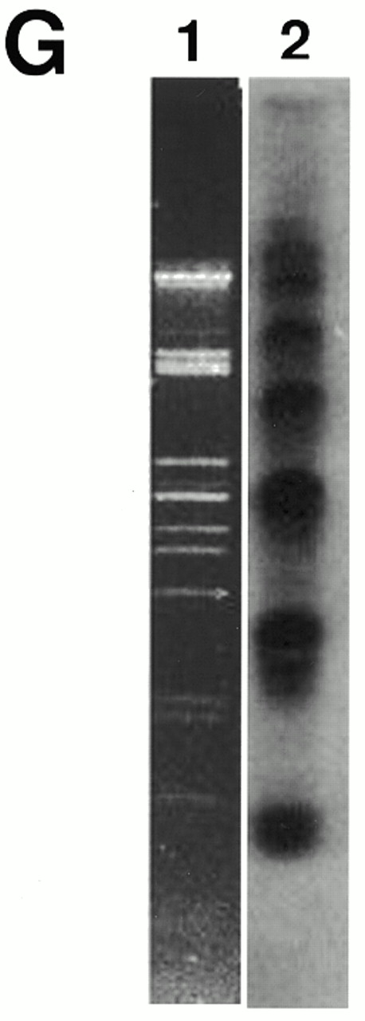
Figure 4. Mitochondrial telomeric minicircles of C.parapsilosis isolated by alkaline lysis of purified ...
Notes:
Figure 4. Mitochondrial telomeric minicircles of C.parapsilosis isolated by alkaline lysis of purified mitochondria. Mitochondrial telomeric minicircles of C.parapsilosis were isolated from purified mitochondria and relaxed with DNase I as described in Materials and Methods. Aliquots were prepared for EM by spreading on a denatured surface film of cytochrome C protein and rotary shadowcast with platinum-paladium (Materials and Methods). Circles with contour length classes of: 0.75 kb (A), 1.5 kb (B), 2.25 kb (C), 3.0 kb (D) and 3.75 kb (E), respectively, are shown. Shown in a reverse contrast. Bar represents 0.5 µm. (F) A histogram of circle lengths measured from micrographs as in A–E. (G) An aliquot of the purified minicircles was subjected to a Southern blot analysis using a 738 bp telomeric tandem repeat unit as a probe (C, lane 2). λDNA digested with PstI (C, lane 1).
Unless provided in the caption above, the following copyright applies to the content of this slide:

Slide 8
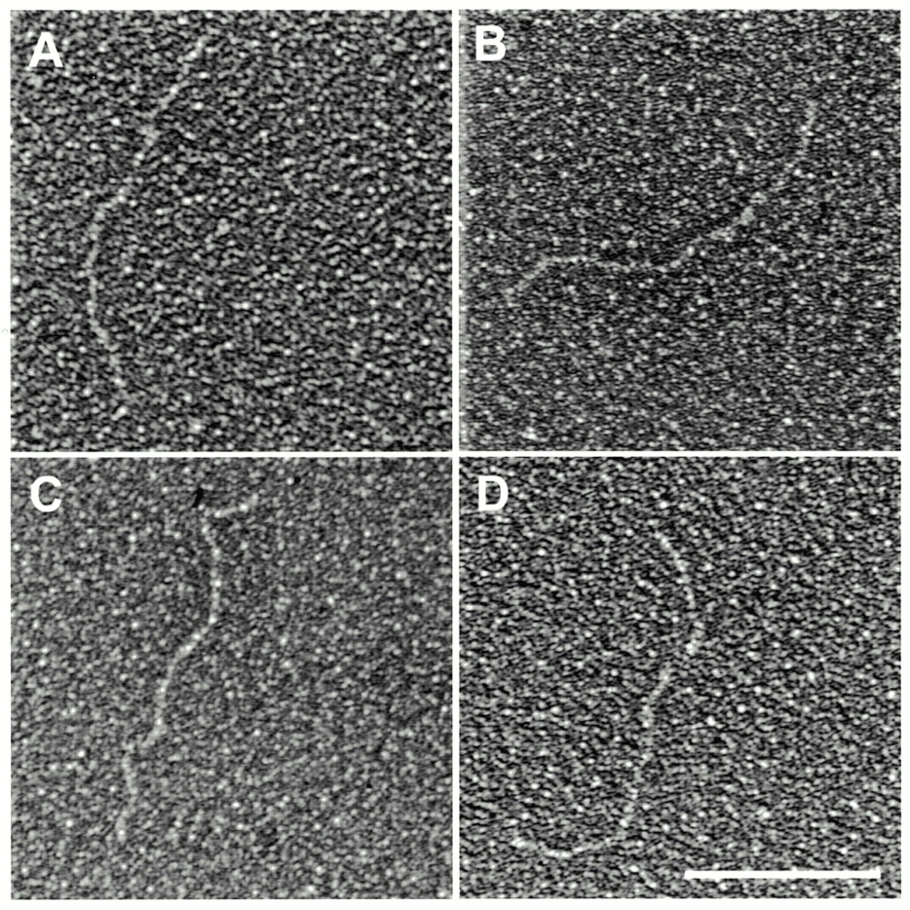
Figure 5. Treatment of the minicircles with EcoRI produces linear fragments of ∼750 bp visaulized by EM (A–D) ...
Notes:
Figure 5. Treatment of the minicircles with EcoRI produces linear fragments of ∼750 bp visaulized by EM (A–D) and Southern blot hybridization with the telomeric EcoRI fragment (E). Shown in reverse contrast. Scale bar equals 0.1 µm.
Unless provided in the caption above, the following copyright applies to the content of this slide:

Slide 9
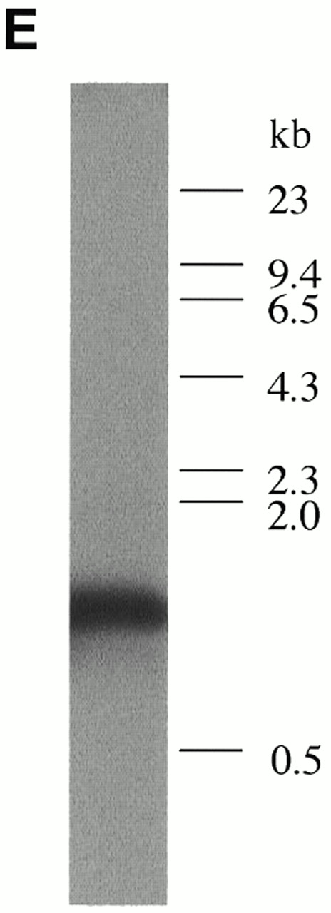
Figure 5. Treatment of the minicircles with EcoRI produces linear fragments of ∼750 bp visaulized by EM (A–D) ...
Notes:
Figure 5. Treatment of the minicircles with EcoRI produces linear fragments of ∼750 bp visaulized by EM (A–D) and Southern blot hybridization with the telomeric EcoRI fragment (E). Shown in reverse contrast. Scale bar equals 0.1 µm.
Unless provided in the caption above, the following copyright applies to the content of this slide:

Slide 10
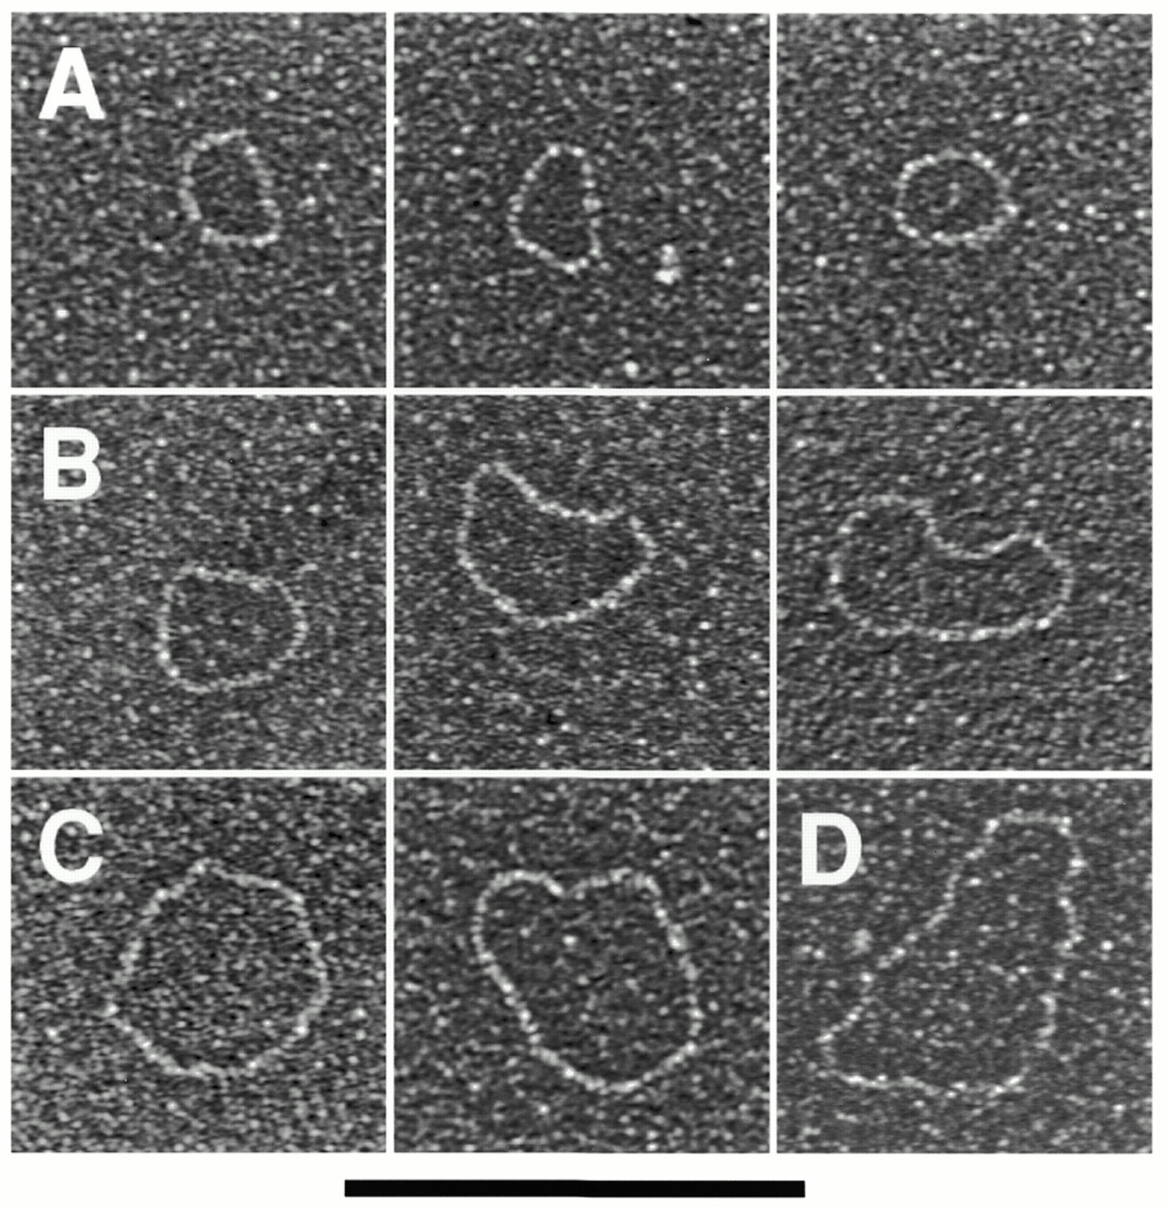
Figure 6. Mitochondrial telomeric minicircles of P.philodendra and C.salmanticensis isolated by alkaline ...
Notes:
Figure 6. Mitochondrial telomeric minicircles of P.philodendra and C.salmanticensis isolated by alkaline lysis of purified mitochondria. Mitochondrial telomeric minicircles of P.philodendra (A–D) and C.salmanticensis (E–G) were isolated from purified mitochondria (Materials and Methods). Due to the very small size of some circles, the samples were directly adsorbed to thin carbon foils in the absence of denatured protein, and rotary shadowcast with tungsten (Materials and Methods). Shown in reverse contrast. Bar represents 0.1 µm. The P.philodendra examples have contour lengths 300 bp (A), 600 bp (B), 0.9 kb (C) and 1200 bp (D), respectively. The C.salmanticensis examples have contour lengths of 200 bp (E), 400 bp (F) and 600 bp (G), respectively. (H) Histogram of circle lengths measured from micrographs as in (A)–(D). (I) A histogram of circle lengths measured from micrographs as in (E)–(G).
Unless provided in the caption above, the following copyright applies to the content of this slide:

Slide 11
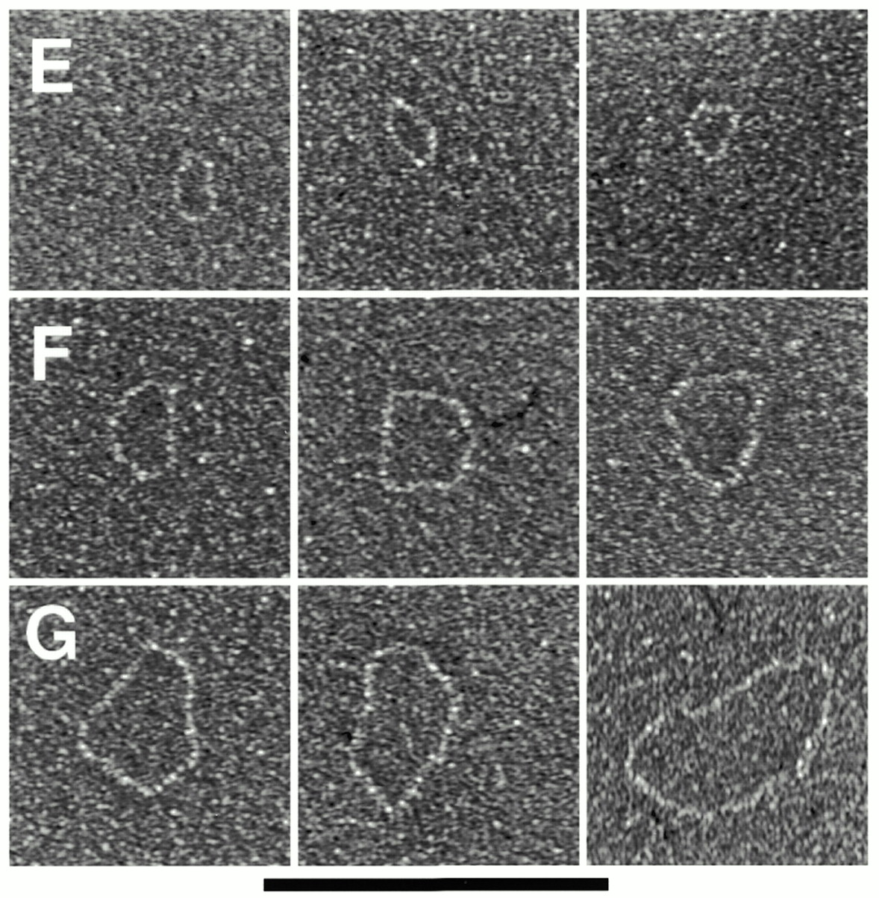
Figure 6. Mitochondrial telomeric minicircles of P.philodendra and C.salmanticensis isolated by alkaline ...
Notes:
Figure 6. Mitochondrial telomeric minicircles of P.philodendra and C.salmanticensis isolated by alkaline lysis of purified mitochondria. Mitochondrial telomeric minicircles of P.philodendra (A–D) and C.salmanticensis (E–G) were isolated from purified mitochondria (Materials and Methods). Due to the very small size of some circles, the samples were directly adsorbed to thin carbon foils in the absence of denatured protein, and rotary shadowcast with tungsten (Materials and Methods). Shown in reverse contrast. Bar represents 0.1 µm. The P.philodendra examples have contour lengths 300 bp (A), 600 bp (B), 0.9 kb (C) and 1200 bp (D), respectively. The C.salmanticensis examples have contour lengths of 200 bp (E), 400 bp (F) and 600 bp (G), respectively. (H) Histogram of circle lengths measured from micrographs as in (A)–(D). (I) A histogram of circle lengths measured from micrographs as in (E)–(G).
Unless provided in the caption above, the following copyright applies to the content of this slide:

Slide 12
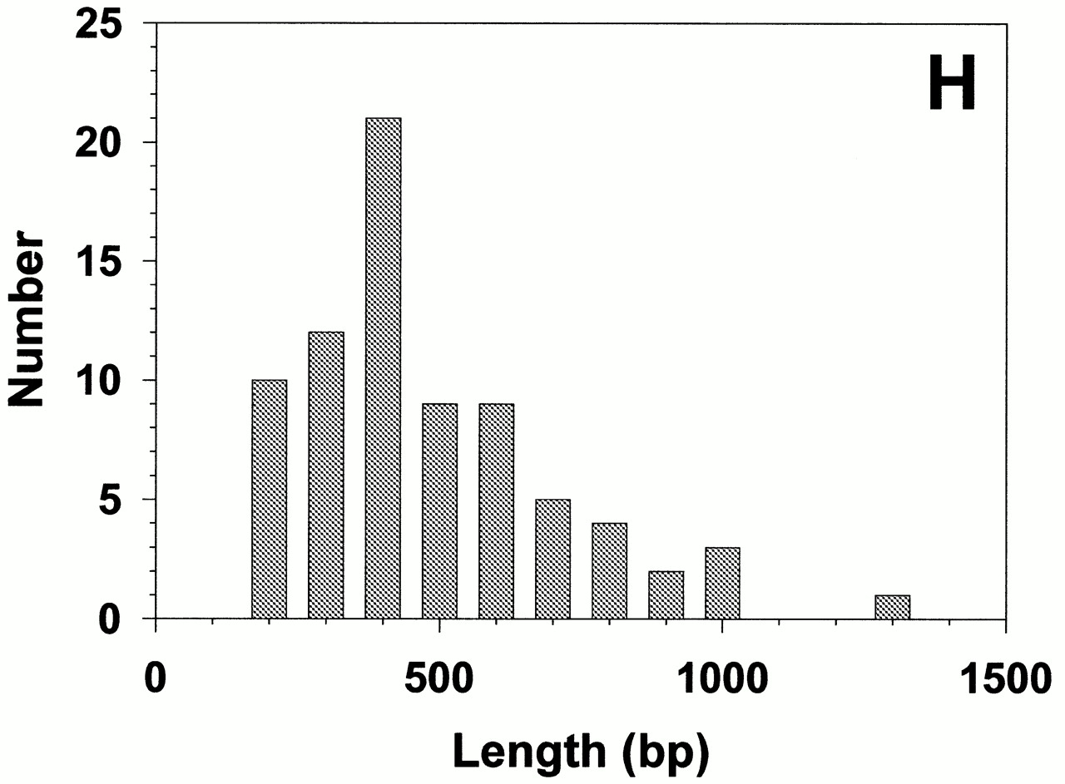
Figure 6. Mitochondrial telomeric minicircles of P.philodendra and C.salmanticensis isolated by alkaline ...
Notes:
Figure 6. Mitochondrial telomeric minicircles of P.philodendra and C.salmanticensis isolated by alkaline lysis of purified mitochondria. Mitochondrial telomeric minicircles of P.philodendra (A–D) and C.salmanticensis (E–G) were isolated from purified mitochondria (Materials and Methods). Due to the very small size of some circles, the samples were directly adsorbed to thin carbon foils in the absence of denatured protein, and rotary shadowcast with tungsten (Materials and Methods). Shown in reverse contrast. Bar represents 0.1 µm. The P.philodendra examples have contour lengths 300 bp (A), 600 bp (B), 0.9 kb (C) and 1200 bp (D), respectively. The C.salmanticensis examples have contour lengths of 200 bp (E), 400 bp (F) and 600 bp (G), respectively. (H) Histogram of circle lengths measured from micrographs as in (A)–(D). (I) A histogram of circle lengths measured from micrographs as in (E)–(G).
Unless provided in the caption above, the following copyright applies to the content of this slide:

Slide 13
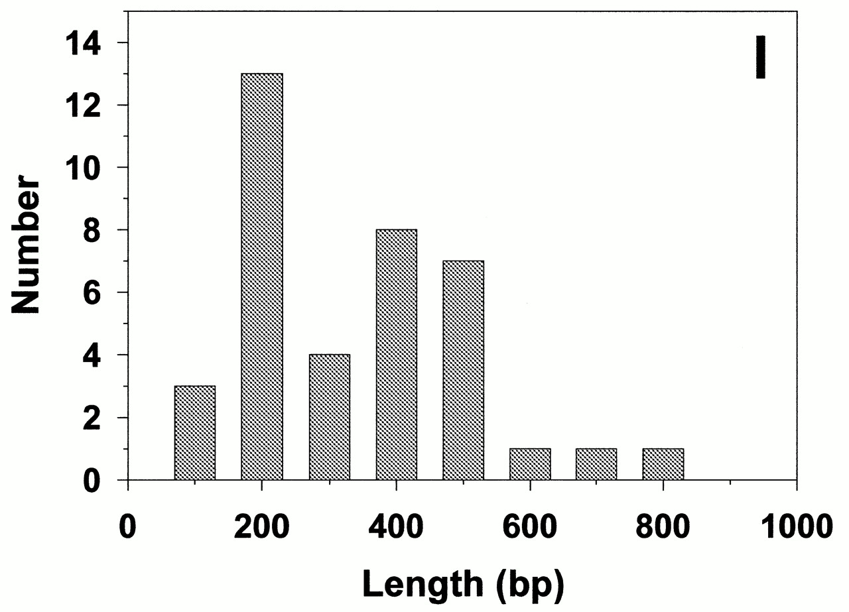
Figure 6. Mitochondrial telomeric minicircles of P.philodendra and C.salmanticensis isolated by alkaline ...
Notes:
Figure 6. Mitochondrial telomeric minicircles of P.philodendra and C.salmanticensis isolated by alkaline lysis of purified mitochondria. Mitochondrial telomeric minicircles of P.philodendra (A–D) and C.salmanticensis (E–G) were isolated from purified mitochondria (Materials and Methods). Due to the very small size of some circles, the samples were directly adsorbed to thin carbon foils in the absence of denatured protein, and rotary shadowcast with tungsten (Materials and Methods). Shown in reverse contrast. Bar represents 0.1 µm. The P.philodendra examples have contour lengths 300 bp (A), 600 bp (B), 0.9 kb (C) and 1200 bp (D), respectively. The C.salmanticensis examples have contour lengths of 200 bp (E), 400 bp (F) and 600 bp (G), respectively. (H) Histogram of circle lengths measured from micrographs as in (A)–(D). (I) A histogram of circle lengths measured from micrographs as in (E)–(G).
Unless provided in the caption above, the following copyright applies to the content of this slide:

