Slide 1
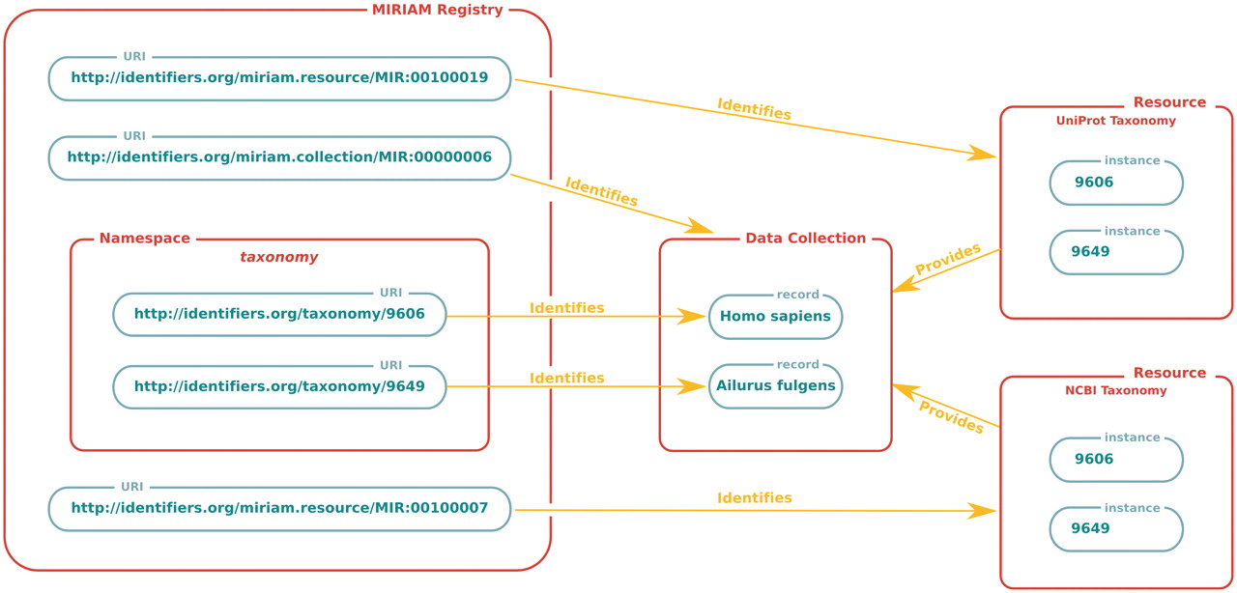
Figure 1. Concepts and component information captured in the MIRIAM Registry. The MIRIAM Registry collects information ...
Notes:
Figure 1. Concepts and component information captured in the MIRIAM Registry. The MIRIAM Registry collects information about data collections and resources, allowing them to be referenced using URIs. Red-bounded boxes represent concepts, while green ones depict specific instances. Each collection, which itself can be referenced via a URI, is assigned a namespace. This namespace can be combined with a suitable identifier in order to form a URI identifying the specific data record, independently of any physical locations holding that information. Each of these resolvable physical locations are regarded as an instance of the data record, and can themselves be identified using a URI.
Unless provided in the caption above, the following copyright applies to the content of this slide: © The Author(s) 2011. Published by Oxford University Press.This is an Open Access article distributed under the terms of the Creative Commons Attribution Non-Commercial License (http://creativecommons.org/licenses/by-nc/3.0), which permits unrestricted non-commercial use, distribution, and reproduction in any medium, provided the original work is properly cited.

Slide 2
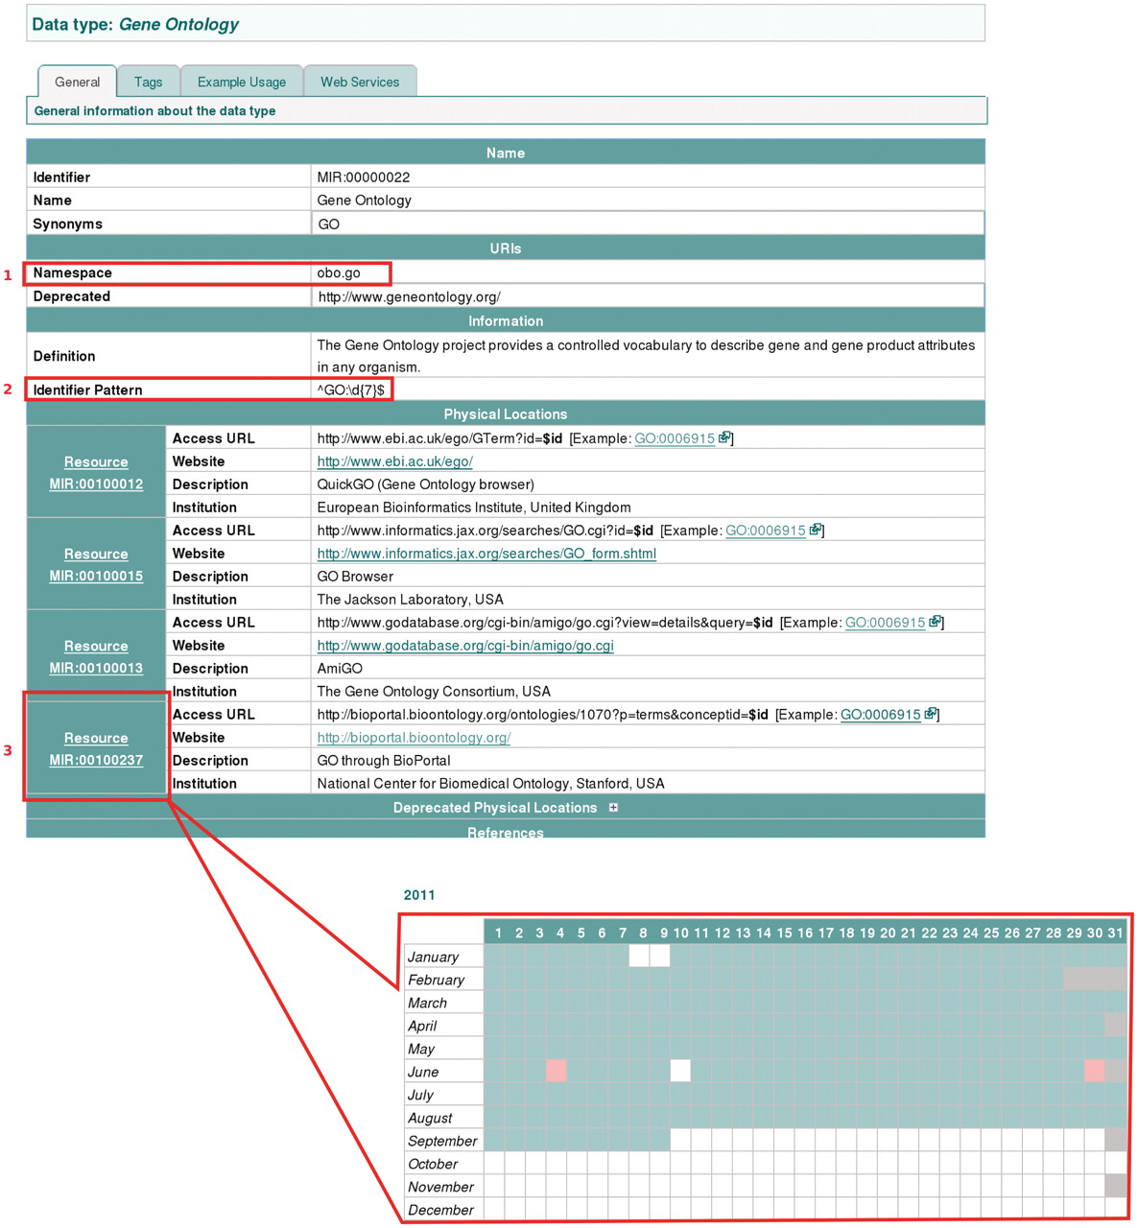
Figure 2. An illustration of the variety of information captured for each data collection in the MIRIAM Registry. Some ...
Notes:
Figure 2. An illustration of the variety of information captured for each data collection in the MIRIAM Registry. Some fields, described in the Information Table 2, are highlighted: (1) Namespace; (2) Identifier pattern, which allows automated checking of identifier validity with respect to the expected expression pattern; and (3) Resource health status, which provides information on resource up- and down-time. A notification of the health status is given through colour coding, while more details are presented on a separate page, via a link on the resource identifier (see inset).
Unless provided in the caption above, the following copyright applies to the content of this slide: © The Author(s) 2011. Published by Oxford University Press.This is an Open Access article distributed under the terms of the Creative Commons Attribution Non-Commercial License (http://creativecommons.org/licenses/by-nc/3.0), which permits unrestricted non-commercial use, distribution, and reproduction in any medium, provided the original work is properly cited.

Slide 3
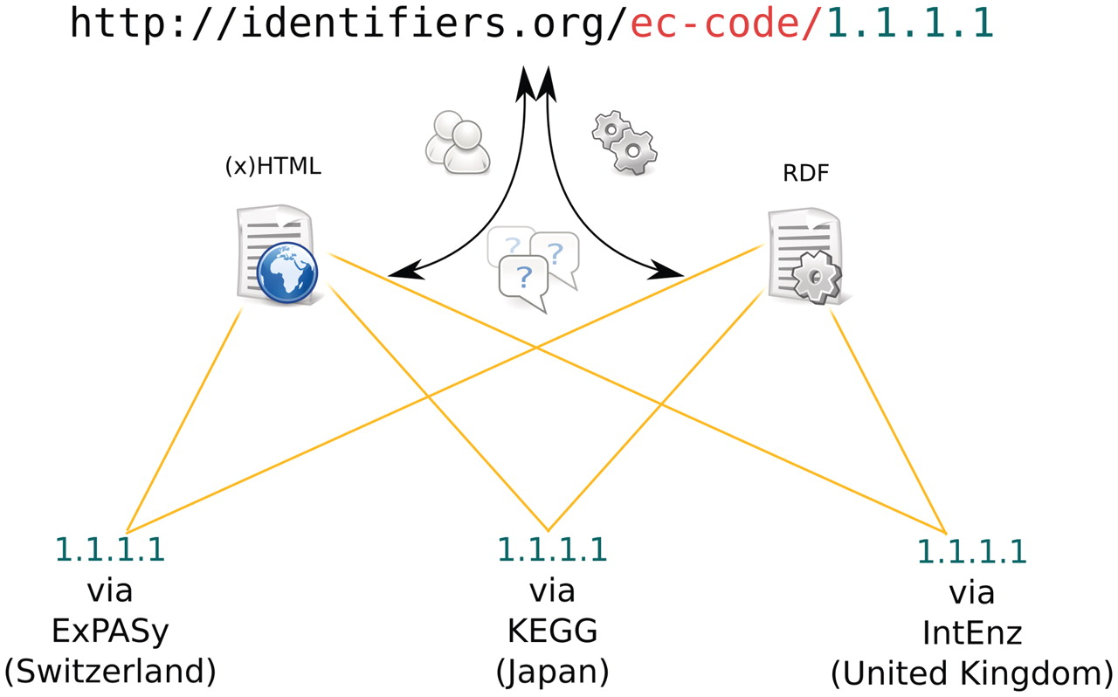
Figure 3. An illustration of the process followed when dereferencing an Identifiers.org URL. The example URL is a ...
Notes:
Figure 3. An illustration of the process followed when dereferencing an Identifiers.org URL. The example URL is a location-independent identifier for an ec-code record. When used in a browser, it resolves to an intermediate HTML page that provides a list of possible physical locations where the data record can be retrieved. The default format of this document is HTML, while an RDF/XML version is available via content negotiation or by using the ‘format’ parameter in the URL (see the ‘Identifiers.org Resolving System’ section).
Unless provided in the caption above, the following copyright applies to the content of this slide: © The Author(s) 2011. Published by Oxford University Press.This is an Open Access article distributed under the terms of the Creative Commons Attribution Non-Commercial License (http://creativecommons.org/licenses/by-nc/3.0), which permits unrestricted non-commercial use, distribution, and reproduction in any medium, provided the original work is properly cited.

