Slide 1
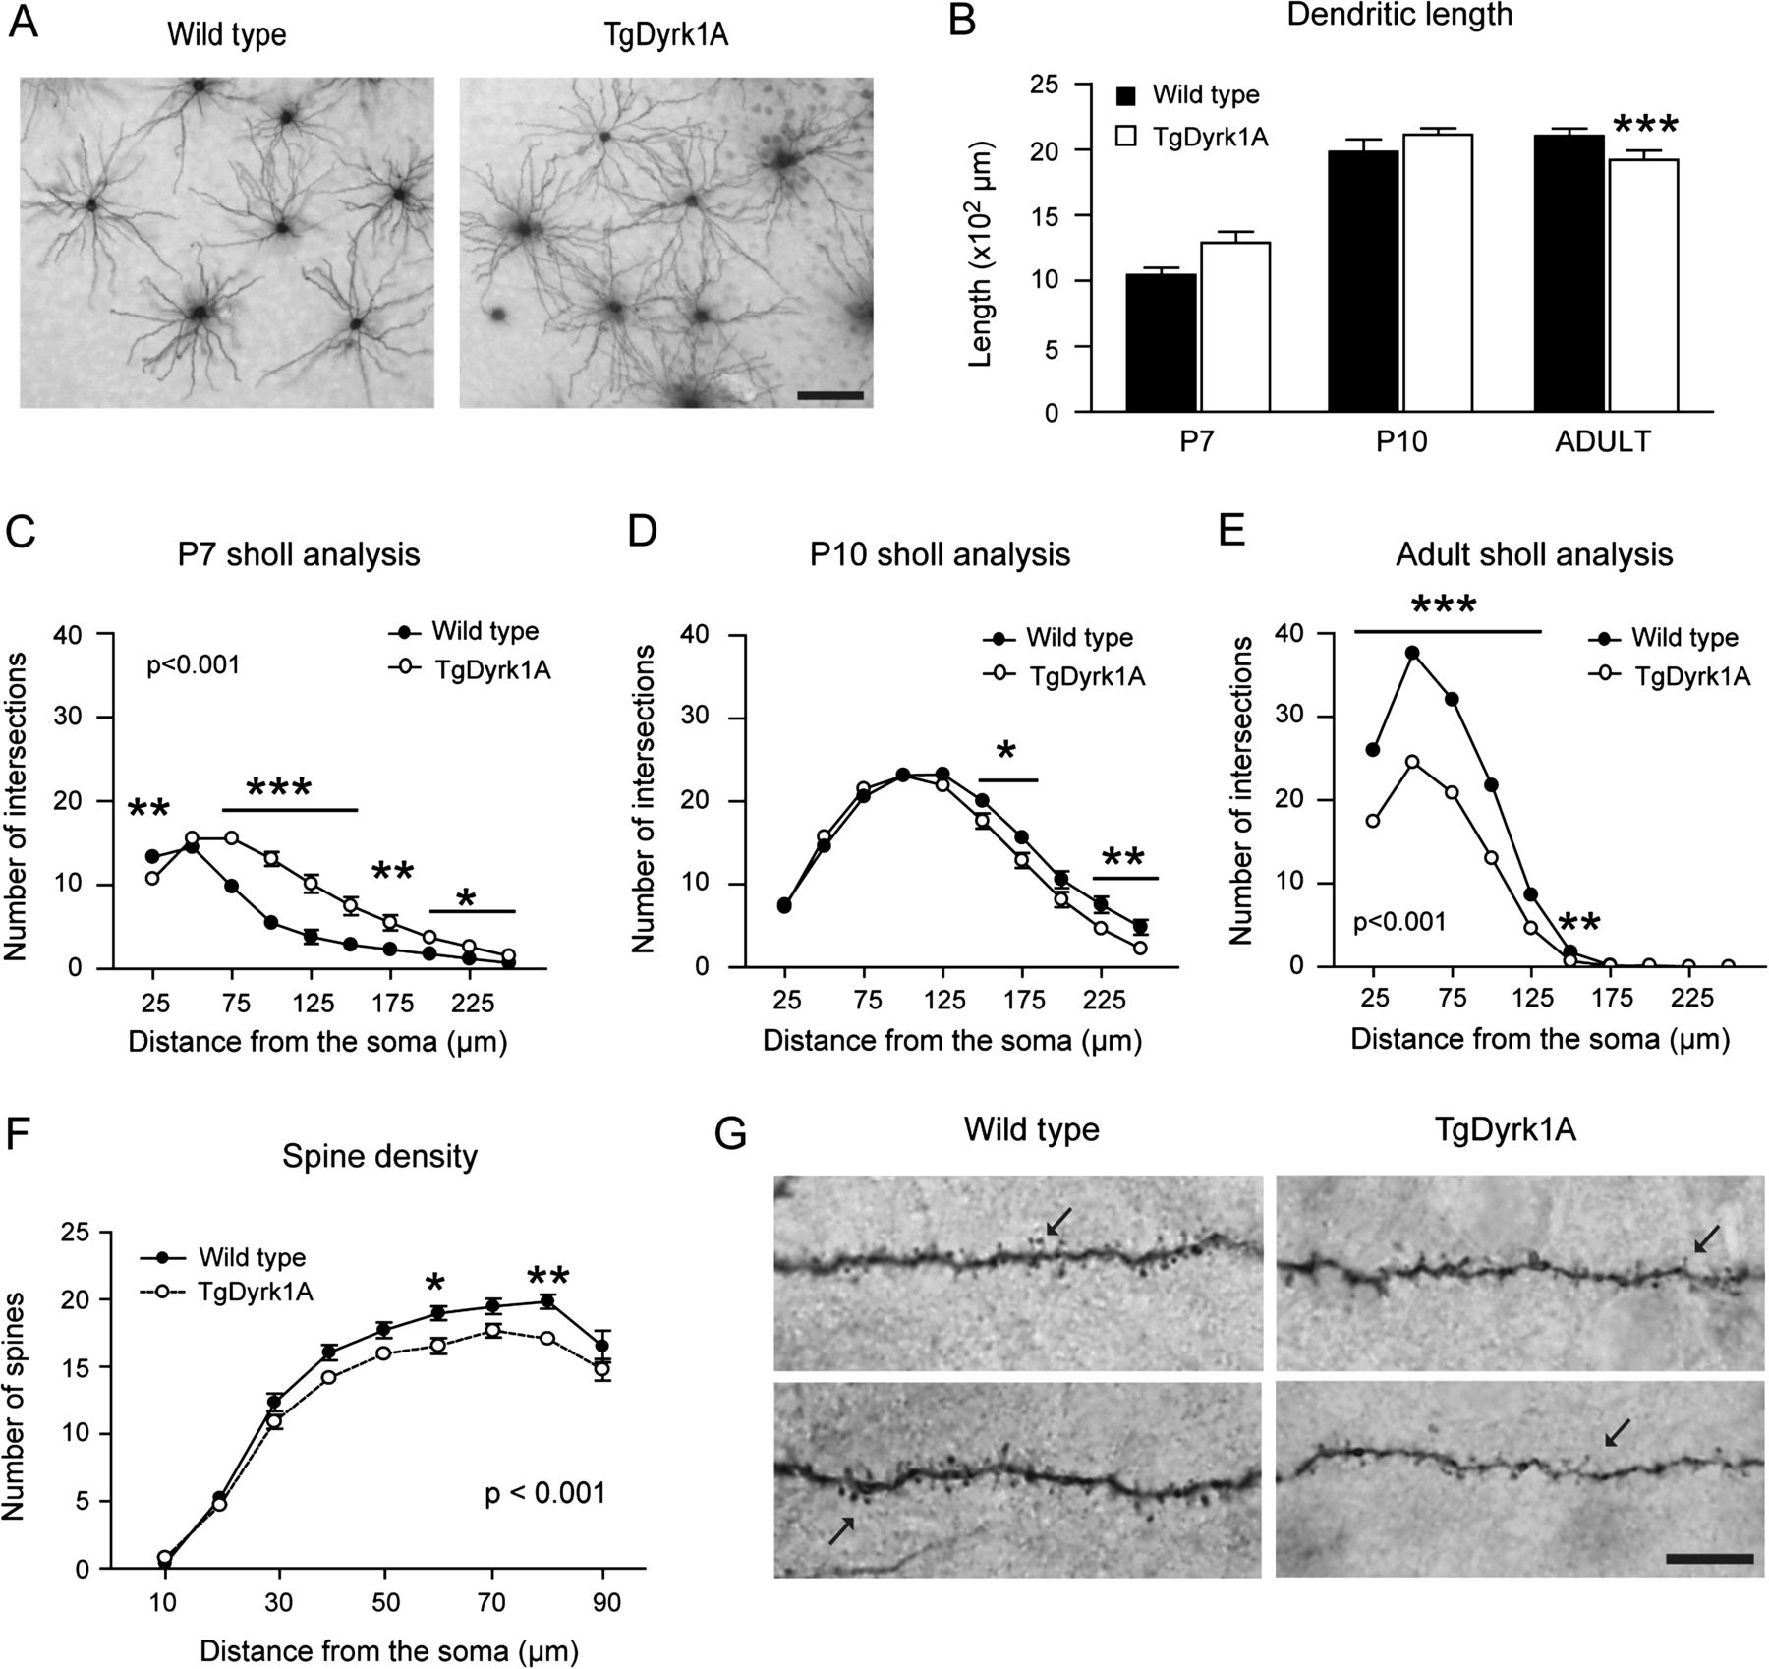
Figure 1. Dyrk1A overexpression recapitulates DS dendritic phenotype. Morphological characterization of the basal ...
Notes:
Figure 1. Dyrk1A overexpression recapitulates DS dendritic phenotype. Morphological characterization of the basal dendritic fields was performed in cortical neurons at P7, P10, and adult TgDyrk1A mice and their wild type littermates. (A) Representative photomicrographs of adult wild type (left panel) and TgDyrk1A mice (right panel) neurons from cortical layer III injected with LY. Scale bar = 125 μm. (B) Total length of basal dendrites. Sholl analysis (number of dendritic branches that intersected concentric circles [centered on the cell body] of radii that incremented by 25 μm) of (C) P7, (D) P10, and (E) adult dendrites to determine the complexity of the dendritic trees. (F) Density of spines along the entire length of the dendrites that were only quantified in adult mice. (G) Photomicrographs of horizontally projecting basal dendrites from adult wild type (left panels) and TgDyrk1A mice (right panels). Arrows show the spines along the neurite. Scale bar = 10 μm. Black bars and symbols represent wild type, and white bars and symbols represent TgDyrk1A mice. Data are represented as means ± standard error of the mean; *P < 0.05, **P < 0.01, *** P < 0.001.
Unless provided in the caption above, the following copyright applies to the content of this slide: © The Author 2012. Published by Oxford University Press. All rights reserved. For permissions, please e-mail: journals.permissions@oup.com

Slide 2
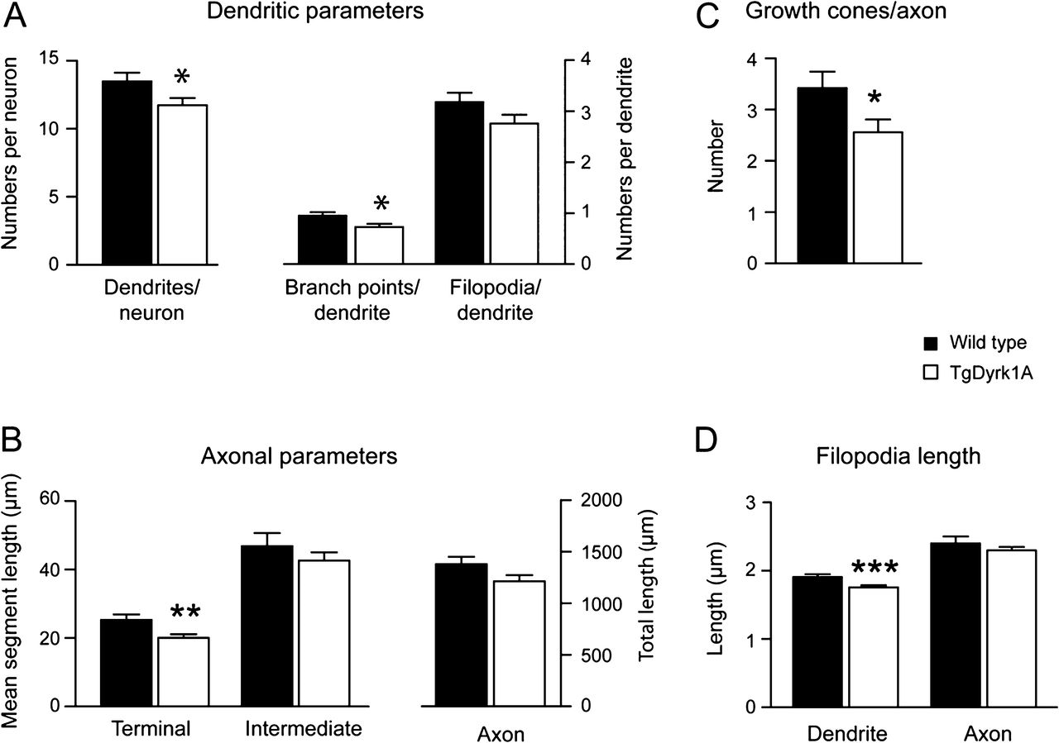
Figure 2. Neuritogenesis is altered in cultured cortical TgDyrk1A neurons. The reconstruction of cultured cortical ...
Notes:
Figure 2. Neuritogenesis is altered in cultured cortical TgDyrk1A neurons. The reconstruction of cultured cortical EGFP-positive cells at DIV 3 allowed the analysis of the neuritogenesis at initial stages. Histograms represent: (A) the dendritic tree complexity, as measured by the number of dendrites emerging from soma, the number of branch points and the number of filopodia per dendrite; (B) the mean intermediate and terminal segment length and total length of the axon; (C) the total number of growth cones per axon; (D) mean filopodia length in dendrites and axons. Black bars are wild type, and white bars, TgDyrk1A cultures. Data are represented as means ± standard error of the mean. *P < 0.05, **P < 0.01, ***P < 0.001.
Unless provided in the caption above, the following copyright applies to the content of this slide: © The Author 2012. Published by Oxford University Press. All rights reserved. For permissions, please e-mail: journals.permissions@oup.com

Slide 3
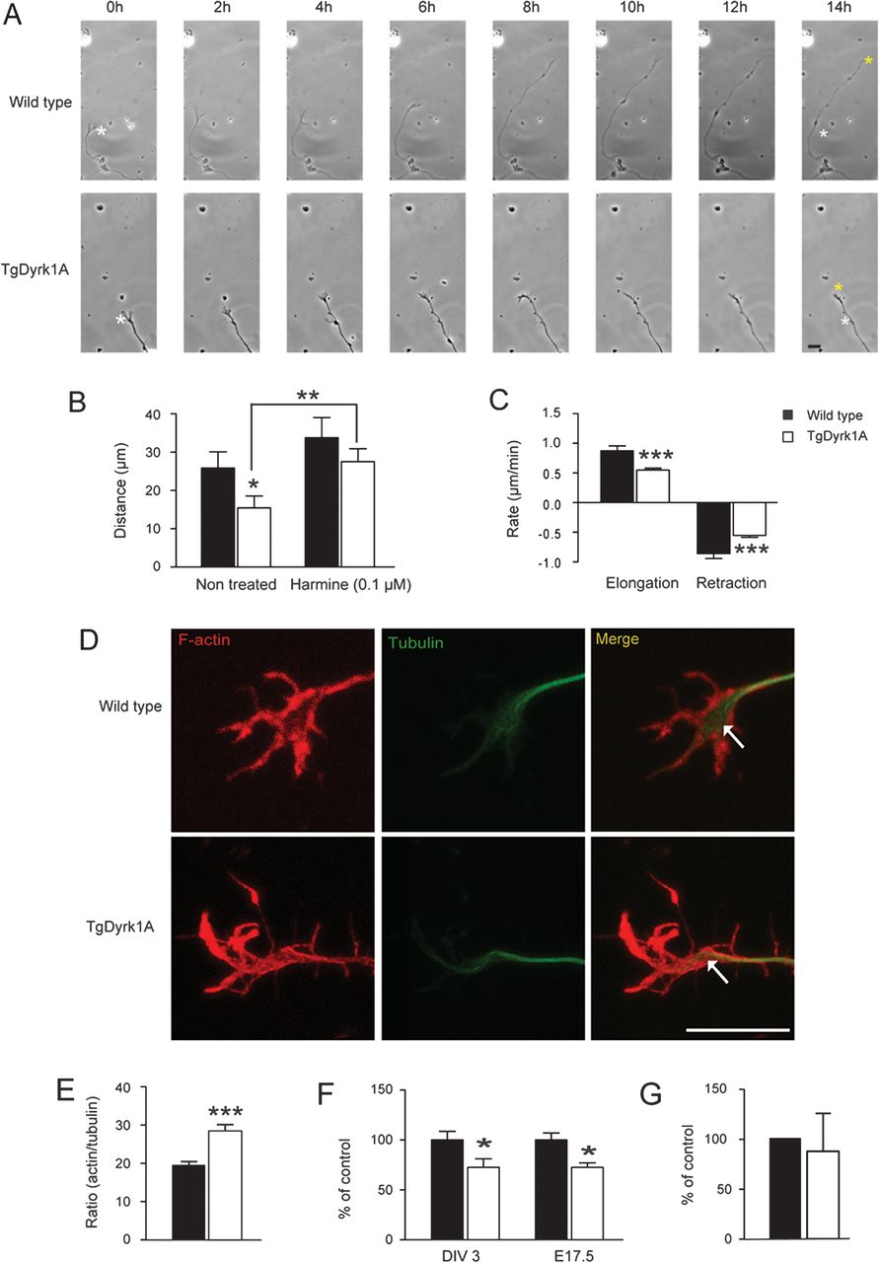
Figure 3. TgDyrk1A neurons showed impaired axon elongation associated with changes in microtubule cytoskeleton. Phase ...
Notes:
Figure 3. TgDyrk1A neurons showed impaired axon elongation associated with changes in microtubule cytoskeleton. Phase contrast time-lapse experiments for 14 h of DIV 1 primary cortical culture were performed to analyze axon growth. (A) Representative images of axonal outgrowth, being white asterisk the initial position and yellow one the final reach point of the growth cone, indicating final traveled distance. The histograms represent the quantification of (B) final distance traveled by the axon and (C) mean speed of forward and reward axon movements. (D) Representative confocal images of immunolabelled growth cones at DIV 1 with F-actin (red), α-tubulin (green), and co-localization of both. Arrows show the extension of microtubules along the neurite and their interaction point with the actin. Upper panel: wild type, lower panel: TgDyrk1A. (E) Histogram represents the ratio between the area occupied by actin with respect to tubulin. (F) Densitometric quantification of immunoblotting graphed as percentage respect to wild type values of total Tau in DIV3 cultures and E17.5 embryo cortex. (G) Histogram represents the ratio of R3-Tau mRNA level respect to wild type values obtained by qPCR. Black bars = wild type, white bars = TgDyrk1A. DIV: day in vitro. Data are represented as the means ± standard error of the mean. *P < 0.05, **P < 0.01, ***P < 0.001. Scale bar = 10 μm.
Unless provided in the caption above, the following copyright applies to the content of this slide: © The Author 2012. Published by Oxford University Press. All rights reserved. For permissions, please e-mail: journals.permissions@oup.com

Slide 4
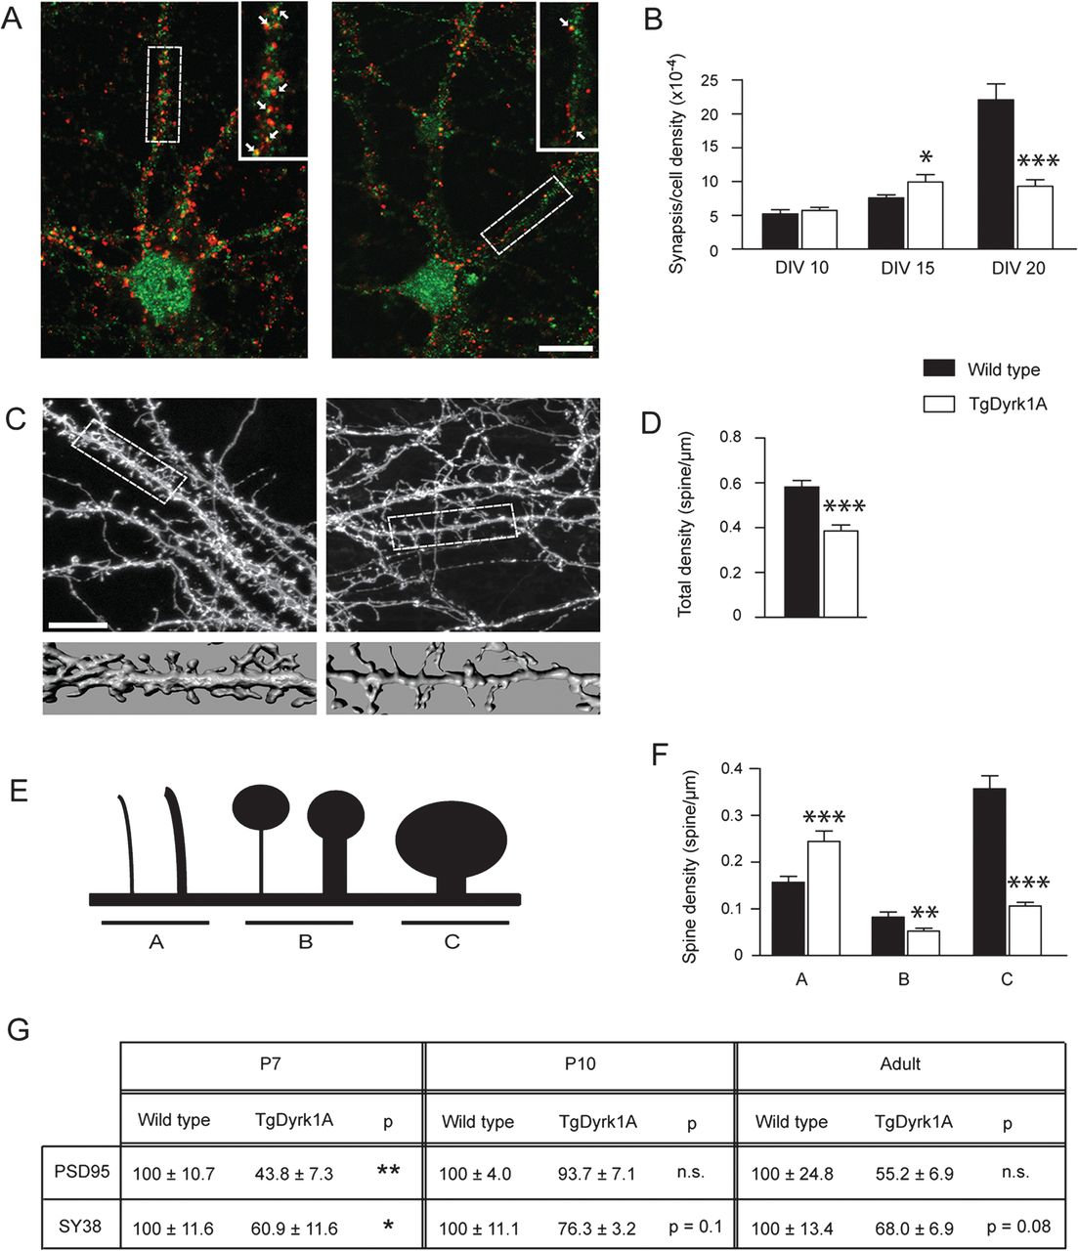
Figure 4. Synaptogenesis is altered by Dyrk1A overexpression. (A) Representative confocal images of neurons at DIV 20 ...
Notes:
Figure 4. Synaptogenesis is altered by Dyrk1A overexpression. (A) Representative confocal images of neurons at DIV 20 immunostained against presynaptic synaptophysin (red) and postsynaptic PSD95 (green) considering the co-localization of both a mature synaptic contact. Right upper insert corresponds to a higher magnification of the dendrite boxed. Arrows denote co-localization. (B) Histogram represents the synaptic density normalized by total cell density at DIV 10, 15, and 20. (C) Representative confocal images showing EGFP-transfected dendrites with spines. Lower surface reconstruction corresponds to a higher magnification of the dendrite boxed of 20-μm length. (D) Histogram represents the total dendritic spine density. (E) Illustration of the morphological categories used to classify spines and (F) density of each type of spine. (G) Table showing the percentage respect to wild type values of western blot densitometric quantification of synaptophysin (Sy38) and PSD95 from cerebral cortex of postnatal days P7 and P10 and adult mice. Black bars are wild type and white bars are TgDyrk1A mice. DIV: day in vitro. Data are represented as means ± standard error of the mean. *P < 0.05, **P < 0.01, ***P < 0.001. n.s., non significant. Scale bar = 10 μm.
Unless provided in the caption above, the following copyright applies to the content of this slide: © The Author 2012. Published by Oxford University Press. All rights reserved. For permissions, please e-mail: journals.permissions@oup.com

Slide 5
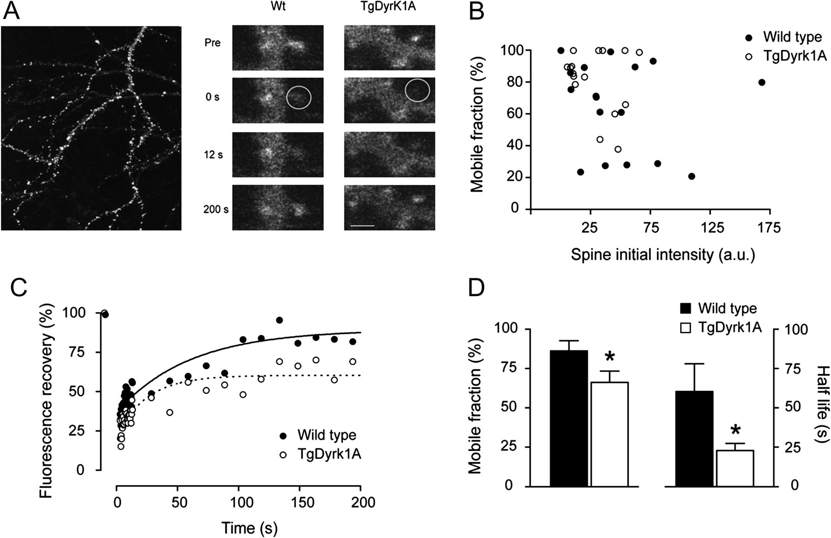
Figure 5. Actin dynamics was altered in spines of TgDyrk1A neurons. (A) Left panel: representative photomicrograph of a ...
Notes:
Figure 5. Actin dynamics was altered in spines of TgDyrk1A neurons. (A) Left panel: representative photomicrograph of a DIV 22 neuron expressing YFP–actin. YFP–actin was highly concentrated in dendritic spines, allowing an easy identification. Right panel: representative examples of wild type and TgDyrk1A spines at sequential fluorescence recovery stages after photobleaching. Initially, both spines showed fluorescence (Pre = prebleaching) that disappeared after photobleaching (time = 0 s). (B) Representation of the percentage of actin mobile fraction versus spine initial fluorescence, normalized in each spine respect to its background. No correlation was found between both parameters in each genotype (a.u. arbitrary units). (C) Illustrative example of actin dynamics in a wild type and a TgDyrk1A spine. (D) Histograms represent the mean average data of actin mobile fraction and half-time recovery of the fluorescence. Black circles and bars represent wild type mice; white circles and bars are TgDyrk1A. Data are represented as the means ± standard error of the mean. *P < 0.05. Scale bar = 2 μm.
Unless provided in the caption above, the following copyright applies to the content of this slide: © The Author 2012. Published by Oxford University Press. All rights reserved. For permissions, please e-mail: journals.permissions@oup.com

Slide 6
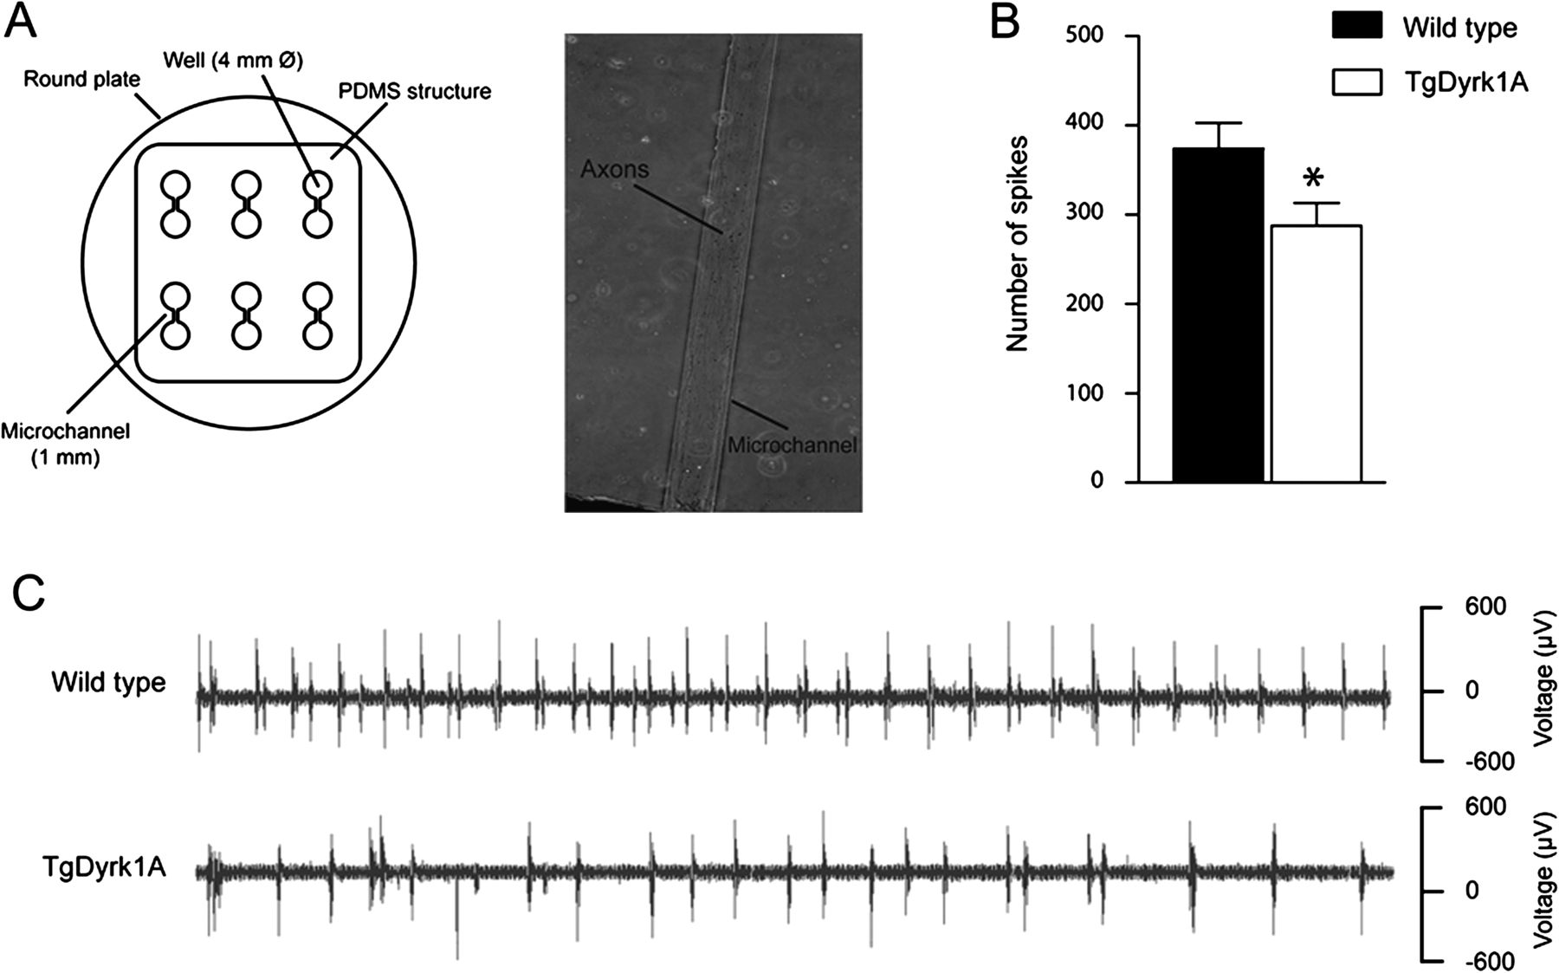
Figure 6. Spontaneous activity was reduced in TgDyrk1A neurons. (A) Schematic illustration of E2-Dish system where ...
Notes:
Figure 6. Spontaneous activity was reduced in TgDyrk1A neurons. (A) Schematic illustration of E2-Dish system where cultures were seeded to obtain electrophysiological recordings. The photomicrograph shows axons coming from both wells growing along the microchannel (1-mm length). (B) Histogram represents the number of spikes fired during 5 min. (C) Representative electrophysiological recordings of the spontaneous activity registered in both genotypes. Black bars are wild type and white bars are TgDyrk1A cultures. Data are represented as means ± standard error of the mean. * P < 0.05.
Unless provided in the caption above, the following copyright applies to the content of this slide: © The Author 2012. Published by Oxford University Press. All rights reserved. For permissions, please e-mail: journals.permissions@oup.com

