Slide 1
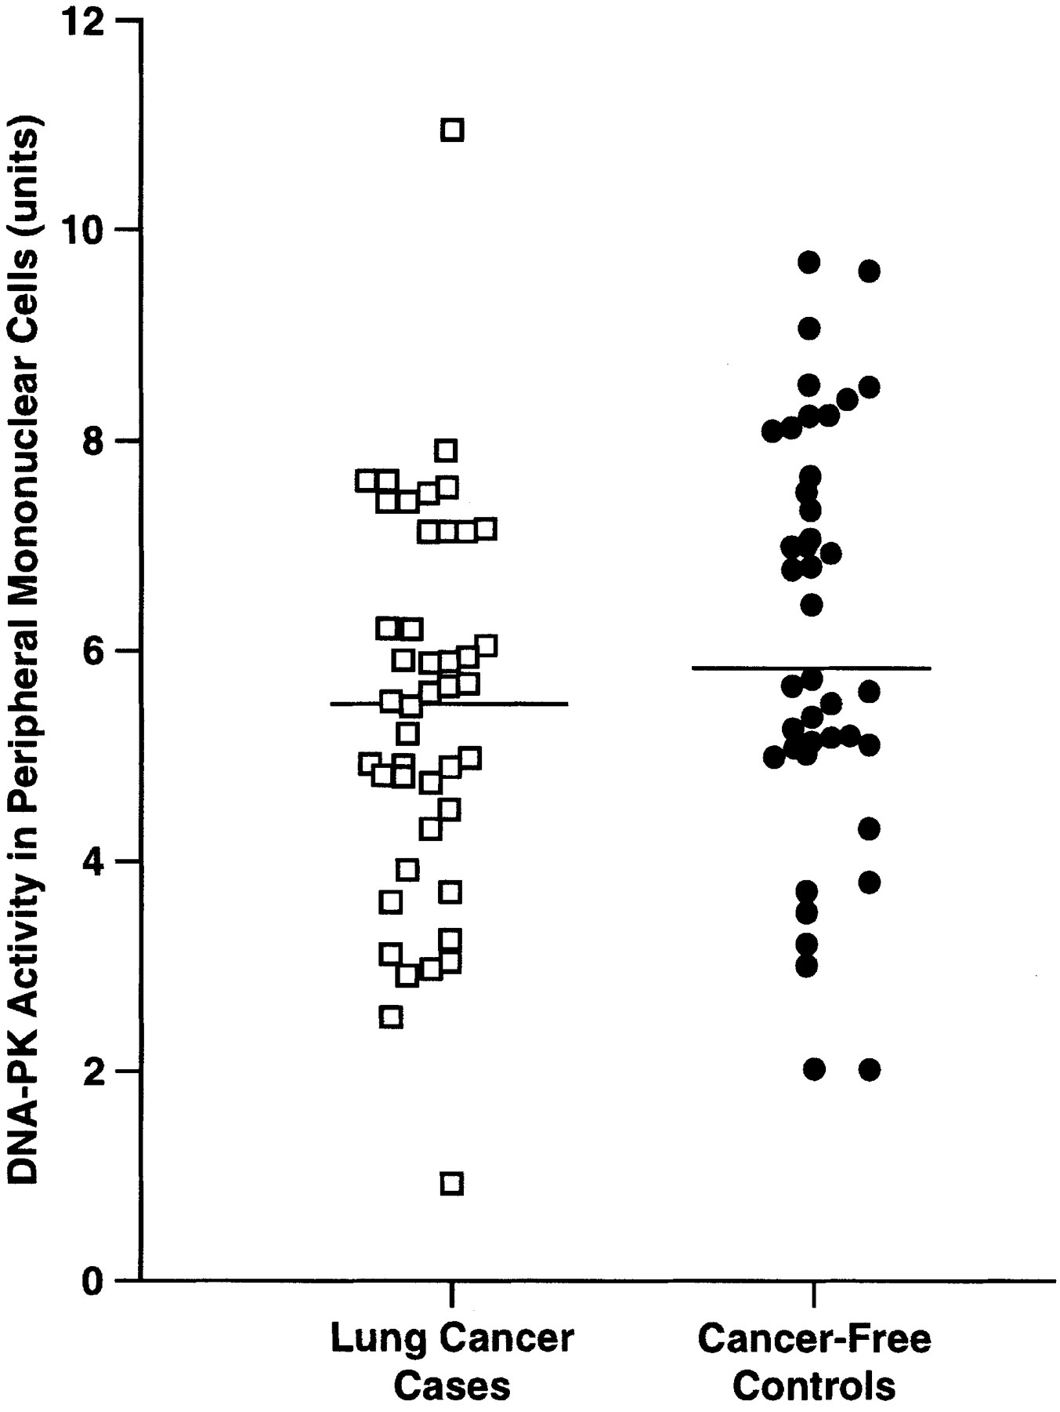
Fig. 1. Schematic representation of cellular response to DNA DSBs. Multiple sensor proteins are shown that physically ...
Notes:
Fig. 1. Schematic representation of cellular response to DNA DSBs. Multiple sensor proteins are shown that physically recognize DNA damage. Multiple transducer proteins then amplify and diversify the DNA-damage signal, and a range of downstream effectors regulate various aspects of cellular function.
Unless provided in the caption above, the following copyright applies to the content of this slide: © Oxford University Press

Slide 2
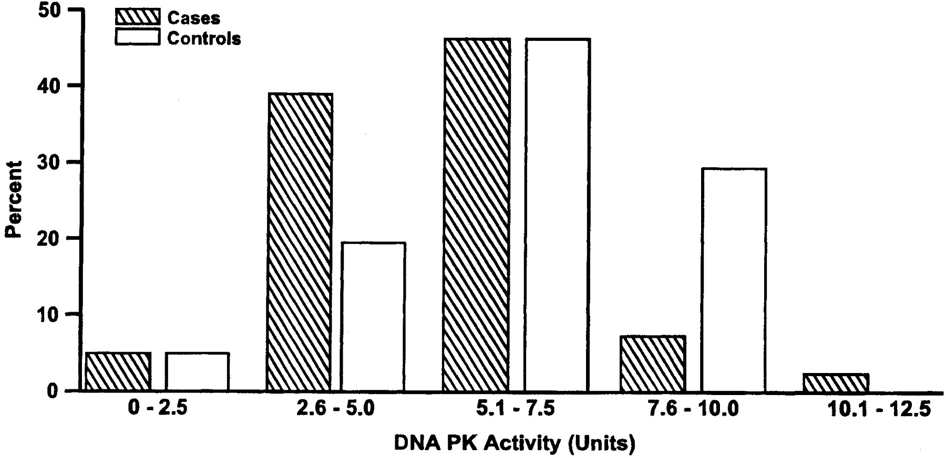
Fig. 2. Schematic representation of the pathway of DNA NHEJ, indicating the known players in this pathway in ...
Notes:
Fig. 2. Schematic representation of the pathway of DNA NHEJ, indicating the known players in this pathway in vertebrates. NHEJ rejoins the two broken ends directly and generally leads to small deletions of DNA sequence. It requires Ku, which binds to free ends and recruits DNA-PKcs. Ku then recruits XRCC4 along with DNA ligase IV, and DNA-PKcs-mediated phosphorylation of XRCC4 may influence its activity. Ligase IV then brings about the physical religation of the DNA ends. The MRE11–RAD50–NBS1 complex, which contains exo- and endo-nuclease and helicase activities, may also function in NHEJ, particularly if the DNA ends require processing before ligation. However, it is possible that other nucleases are involved in addition to or instead of the MRE11 complex, and candidates for such a nuclease include mammalian Artemis (shown) and S.cerevisiae Rad27p. In many cases, NHEJ may also require the actions of a DNA polymerase(s).
Unless provided in the caption above, the following copyright applies to the content of this slide: © Oxford University Press

Slide 3
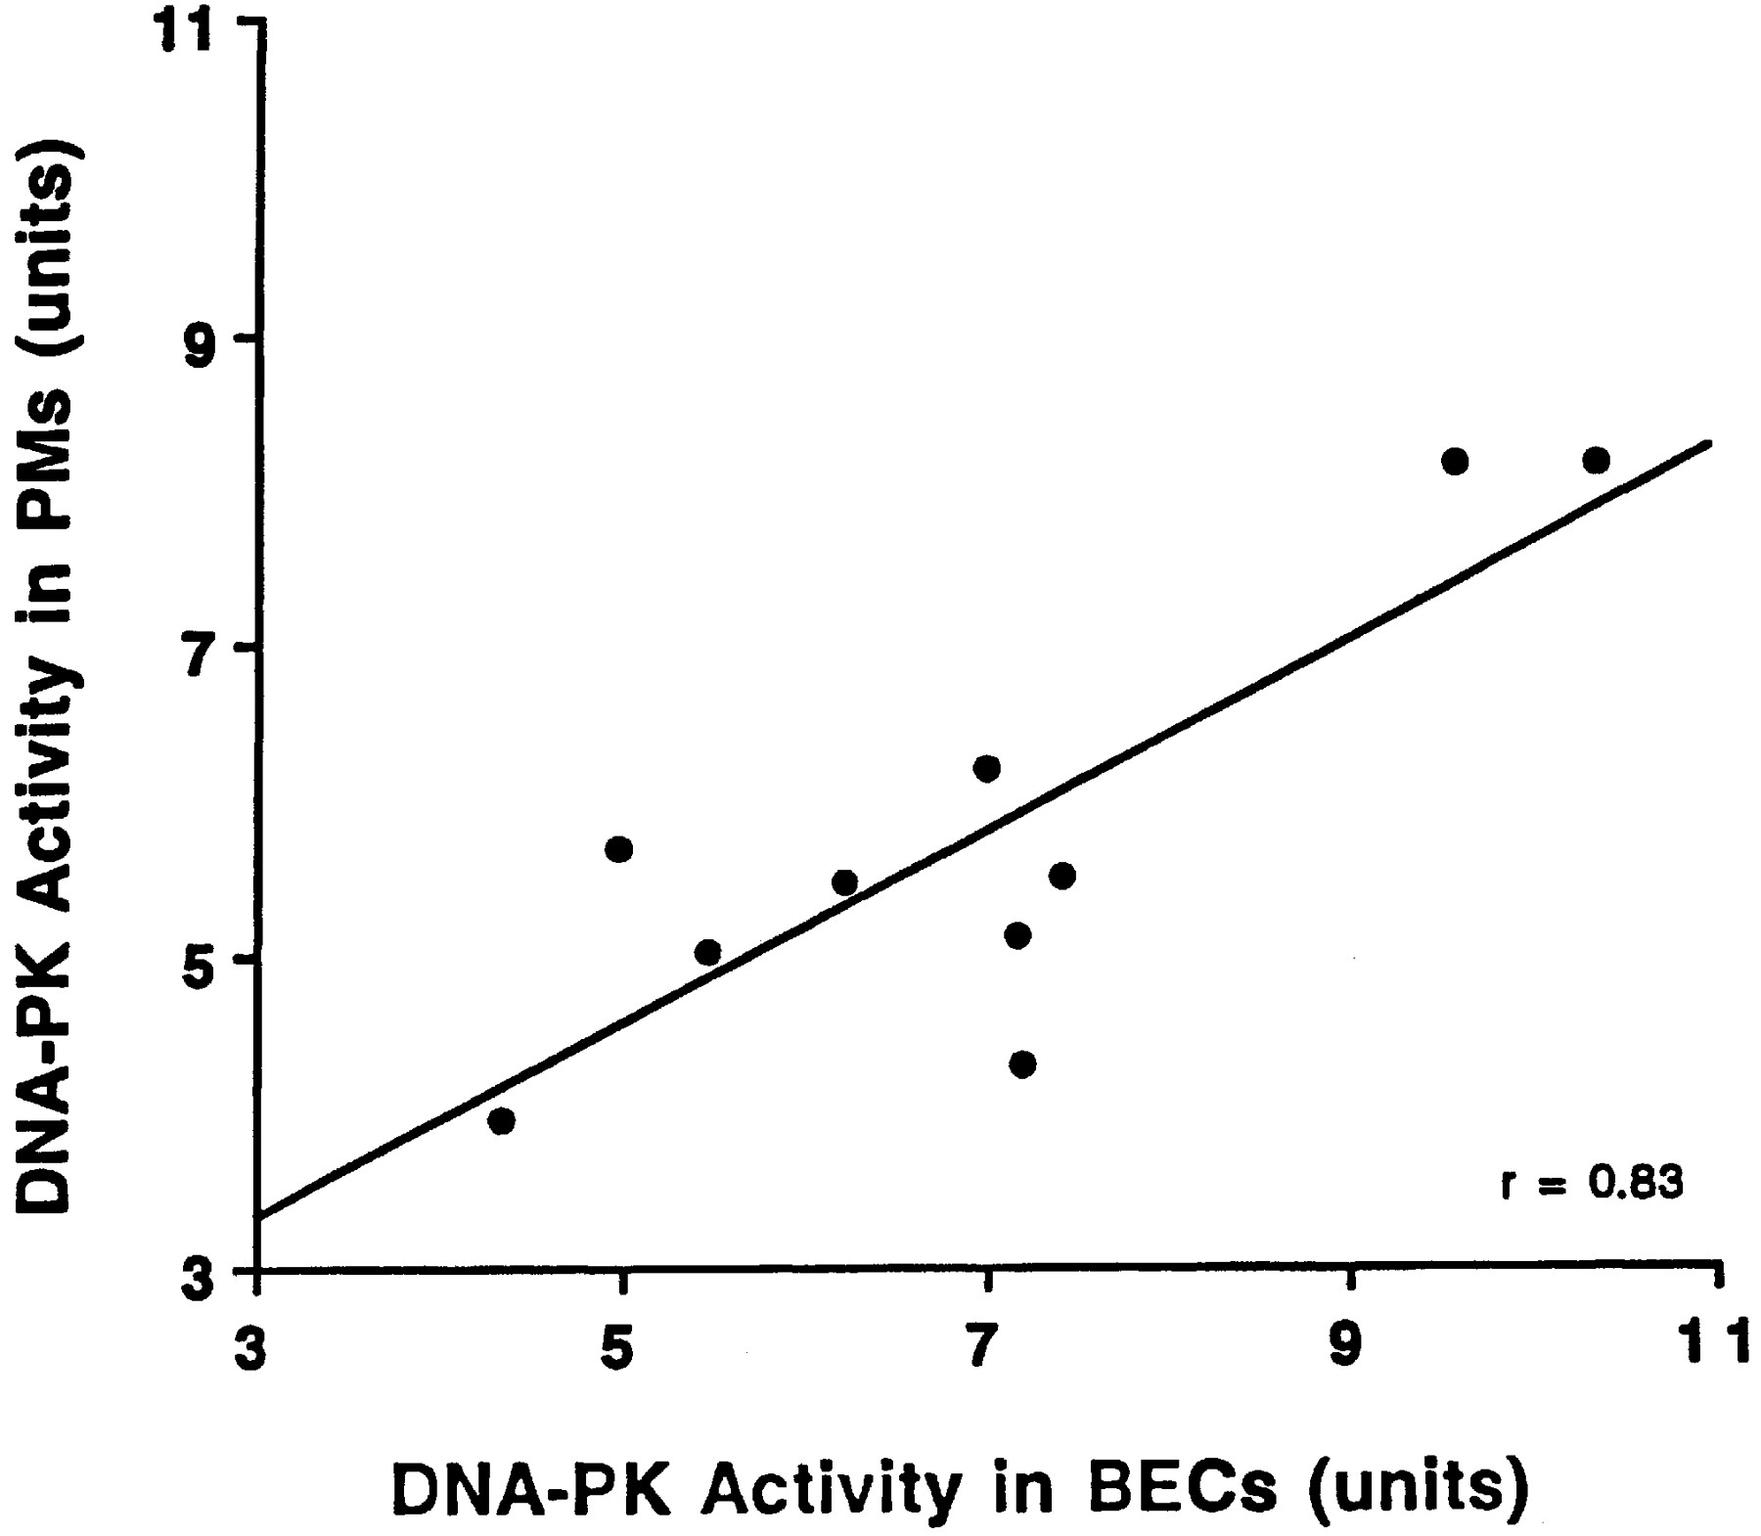
Fig. 3. Overview of the main steps and factor requirements of the DNA DSB repair pathway of HR. See main text for ...
Notes:
Fig. 3. Overview of the main steps and factor requirements of the DNA DSB repair pathway of HR. See main text for details.
Unless provided in the caption above, the following copyright applies to the content of this slide: © Oxford University Press

