Slide 1
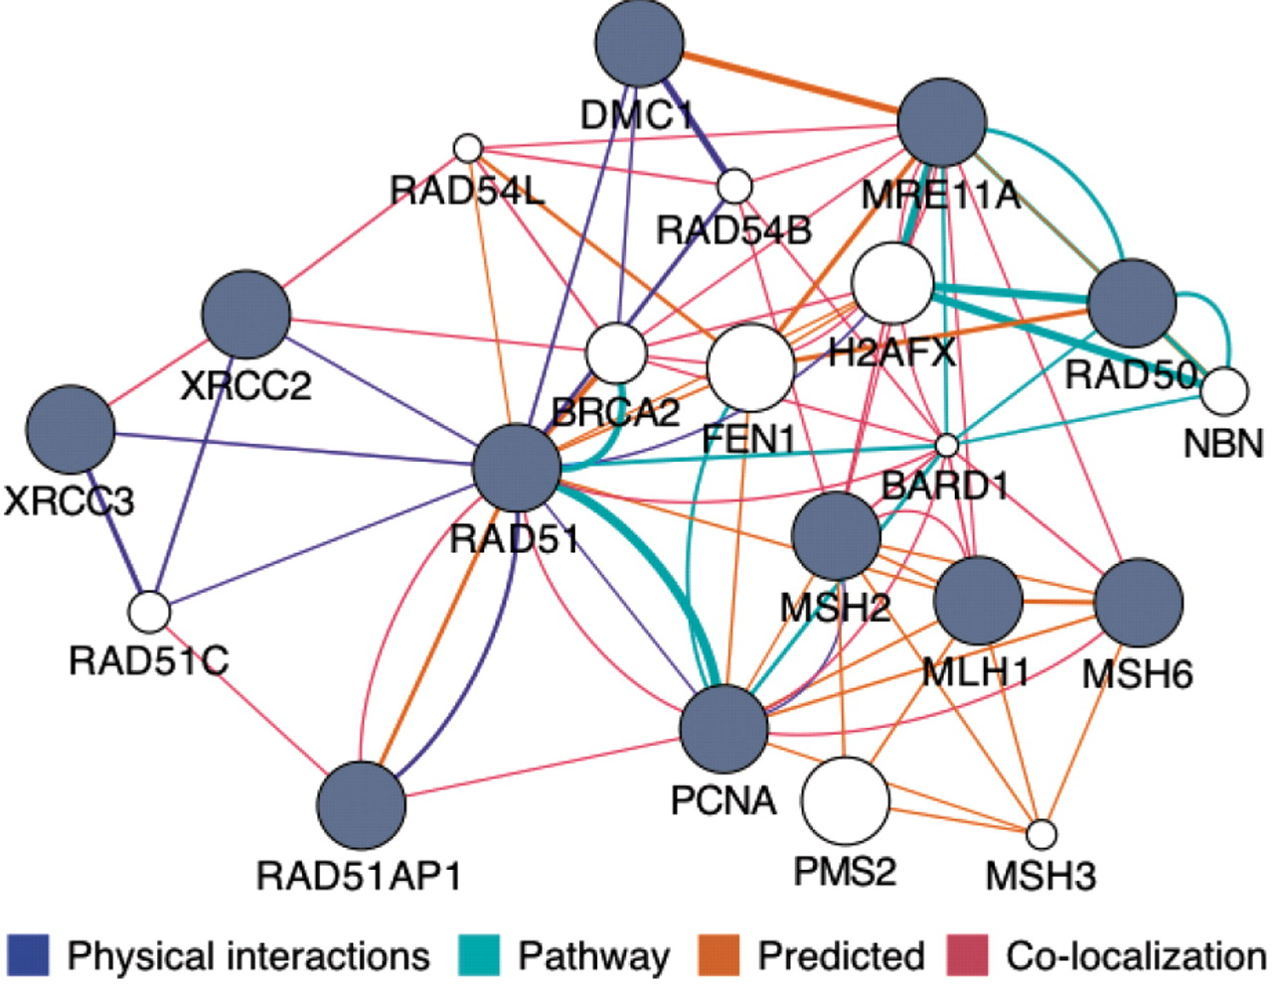
Fig. 1. The GeneMANIA Cytoscape plugin analysis view showing an example prediction. A set of known DNA repair genes ...
Notes:
Fig. 1. The GeneMANIA Cytoscape plugin analysis view showing an example prediction. A set of known DNA repair genes were provided as a query (gray nodes) and a number of additional DNA repair genes were predicted to be related (white nodes).
Unless provided in the caption above, the following copyright applies to the content of this slide: © The Author(s) 2010. Published by Oxford University Press.This is an Open Access article distributed under the terms of the Creative Commons Attribution Non-Commercial License (http://creativecommons.org/licenses/by-nc/2.5), which permits unrestricted non-commercial use, distribution, and reproduction in any medium, provided the original work is properly cited.

